Slide 1


OVERVIEW OF PULSED POWER SYSTEMS (APPS) FOR ADITYA/ADITYA-U TOKAMAK
ADITYA/ADITYA-U Team

Slide 2
CONTENTS
Commissioning of 50 MVA, 132kV AC Systems and DC Power Supplies (1987-89)
Initial ADITYA Operations (1991-92)
132 kV system upgradation with additional 75 MVA Transformer (1992)
Operation of APPS for higher parameters with ADITYA (1992)
Vertical field modifications for higher plasma ramp up (2001)
Operation with negative converter for higher volt-seconds(2002)
Operation of power supplies for SST-1 (2013)
Commissioning and Operation of APPS with ADITYA-U for longer plasmas (2017)
System maintenance and precautions
Future plans and upgradation
Publications

Slide 3
INTRODUCTION
ADITYA/ADITYA-U Tokamak (R=0.75, r=0.25) is operated with high current DC power supplies based on the combination of power transformers, line commutated 12 pulse converters, wave shaping circuitry and associated control systems.
The subsystem is named as ADITYA/ADITYA-U Pulsed Power System (APPS) supplied by HBB (Baroda), AEG (Germany) and Commissioned by AEG-NGEF consists the following
AC Power System: 132/11 kV, 50 MVA
DC Power System: 50 kA Toroidal Field Power Supply, ±20 kA Ohmic Power Supply, 28 kV rated Wave shaper and 12.5 kA Vertical Field Power Supply
Feedback Power Supply (FFPS): 0.25 kV, ±2 kA (Indigenously procured)

Slide 4
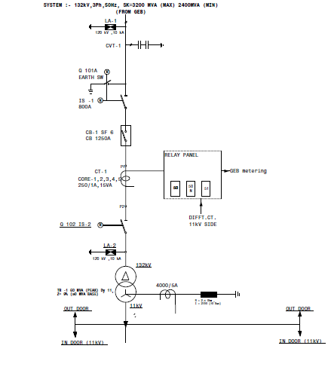
132 kV AC POWER SYSTEM (1987)

Slide 5
TESTING OF NEW 37.5 MVA (75 MVA -peak) TRANSFORMER of NGEF MAKE(1992)

Slide 6
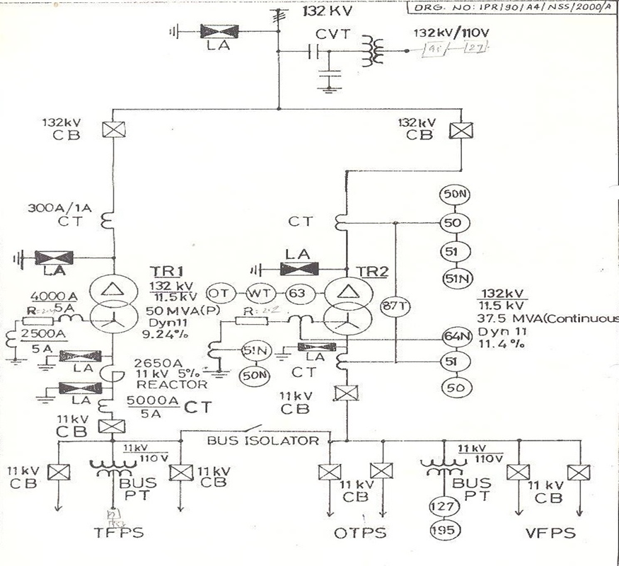
132 kV SYSTEM (1992)

Slide 7
11 kV SYSTEM

Slide 8
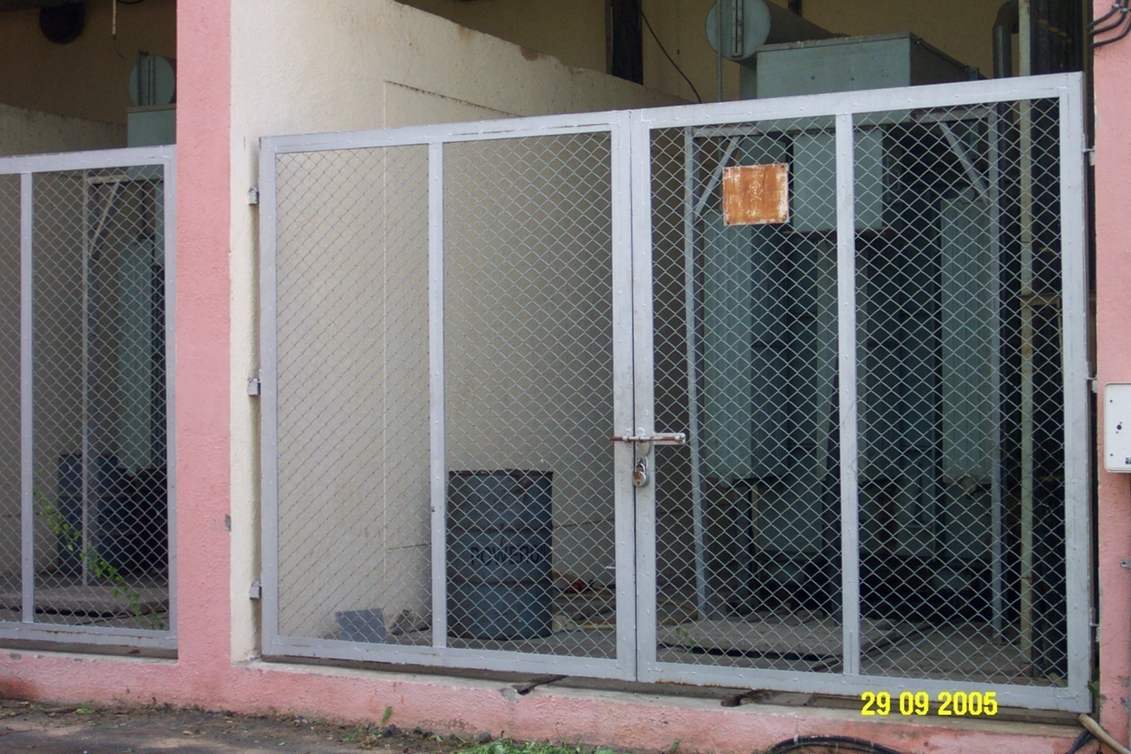
PULSED DUTY CONVERTER TRANSFORMER

Slide 9
DC POWER SUPPLIES AND WAVE SHAPER
The DC Power Supplies are supplied and commissioned by AEG, Germany consist the following
Toroidal Field Power Supply (TF): 400V, 50 kA DC
Ohmic Transformer Power Supply (OT): ±2.2 kV, ±20 kA (Bipolar DC) with Circulating converter: -1.6 kV, -2.2 kA
Vertical Field Power Supply (VF): 2.2 kV, 12.5 kA DC
Wave Shaper (WS): system rated for 28 kV, 20 kA

Slide 10
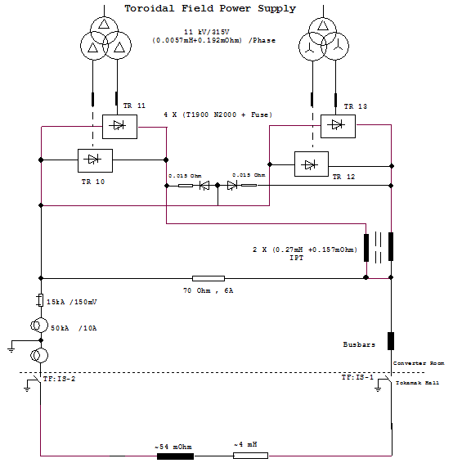
TF Power Supply

Slide 11
OHMIC AND VF WITH PROPOSED 11 kV CIRCULATING CURRENT TRANSFORMER

Slide 12
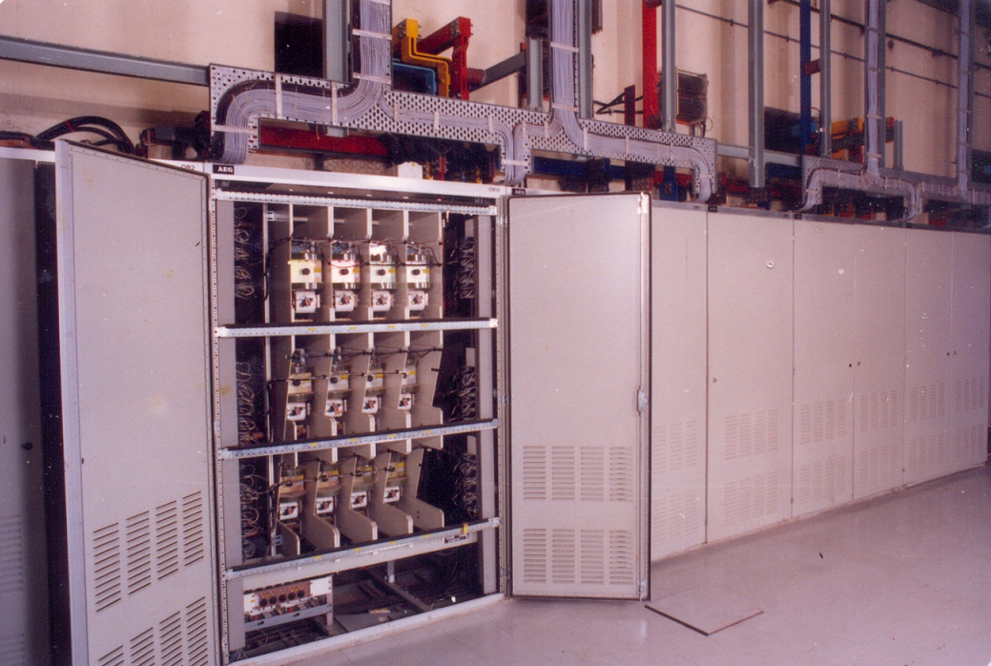
Converter Panels of OHMIC (1988)

Slide 13
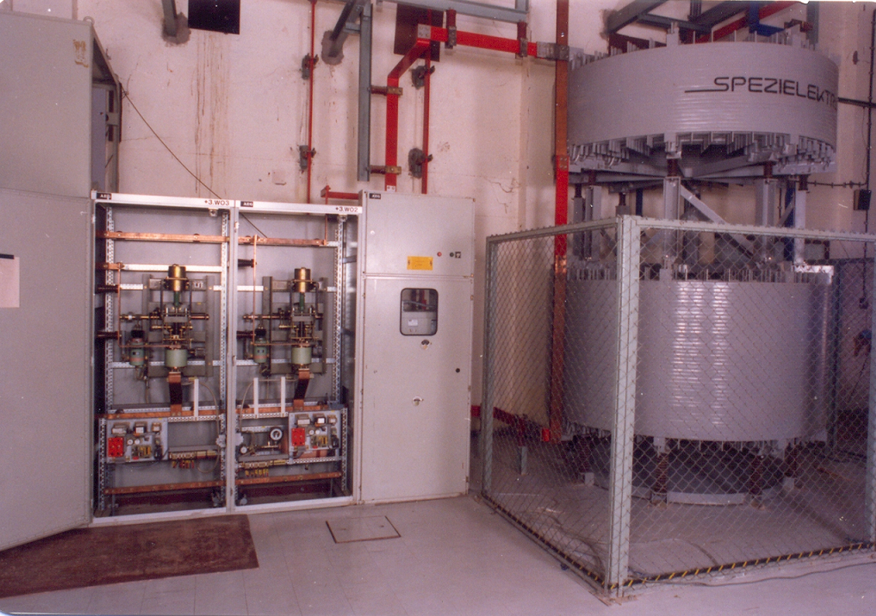
FMS, VCB and Anti Transformer of WAVE SHAPER (1988)

Slide 14
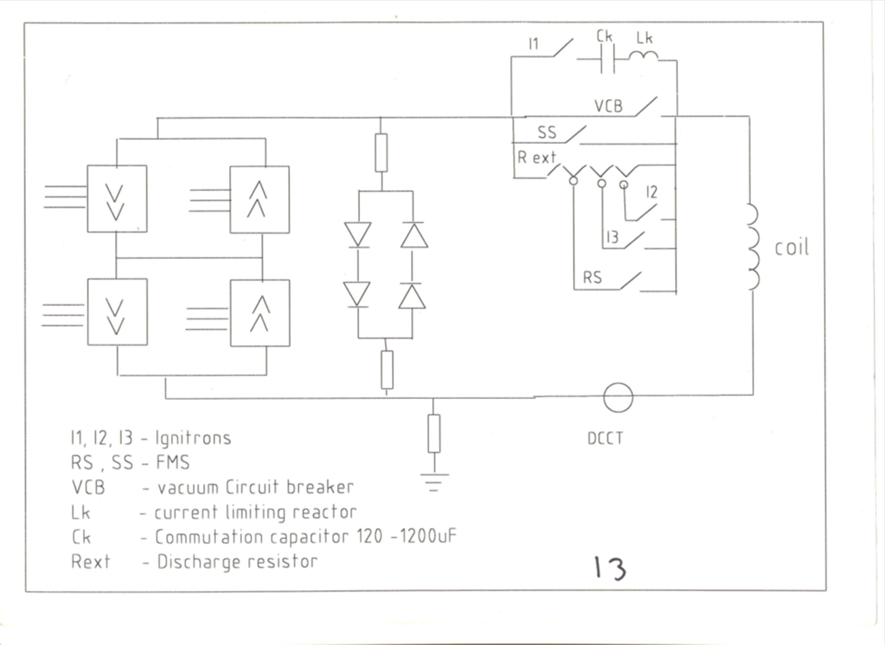
OHMIC WAVE SHAPING SCHEME

Slide 15
OHMIC WAVE SHAPING TASKS
Supply the necessary energy to commutate the current through the DC VCB into the discharge resister.
Create plasma ignition voltage of 50 V max. with a delay between 0.5 to 5 mSecs from VCB open.
Switching the resisters for ignition voltage shaping
Control the Ohmic current di/dt in a way to meet the required V_{plasma} versus time.

Slide 16
PLASMA IGNTION VOLTAGE
Ohmic transformer turns ratio = 300/1
The required primary voltage for 50 V across the plasma torus (M=10.1 mH) = 15 kV
di/dt required for 15 kV = 1485 kA/Sec
Stray inductance (L=8.3 mH) drop = 12 kV
Supporting resistive drop (IR) = 750 V
Supporting inversion voltage = 1250 V
Required voltage across wave shaping resister = 25 kV

Slide 17
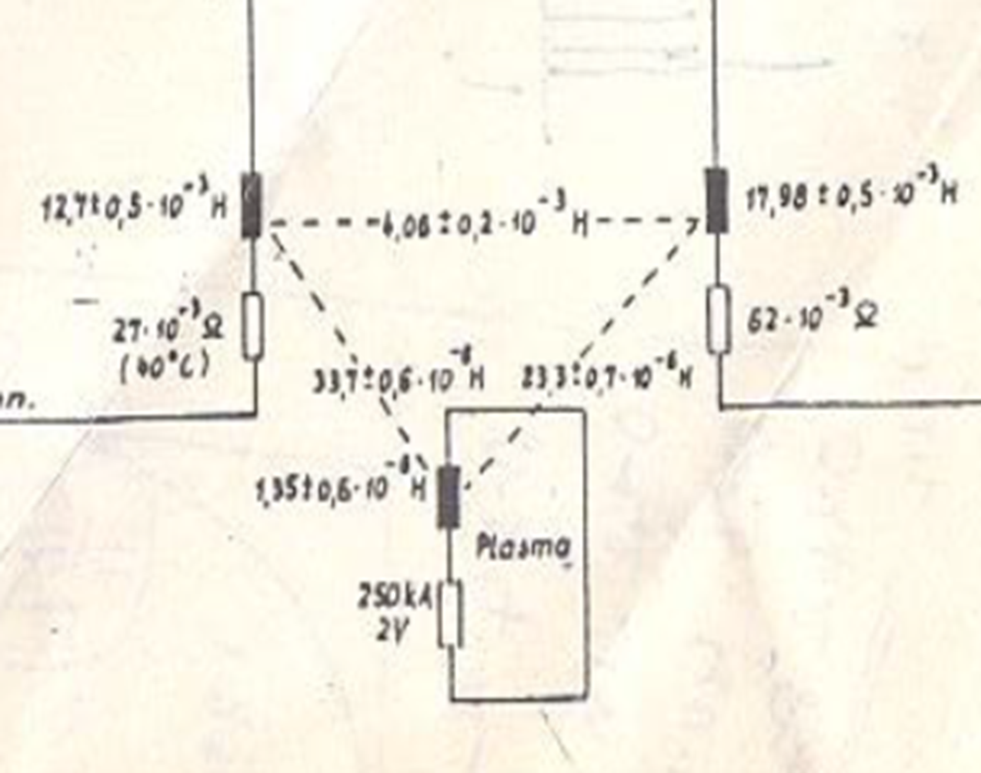
OT/VF/PLAMA INDUCTANCES

Slide 18
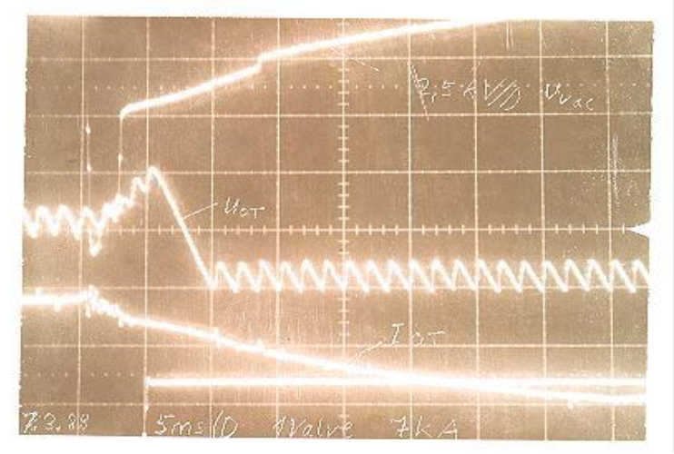
FIST PRIMARY IGNITION (LOOP) VOLTAGE (07/03/1988, 18:48)
I_{OT} = 7 kA
C = 120 µF
R = 1.44Ω
R₁ = 1.32Ω
R₂ = 0.72Ω
R₃ = 0.60 Ω
V_{COT} = 7000 V

Slide 19
Synchronisation of VF WITH PRIMARY LOOP VOLTAGE (1988)

Slide 20
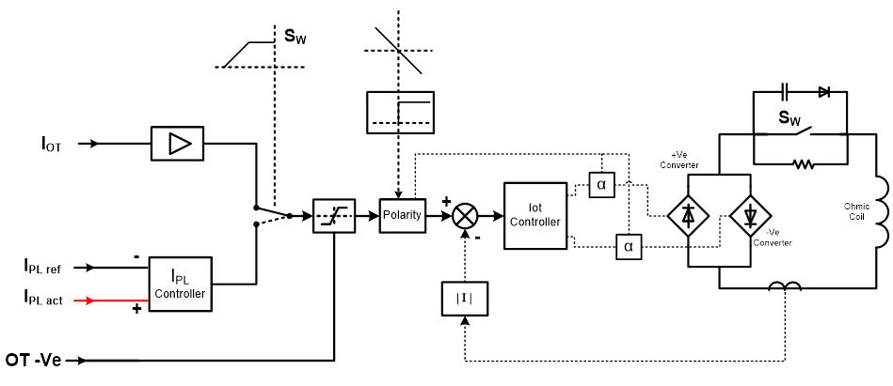
OHMIC CONTROL SYSTEM

Slide 21
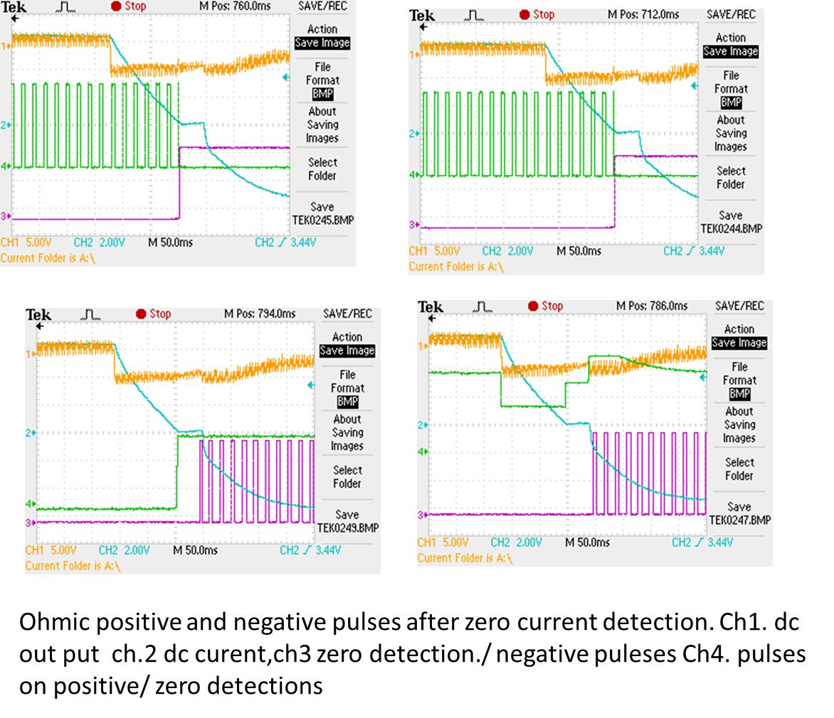
OHMIC POSITIVE AND NEGATIVE FIRING WITH ZERO CURRENT DETECTION

Slide 22
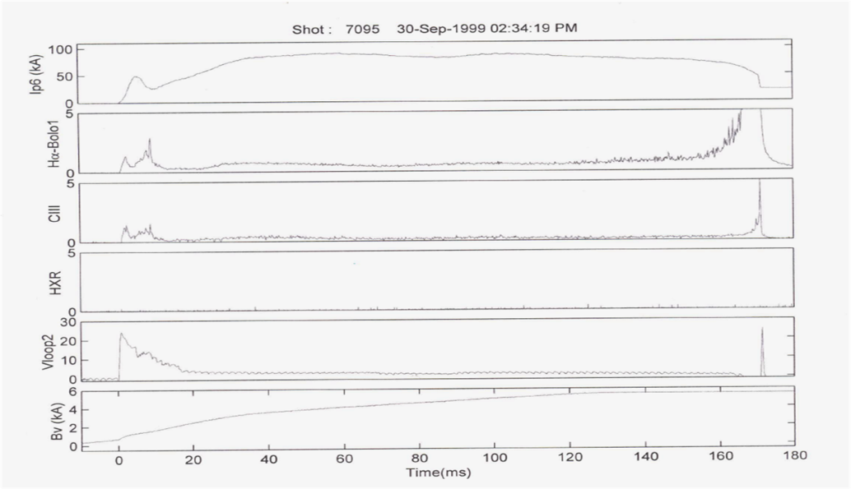
NEGATIVE CONVERTER OPERATION (90s)

Slide 23
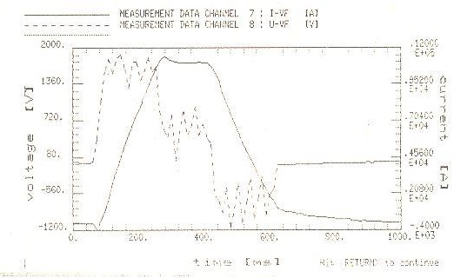
VF COMMISSIONED FOR 10 kA (1991)

Slide 24
VERTICAL FIELD CONTROL SYSTEM

Slide 25
MAINTENANCE REQUIREMENTS FOR PULSED POWER SYSTEM
Transformer design mainly focus to contain axial and radial forces. Periodical reconditioning of converter transformers envisaged
System fault level is high as transformer impedances are kept low for Thyristor commutation. Preventive maintenance to be carried out avoid any converter shot circuits
High inrush currents are flown in every switching. Restriction of switching will improve the system life
Tightening of active components before every campaign
As pulsed systems are designed for a specific number of operations, prudent operation methods increase the system life
Timely replacement of extensively used components like SCRs, Diodes, VCBs, FMS, Resistors, Damping circuits etc.
Maintenance of grounding is very important due to EMI

Slide 26
SUBSYSTEMS REPLACED/MODIFIED
11kV SF₆ CBs phased out and VCBs installed
± 2 kA Transistor based Feedback power supply replaced with IGBT based supply
VF modified with additional slow bank capacitors and 1.6 kV, 3.5 kA booster power supply
WS resister bank, VCBs, fast make switches, circulating transformer are upgraded
Central control computer PDP 11/23+ replaced with VME
Modicon PLCs partially replaced

Slide 27
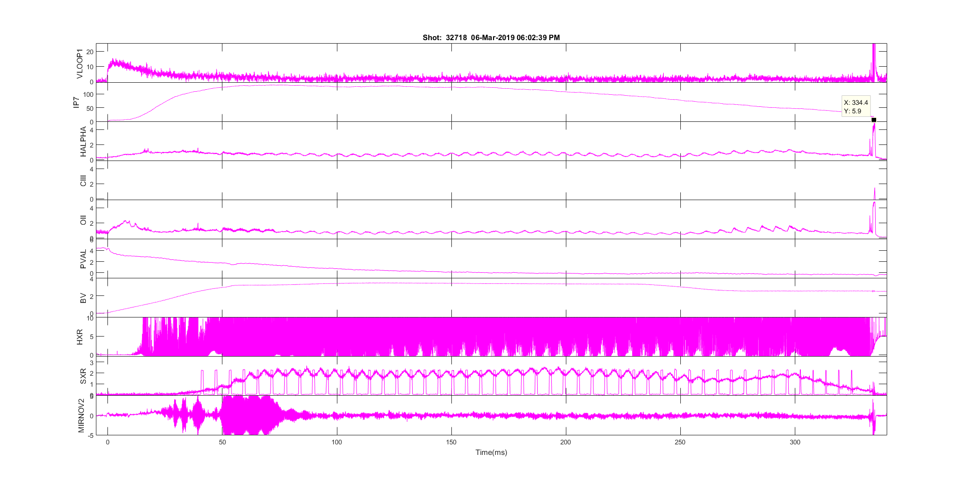

ADITYA-U OPERATION

Slide 28
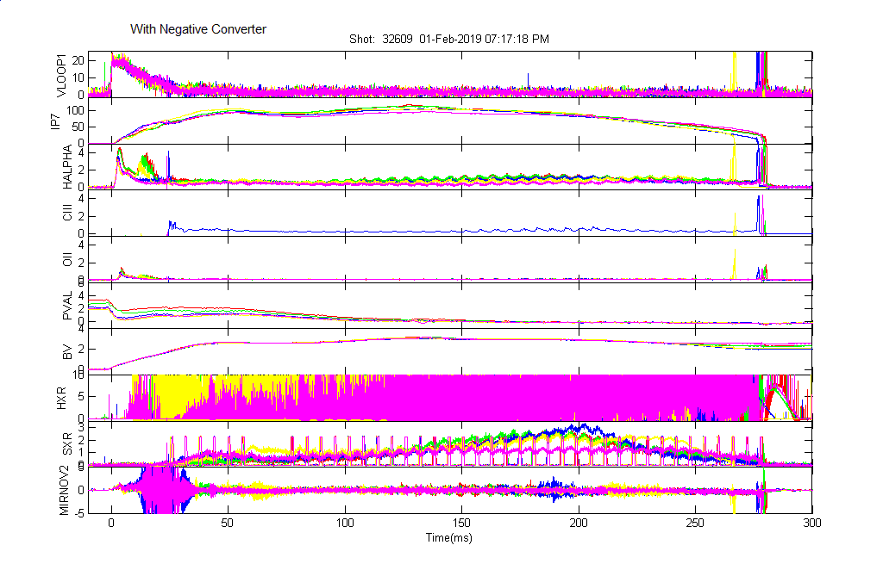
ADITYA-U OPERATION

Slide 29
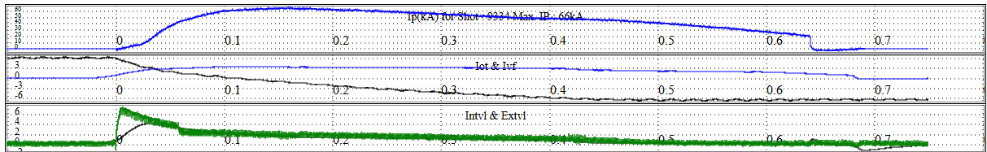
SST-1 OPERATION
OT operated for typically +5.8 to +6.8 kA and -6.0 to -7.0 kA with 1.8 kA circulating current.
VF operated for about 3.2 to 3.9 kA up to 1000 m Sec.
OT and VF support for plasma with typical currents of 65 to 89 kA and time duration up to ~ 650 m Sec.

Slide 30
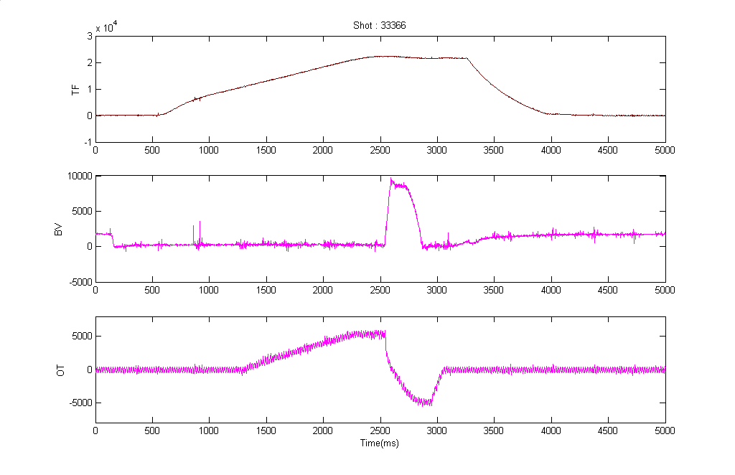
TF/VF/OT CURRENTS

Slide 31
Future plans and upgradation
The following upgradations are proposed for operating the power system for ADITYA-U and SST-1 to meet all power parameter requirements like current, voltage, di/dt and loop voltage shapes etc.
Circulating current transformer of OT upgradation to 11 kV transformer
Controller upgradation of Vertical Field Power Supply
Controller upgradation of Ohmic Transformer Power Supply
Controller upgradation of Wave Shaping circuit and other control interfaces.
Procurement of new Vertical Field Power Supply: 6.25 kV and 8 kA with 5 kV capacitor charging.

Slide 32
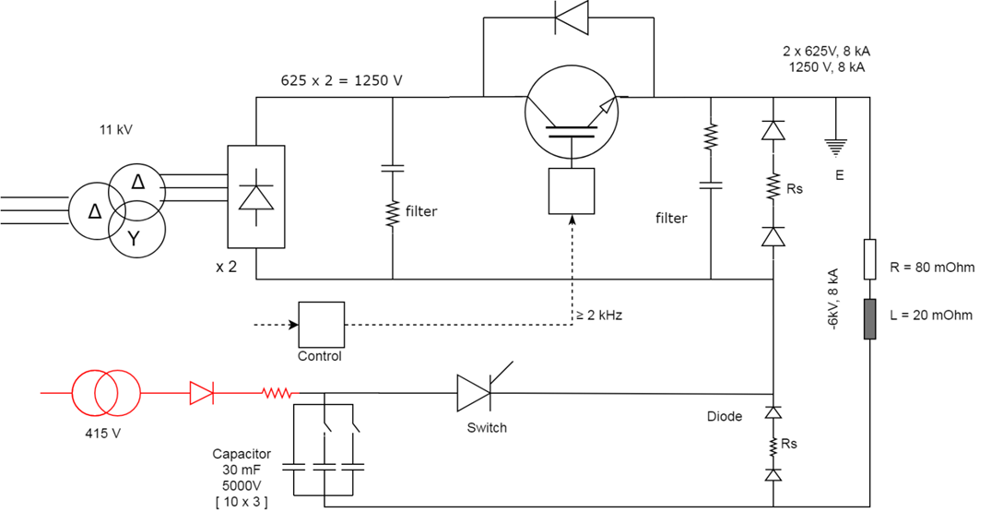
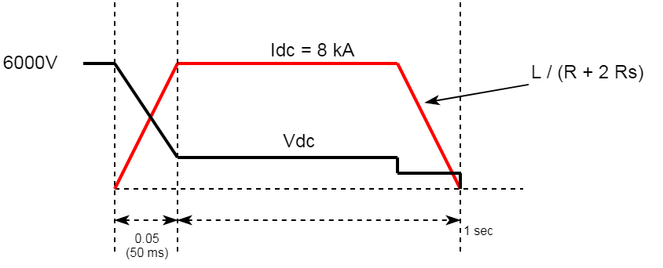
PROPOSED NEW VERTICAL FIELD POWER SUPPLY
t_rise | 50 ms
Vc, Cap (max) | 5000V, 30 mF
Switch | Thyristor
Diode | Blocking diode, 8 kA, 5 kV
Positive (+Ve) | Earth
Negative (-Ve) | -6.25 kV
Chopper 625 x 2 V = 1250V, 8 kA | 0 – 1250 V, ≥ 2 kHz 1 sec

Slide 33
PUBLICATIONS
Four papers published/presented in international journals/conferences
Seven papers published/presented in national journals/conferences

Slide 34
THANK YOU

Slide 35
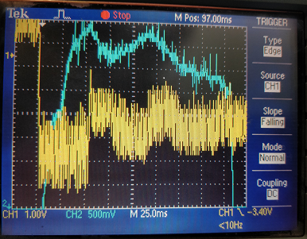
PLASMA FEEDBACK CONROL ON OHMIC

Slide 36
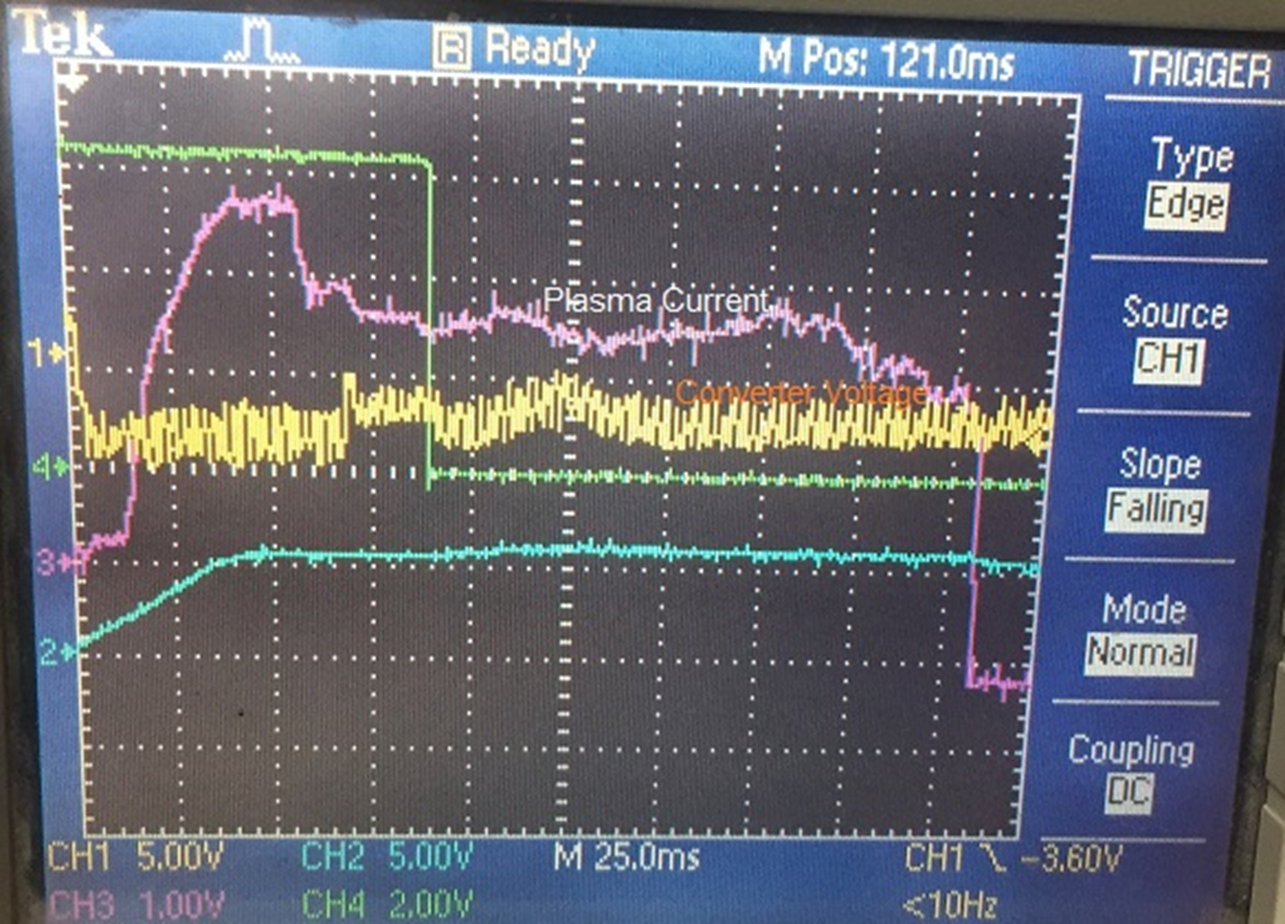
PLASMA FEEDBACK CONTROL ON OHMIC

Slide 37
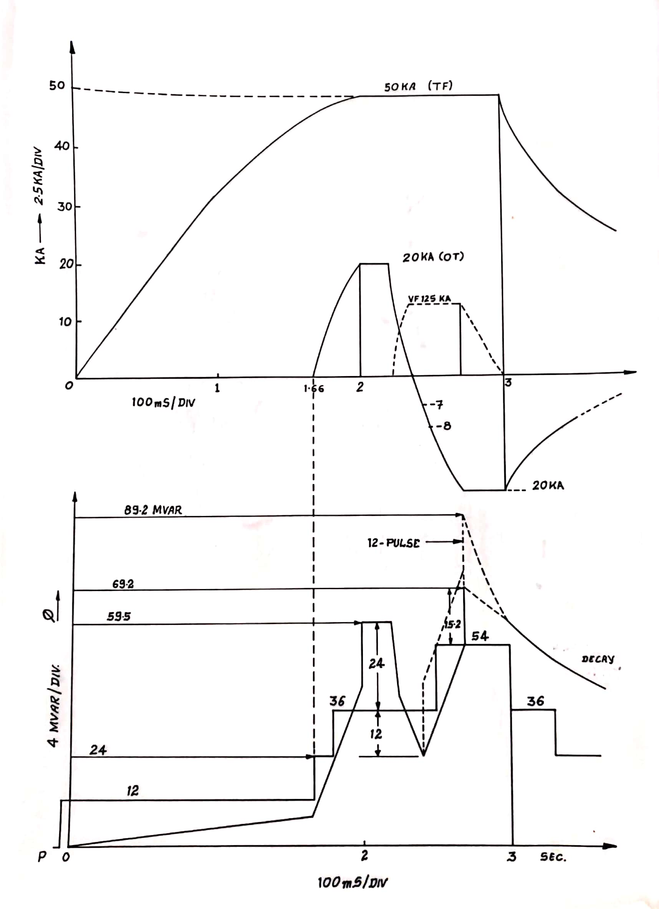
ACTIVE AND REACTIVE POWER

Slide 38
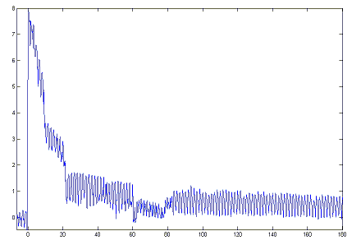
LOOP VOLTAGE

Slide 39
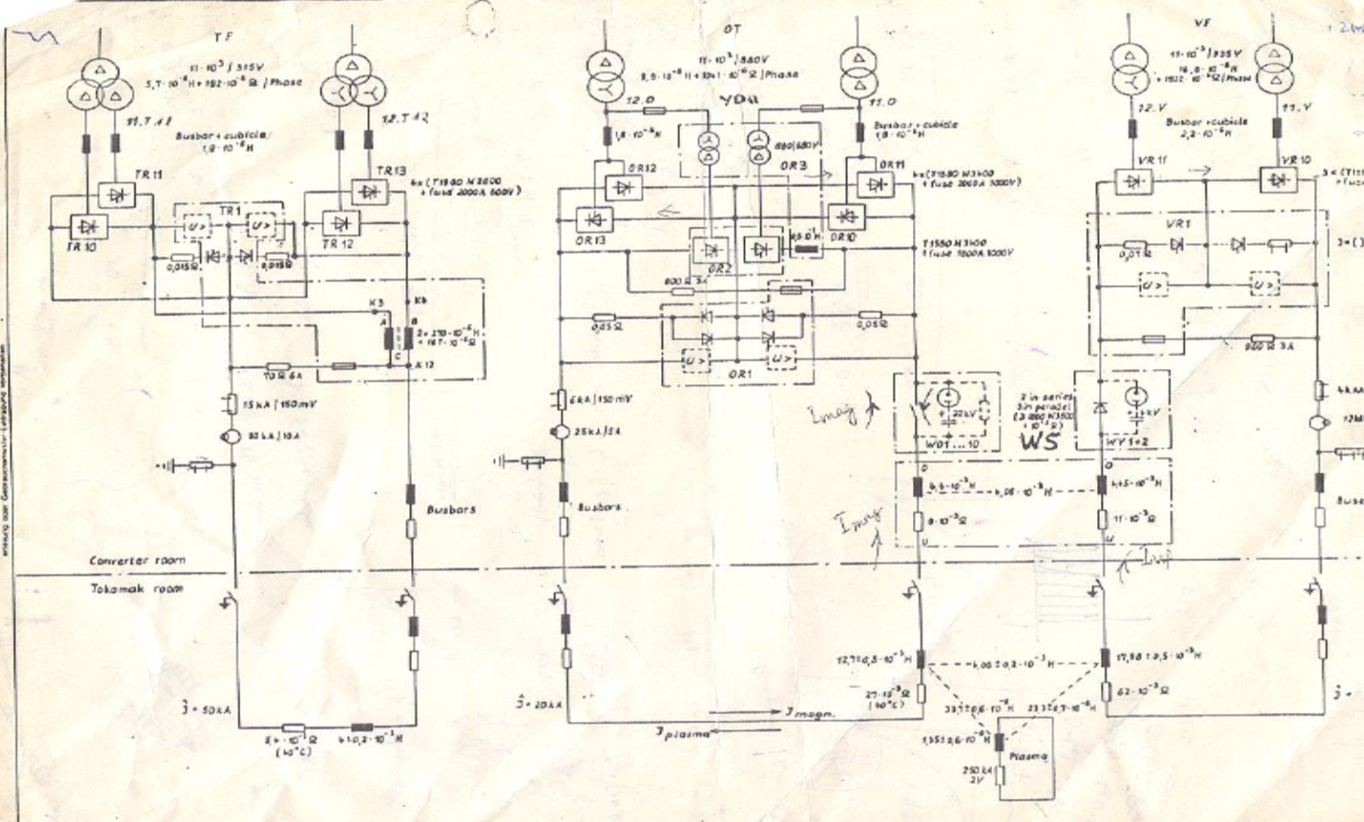
TF/OT/VF/WS/Plasma configuration

Slide 40
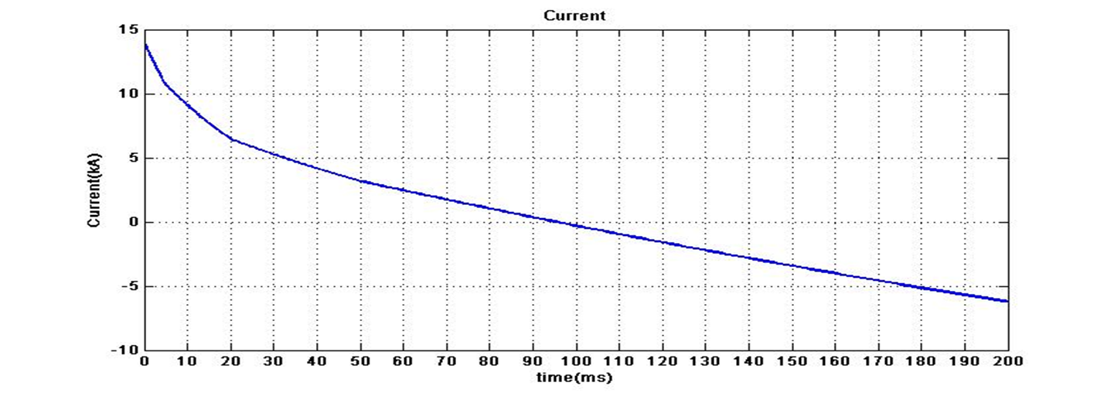
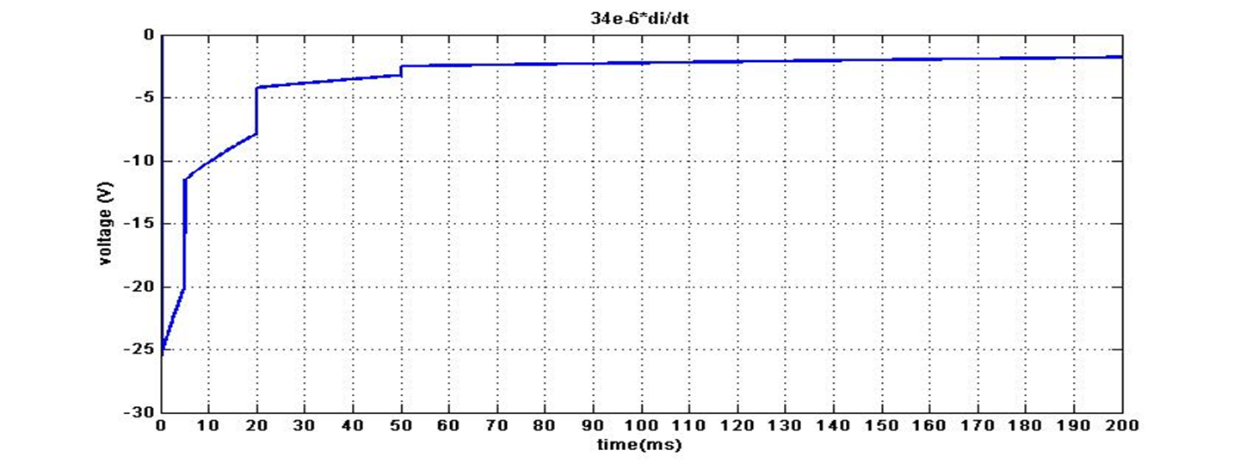
Ohmic / Wave Shaping Simulation Result

Slide 41
OT/WS

Slide 42
Ohmic / Wave Shaping Simulation Result

Slide 43
OHMIC POSITIVE AND NEGATIVE FIRING WITH ZERO CURRENT DETECTION

Slide 44
LOOP VOLTAGE AND VF

Slide 45
FIST PLASMA IGNITION (LOOP) VOLTAGE (0703/1988, 18:48)
I_{OT} = 7 kA
C = 120 µF
R = 1.44Ω
R₁ = 1.32Ω
R₂ = 0.72Ω
R₃ = 0.60 Ω
V_{COT} = 7000 V

Slide 46
11 kV SLD

Slide 47
132/11 kV

Slide 48
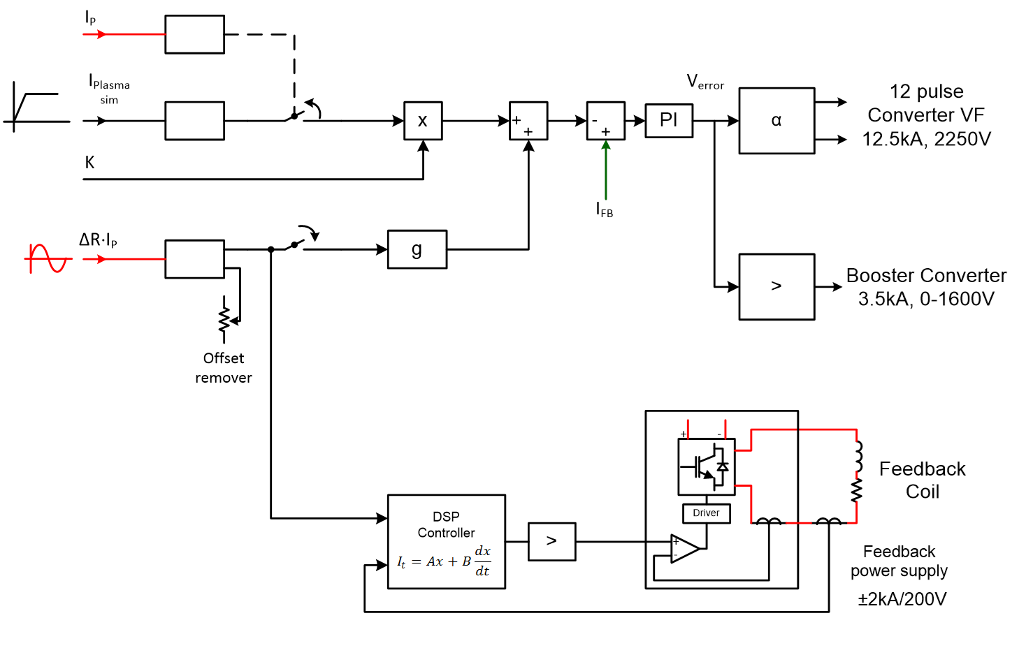
VF CONTROL

Slide 49
CENTRAL CONTROL FROM PDP 11/23+ to VME

Slide 50
11 kV CONVETER TRANSFORMERS RECONDITIONING

