Slide 1
High Performance Data Acquisition Systems for Large Physics Experiments Anita Behere BARC

Slide 2
Outline:
Generic requirements of DAQ for Physics Experiments
Event Acquisition System for MACE Telescope
Design approaches
Features and implementation details
Conclusion

Slide 3
Aim of a physics experiment: Acquire signals from detectors Process the signal to extract Pulse amplitude, charge, pulse shape, time of occurrence, time of flight Collect and integrate data from all detectors Analyze and filter out unwanted events Store for later detailed analysis
Configure and control experiments
Monitor detectors/hardware to ensure safety and stability of operating parameters
Monitor data to ensure quality

Slide 4
Common terms & definitions
Event: The complete set of signals which describe a single interaction is called an Event
Trigger: Events are random in nature, signals from a set of detectors are combined to make a decision on when an event has occurred. This is called a trigger.
Real time detection
Trigger efficiency - detect all events of interest and reject events which are not of interest.
Dead time: System busy time during which it can not acquire a new event is called dead-time

Slide 5
Difference from control and monitoring DAQ systems:
Attribute | C&M | Experiments
Events | Regular (cycle time) | Random, Burst
Signal acquisition | Continuous | Event triggered
Data storing | Continuous | Selective
Signal bandwidth | KHz | MHz
Timings | ms | ns , us
Hardware | - | Configurable

Slide 6
Few categories of DAQ for Large Physics Experiments: Accelerator based experiments Ground based Atmospheric Cerenkov experiments Neutrino experiments

Slide 7
Ground based Atmospheric Cerenkov experiments Event Acquisition System for MACE Telescope

Slide 8
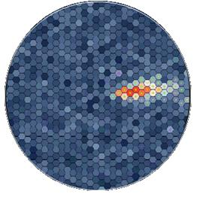
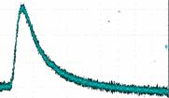
Ground Based Atmospheric Cherenkov Experiments (ACE)
- Gamma Ray telescope
Gamma-ray from deep space
Distribution of photon
flux on the camera
Charge Particle
shower
~ 10 km
Image formed by
Cerenkov event
Energy of cosmic Gamma ray
=> Current pulse from PMT
Rise-time ~ 1-2ns
Pulse width at base ~ 6-10ns
Camera

Slide 9
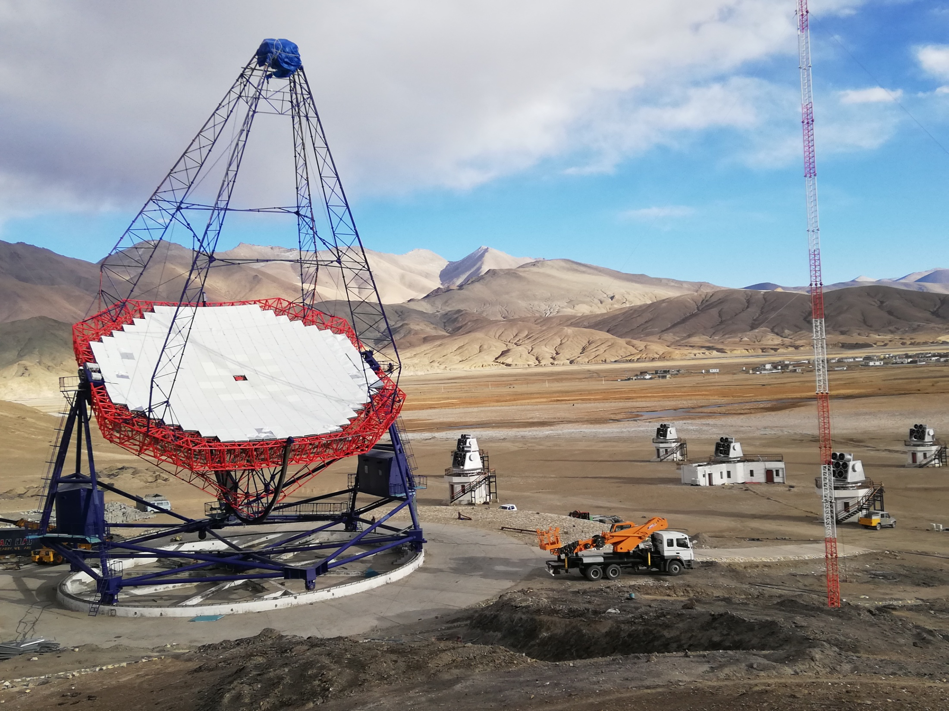
MACE Telescope, Leh, Ladakh –
Actual site photograph

Slide 10
Camera specifications:
Wide dynamic range – 20GeV to 5TeV, 3pe to 1500pe
Acquisition of pulse profile of PMT signal of rise time ~1-2ns
Large number of camera pixels: 1088
Low event threshold – 3-5 pe => 30 to 50mV
1 KEvent/sec Event rate
Low Dead time: for better event pair resolution
Low accidental event rates at high singles rate
Control and Monitoring
Ensure safe operating conditions for PMTs: Anode current / Scalers
Ensure stable and healthy operating conditions
Challenges: High density, low power, low noise, wide band channels in compact area

Slide 11
Non functional engineering specifications:
Remote location
Harsh Climate – 1400 ft ASL, -20 to +20 oC opearting temp
Availability : Reliability and Ease of maintenance
Self Diagnostics, graceful degradation in availability
Camera located at focal plane (25mts) of telescope
Weight and volume
Hence the designs should be simple and hardware easily accessible

Slide 12
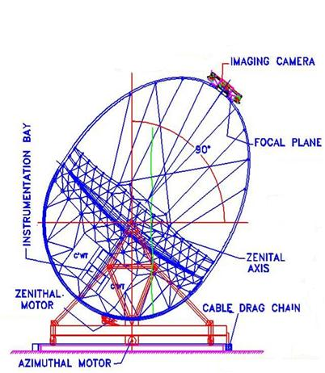
Implementation options for camera electronics
1. PMTs on camera. PMT signal to ground station. Entire signal processing as well as HV generation at ground station
2. PMTs along with amplifiers and laser diode modulators for transmission on the camera. Digitization at ground station
3. Entire electronics on camera, only power and communication cables to camera from ground station
Constraint: Weight, Size and Power

Slide 13
Typical experimental setup DAQ system with CAMAC- FERA
Crate
ADCs
Crate
ADCs
Controller
Controller
PCI interface for
PCI interface for
controller
controller
PCI interface
CONTROLBUS
PCI interface
Control bus
GAI
GAI
GAI
CLI
PASS /
CLI
PASS /
REN chain
REN chain
PASS
REO
data bus
ECL output bus
FERA controller
FERA readout controller
Crate
ADCs
Crate
Standard buses:
CAMAC / VME / PCI
ADCs
Controller
Controller
Control bus
CONTROLBUS
PASS /
PASS /
REN chain
REN chain
data bus
ECL output bus

Slide 14
TACTIC DAQ in control room
No. of Pixels for TACTIC: 349
No. of Pixels for MACE: 1088

Slide 15
SubSystems of Event Acquisition System:
Front-end Camera Integrated modules (CIM): 68 nos., 16 channel for 1088 pixels
Backend units, 1 each:
Data Concentrator, SBC based
Second Level Trigger Generator, CPLD based
Camera Controller, SBC based

Slide 16
Block diagram of camera electronics
C&M link
Data link
To ground
station
C&M link
IRIG-B time code

Slide 17
Point to Point Interconnections for event acquisition
CIM#1
CIM
CIM
Data link
differential pair LVDS)
CIM
Data Concentrator
Second Level Trigger Generator
Block_SLT
SLT
CIM
Gigabit ethernet
CIM#68
Data archive at ground station

Slide 18
Point to Point Interconnections for trigger detection
CIM#1
CIM
CIM
Trigger link
differential pair (LVDS)
FLT group
CIM
SLT
Second Level Trigger Generator
CIM
CIM#36

Slide 19
Front End Camera Integrated Module (CIM)
Sixteen pixel Front End Data Acquisition Module

Slide 20
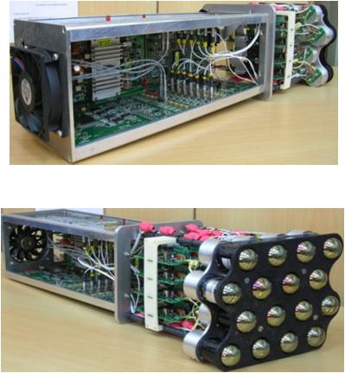
Camera electronics for MACE telescope
Front-end electronics –Camera Integrated Module (CIM) for 16 PMTs:
High Voltage,
Voltage Divider Network,
PreAmplifier,
Main amplifier,
Discriminator,
Scaler,
Local control & monitoring,
First level trigger

Slide 21
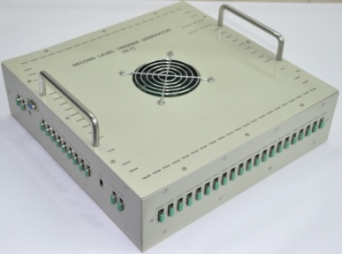
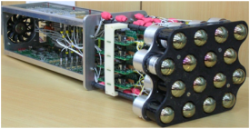
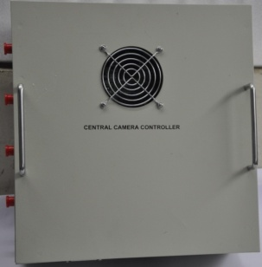
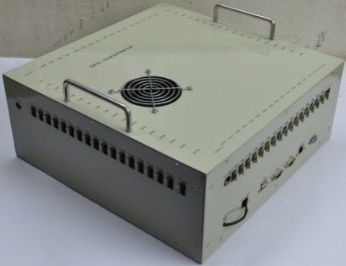
Block diagram Of Camera Electronics
Main control link (I²C )
Second Level Trigger generator
SPI Status/control link
LVDS
Trigger Link
1 to 68 CIMs
Data Concentrator
LVDS
Data Link
RS232 command link
Central camera Controller with Temperature and Lid Controllers
Ethernet Communication links to Control room
Time code from Master Clock in control room

Slide 22
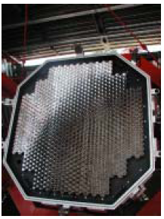
MACE
HESS
Front view of Imaging Camera

Slide 23
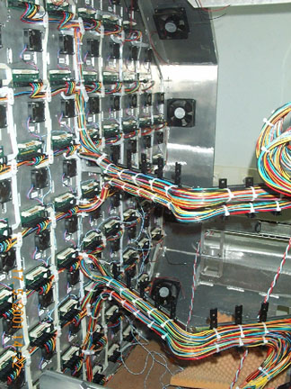
MACE
HESS
Rear view of imaging Camera

Slide 24
Event Detection – Trigger generation
Singles rate ~ 1MHz
PMT1
PMT2
PMT3
Coincidence
window
δT
Trigger region of 576 pixels
Trigger generation time with δT jitter
PMT576
Stops sampling of PMT signal and starts digitization
Final Trigger

Slide 25
Basic philosophy of trigger generation
space-time correlation among detectors in a close cluster of neighboring detectors
Apart from genuine event occurrence, all the detector channels experience random excitations due to detector dark current and background noise. There are some spurious triggers generated due to pure chance coincidence of such random excitations.
The choice of cluster size and geometry is a tradeoff between event detection efficiency and spurious trigger rejection.

Slide 26
Chance coincidence rate expression
The chance coincidence rate (CCR) is given by
where
r = single channel rate for each channel (SCR)
τ = coincidence time window
N= Number of channels among which coincidence happens
k = number of ways N channels can be chosen in the detector array
Optimization – low τ , low r, high N (for r*τ << N)
to reduce the chance trigger rate
detect all genuine events

Slide 27
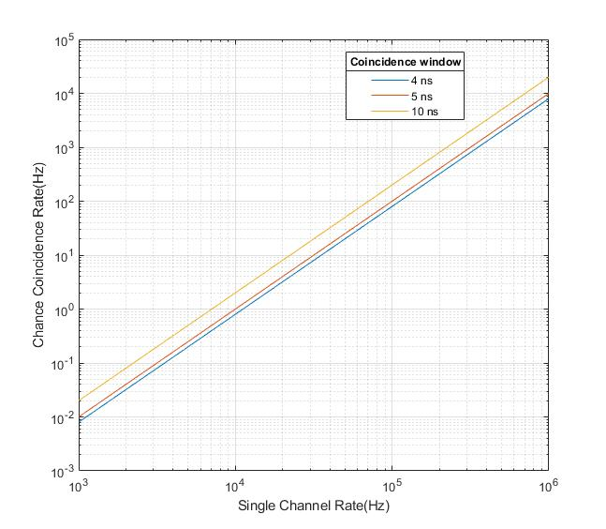
Effect of coincidence window on CCR
chance trigger rate of 20
Shorter coincidence window helps to achieve lower chance trigger rates.

Slide 28
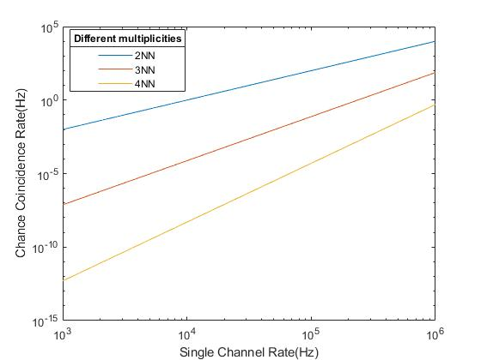
Effect of multiplicity on CCR
chance trigger rate of 20
Bigger cluster size reduces the chance trigger rate

Slide 29
ACR v/s SCR and operating point for telescope for 4NN FLT 5ns, SLT 10ns
Total 4NN combinations

Slide 30
Trigger generation, MACE telescope – two stage, two phase pattern based coincidence
from amplifier
Discriminator
FLT
( Nearest neighbor patterns)
L0_Ch#1
SLT with border resolution
System wide global trigger
L1_CIM#1
Photo-electron programmable threshold, pe
L0_Ch#16
L2_CIM#36
FLT => ~ 5 ns SLT => ~ 8ns
Tight cluster pattern of 3 to 5 pixels at threshold ~ 3 to 5 photo-electrons
FLT
( Nearest neighbor patterns)

Slide 31
Holding signal till trigger decision arrives:
Traditional
Analog delay (low power, low footprint)
Digital delay
ADC / CDC
Detector
FE
Cable delay
Event Readout
Trigger
Gate
Detector
FE
Analog memory
ADC
Data Buffer
Digital memory
(FIFO)
Detector
FE
Flash ADC
Event Data Buffer

Slide 32
Event Data Flow (MACE Camera)
CIM 1
Data Concentrator
Data Archiver (Server)
CIM 2
CIM 3
Central Camera Controller
MACE CAMERA (Operator Console)
CIM 4
CIM 67
Second Level Trigger Generator
0
0
1
3
5
0
3
0
5
0
0
0
0
0
0
n
n
n
µ
µ
S
S
S
S
S
CIM 68

Slide 33
Dead-time – loss of events when system / detector is not available
Many factors and may levels
System busy : few us – ms
Subsystem hang : few ms – sec
System hang : few sec – min
System busy for time τ, for each acquired event
Average input event rate – f1, Output event rate – f2
Dead time = f2*τ, Live time = (1− f2*τ)
f1∗(1− f2*τ) = f2 for random stochastic events
f2 ~= f1 if f2*τ << 1 for stochastic events
f2 = f1 if τ is just < 1/f1 for regular events
By de-randmizing events (buffering) dead-time can be improved

Slide 34
Event Data Flow
CIM#1
LVDS (20MBps)
FIFO
Local bus (33MHz, 33MBps)
FPGA: Event formatter, 8 to 32 bit converter
(FIFO)
Single Board Computer (FIFO)
PCI
(33MHz, 132MBps)
Ethernet (Gbps)
Data archive at ground station
CIM#68
FIFO

Slide 35
Event flow ( Generic Timing Diagram)
Initialization
Trigger Generation
Event Digitization
Event Processing
Event data transfer and Storage
Hold PMT pulse till Trigger Arrives
Raw Events Buffered in module
Events Buffered in DC
Time
0
t₁
t₂
t₃
t₄
Dead time of the system = t₂-t₁ ~50 us (Time required to digitize Region of interest)
Instead of t4-t0 ~ 500 us

Slide 36
Event formatting
Identify the event,
Identify the detector,
complete useful information with zero suppression
Format must be compact, but self documenting
Information about data quality
Include CRC to verify data integrity
Event Data volume :
Event Size = 12762 Bytes with charge for all pixels and profile only for hit pixels. Data volume at 1.6KHz ~ 20 MB/s
Transferred to archival at 1Gbps on aggregated fibre optic link

Slide 37
Calibration system
Sky calibration - subtract the Night Sky Background (NSB) contribution while cleaning raw images.
LED Calibration to calibrate the channels in terms of relative gain
Novel event type encoded in pulse width

Slide 38
Results: The desired performance achieved
1.6 KEvents/s with
50us event pair resolution
burst of 50 events
20MB/s throughput
Low trigger threshold – 3-5 pe => 30 mV
Coincidence window – 5ns & 8 ns

Slide 39
Results: Control and monitoring
System health parameters monitored:
Anode Current / Noise Rates / HV, Discrimination Threshold / Temperatures across modules and Camera
Safety mechanisms implemented
PMT safety mechanism due to overexposure to light
Camera temperature monitoring
Data integrity checks
CRC in data
Numbering of events
Checks for event synchronization
Remote configuration and control from BARC through Anunet

Slide 40
Cherenkov Events @ MACE Camera

Slide 41
Cherenkov Events @ MACE Camera
PMT pulse profile of events acquired in a CIM of MACE Camera (Time = 31 nS)

Slide 42
Summary
Proprietary design in custom packaging using techniques: 1. Analog memory 2. FPGA / CPLD based trigger, event acquisition and processing in front-end modules 3. Data buffering at different stages 4. Analog – Digital mixed signal design 5. Embedded software
6. Hardware-software co-design

Slide 43
Summary
Production with Environmental Qualification as well as ESS screening
Thermal analysis
Installation completed
Commissioning in progress
Future upgrades
Higher sampling rate
Higher event rate
Other sensors for PMTs
Trigger configuration to reduce jitter

Slide 44
Thanks
Contribution from colleagues from Electronics Division, ApSD, CDM, BARC and ECIL

