Slide 1
Complexities of electricity supply options
RB Grover
Emeritus Professor, Homi Bhabha National Institute
27 January 2020
Institute for Plasma Research, Gandhinagar

Slide 2
Future evolution of global energy mix
Worldwide, electricity sector emissions currently average approximately 500 gCO2/kWh. A widely discussed target for 2050 emissions for the electric sector is well below 50 gCO2/kWh. (MIT 2018)
Energy as well as electricity demand is growing. Growth in electricity demand is likely to be higher (about 2.5% per annum) than growth in energy requirements (about 1% annum) due to structural shifts taking place within the energy sector. (KWES-2019)
Further growth in energy supply has to be manged with minimum carbon emission.
Globally one has to move away from coal-fired power plants, which at present are the mainstay of electricity generation. This has to be done in a manner that electricity continues to be available to the consumers as per demand in a reliable manner.

Slide 3
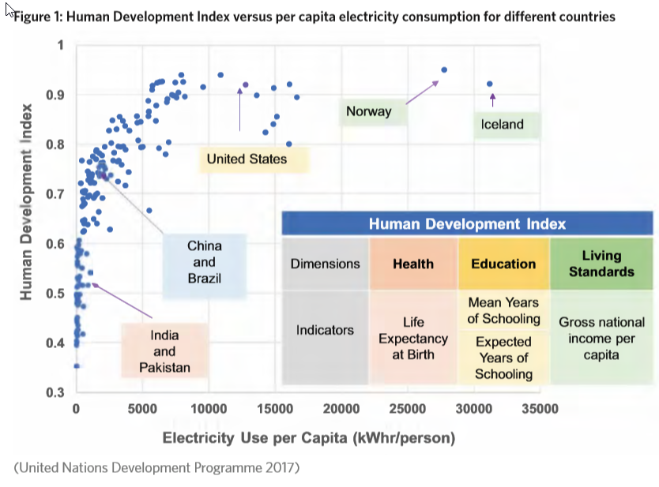

Slide 4
Typical all India Load curve (Source: Electricity demand pattern analysis, Power System Operation Corporation Ltd., 2016)

Slide 5
All India hourly load profile and Net load curve (Duck Curve) Ref: National Electricity Plan, Volume I: Generation, January 2018.

Slide 6
Low carbon technology options for generating electricity
Nuclear
Fission
Fusion: Aditya, the first Indian Tokamak. SST-1. What next?
Solar (Deterioration in performance due to high dust level and high temperature)
Wind: on-shore and off-shore (corrosion due to salinity and high temperature)
Hydro
Run of the river plants, it has “must run” status.
Pelton wheel, very good for balancing,
Francis Turbine, good for balancing.
Gas: A source which can balance intermittency of renewables.
Peaker plants (Low capital cost, may not be very efficient and so high emissions, low resilience)

Slide 7
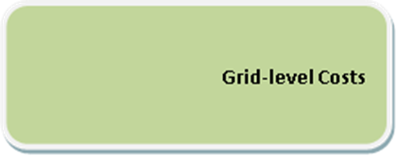
System Cost
Capital cost and generations cost are plant level costs
Grid level costs are
Grid connection,
Grid-extension and reinforcement,
Short-term balancing costs, and
Long-term costs for maintaining adequate back-up supply
Other system costs consist of (i) Health externalities arising from environment effects, (ii) Benefit and loss of integrating new capacity (the cost of creating new capacity and integrating it into the grid, and loss to existing players because of integrating new capacity say by distortion of residual load profile for dispatchable generators by VRE.), (iii) Other externalities such as security of supply and resilience, cost of accidents and net energy gain.

Slide 8
System effect
EROI doesn’t differentiate a despatchable source from an intermittent source, and so doesn’t capture the full impact of penetration of solar and wind in a national grid.
Intermittency and low capacity factor manifests as high system cost.
Grid-parity can be at the generator end or the consumer end.
Because of difference in system costs, generator end grid-parity doesn’t ensure consumer end grid parity.
Solar and wind have reached generator end grid parity and more development work is needed to achieve consumer end grid-parity.
Comparison based ‘LCOE generation’ method is inadequate and doesn’t provide meaningful results. Reliance on LCOE have led to wrong policies.
Several new methods have been proposed to replace LCOE, but conclusion is that system analysis needs to be done to arrive at realisitic cost implication of adding intermittent sources.
Notes:
Levelised cost of energy generation: the way it is calculated no differentiation between intermittent and despatchable generation.

Slide 9
External cost
External costs denote the costs that the party responsible for generating emissions does not account for and consequently consumers of electricity do not pay for.
External costs are paid in terms of health effects (deaths, serious illness, minor illness) by those who are exposed to emissions.
Studied extensively under the project ExternE
Markandeya A and Wilkinson P, (2007), “Electricity generation and health”, Lancet; 370:979-90. (This is an open access paper)

Slide 10
EU data: External costs of various electricity generation technologies New Energy Externalities Development for Sustainability (Ricci A, 2009)
There are similar reports from the USA

Slide 11
Key messages from studies on external costs
Access to electricity is a pre-requisite for the achievement of health.
Electricity generation from fossil fuels is a cause of substantial adverse health burdens.
An accelerated switch to renewable sources has the potential to deliver appreciable health benefits, though intermittency, land requirements and cost pose challenges.
The demand for valuable agricultural land will limit the role of energy crops.
Nuclear power has one of the lowest levels of greenhouse –gas emissions, smallest levels of direct health effects, yet there are fears about nuclear accidents, weapons use of fissionable material and waste storage. There is a need to explain facts to public.
Carbon capture and storage could have a role in future, but its health effects are likely to be mixed as it will result in efficiency losses leading to greater consumption of primary fuel and other resources, and greater production of waste.
Fusion power offers hope, and I urge the community gathered here to establish its scientific as well as commercial viability.

Slide 12
Energy Cliff
EROI= Eout/ Ein; Eout = 100; Gain = Eout – Ein
EROI | Gain %
1000 | 99.9
99 | 99
50 | 98
20 | 95
10 | 90
8 | 87.5
4 | 75
2 | 50
1 | 0

Slide 13
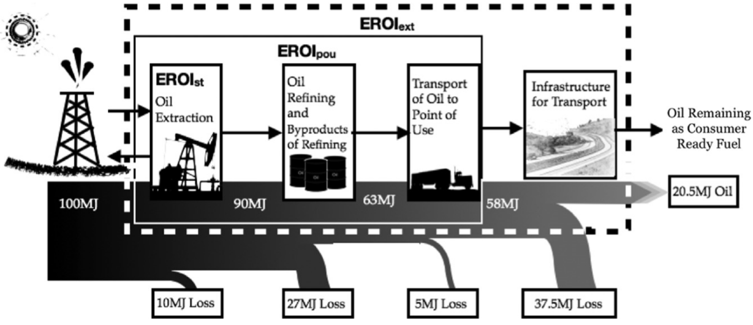
An example of boundaries of analyses for EROI
(Reproduced from Hall, Lambert and Balogh, Energy Policy, 2014)

Slide 14
Energy returned on energy invested (EROI)
Results depend on growth scenario chosen. According to one study, calculated based on primary thermal equivalent basis, is high for coal (38), nuclear (62), large hydro (57) and wind (39). Its value is low for solar PV (6). For the reference growth scenario, the average value is 14. (Neumeyer & Goldston, 2016)
One can think in terms of EROI of an individual source or in terms of the grid as a whole. Research on this subject is ongoing, but some opinions have already emerged. The US economy requires a primary energy system with a minimum EROI of 11 to enjoy a positive rate of growth. (Fizaine and Court, 2016)
Brandt (2017) notes that discretionary spending drops rapidly when EROI of a society falls below 5.
Lambert et al. (2014) estimate that for a society having EROI less than 15 to 25, quality of life is likely to be poor. A threshold is passed when EROI exceeds 20 to 30.
Low the value of EROI severely impacts resource sustainability.

Slide 15
Economics of electricity generation: aspects to be considered
Capital cost of setting up of power plants
Generation costs
Cost of capital (Debt + equity; sensitivity to interest rate)
Cost of fuel (fuel, transportation, processes prior to loading the fuel)
O & M cost
System cost
Plant level costs: Capital cost and generation cost
Grid level costs: Grid connection, extension, reinforcement, balancing cost, replacement cost
Other system costs: External costs, Net energy gain expressed in terms of EROI, Security of supply, resilience (Onsite fuel availability)

Slide 16
Final thoughts
Merit order dispatch: Lowest variable cost is not the only merit. A country where the cost of capital is very high cannot afford to ignore sunk costs.
Due to high system cost of solar and wind, the cost of incremental power from renewables increases dramatically. (IEA reports, MIT 2018).
We have to examine attributes and performance of all technologies in India; a country with high density of population, tropical climate, high cost of capital.
Renewables alone or with efficiency improvements cannot meet electricity needs of India. Efficiency improvements are likely to be accompanied by rebound effect.
“At the levels of ‘deep decarbonization’ that have been widely discussed in international policy deliberations…including nuclear in the mix of capacity options helps to minimize or constrain rising system costs, which makes attaining stringent emissions goals more realistic.” (MIT 2018).

Slide 17
Thank you

Slide 18
The risk of energy production
Every activity has some risks: Deaths per TWh.
Coal average | 161
Coal – China | 278
Oil | 36
Natural gas | 4
Biofuel | 12
Peat | 12
Solar (Rooftop) | 0.44
Wind | 0.15
Hydro | 0.10
Hydro world including Banqiao | 1.4
Nuclear | 0.04
Notes:
The Banqiao Reservoir Dam is a dam on the River Ru in Zhumadian City, Henan province, China. Its failure in 1975 caused more casualties than any other dam failure in history at an estimated 171,000 deaths and 11 million displaced. Construction was rstarted and the dam was completed in 1993.
http://www.nuceng.ca/refer/risk/risk.htm

Slide 19
Population density (pop/km²) of select countries (Jan 2019)
Bangladesh = 1152
South Korea = 515
India = 408
Japan = 334
UK = 272
China = 145
EU = 112
USA = 33
Brazil = 25
Argentina = 16
Russia = 9
Canada = 4

Slide 20
Comparison of Energy Release
Chemical Reaction: 4 to 12 eV
(Combustion of one atom of carbon)
Nuclear Fission: 200 Million eV
(One atom of uranium ²³⁵) (~20,000,000 times more)

