Slide 1
ADITYA – 30 : a look back and some thoughts on the future
Abhijit Sen
Institute for Plasma Research
January 27, 2020

Slide 2
A bit of pre-history - the sowing of early seeds!
1970 - a faculty meeting in PRL – Prof. A.C. Das witness
Dr. Sarabhai outlines a plan for a plasma physics
and fusion program for the lab!
Clear strategy in mind – first find the right people

Slide 3
Gathering the troops…….
Raiding TIFR
Prof. R.K. Varma – disciple of Rosenbluth –the “Pope”
Prof. R. Pratap – Brussel school of Prigogine
Dinner with Chandra
Prof. Bimla Buti - Prof. Chandrasekhar’s student
Lunch meeting in Washington
Prof. A.K. Sundaram

Slide 4
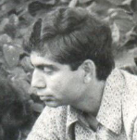
The Prize catch ………
Prof. P. K. Kaw
In him he launched a dream and
Lit a fire

Slide 5
Beginning of the ground work ……
Mid-1971 the entire core group was in place – including
myself – the last member to join!
New areas of research
Plans for the immediate future
Initiate an experimental program – aligned with PRL space research
Recruit experimental faculty
Start an active graduate program in
plasma physics

Slide 6
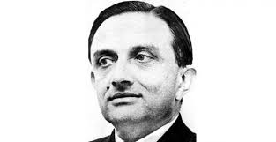
A pall of gloom
December 30, 1971
– shattering news of Dr. Sarabhai’s sudden demise in Kovalam
an unfulfilled dream
As we celebrate his birth centenary it is fitting to
remember that he sowed the early seeds of a
Fusion program in India
1919-1971

Slide 7
The dream did not die!
1971- 1975
- an exciting period that built the bedrock for the future fusion program
Induction of experimental faculty – future core group for fusion
Start of many basic experiments – skill building and experience
Vigorous graduate program – future manpower
``Dawn of a new age of Plasma Physics in India’’

Slide 8
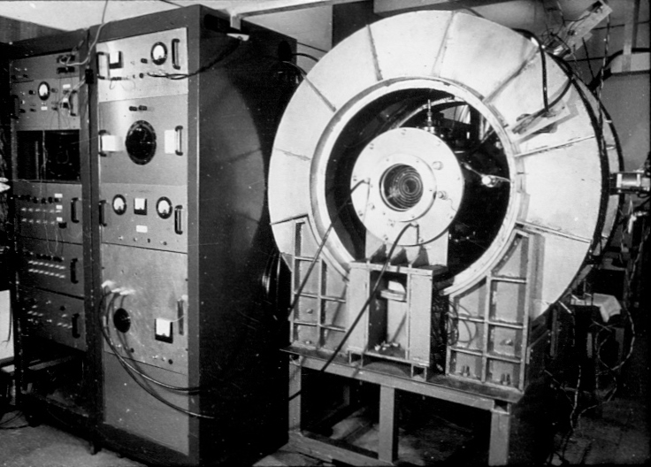
The early experimental program
Electrojet Instability Experiment
Development of an experimental core group
Prof. P.I. John
Prof. Y.C. Saxena
Prof. S.K. Mattoo
Skill development and experience in:
High vacuum
Pulsed power
Magnet design
Diagnostics

Slide 9
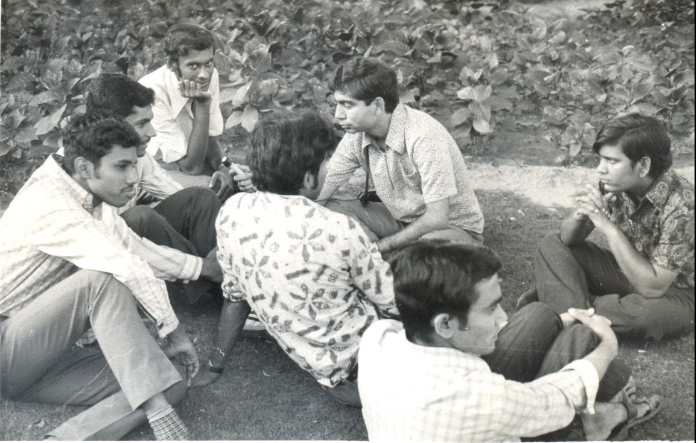
PKK - the Spearhead …..
Led from the front – research, planning, teaching & inspiring the young
- totally electrified the environment at PRL
What drove him? - the dream was still alive in him and he had hope

Slide 10
Fading of the dream
Intensive efforts and `knocking on the doors’ at various
platforms to launch a fusion program
However times had changed and the prospect of
starting such a program seemed to fade rapidly !
He quit in 1975 and went back to Princeton

Slide 11
The long hiatus….1975-1982
Strong upsurge of fusion activities in the world – particularly in the U.S.
Tokamak performances were improving dramatically everywhere
Indian plasma physicists abroad had long and intense discussions
whenever they met at international and U.S. meetings
A decision was taken to submit a proposal based on the tokamak
device be submitted to the GOI
A long chase of 4 yrs from 1978 through the labyrinths of bureaucracy
and `corridors of power’ before the proposal saw daylight

Slide 12
Establishment of PPP at PRL - 1982
A DST supported independent program nucleated at PRL
Earnest work on tokamak design begins – early approach
somewhat modest
1984 Prof. Kaw returns to assume directorship of project
A more ambitious design to enable exploration of the
latest tokamak advances – the leapfrog approach
ADITYA is born! – the name reflects both the optimism
of the day and our future ambitions

Slide 13
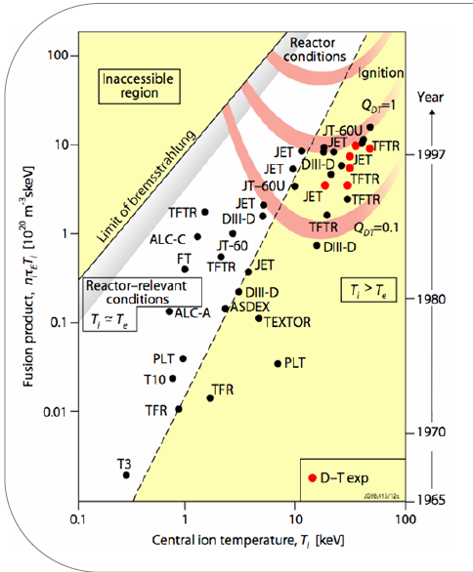
World Perspective
We started here
A Challenging debut
?

Slide 14
ADITYA achievements
As the first indigeneously made tokamak in the country its history over the past
30 years tells a remarkable tale of achievements on many fronts –
Technological
Scientific
Project management
Development of human resources
As the entry step of our fusion program it quickly put us in the mainstream
of the international fusion effort
It has also paved the way for our taking bigger strides towards our ultimate quest
for fusion power
We have much to celebrate today

Slide 15
Future course of ADITYA?
With celebrations it is also time for some introspection and self-criticism
to help us learn from our past experience and to leap forward to
higher heights as we continue on ADITYA-U
The goal should be to get the highest quality (by world standards)
scientific results and progress rapidly towards the achievable `fusion’
milestones on a machine of this kind
ADITYA is also an integral part of our overall fusion program – so it can
play an important role towards the success of that program

Slide 16
Story beyond ADITYA…..more leapfrog steps!
Mid-1990s when news of China’s superconducting tokamak program
caught the PMO’s attention PKK was ready to seize upon the opportunity
IPR got the SST-1 project in 1996 – that put us right at the then frontiers
of world tokamak research – a major coup
Then again in early 2000s when ITER was looking for an additional partner
PKK was able to convince them about India’s suitability and the GOI about
the importance of joining this mega international project – major role
played by Dr. Kakodkar and Dr. Grover
2005 India joined ITER

Slide 17
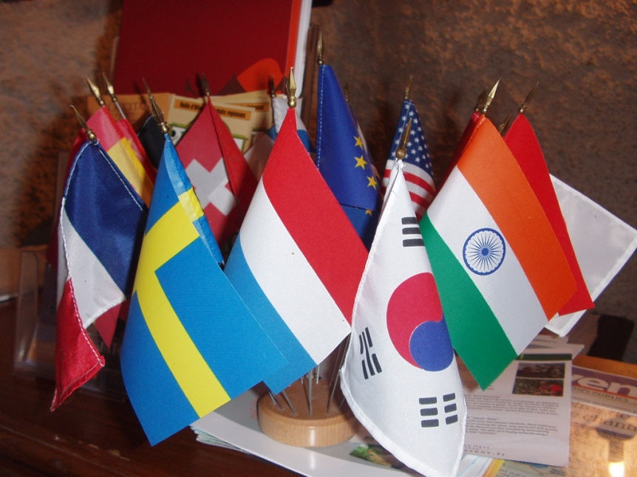
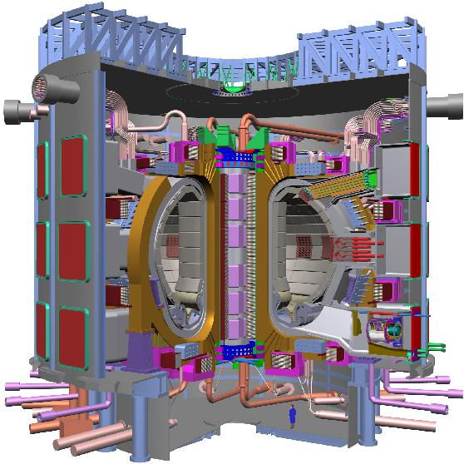
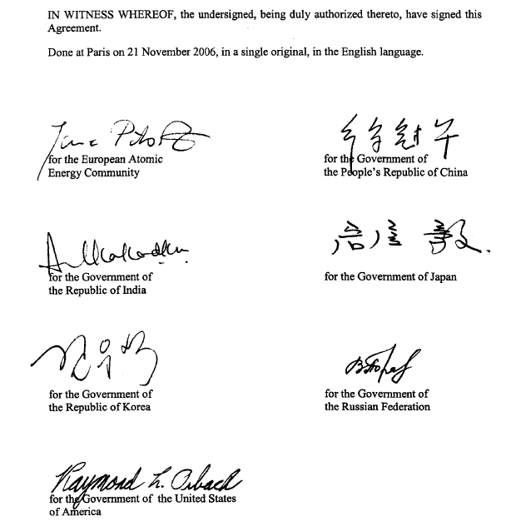
India joins ITER
December 2005
To supply 10% of 150 procurements
2004 Design

Slide 18
Power Plant
2050
Indian Fusion Program
Fusion Power Reactor
DEMO 2037
2 x 1GWe Power plant by 2060
Qualification of Technologies
Qualification of reactor components & Process
Qualification of materials
SST-2, 2027
Indigenous Fusion Experiment
ITER Participation
2005
scientific and technological feasibility of fusion energy
SST-1 1996
Steady State Physics and related technologies
ADITYA 1984
Note: Years represent start of project
First Tokamak

Slide 19
Strategy behind Roadmap
Leverage our present scientific experience in building and
operating ADITYA and SST-1 combined with the technical
knowledge and industrial base developed for ITER packages
to leap frog to an accelerated path to fusion energy
Strategy in line with most ITER partners particularly Asian
countries like S. Korea and China
SST-2 option provides a flexible alternate option of pursuing
a fusion-fission hybrid path
Target dates will allow us to meet India’s energy needs in a
synergistic way with the nuclear energy program

Slide 20
Desiderata for Success – a personal view
Roadmap needs to be updated – “living document” – needed to provide focus
Get an “ITER generation” ready – scientists who will use ITER – urgent need
Use ADITYA-U, SST-1 + world fusion resources to do this
Rapidly expand human resources to man our science and technology progs
Open up our world! – this is the age of collaborative research – we
need to make our presence felt - take a pragmatic approach

Slide 21
A Message for the young
Achieving Fusion Energy would be the greatest of societal benefits
but the path to get there is very long
So to get there :
One has to Believe in Fusion
One has to have Passion to do fusion research
One has to be very very Patient
Finally you must be able to dream Big!

Slide 22
The ultimate dream
"Having done so much on ITER, we should actually prepare ourselves to do the DEMO plant done on Indian soil - an International DEMO plant done on Indian soil –
that will enable us to leap frog even faster - that's my dream.”
- Dr. Anil Kakodkar

Slide 23
Thank You

