Slide 1
Aditya: The Beginnings
P. I. John

Slide 2
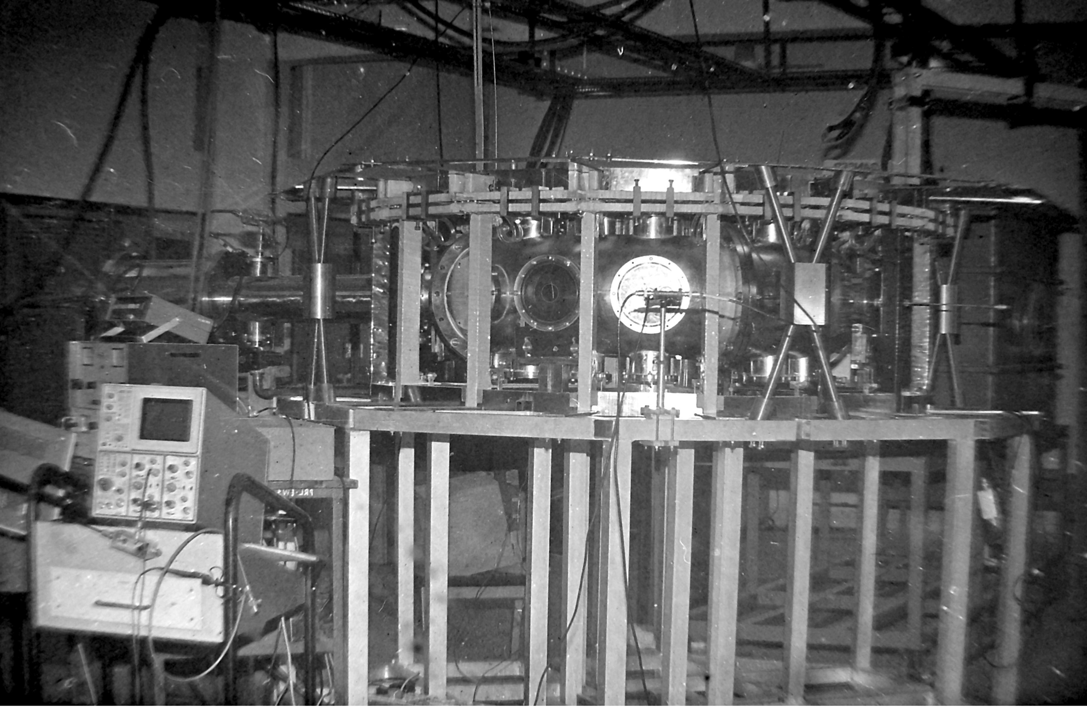

Slide 3
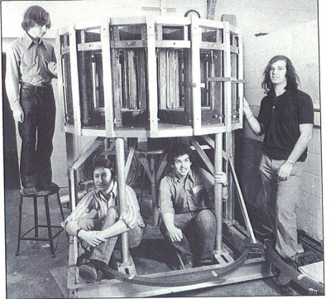

Slide 4
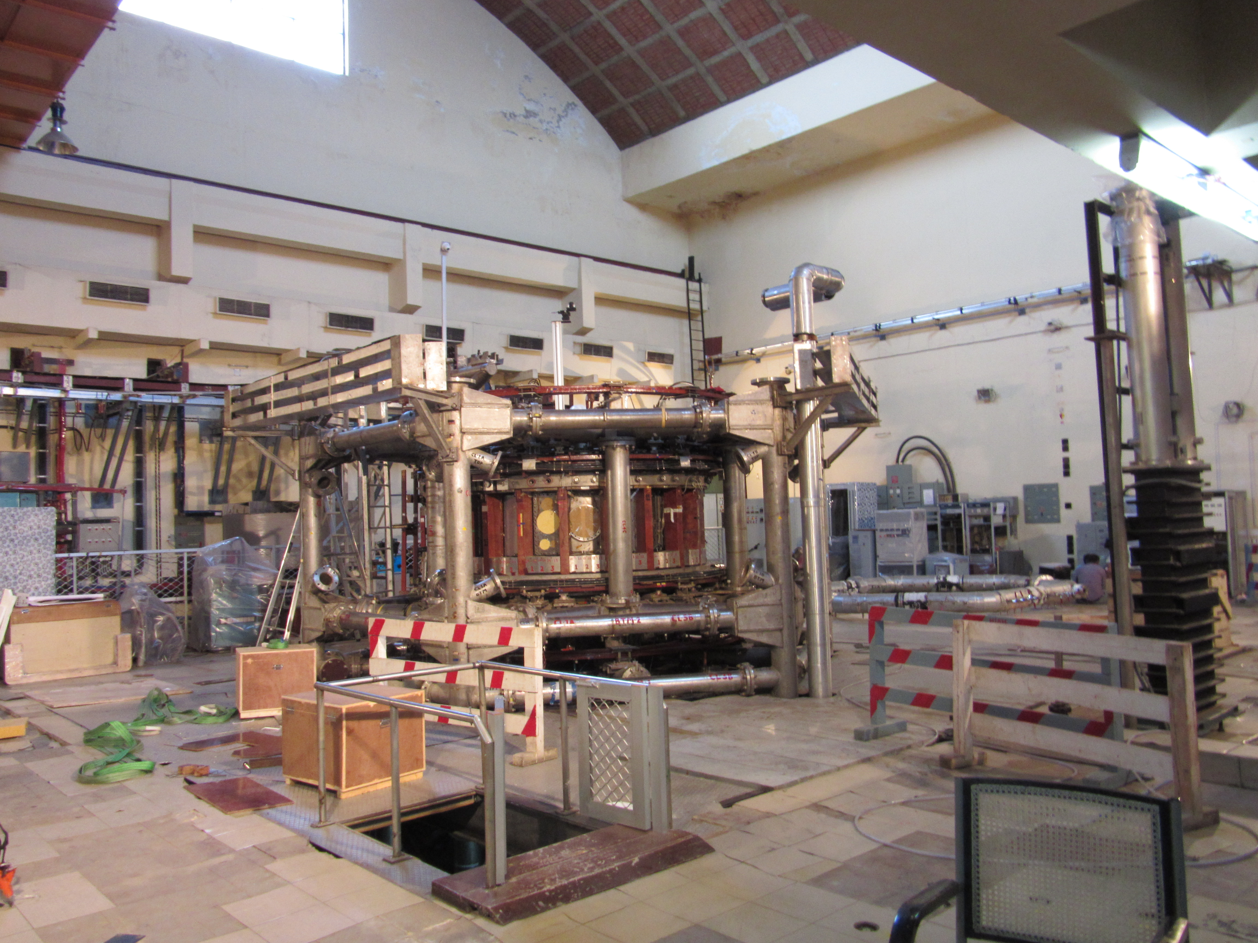

Slide 5
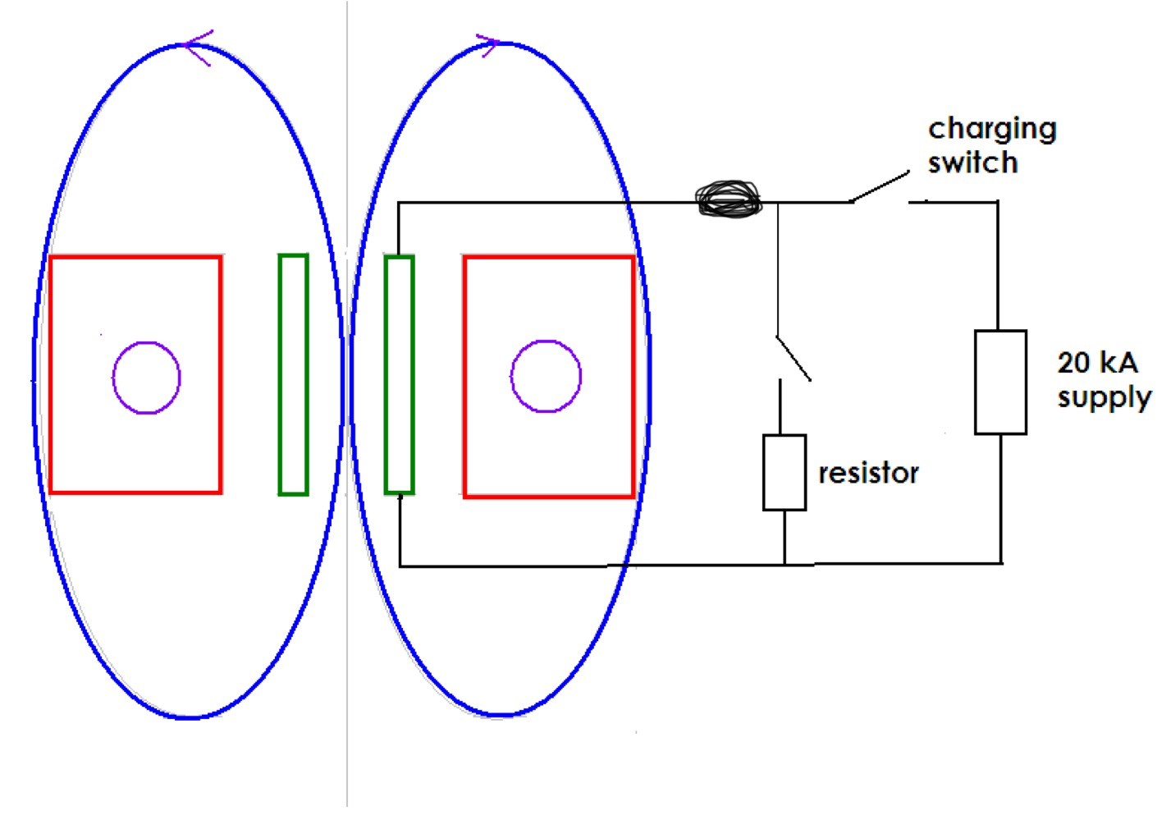

Slide 6
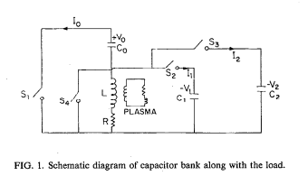

Slide 7
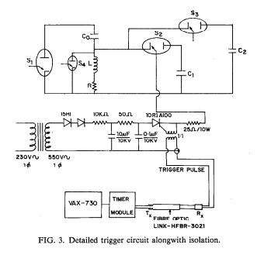

Slide 8
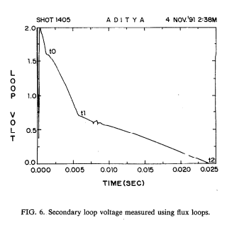

Slide 9
UNIQUE ACHIEVEMENTS OF ADITYA
the largest UHV system in India
largest deployment of turbo pumps in India
the largest pulsed power system in India
the first and the largest inductive energy storage system in India
the only power consumer tapping two different power grids, GEB and AEC
the only power consumer who measures its own power consumption.
Aditya, during a shot was hottest spot in India at a few million degrees.

Slide 10
My First Paper on ADITYA!
Bopal July 1989
A Technically Correct Representation of Plasma Formation In ADITYA

Slide 11
Song of the Stray Electron
……
Stroked by the tendrils of the induction field,
decreed by Lenz and Faraday, to yield
and start my free fall, inertia and all
round and round, away from the silvery wall
caught in the clasp of this magnetic maze
survival of the fastest is the secret of this race
By now, we are a crowd, those started late
have also joined the race, given the mandate
to jostle the atoms, excite a few.
Deep in the torus is the shade of a glow
before we could say avalanche
we have multiplied in revanche
Freed from the bondage a la Bohr
collective consciousness begin to soar
Catch the impure, burn them in our fire.
Break through the barriers, radiation and others
soar to the flat top, promised by the designers.
We dance, saw teeth and radiate
in a ring of fire, primeval, inchoate
it shall not matter that we shall quench or disrupt
if only you would say in our obit
that, for a moment, we made a starlet in Bhat!.

