Slide 1
ADITYA Upgradation with Divertor Configuration
R. Srinivasan
Institute for Plasma Research,
Bhat, Gandhinagar
Contributions from:
Deepti Sharma – Equilibrium study (IPREQ)
Richa Bandyopadhyay – Transport simulation (TSC)
Himabindu and Anil Tyagi – Divertor study (SOLPS)

Slide 2
Typical Tokamak
Toroidal Field coils- for main confining field
Central solenoid
Poloidal coils – for plasma shaping & control
Plasma
Tokamak is an Axisymmetric torus with Toroidal magnetic field produced by external coils and poloidal field produced by toroidal plasma current and external coils.
Both fields are necessary to confine charged particles or plasmas.

Slide 3
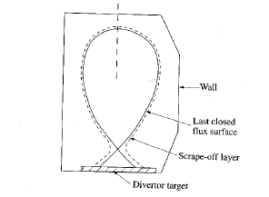
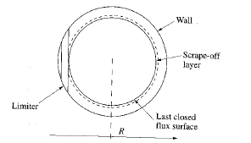
Limiter & Divertor Configurations
In limiter plasma, the plasma is limited by a solid surface where as in divertor configuration, the plasma is confined within the Last Closed Flux Surface (LCFS). Beyond LCFS, the field lines are open and fall on the divertor plate. Divertor is needed for steady state operation
Shaping of plasma (elongation, traingularity) achieved with external coils, and shaping helps in achieving H-mode plasmas easier.
Proposal for the upgrade involves the implementation of a divertor plasma with shaping capabilities

Slide 4
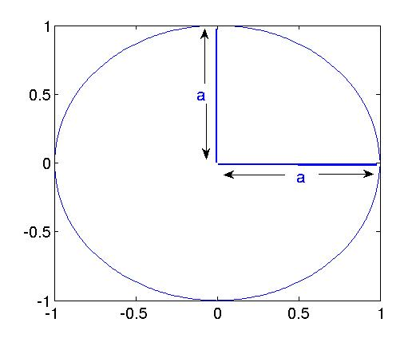
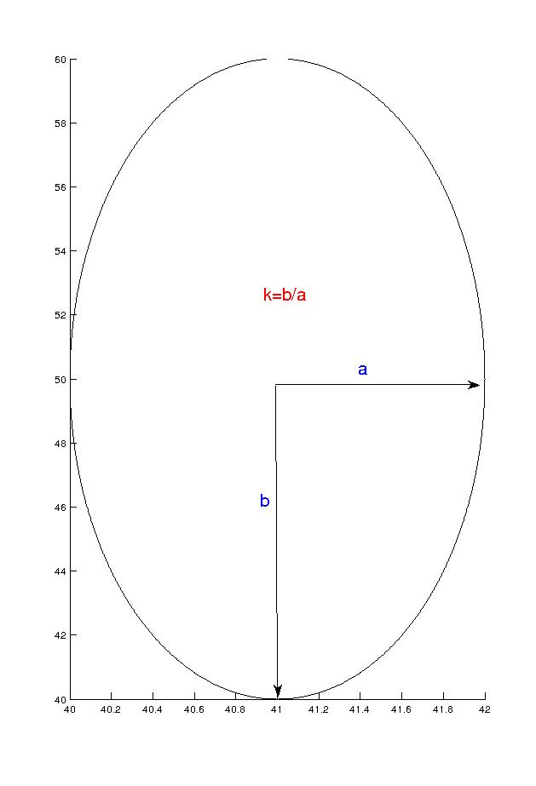
B=0
κ -- elongation &
δ -- triangularity.

Slide 5
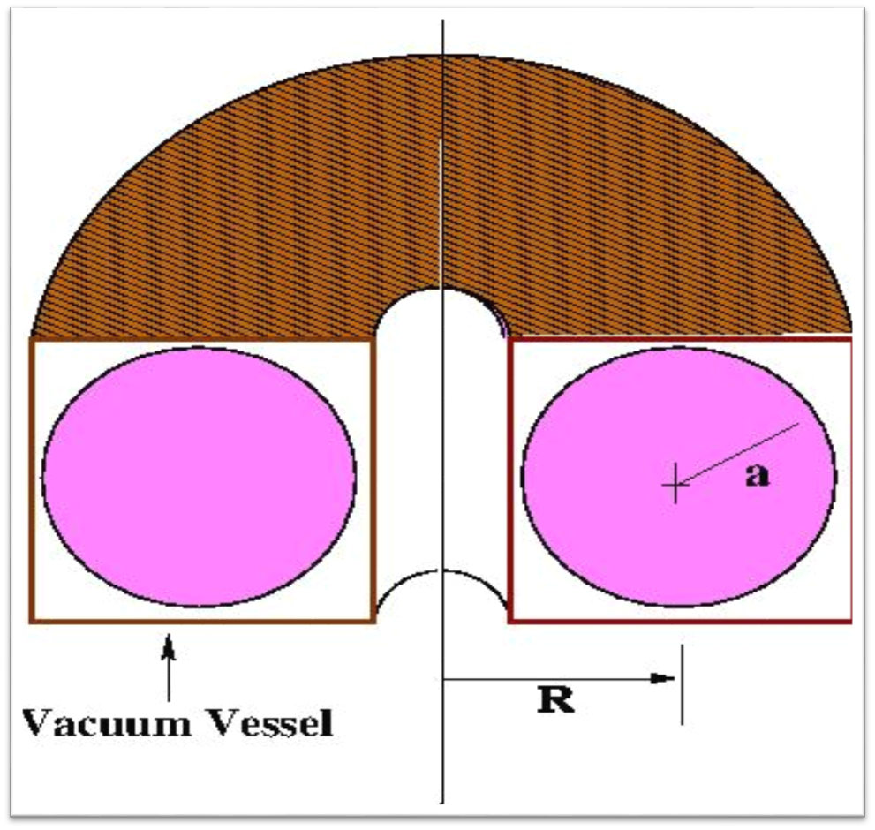
Original Aditya Tokamak:
Machine Parameter:
Rectangular Vessel.
Major Radius : 75cm
Minor Radius : 25cm
Toroidal field : .75-1.0T
Plasma Parameter
Plasma current : 100 kA
Electron density : ~10¹³ cm⁻³
Electron Temp ~ 400eV

Slide 6
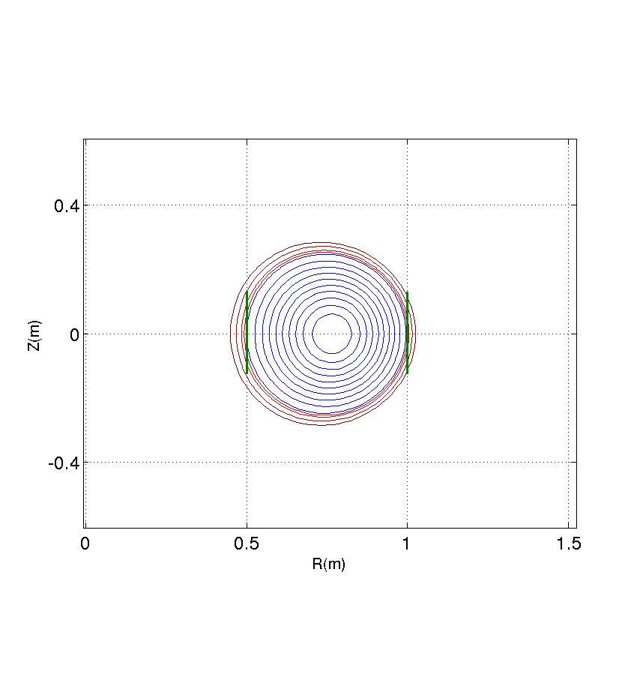
Original Aditya equilibrium configuration
2 pairs of coils BV1 (60 turns);
2 pairs of coils BV2 (22 turns) connected in series with different number of turns.
 | BV1 | BV2
R(m) | 0.376 | 1.634
Z(m) | ±1.05 | ±1.19
ΔR(m) | 0.164 | 0.18
ΔZ(m) | 0.115 | 0.038
NI(MA) | -0.128 | -0.065

Slide 7
Constraints involved in ADITYA-U
Down time of the device should not be more than 2 years
  Refurbish the existing TF coils and this limits the vessel boundary
Existing power supplies and ohmic & vertical field coils to be used
  Additional coils compatible with existing ones to be used to vary the plasma shape (limited shape flexibility)
Space available for additional coils limited by new vessel and existing TF coils
  Limits the divertor coil current and this limits the plasma current for divertor configuration

Slide 8
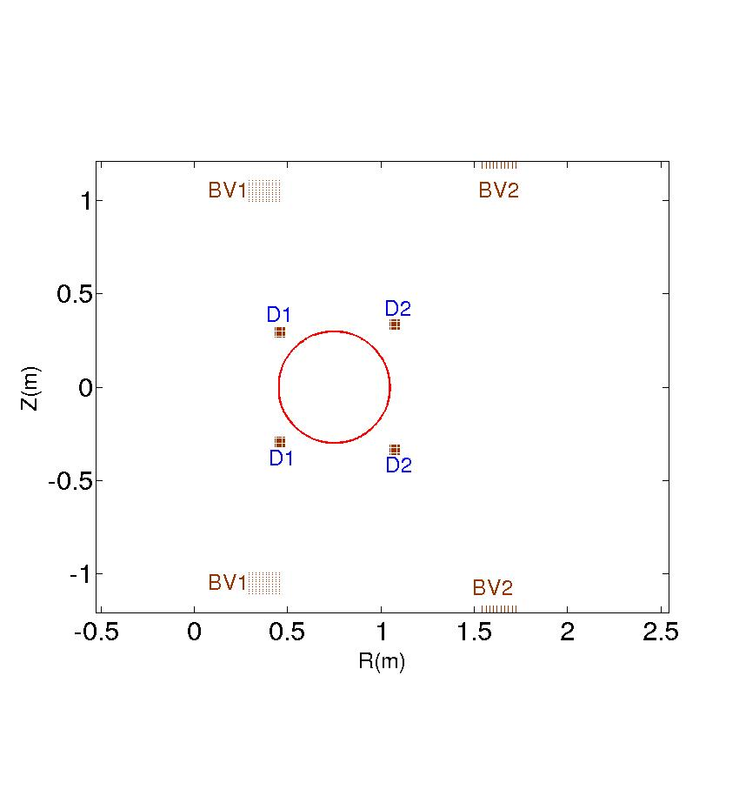
Possible divertor coil positions
New circular vacuum vessel with
diameter of 60cm.
D1 & D2 are two pair of symmetric diverter coils
 | BV1 | BV2 | D1 | D2
R(m) | 0.376 | 1.643 | 0.460 | 1.075
Z(m) | ±1.05 | ±1.19 | 0.295 | 0.333
ΔR(m) | 0.164 | 0.18 | 0.05 | 0.05
ΔZ(m) | 0.115 | 0.038 | 0.05 | 0.05
NI(MA) | -0.288 | -0.105 | 0.150 | 0.150

Slide 9
Aditya Divertor Configuration
To provide operational flexibility, Aditya is Upgraded from circular plasma to X-point plasma.
Old BV1, BV2 coils have to be fed independently.
D1 & D2 are two pairs of poloidal field coils (divertor coils) with current limit of 150KAt.
Rectangular vessel is converted into circular vessel with diameter 60cm.
Divertor coils are positioned at the available space.
Plasma Parameter for Upgradation case:
Plasma current : 100 kA
Electron density : ~10¹³ cm⁻³
Electron Temp ~ 400eV
B_{tor} = 1.5T

Slide 10
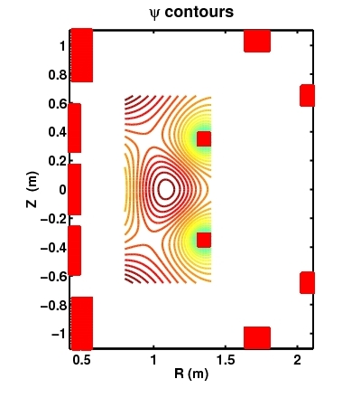
IPREQ: Plasma equilibrium study
SST-1 PF design with IPREQ
Tokamak Equilibrium code IPREQ
Equilibrium Reconstruction
PF DESIGN CODE FOR TOKAMAKS (Single/Double null plasmas with strike point constraint)
MHD stability analysis with stability codes like ERATO, PEST2
IPREQ used to obtain optimized design of ADITYA-U divertor configuration

Slide 11
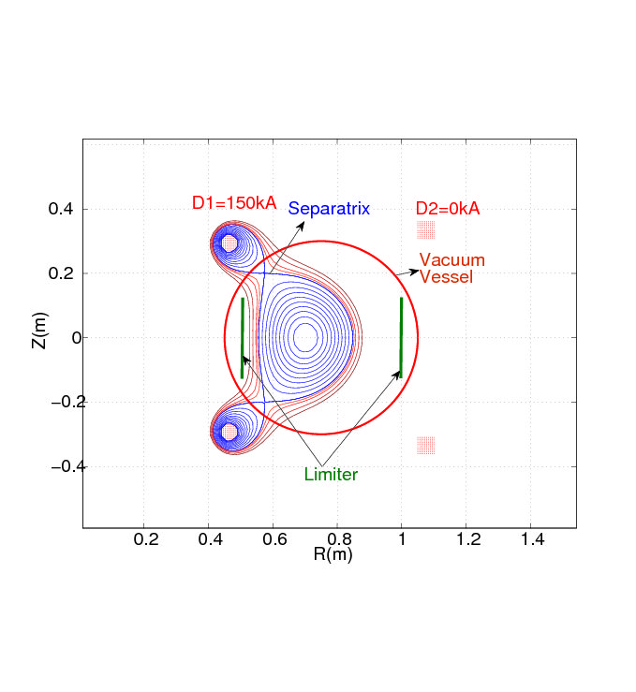
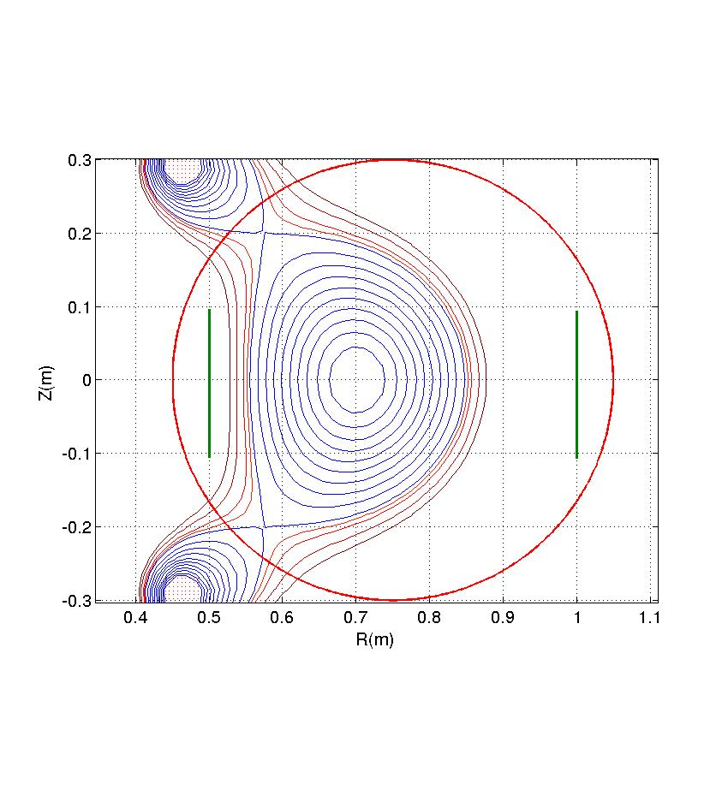
Double Null Configuration low β_{p}
Equilibrium case -1(D2=0kA)

Slide 12
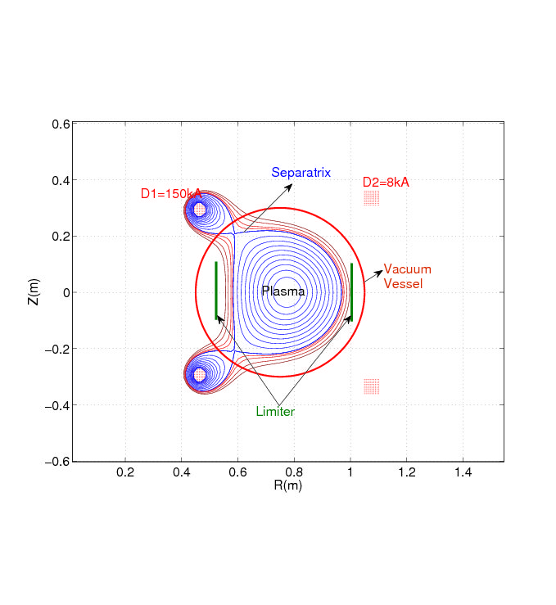
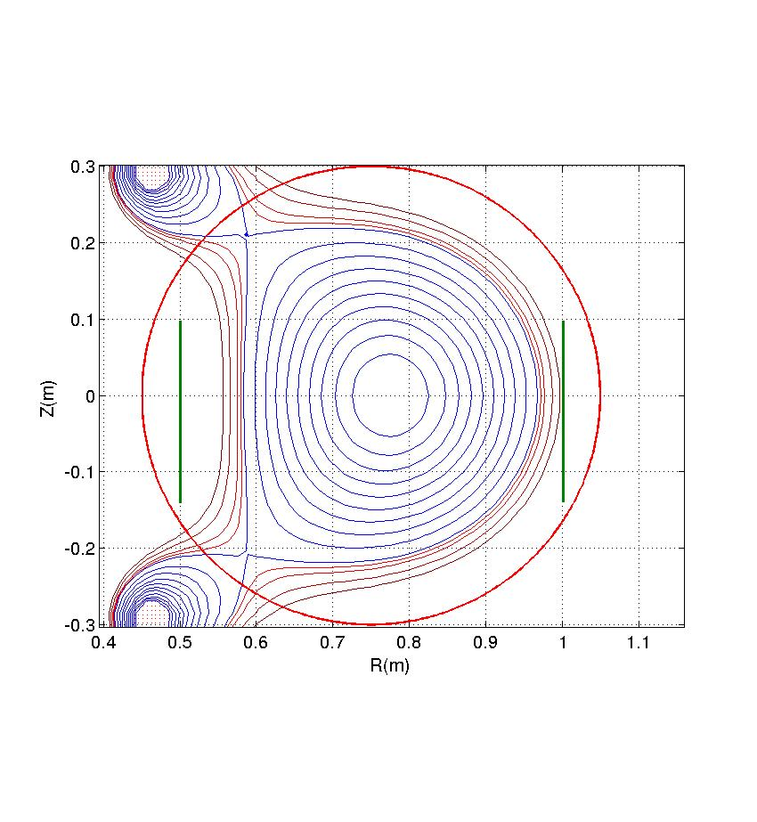
Equilibrium case -2 (D2=8kA)

Slide 13
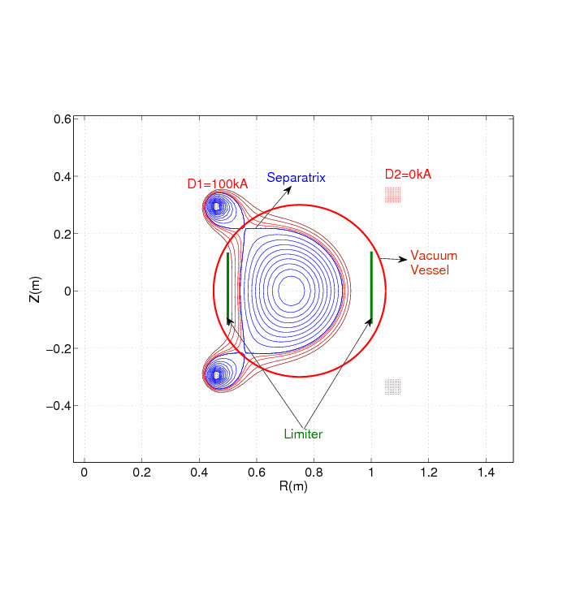
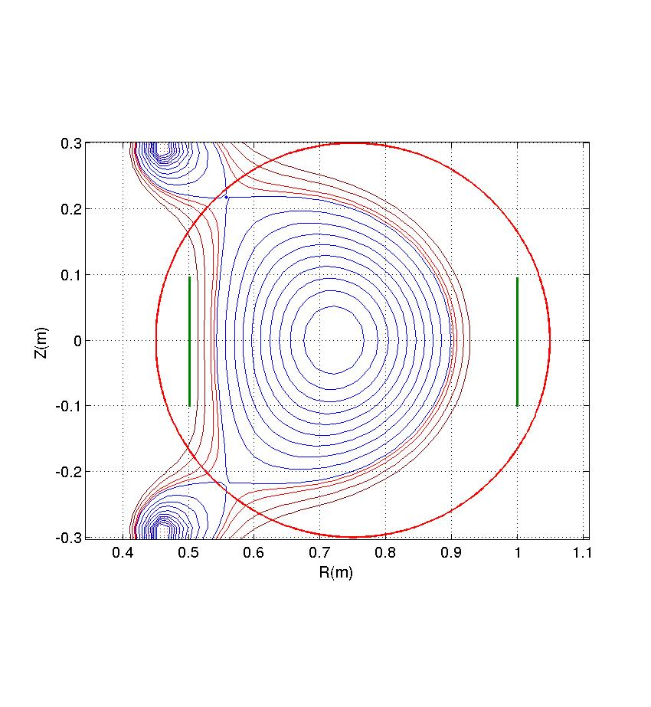
Equilibrium case -3

Slide 14
Comparison of equilibrium case 1 &3

Slide 15
Parameters of ADITYA-U DN Low β_{p}
 | Case-1 | Case-2 | Case-3
BV1 | -136kA | -136kA | -136kA
BV2 | -50kA | -50kA | -50kA
D1 | 150kA | 150kA | 100kA
D2 | 0kA | 8kA | 0kA
βp | 0.02 | 0.02 | 0.02
R₀ (cm) | 70.2 | 77.6 | 72.1
A(cm) | 14.5 | 19.1 | 17.7
Vol | 0.39 | 0.67 | 0.56
κ | 1.347 | 1.13 | 1.224
ι_{I} | 0.97 | 1.08 | 1.01
If possible to move D1 little outward, it would have given more flexibility in terms of plasma current

Slide 16
Parameters of ADITYA-U high β_{p}
 | Case-1 | Case-2 | Case-3
BV1 | -136kA | -136kA | -136kA
BV2 | -50kA | -50kA | -50kA
D1 | 150kA | 150kA | 100kA
D2 | 0kA | 4kA | 0kA
βp | 0.29 | 0.29 | 0.29
R₀ (cm) | 72.5 | 76.8 | 75.1
A(cm) | 15.8 | 18.5 | 19.9
Vol | 0.46 | 0.62 | 0.70
κ | 1.26 | 1.15 | 1.12
ι_{i} | 1.04 | 1.13 | 1.14

Slide 17
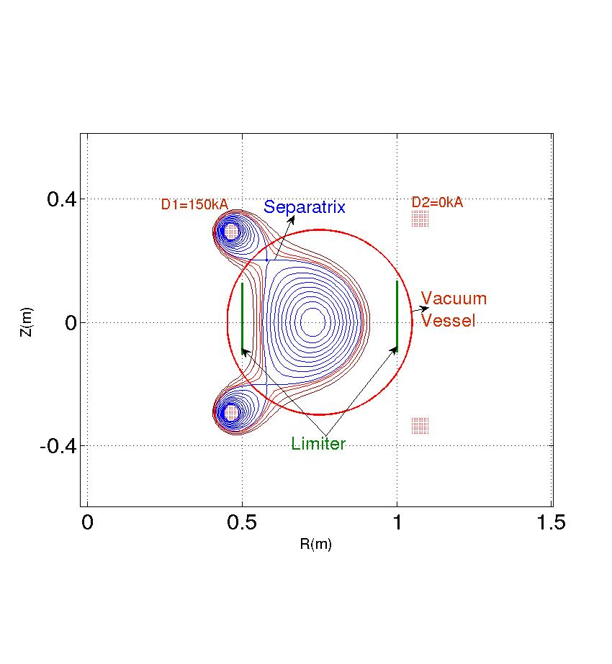
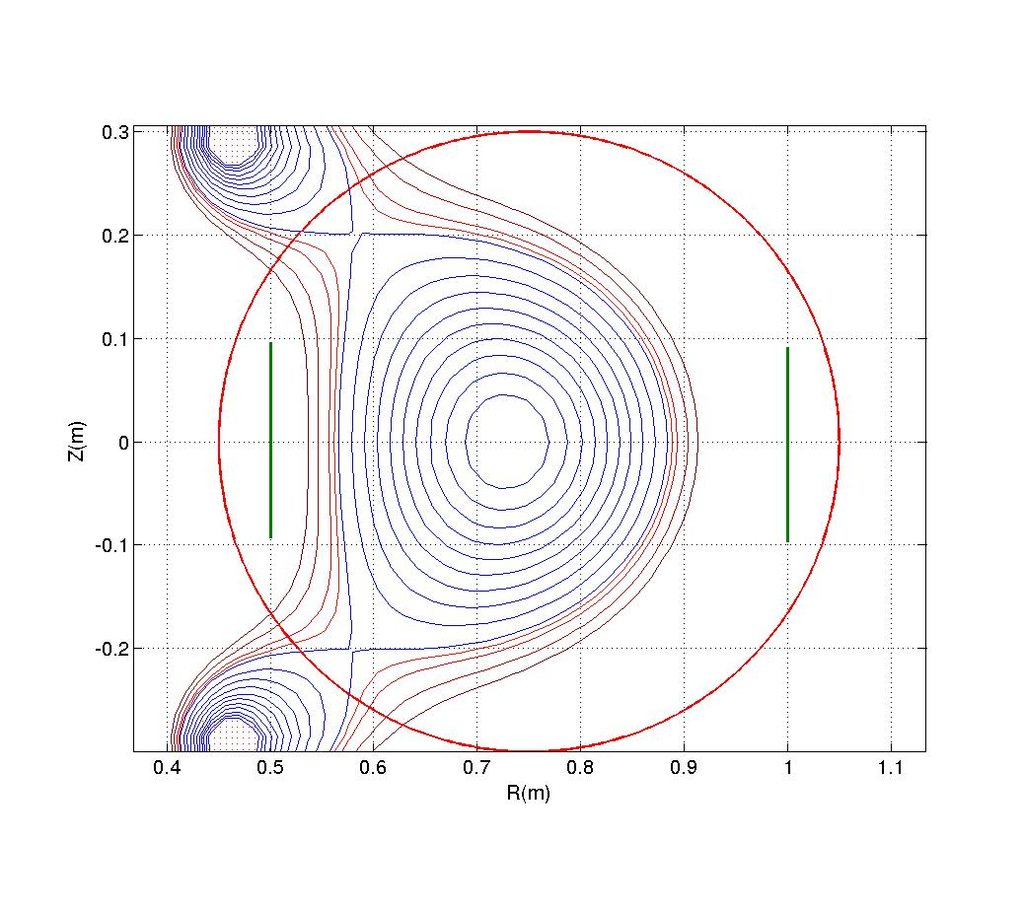
High β_{p} equilibrium case -1

Slide 18
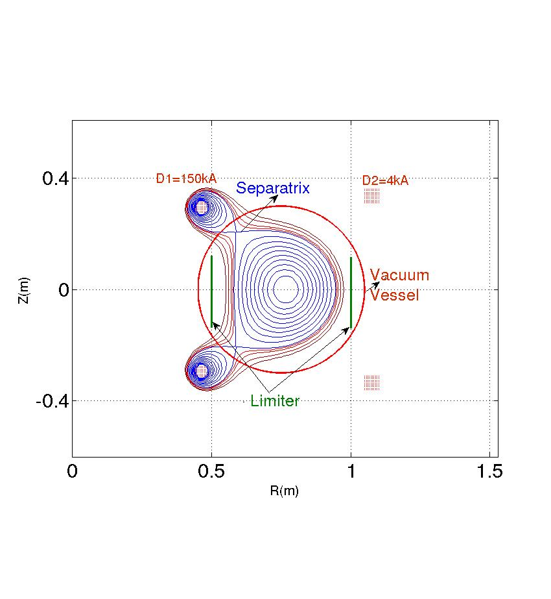
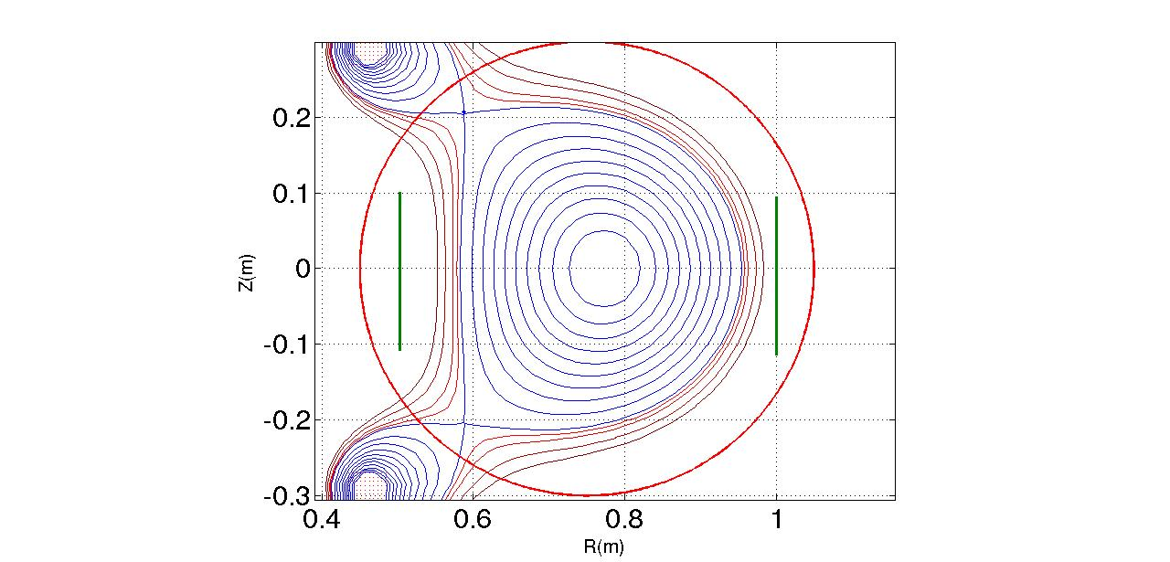
High β_{p} equilibrium case -2

Slide 19
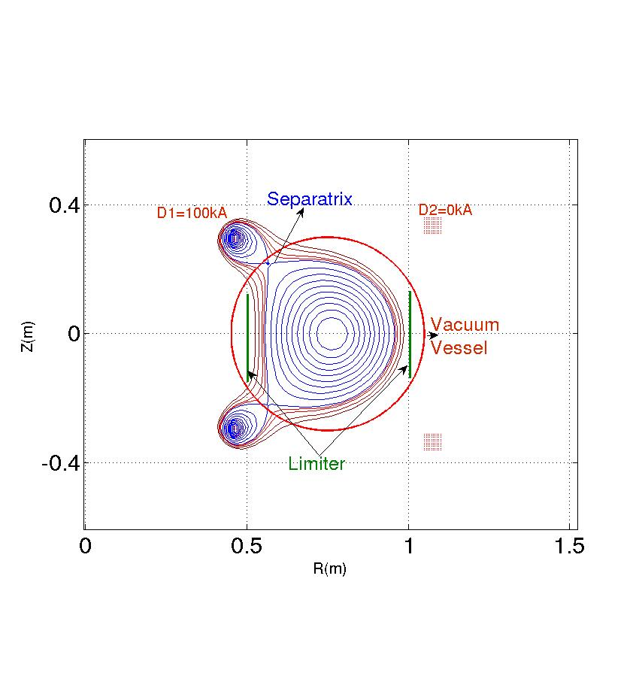
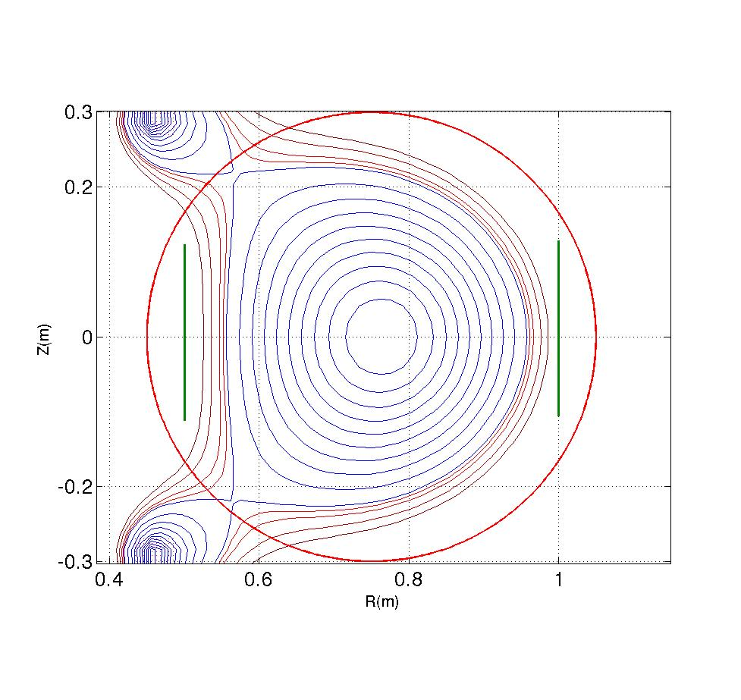
High β_{p} equilibrium case -3

Slide 20
Single null equilibrium case
 | Single null
BV1 | -98kA/-68kA
BV2 | -47kA/-98kA
D1 | 120kA/150kA
D2 | 10kA/9kA
βp | 0.02
R₀ (cm) | 75.8
A(cm) | 17.1
Vol | 0.53
κ | 1.05
ι_{i} | 0.87

Slide 21
Predictive Simulation of ADITYA-U using TSC
Initial and target plasma equilibrium is prescribed
Plasma density profile is fixed
Ohmic system with current feedback is used to achieve the prescribed plasma current evolution
Vessel and other passive elements are modeled and eddy current impact on plasma evolution is taken
Provides the evolution of plasma from circular to diverted configuration as well as ramp up to ramp down scenario.
Shows the stable path of plasma evolution

Slide 22
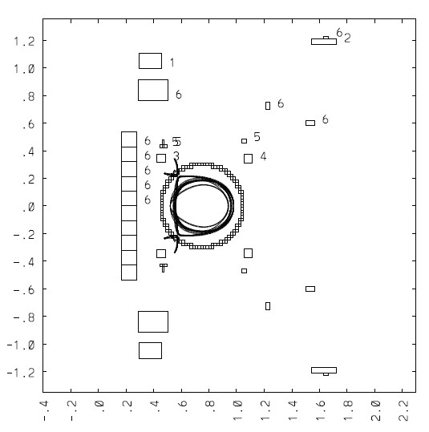
ADITYA-U Coil System
Coil Labeled 6 are the Ohmic Coils.
TR1 , TR2, TR3, TR4 and TR5 corresponds to ohmic system
Plasma current feedback is given through a PID controller on the Ohmic Transformer current.

Slide 23
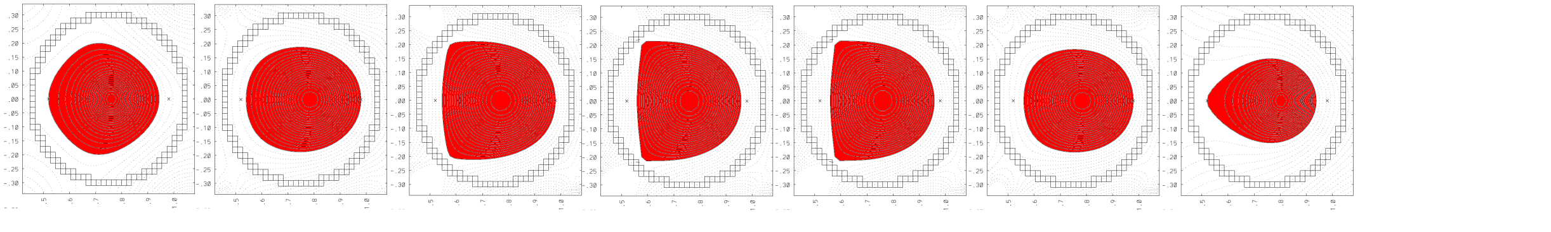
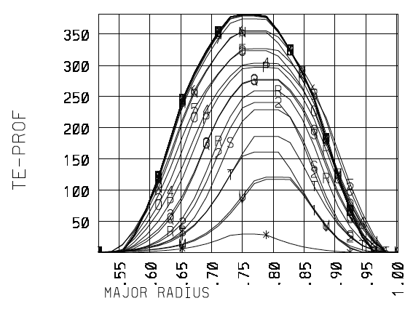
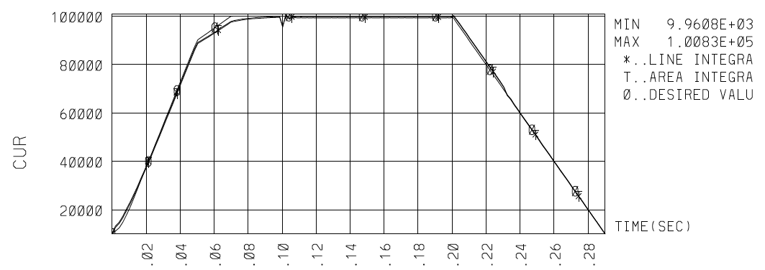
Aditya-U Plasma evolution in TSC
1
2
3
4
5
6
7
t=0, Ip=10kA
21ms, Ip=39kA
62ms, Ip=94kA
107ms, Ip=100kA
197ms, Ip=100kA
247ms, Ip=53kA
290ms, Ip=10kA
3
4
5
6
2
1
7
Ip (A)
Te (eV)

Slide 24
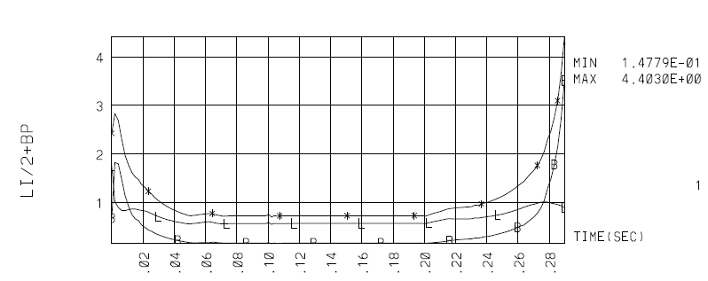
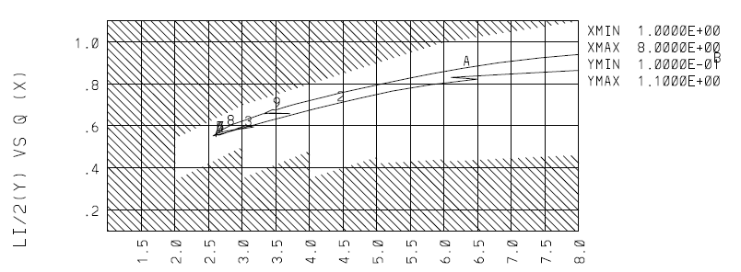
TSC Output

Slide 25
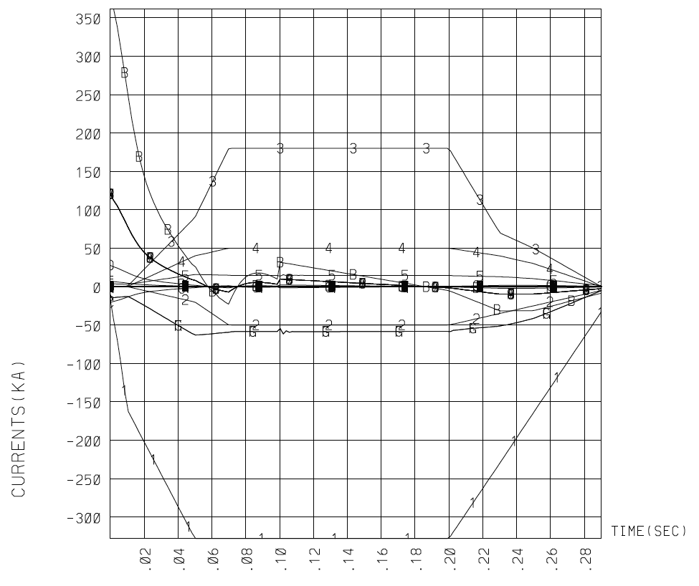
Coil Currents

Slide 26
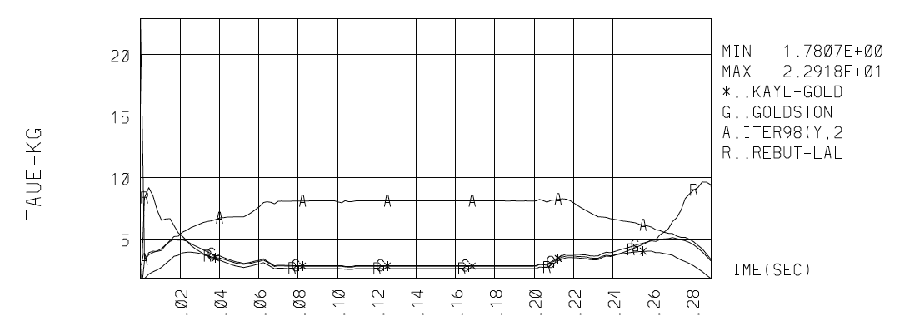
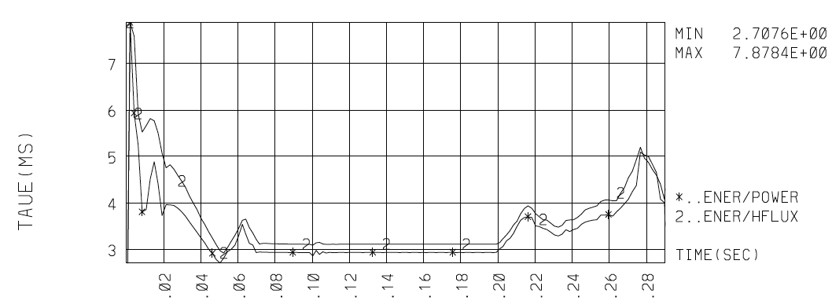
Confinement Time

Slide 27
Preliminary study of ADITYA-U divertor using SOLPS
Double null plasma equilibrium with actual divertor plate is used
The core edge interface density is fixed at 1 x 10¹⁹ m⁻³
Input power is taken as 200 kW (only ohmic, no auxiliary heating is considered)
Cross-field diffusivities assumed
Computational domain extended over the entire vessel
The peak heat load obtained at the divertor plate is about 1 MW/m²

Slide 28
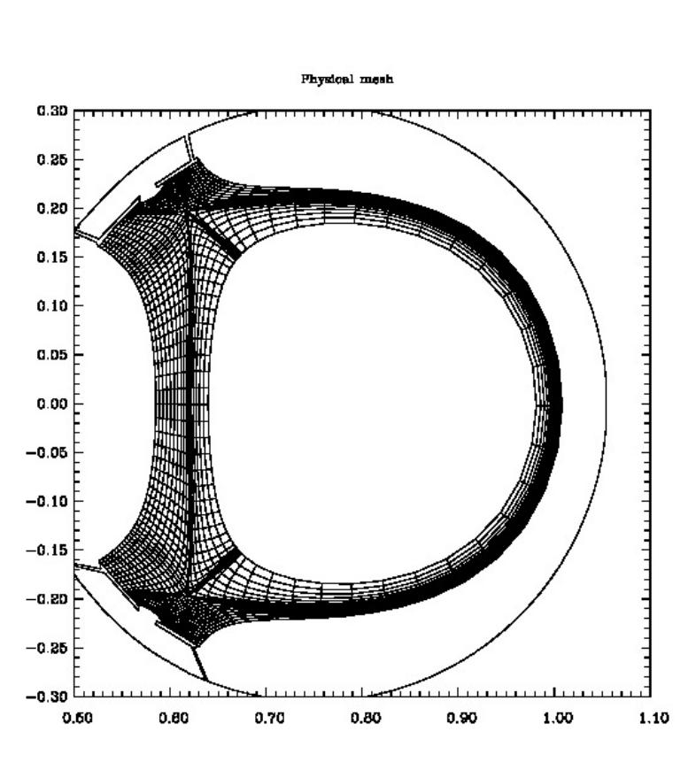
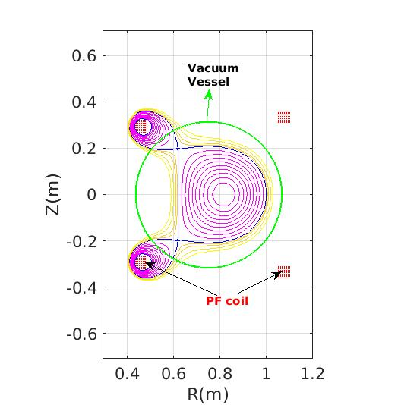
(1) Aditya DN Equilibrium 2) Grid nx X ny =114 X 20

Slide 29
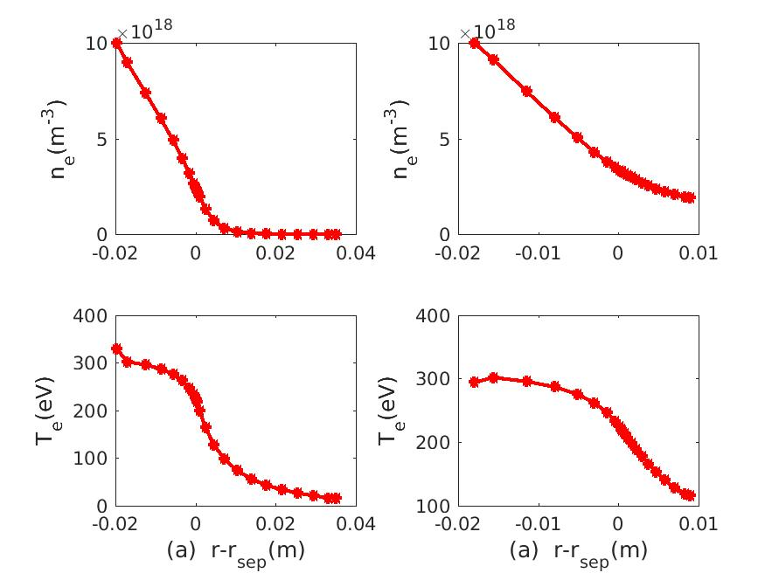
Mid-planes profiles of density and temperature
Inner-miplane Outer-midplane

Slide 30
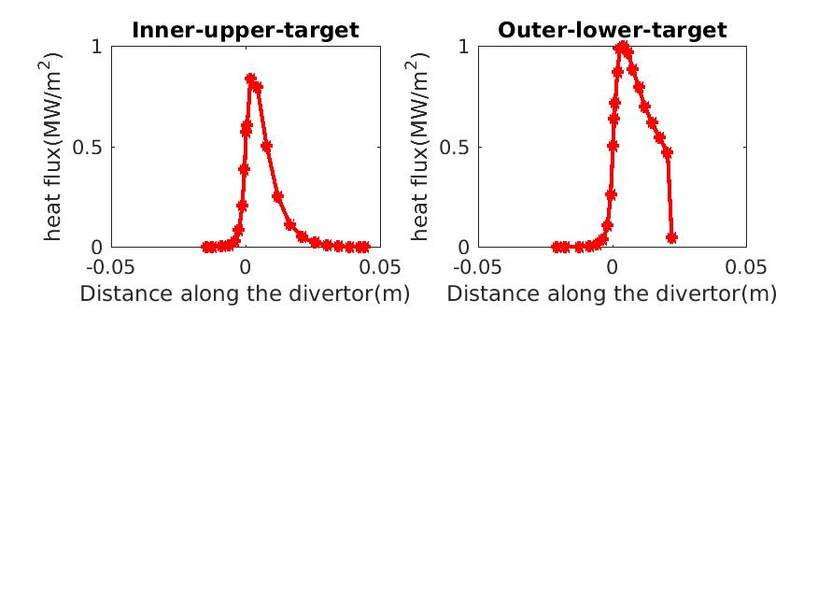
Heat flux profiles on the divertor targets

Slide 31
Conclusion
ADITYA-U can produce double and single-null plasma confuguration
Plasma radius of 15 to 20 cm, nominal elongation but with strong triangularity can be achieved
Divertor configuration can be produced with 100 kA plasma. For higher plasma current, auxiliary divertor coils will be used
The preliminary study shows that the expected heat load on divertor is about 1 MW/m² which is twice the SST-1 heat load and 1/10th of ITER steady state heat load.
With auxiliary heating power, one can have higher heat load at the divertor plate
These experiments will be carried out in coming years

Slide 32
Thank you

