Slide 1
Experiments on Tokamak Aditya using Indigenously Developed 20-40 MHz, 1 MW ICRH System
S. V. Kulkarni,
ICRH-RF Group,
Aditya Team
and
Diagnostics Group
Institute for Plasma Research
Bhat, Gandhinagar 382 428

Slide 2
Applications of RF Waves in Tokamaks
1. RF heating in ICRH range
Fast wave heating at second harmonic
Minority heating
Ion Bernstain wave heating
2. RF current drive using phasing of antennas
3. RF Pre-ionization and current ramp-up
4. RF wall conditioning in presence of continuous toroidal magnetic field: for steady state tokamaks
5. Disruption Mitigation

Slide 3
Plasma Heating: Why?
As the plasma temperature rises, the efficiency to heat the plasma by Ohmic heating decreases.
At low temperatures the Ohmic heating is quite efficient but because the resistance of the plasma varies with temperature as T_{e}^{-3/2}, it becomes less effective at higher temperatures.
Also radiation losses increase with increase in temp. and finally heating and losses get balanced to make Ohmic heating in-efficient further. (Max.T~1-2keV)
To further raise the temperature of the plasma to start fusion, one has to use auxiliary heating schemes.

Slide 4
What is Ion Cyclotron Heating ?
The charged particles gyrate along the magnetic field lines and travel along the electric field lines.
If we allow Electric field of RF or its component, to rotate in the direction of rotation of charged particle then the particle sees as if it is moving in the DC field and gets accelerated and acquires energy from the wave, then transfers energy to other particles through collisions and heating of plasma takes place.

Slide 5
Fast wave heating in ICRF range
Fast magneto-sonic waves (compressional Alfven waves) do not resonate at the cyclotron frequency.
The fast waves are right-circularly polarized and do not couple energy to the ions in a purely single species plasma at fundamental cyclotron resonance frequency due to the fact that E field of RF rotates almost entirely in the opposite direction to that of the ions.
However at a second harmonic resonance in a single species plasma, a significant fraction of the E_{perb} possesses the polarization required to couple to the ions/rotate in the direction of ions.
In the presence of a minority species, very efficient heating has been observed at fundamental cyclotron frequency

Slide 6
Heating Mechanism
The wave energy is absorbed either directly by ions through cyclotron absorption, or indirectly via mode conversion in a single or multi species plasma.
Fast waves have also been seen to transfer their wave energy to electrons broadly by two mechanisms.
The first one is indirect electron heating, where resonating majority or minority ions pick up energy from waves and transfer their energy to electrons via collisional equi-partition.
The second mechanism is a direct electron heating where FW is damped on electrons via non-linear electron Landau damping (ELD) and transit time magnetic pumping

Slide 7
Steps of RF heating
Generating RF power
Transmitting RF power
Course matching in vacuum
Conditioning of antenna, interface and Tx. Line
Characterization of antenna for radiation pattern
Launching RF power in the tokamak.
Radiation of RF power by antenna
Reaching RF power up to resonance layer
Absorption of RF power
Thermalisation of RF power in plasma
Heating of plasma.

Slide 8
Block diagram of ICRH system on Aditya
Pre-Trigger
Osc
LPA
2kW--->20kW---> 200kW
RF AMP Stages
Aditya CAMAC
Aditya Control room
Dummy
Load
SPDT Switch
Opto-isolator
RF ground
Voltage probes, FP, RP
Diagnostics electronics
RF edge diagnostics for antenna
Matching Network
(stub, Phase Shifter)
Vacuum window
TMP
Antenna
VTL / Interface
DC break
Ground isolation
Vacuum vessel
Safety ground

Slide 9
Diagnostics for ADITYA-ICRH Expts.
Interferometer: Electron density- nave along chord
Reflectometer: Edge plasma measurements like n(r)
Electron Cyclotron Emission: Electron temperature Te(r,t) and profile
Soft X- Ray Diagnostic: Electron temperature
Hard X ray: Bremstrahlung, no. density and energy of runaway eles.
Voltage Loops: Loop voltage measurement to get Ele.Field
Rogowski Coils: Plasma current I_{p}(t)
Diamagnetic Loops: Stored energy and plasma pressure
Magnetic Probes: Spectrum of plasma oscillations, plasma position
Mirnov Coils: MHD activity studies
Langmuir Probes: Plasma density and temperature fluctuations.
Charge Exchange : ion temperature (ion distribution function)
Doppler Broadening of impurity lines: Ion temperature
Thomson Scattering : Electron temperature Te(r)
CCD Camera: Tangential plasma view

Slide 10
Spectroscopy : UV, VUV and visible
i:Absolute intensities of H, CII, CIII, OII, OIII and quantify the fluxes of H, O and C from the SS wall and the Graphite limiters. ii: From the visible BL measurement the Z_{eff,} iii: spectral lines from low ionization states of Oxygen and Carbon iv: To detect presence of Fe, Cr, Si from plasma facing components v: To detect H_{α} for ionization of neutrals,vi:VUV spectra to detect ionized states of Oxygen and Carbon
Rogowskii Coil: Antenna current
Directional Coupler: Forward and reflected power
VSWR Probes: 20 nos. for VSWR: antenna impedance
Dipole Probes : RF Electric field
Magnetic Loops: RF magnetic field measurements
Langmuir Probes near antenna : Edge density andemperature

Slide 11
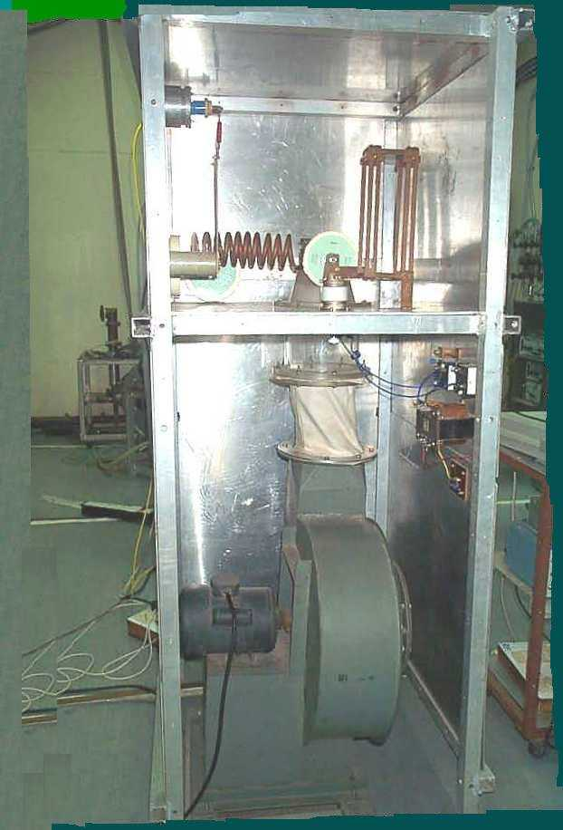
RF Generator Stages (20 MHz – 40 MHz)
Complete chain
5mW oscillator modulator & 30W solid state LPA
2kW Pre-driver stage using 3CW5000A7
20kW Driver stage using 3CW30000H7

Slide 12
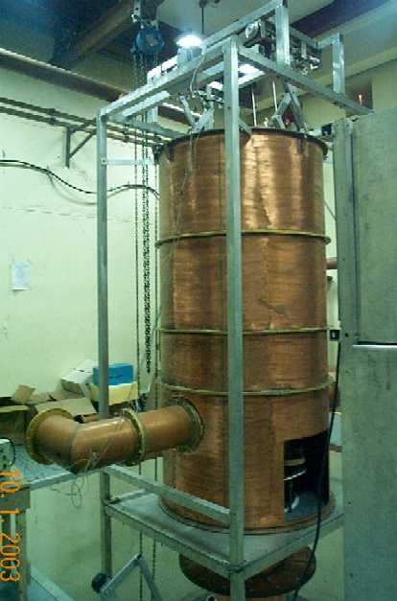
RF Generator Stages (20 MHz – 40 MHz)
200kW 1st output stage using 4CM300000GA
1.5MW final stage using 4CM2500KG
No harmonic distortion

Slide 13
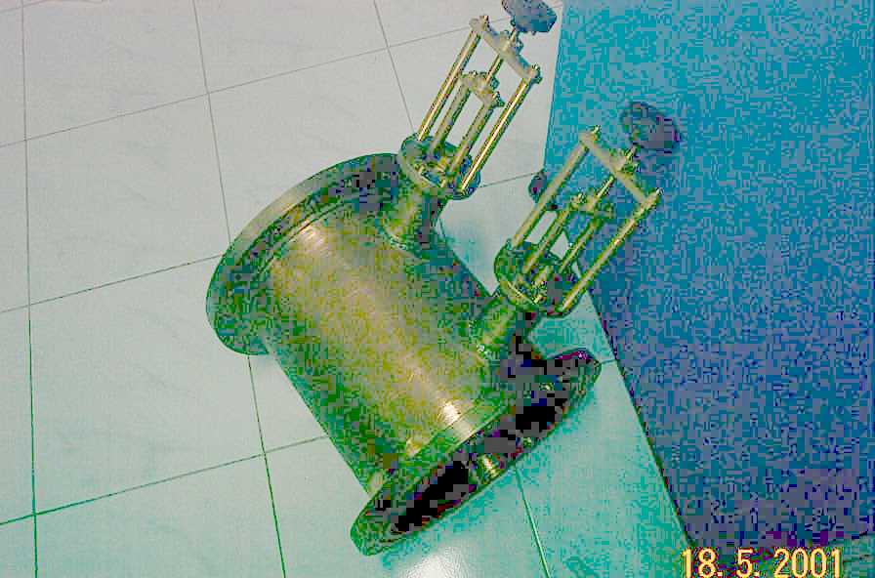
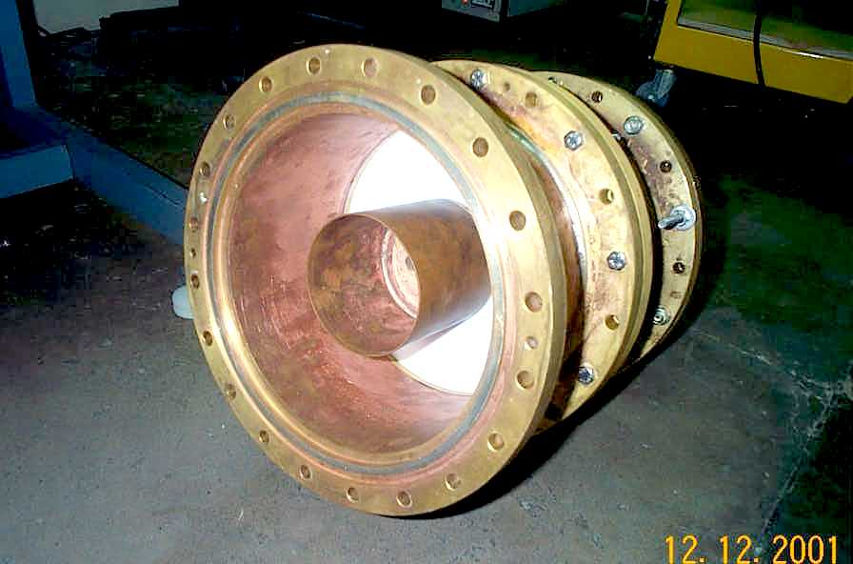
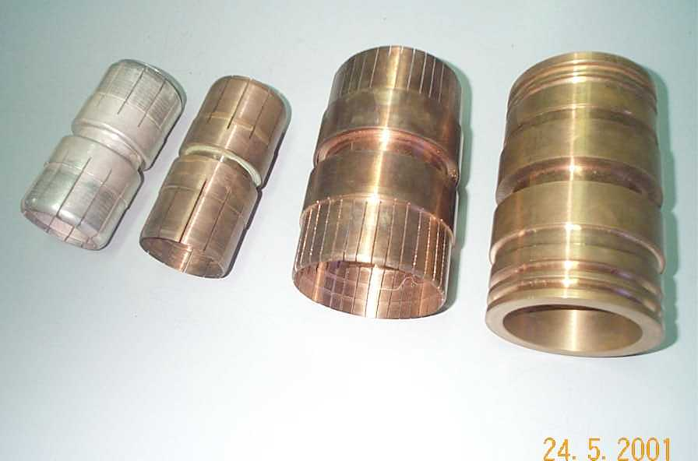
High Power Co-axial Tx-line components

Slide 14
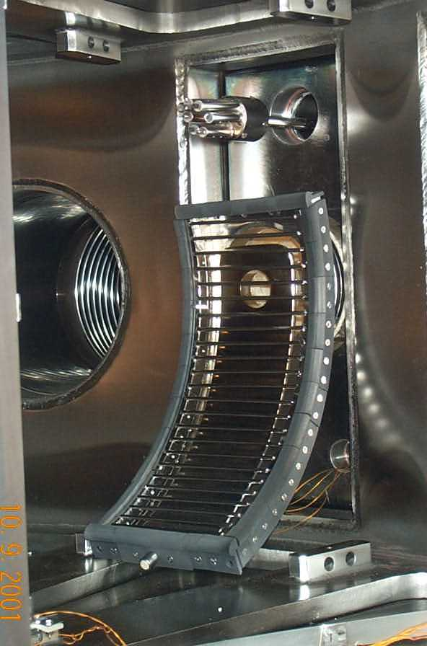
ICRH Antenna Details
Material: SS304L with graphite tiles
Length (cm): 30 cm
Number of straps: 1
Strap width (cm): 10.0
Distance between plasma and
Faraday shield (cm): 1.0 cm
Distance between plasma and antenna (cm): 3.5 cm
Distance between plasma and wall (cm): 5.8 cm from limiter
Antenna specifications
length (cm): 30 cm
number of straps: 1
strap width (cm): 10.0
Distance between plasma and Faraday shield (cm)
(counted from scrape-off edge): approx.1.0 cm from limiter
Distance between plasma and antenna (cm): 3.5 cm from limiter
(counted from scrape-off edge)
Distance between plasma and wall (cm): 5.8 cm from limiter
(counted from scrape-off edge)
14

Slide 15
Computational Aspects
Indigenously developed codes based upon warm plasma dispersion relation to get 3 roots and the variation of n_{perb}² against position shows a very less evanescent layer in fast wave propagation which has helped in fast wave heating.
The computational work using TORAY code shows that for Adity-ICRH experimental parameters, 55% electron heating and 45% ion heating should take place.
The codes are used for,
selecting experimental parameters and for dimensions of antenna,
for getting better antenna-plasma coupling,
for getting plasma impedance for the design of matching system,
for understanding the propagation characteristics , evanescent layer
For getting the idea of partition of power into different waves
For deposition of power on the way or at the layer

Slide 16
Second Harmonic Heating Experiments
RF pulse durations (5 ms-100 ms)
RF powers (40 kW-200 kW, 24.8 MHz)
The soft X-ray data shows an electron temperature rise from 250 eV to maximum of 500 eV,
NPA data as well data from Doppler broadening shows the ion temperature rise up to 350 eV.
Parameters varied: power, magnetic field, operating pressure and of RF duration

Slide 17
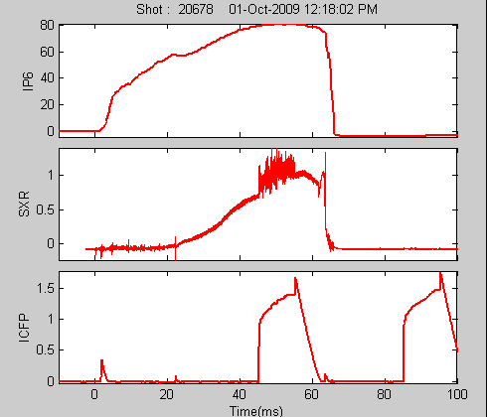
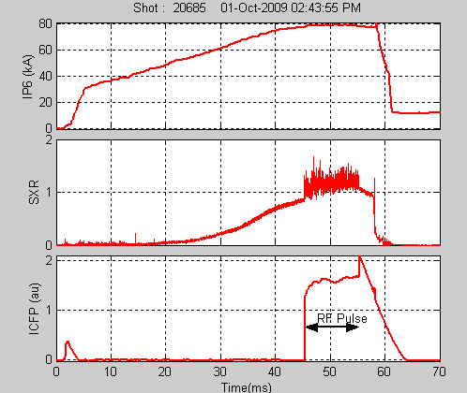
Two RF pulses: No pick-up
Soft X-ray signal with RF

Slide 18
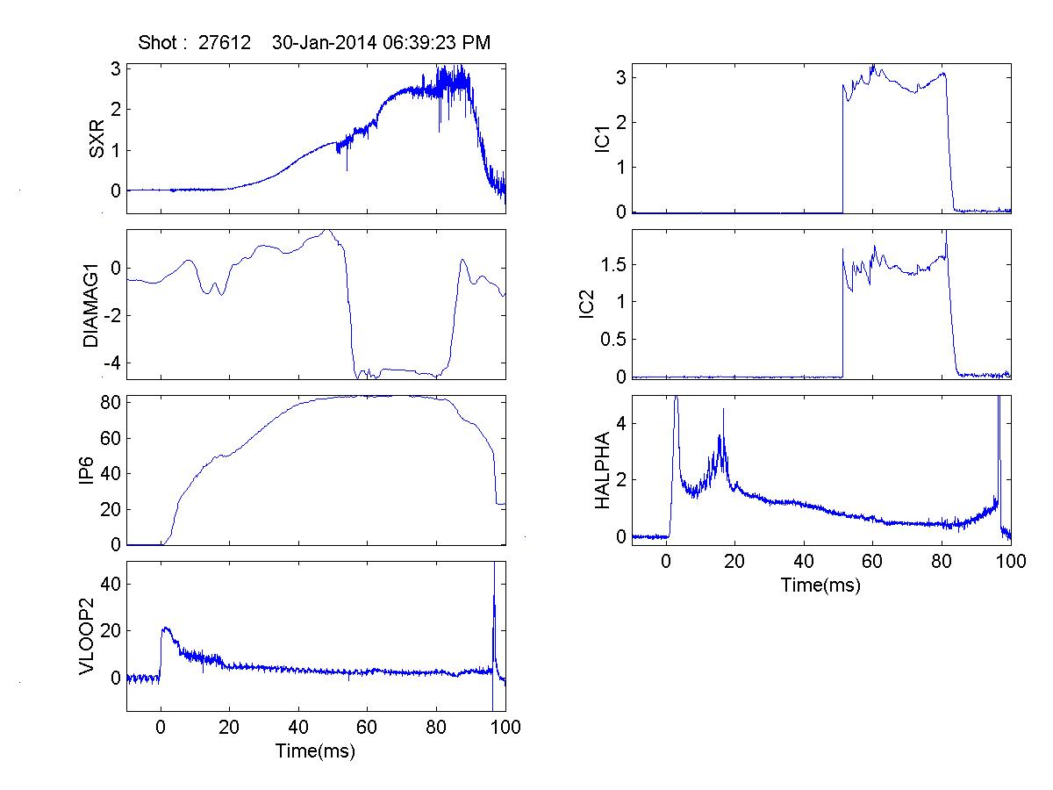
Second Harmonic Heating at 146 kW RF Power

Slide 19
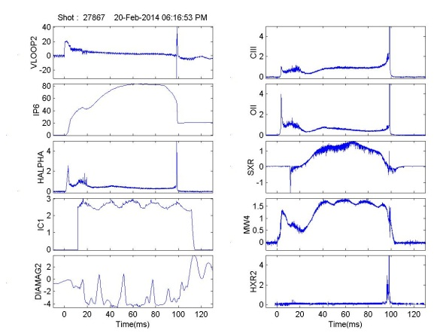
RF heating: single pulse: 100 ms, 116 kW RF power

Slide 20
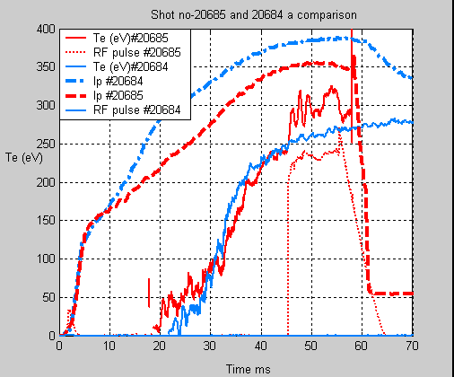
Soft X-ray Signal
The temporal variation of electron temperature for shot no #20685 shows that with RF pulse, the temperature increases from 200eV to 300eV during the duration of RF pulse (45-55ms), whereas a similar shot without RF (#20684) shows no change in temperature during 45-55 ms

Slide 21
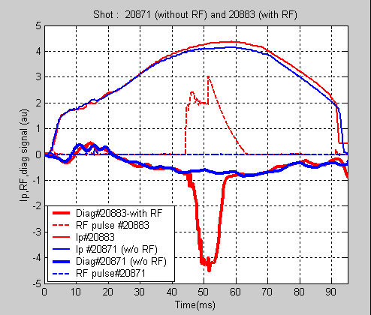
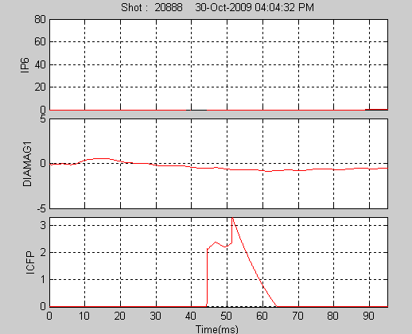
Diamagnetic Loop Signal (raw)
Diamagnetic signal shows an
Increase in stored energy with RF
Pulse. It is interesting to note that
there is a finite delay in response
of diamagnetic signal with RF.
A Similar shot without RF shows
no change in diamagnetic signal.
Vacuum shot shows no change in
diamagnetic signal with RF ruling
out any possibility of pick-up or noise

Slide 22
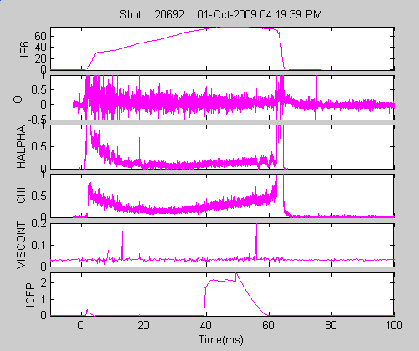
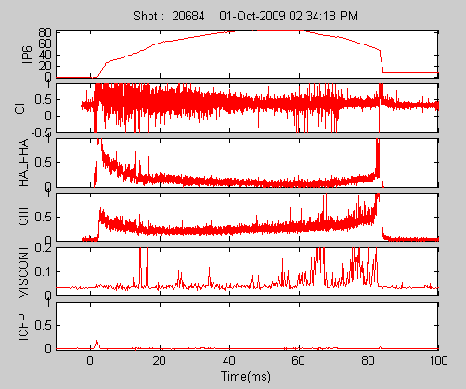
Impurity Signals Detected by Spectroscopy Diagnostics:
No additional impurities due to RF
With RF power
Without RF power

Slide 23
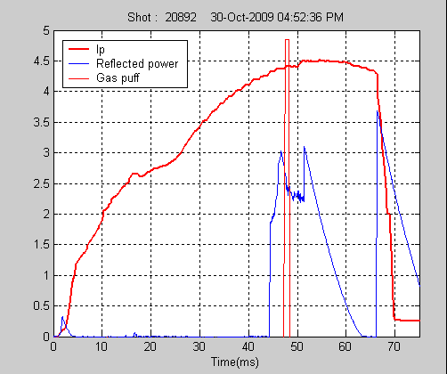
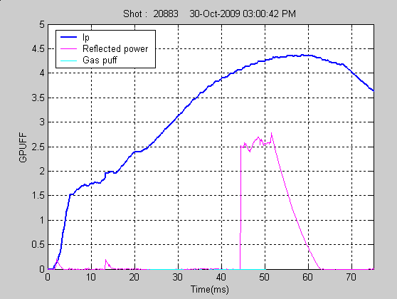
Effect of Gas Puff
Plasma shot is with gas puff
Plasma shot without gas puff

Slide 24
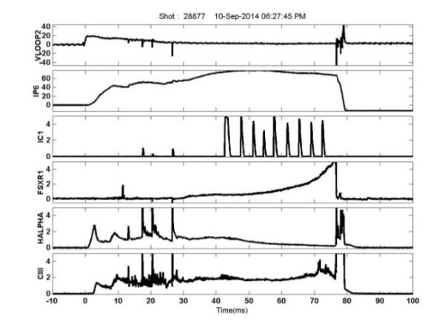
Figure : Multiple RF pulses (100 kW) of short duration also give similar RF heating of plasma

Slide 25
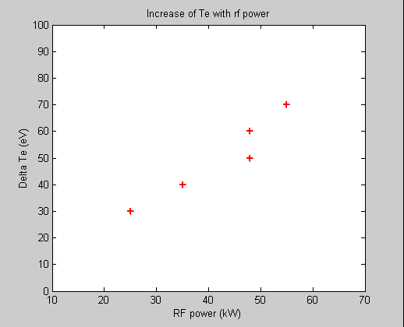
Increment of electron temperature with input rf power shows almost linear dependence which is observed in many tokamaks including JET

Slide 26
Charge Exchange Diagnostic
In case of normal plasma discharge (without ICRH pulse) it has been observed that the ratio of surface temperature at ion heating-side to electron heating-side of the limiter remains <1 at any point of time during the discharge.
It has been observed that for the set of plasma discharges (~14 discharges) the ratio is >1 just after the introduction of RF pulse.
This can be attributed to the absorption of ICRH energy by ions and increase in the perpendicular ion velocity component which can increase cross-field diffusion and this may results in deposition of higher heat flux at ion flow-side of the limiter surface compared to limiter electron flow-side.

Slide 27
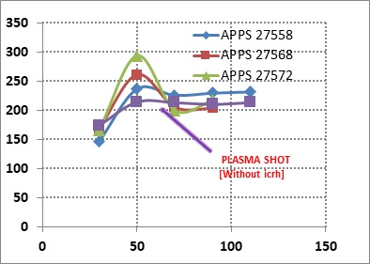
Figure: ion temperature evolution with time for different RF powers., Y axis: Ti in eV, X axis: time in ms

Slide 28
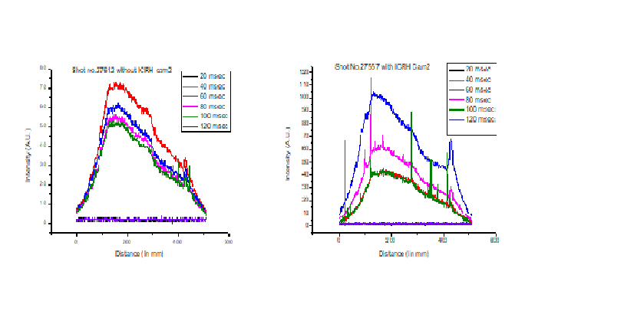
Time evolution of H_{α} using Linear Array Camera
The time evolution of H_{α} profile during ICRH heating experiments is also measured using the 512 elements linear array camera which is position aligned to view the complete poloidal cross section of plasma.
After the ICRH power is launched, there is reduction in H_{α} intensity indicating the rise in plasma temperature and also shows that the position of plasma remains same.
Figure : Time evolution of plasma profile during RF heating (a) RF power: 125kW, RF duration:30 ms (b) RF power : 60 kW, RF duration: 10 ms

Slide 29
Methods of Heating ?
Impurity Heating ?: No reso. layer for C and O and from results of spectroscopy diagnostics.
Heating Possibilities:
(A) First ion heating and then electron heating:
For ion-electron collisional process the minimum time is 18 ms for present parameters. Experimentally we observe electron temp. rise in less than few microseconds
B. Direct Electron Heating:
Typical time scale for electron-electron collision time is few microseconds.
Direct electron heating is possible through NLD and TTMP
A linear dependence of electron temperature with RF power (observed on JET).This should also give rise to ion heating.
In current experiment, a combination of ion heating through cyclotron resonance and direct electron heating due to NLD and TTMP is happening.

Slide 30
Summary of RF Heating Experiments
The two RF pulses given during and after the plasma shot shows that there is no RF pick-up in most of the diagnostics signals
Soft X-ray diagnostic shows that there is an immediate increase of 80-100 eV temperature rise during RF pulse of 70-80 kW power and shows that electron heating is taking place.
Diamagnetic loop signal shows that there is an increase in internal energy (0.6-1kJ to 1-1.3 kJ) of the plasma during rf pulses indicating that due to heating the stored energy of plasma increases after thermalisation.
The estimated energy confinement time is 2-4 ms in Ohmic phase and 3-6 ms during rf heating phase.

Slide 31
The spectroscopy diagnostics show that the impurity level keeps on increasing with time and do not show extra increase in impurities during RF pulse, indicates that the possibility of impurity heating is less.
Microwave interferometer signal shows that there is slight increase in the plasma density during RF pulse which is reported on many tokamaks.
Microwave interferometer signal also shows enhancement in amplitude of MHD activities during RF pulse

Slide 32
Why PI is required
To have initial no. of electrons available for highly reproducible plasma discharges
to save volts-seconds from Ohmic transformer
To have a longer plasma discharge
To produce plasma at lower loop voltages in case of super-conducting tokamaks because of design of superconducting ohmic transformer and decrease in loop voltage due to penetration depth of cryostat
Experimental parameters:
RF Power : 19 kW to140 kW at 24.8 MHz
B Toroidal : 0.075 T- 0.825 T
Pressure : 10**-3 to 10**-5 torr
Current Ramp up: up to 90 kA, 90 ms

Slide 33
Experiments done on Aditya
In first phase only RF breakdown plasma is produced at 24.8 MHz using a fast wave antenna without toroidal magnetic field and loop voltage.
In this phase it was observed that the breakdown is produced in antenna box in a wide range of pressures between 10⁻³ Torr to 5x10⁻⁵ Torr.
However the position of breakdown changes with pressure.
In second phase, RF plasma is produced at 24.8 MHz, in
presence of toroidal magnetic field.
Parameters varied: B Toroidal; 0.075 T to 0.825 T
Pressure: 8x10-4 to 3x10-5 Torr
RF Power: 19 kW to 120 kW
Minimum TF : 900 Gauss, Minimum RF power for PI: 19 kW

Slide 34
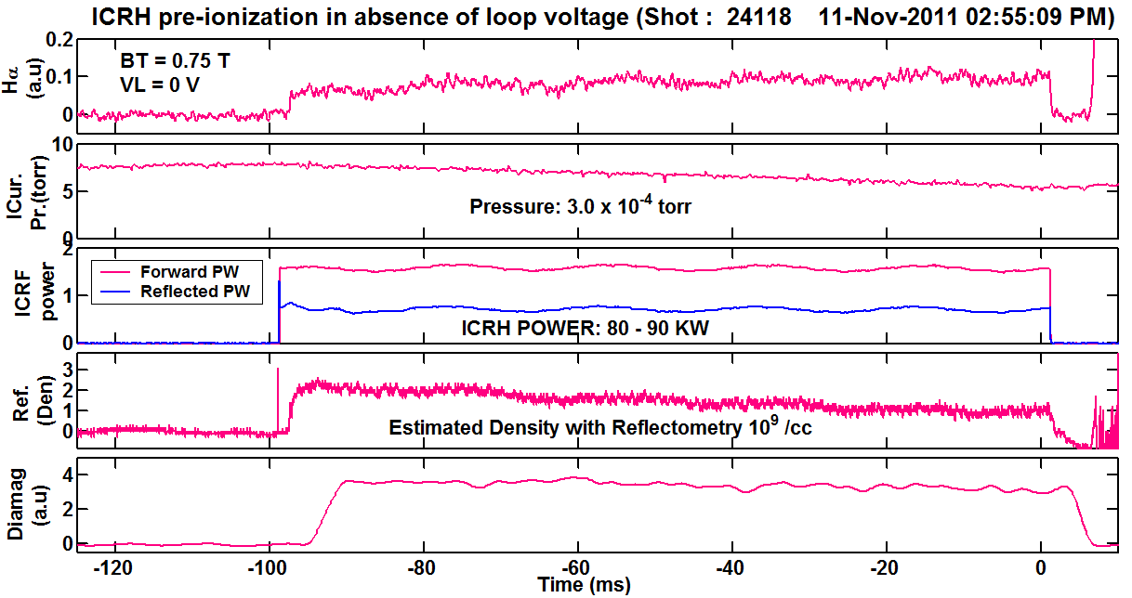
Figure . (a) H_{α} (a.u)
(b) Pressure(value x calib. factor 4)
(c) ICRF power
(d) Reflectometry
(e) Dia-magnetic loop signal

Slide 35
In third phase, the experiments are carried out with RF power and the full loop voltage of 22 volts. The duration of pre-ionization pulse is from -150 ms with reference to Ohmic loop voltage starting at 0 ms.
In this experiment, the over-lapping time of RF power with loop voltage is varied and also the RF power is varied. The adjustment of the vertical field as well as the magnitude, duration and the frequency of the gas puff is varied to have current build up.

Slide 36
In fourth phase the loop voltage of Ohmic transformer is decreased by decreasing the current through the transformer due to which the available volts-sec also decrease.
In fifth phase the resistors in the ohmic transformer are changed to keep available volt-seconds constant and the current ramp-up experiments are carried out at 22V to 8 volts loop voltage.
In sixth phase the current build up experiments are carried out at fixed low loop voltage (8volts) at fixed RF power and gas pressure but with a slow rise time.

Slide 37
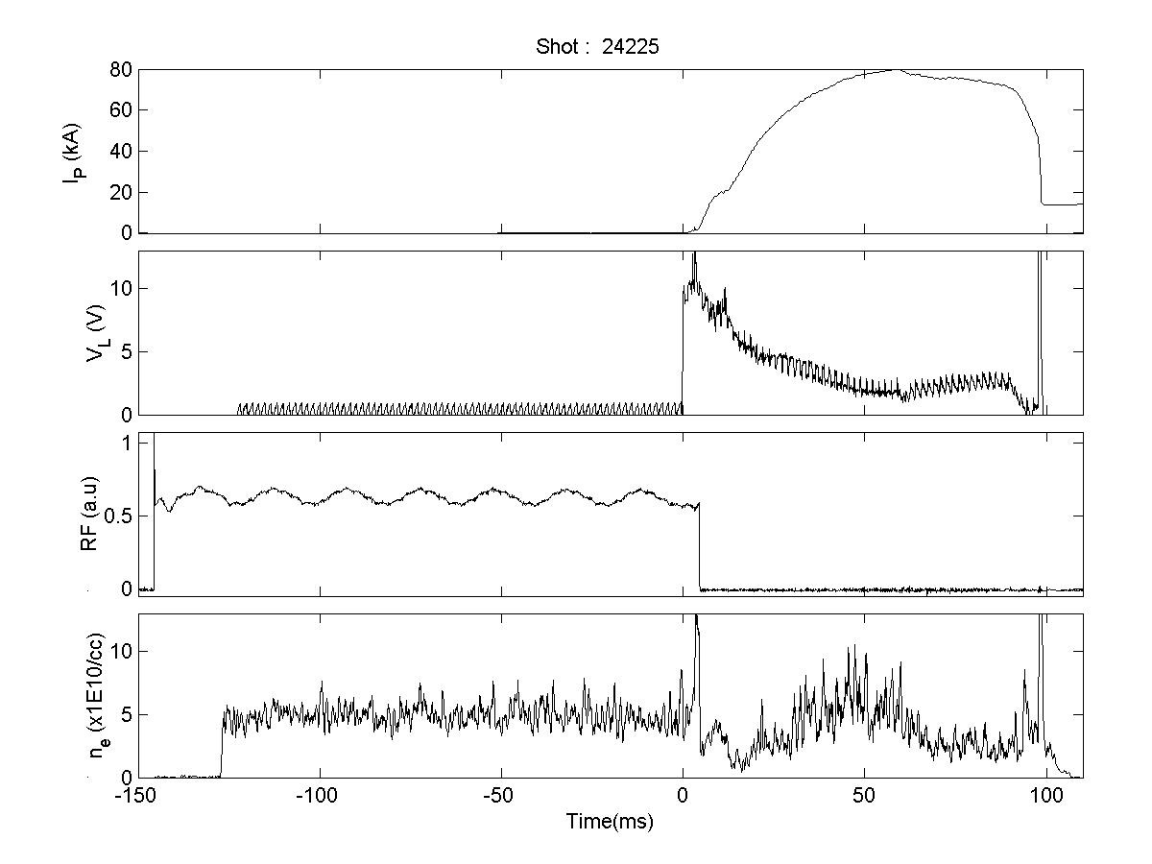
Current ramp-up at 10 volts using 90 kW RF power

Slide 38
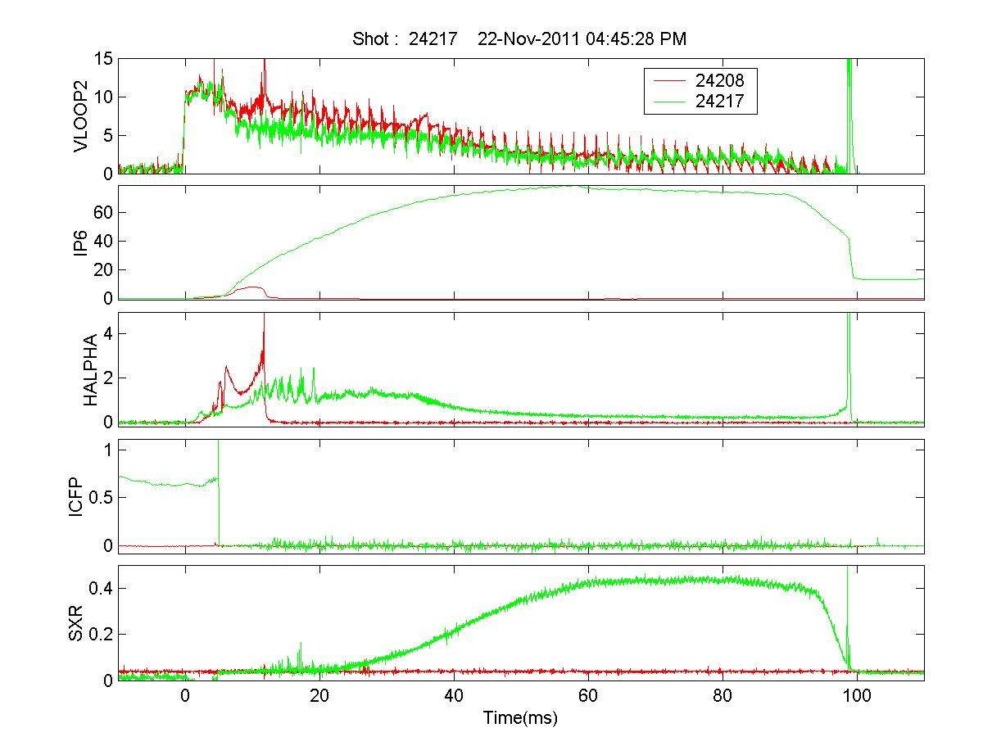
Current ramp-up at 10 volts using 90 kW RF power

Slide 39
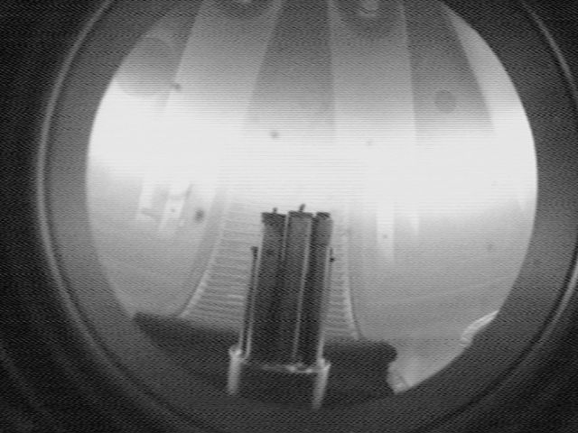
Shot no. 24115 RF - 70 kW, TF - 0.75 T, Pr - 7-8e-5 mBar, Vloop - 22 volts

Slide 40
Density Disruption and Prolongation with ICRH
Disruption is done using gas puff
Operation: pre-programmed and real time feedback control
After obtaining normal repetitive discharges of 100 ms durations, hydrogen gas is puffed in sufficient amount during the plasma current plateau phase (from 40 to 45 ms) to obtain disruptive discharges.
These disruptions are successfully mitigated by application of ICRH pulse of power of ~ 50 to 70 kW RF launched ~ 5 ms prior to the gas-puff.
Feedback to RF is given from H alpha signal of certain magnitude.

Slide 41
Experimental Details:
RF power introduced: 65-100 kW
Antenna: Poloidal Fast Wave Antenna
Toroidal Magnetic Field: 0.75 and 0.82 T
Density Disruption by : Gas puff
Disruption Mitigation done by two methods:
1. RF is introduced at particular time in a pre-programme mode
2. RF is introduced from feedback from H alpha signal set above certain level.
Conclusions: The experiment is repeated four times and all the time we could mitigate the disruption successfully in manual as well as feedback mode.

Slide 42
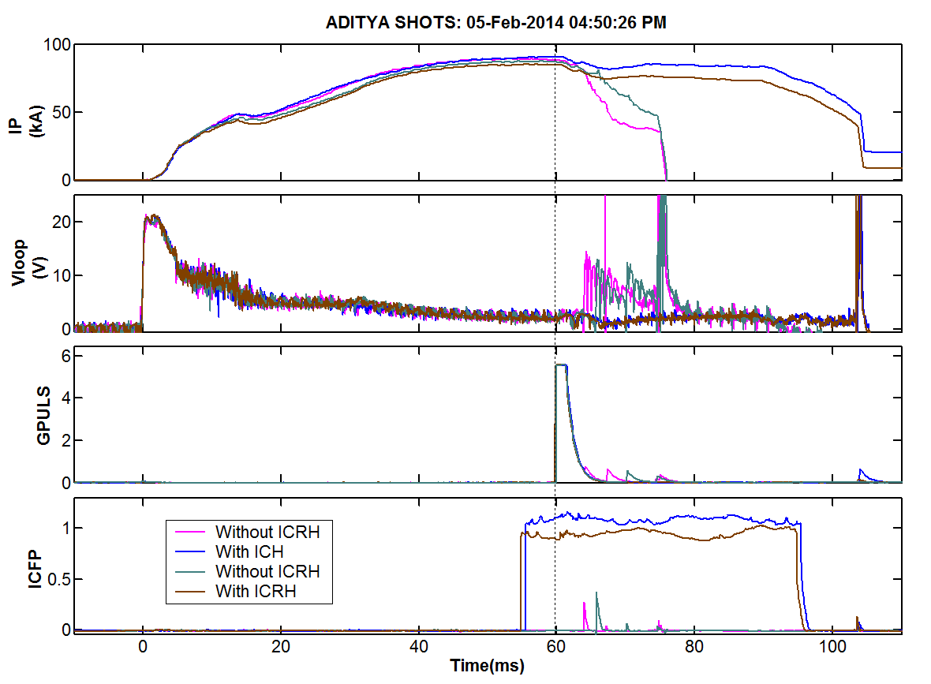
Disruption mitigation with pre-programmed ICRH

Slide 43
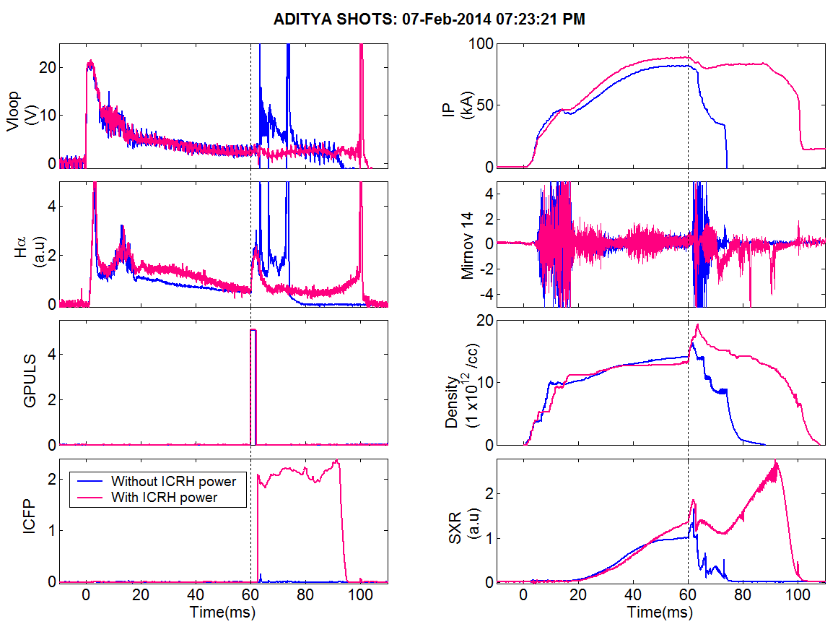
Real time Disruption mitigation using ICRH

Slide 44
Summary of Disruption Mitigation Expt.
In an attempt to control the disruptions in real time, the gas-puff is used to give rise to disruption which also gives rise to H_{α} intensity increase and is used as a precursor for the disruption.
A special comparator based trigger circuit is designed to generate a trigger for the onset of ICRH pulse when the H_{α} intensity crosses a pre-set threshold.
It is expected that these results will be useful for future steady state tokamaks.

Slide 45
Wall Conditioning for Steady State Tokamak
RF Pulses: 50 ms to 1 sec (single and many)
RF Power: 50-60 kW, 24.8 MHz
Pressure: 1 x 10⁻⁴ to 3 x 10⁻⁴
Diagnostics: RGA and Spectroscopy
Set 1: 0.75 T resonant WC
Set 2: 0.45 non-resonant WC
Set 3: 0.45T, non-resonant WC with 20% He

Slide 46
Observations
Significant change in M15, M16, M17, M18 after ICWC in all 3 sets, more effective in releasing wall impurities like water & methane as half an order of initial vacuum condition.
M15, M16 are carbon contain impurities, M17, M18 are oxygen contain impurities.
Set-1: Maximum M₁₆ (Methane CH4) was released in set-I under resonant condition in factor 5.94 (Before: 1.9e-9 Torr, after: 1.2e-8 Torr
Set-2: Maximum M₁₈ (water vapor H2O) was released under non-resonant condition in set – II in factor of 4.45 (Before: 3.4e-8 Torr, After: 1.5e-7 Torr) compared to sets I (factor: 4.34) & III.
Set 3: , the factor found was 2.54, which is very less ( ~ 40 %) compared to other sets I & II.

Slide 47
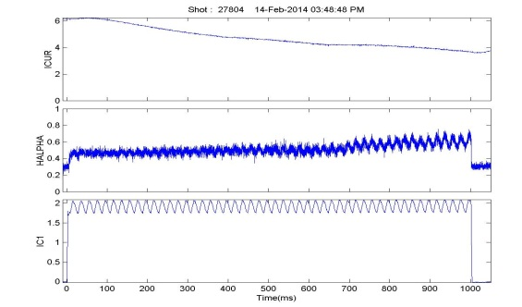
Wall conditioning: single pulse of 1 sec, RF power: 85 kW

Slide 48
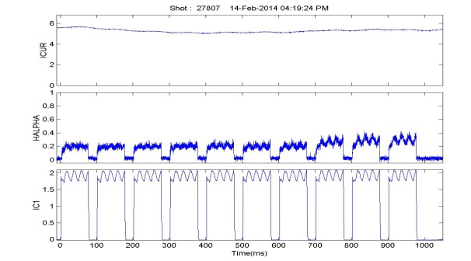
Wall Conditioning: multiple pulses: 85 kW

Slide 49
Summary of ICRH-Wall Conditioning Expts.
The experiments are done using ICRH system under both resonant and non-resonant conditions.
Both the methods are much more effective than normal pulsed glow discharge conditioning.
The resonant ICWC is more effective to reduce carbon impurity and non-resonant ICWC is more effective to reduce oxygen impurity from vessel.
It is observed that long RF pulse conditioning gives more impurity release as compared to many short pulses.
ICRH wall conditioning can be used in presence of toroidal magnetic field and hence is a good candidate for ITER like fusion grade machines to have conditioning in between shots without removing magnetic field.

Slide 50
Conclusions
ICRH Group indigenously developed 1 MW RF system in the frequency range of 20-40 MHz and interfaced with Aditya tokamak after good amount of computational work.
The fast wave heating experiments showed that direct electron heating is possible by NLD and TTMP.
Pre-ionisation and current ramp up experiment was successful and is useful for steady state tokamks for saving volts-seconds and to operate the tokamak at low loop voltages.
Disruption mitigation is a novel idea which was experimented successfully .
Wall conditioning in presence of toroidal magnetic field shows that it is useful for future fusion reactors and iss also much more efficient than conventional discharge cleaning methods.

Slide 51
Thank You

