Slide 1

RF Experiment in ADITYA & ADITYA-U
Prabal K Chattopadhyay
Acknowledgement
Sunil Kumar, Pramod Sharma, B. K. Shukla, Kishor Mishra and ADITYA team

Slide 2
OUTLINE
Importance/ Relevance of RF in Tokamak
ECRH in ADITYA
LHCD in ADITYA
ICRH in ADITYA
Summary
  Experimental Achievement so far
  Future Plan

Slide 3
RF IN TOKAMAK
Controlled thermonuclear fusion reaction needs sufficient density, temperature & confinement time.
nτT>3x10²¹ m⁻³.keV.s with T ~ 10 keV
Ohmic current provides both poloidal magnetic field for stable equilibrium and plasma heating.
Ohmic heating cannot provide enough power; plasma conductivity increases and the heating efficiency decreases with increasing temperature.
The maximum toroidal current in a tokamak is limited by MHD instabilities (q limit).
Therefore, various forms of auxiliary heating have been pursued to obtain ignition temperatures.
Besides providing additional heating, auxiliary systems need to drive non-inductive current as Tokamak operation is intrinsically pulsed.
Steady state operation of a real fusion reactor relies on the non-inductive current drive.
At least 20% of the total current drive is needed from auxiliary heating & current drive.
Rest 80% will come from the bootstrap current caused by the pressure gradient.
Neutral beam injection(NBI) is another significant heating & CD scheme.

Slide 4
RF IN TOKAMAK
Fusion plasmas, being collisionless, rely on collisionless mechanism.
When f_{rf}~f_{ce,ci} the corresponding charged particle is then accelerated by the oscillating electric field of the wave in the perpendicular direction. Thus the wave energy and momentum could be transferred from the wave to the charged particles.
In the parallel direction, the wave can also be damped through a collisionless mechanism called Landau damping.
The above two heating mechanisms are governed by the wave-particle resonance condition.
Depending on the frequency, waves are categorized as the ion cyclotron range of frequency (ICRF), lower hybrid (LH) and electron cyclotron range of frequency (ECRF): ICRH: 25-75 MHZ, LHCD: 1-10 GHZ, ECRH: 30-200 GHZ
Although the electromagnetic waves carry negligible momentum, it could achieve current drive by heating particles in one specific direction. The particles that are heated become less collisional than those who are travelling in the opposite direction. Thus a net current is formed. This is the principle of the RF wave current drive.

Slide 5
RF IN TOKAMAK
The lower hybrid wave is generally the most efficient auxiliary method for non-inductive current drive in present-day Tokamak, while the electron cyclotron wave is an ideal tool to provide localized current drive and heating.
Among these three wave types, the lower hybrid and electron cyclotron wave mainly damp their waves directly on the electrons (although it can also indirectly heat ions through collisions.
ICRH has a variety of heating scenarios and relatively cheaper to build, making it a very popular auxiliary heating method.

Slide 6
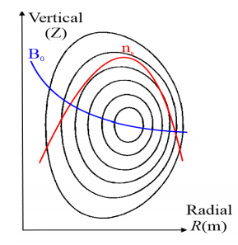
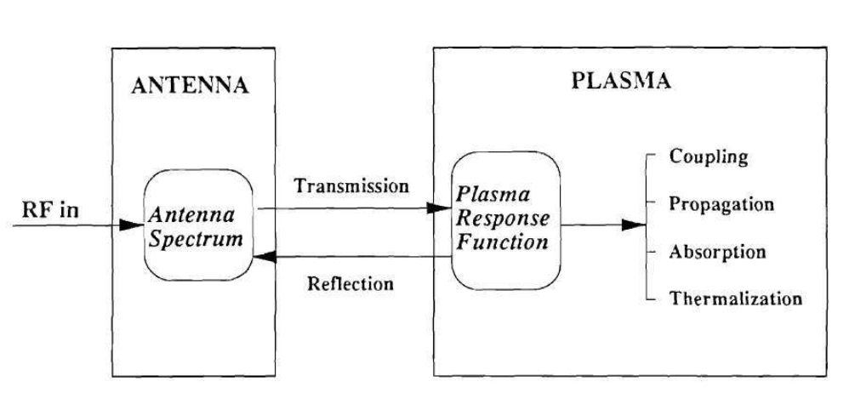
RF IN TOKAMAK
Typical tokamak plasma profiles relevant useful for understanding different wave propagation
Generic consideration for rf plasma interaction for heating and current drive
Most of the plasma waves (except ECRF) do not propagate in vacuum from where wave gets excited.
Inhomogeneous plasma: high field low field wave propagations are different.
Antenna excites desired wave (as per dispersion relation) and is dictated by antenna spectrum & plasma parameters.
Antenna plasma interaction responsible for coupling and propagation,
Wave plasma interaction leads to Absorption & thermalization and hence heating and/or current drive.

Slide 7
ECRH EXPERIMENTS ON ADITYA

Slide 8
ECRH EXPERIMENTS in ADITYA
ECRH has been traditionally used in tokamak for
Breakdown & startup mainly with 1st harmonic O-mode polarization
heating with 2nd harmonic X mode polarization
current drive with 2nd harmonic X-mode polarization
No issue of coupling
High density (optically thick) is required for heating and current drive experiment
Aditya has experimented ECRH for:
Breakdown and Startup in Aditya using 28 GHz at 1st harmonic
Breakdown and Startup in Aditya-U using 42 GHz at 1st and 2nd harmonic
No heating and current drive experiment has been performed.

Slide 9
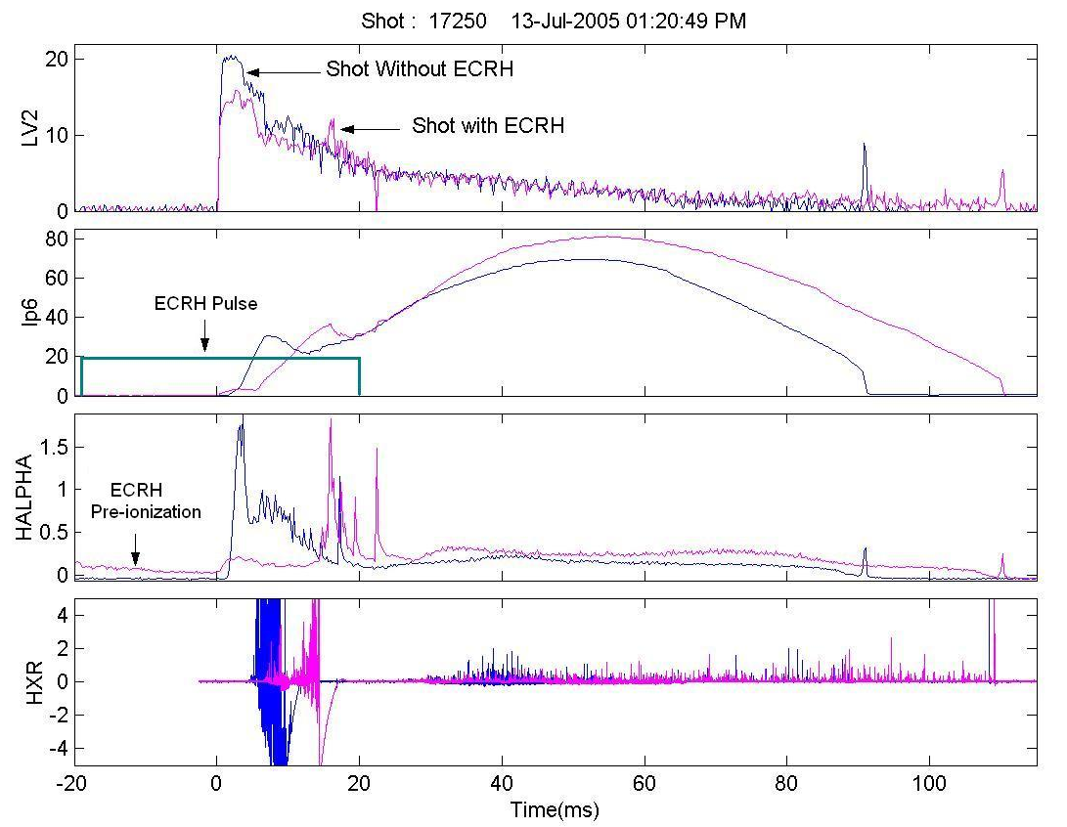
28GHz ECRH Assisted Plasma Start-up (with & without EC)
Lower loop voltage breakdown and start-up has been achieved.
Ramp up is slow as expected
Hard x-ray is low as expected
Initial volt-sec consumption is less as expected.
Plasma control during start up is not upto the mark.
Power ~ 45kW, Fundamental O-mode, Operating BT : 0.75T, Pulse duration : 40ms,
ECR pulse starts @ -15ms (Vloop ref.), H₂-Pr. : 3.4 x 10⁻⁵ torr (17250)

Slide 10
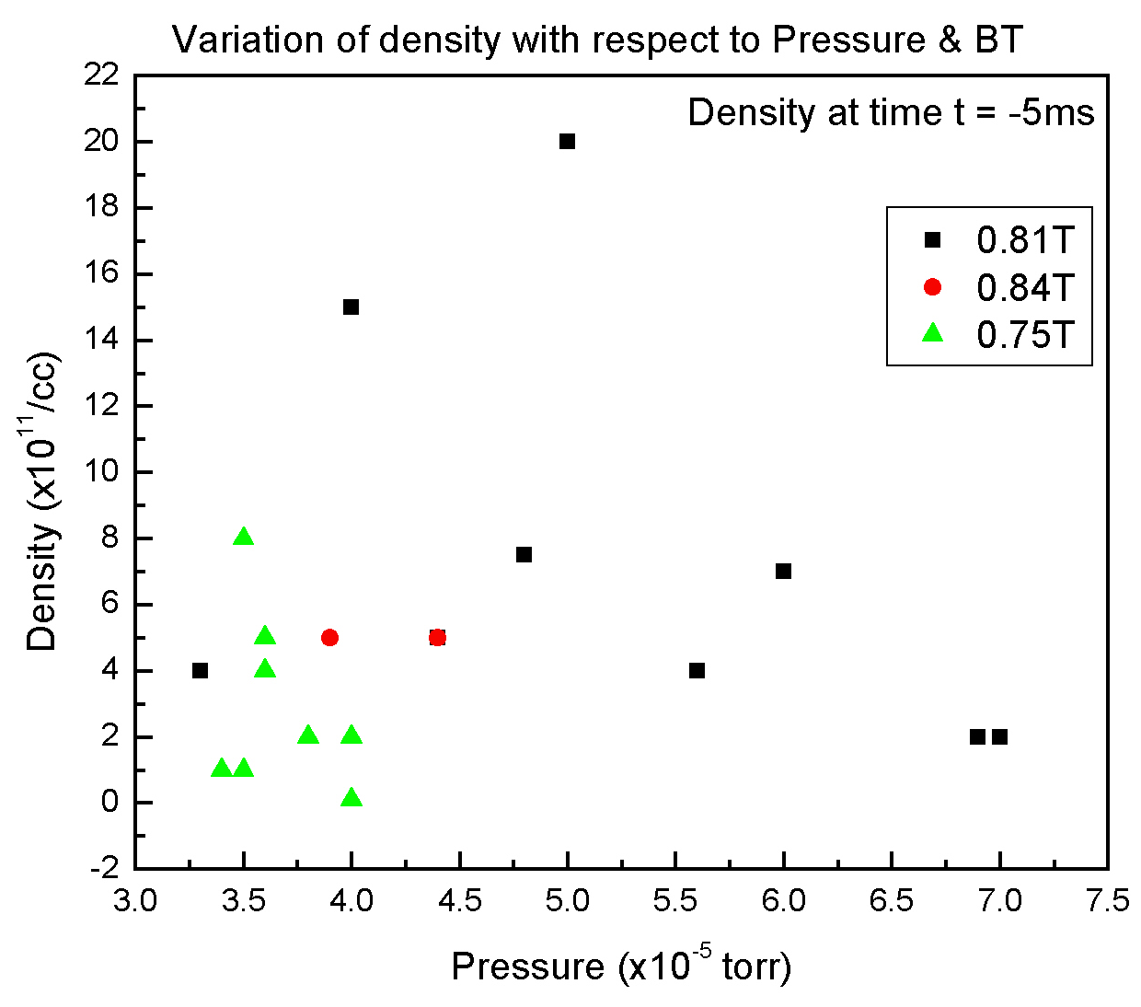
Pre-ionized Density with 28GHz EC vs Fill Pressure
Density measured at plasma center while ECR layer is inboard side.
Pre-ionized density at t=-5ms (5ms before the loop voltage)

Slide 11
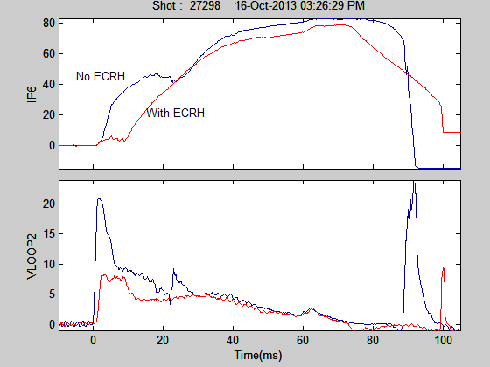
Start-up Experiment with & without EC (42 GHz) for 2nd Harmonic in ADITYA
Second harmonic launch ECRH f = 42GHz; BT : 0.75T (0.75-0.85T)
Power -> 100 kW: Pulse duration -> 70ms
ECRH start @ -50ms w.r.t. loop voltage: Polarization: X-mode
Low loop voltage 7 V from 20V achieved

Slide 12
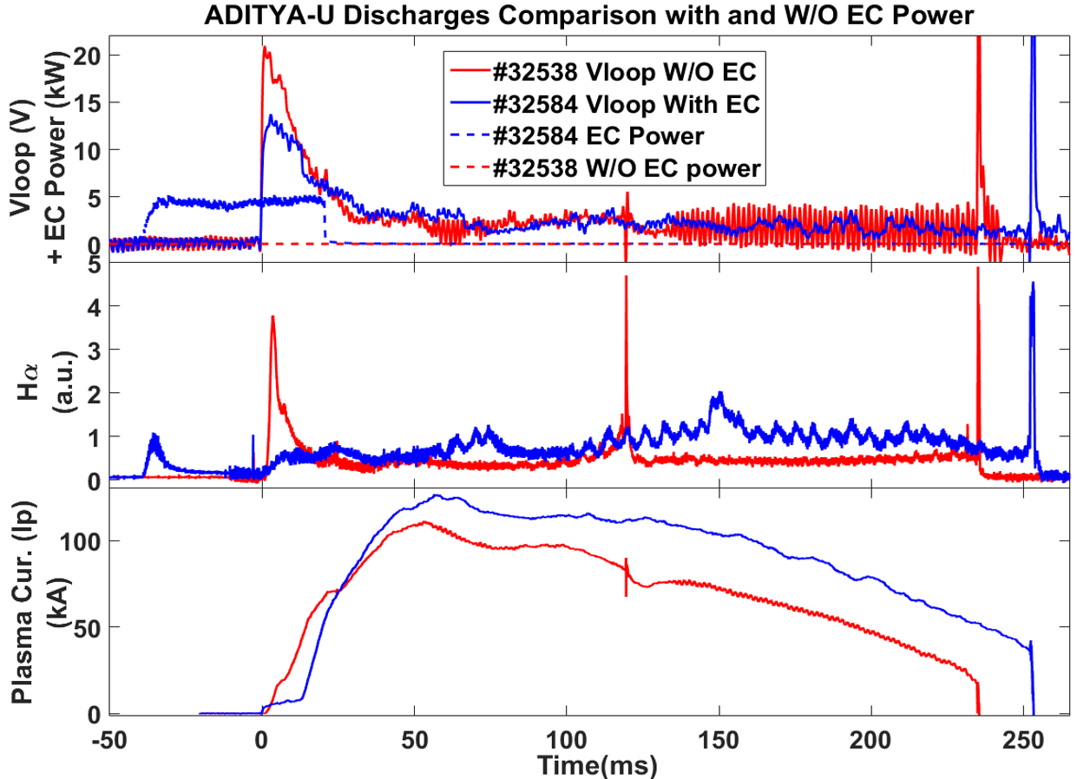
ECRH (42 GHz, 1st Harmonic) Experiment on Aditya-U
ECRH power : 150 kW, Fundamental O-mode
EC power ~30ms before the V_{loop}
EC pulse duration 70 ms
Shot no. 32528 at 20 V loop voltage without EC power
Shot no. 32584 at ~12 V loop voltage with EC power.
Low loop voltage 10 V from 20V achieved

Slide 13
LHCD EXPEIMENTS ON ADITYA

Slide 14
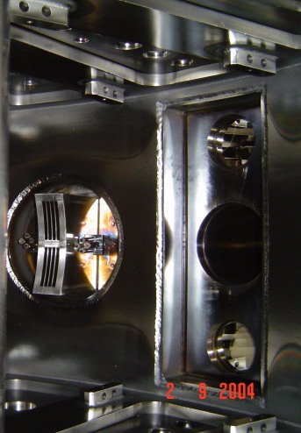
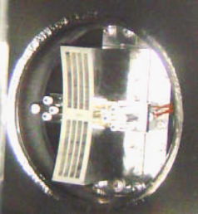
LHCD Grill Launcher
Parameter | ADITYA
<n_{e}> / <T_{e}> | 2 x 10¹³ cm⁻³ / ~400eV
B_{t} | 1.5 T
R / a | 0.75m/ 0.25m
I_{P} | 200kA
κ / δ | Circular
Gas | Hydrogen
f_{o} / Power | 3.7 GHz / 120 kW-1s
Antenna type | Conventional grill
No. of elements | 4nos. X 2 rows
Periodicity | 9 mm
Element size | 76 mm x 7 mm
Septa thickness | 2 mm
Δϕ | 60º – 160º
N// | 1.5 – 4.0
Power flux | 3 kW/cm² (1MW)
Antenna Spectrum
Sharma, et. al., FED, 2007.

Slide 15
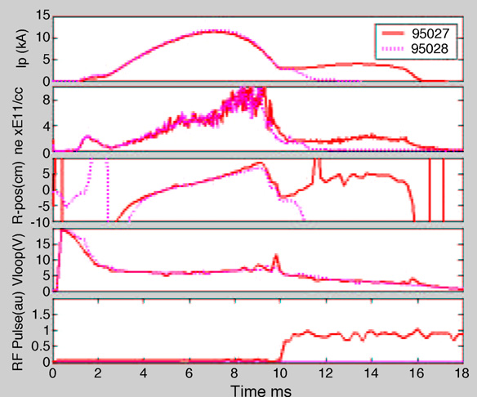
Better coupling -> suitable edge density is needed.
LHCD Experiment in ADITYA
Current drive is observed
Not sufficient
Sharma, et. al., FED, 2007.

Slide 16
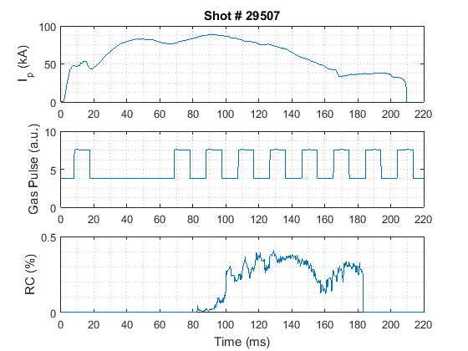
Long Pulse discharges supported by LHCD in ADITYA-U
B_{t}=1.125T
10ms
10ms
Need proper dynamic control system for plasma position & current
Short and frequent gas puff produced better coupling and thus longer discharge.
The current in the OH coil was reduced to lowest level ~7kA (20kA gives 0.6V-s) so that long discharges cannot be obtained with OH alone.
Sharma, et. al., PFR, 2018.

Slide 17
ICRH EXPEIMENTS ON ADITYA

Slide 18
ICRF Experiments on ADITYA
Direct power coupling to ions is a distinct feature of ICRF
  control plasma reactivity,
  Modify ion temperature profile
  control of current profile
  Induce intrinsic toroidal rotation
Power can be delivered to electrons via ELD+TTMP
  Efficient current drive in STs
  Electron temperature profile modification
Other ancillary aspects
  Assistance in Low voltage Ohmic start up
  Wall conditioning and coating in SC tokamaks

Slide 19
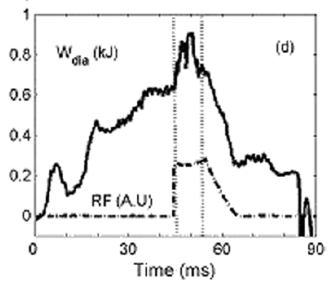
ICRF Experiments on ADITYA
Direct Electron Heating through ELD + TTMP
Mishra et. al, PPCF 2009
ICRF power coupled (~ 47% as calculated from TORIC) directly to electrons.
Time scale dominated by electron-electron time scale. Linearity of ΔT_{e} with P_{rf}.
P_{injected} = 38 kW; δφ decreases from, 0.5 to 0.41 mWb
β_{p} increases from 0.31 to 0.44 W_{dia} increases from 630 J to 895 J
Kumar et. al, RSI 2010, Asim et. al, Pramana 2015

Slide 20
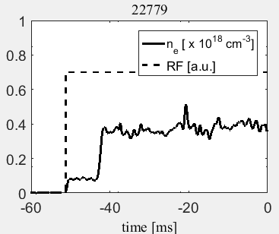
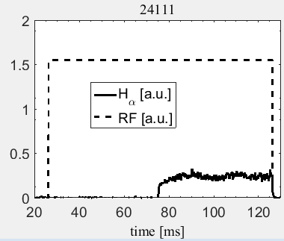
ICRF Experiments on ADITYA
ICRF only plasma formation and expansion through FW
Mishra et. al, IAEA 2018
Plasma produced due to ICRF power without Ohmic field.
With Bt, plasma expanded toroidally.
At a critical Bt, FW induced spontaneous plasma expansion towards HFS is observed.
Uniform plasma expansion can be exploited for wall conditioning and uniform wall coating.
ICRF Plasma formed infront of Antenna at two Bt
ICRF plasma density and breakdown delay in typical shots

Slide 21
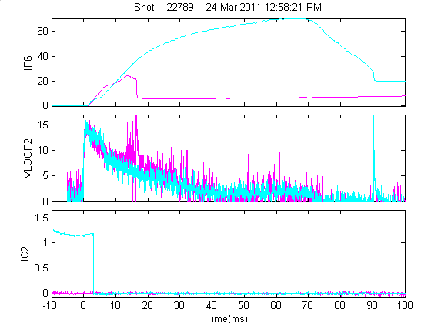
ICRF Experiments on ADITYA
ICRF Plasma assisted low loop voltage start-up in ADITYA
Kulkarni et. al, IAEA 2012
Normal loop voltage ~20 V
With ICRF assistance, VL= 10 V
precise control of P_{fill} and pulse length was required
H₂ P_{fill} = 4-8⁻⁵ mbar, P_{rf}=80 kW,
B_{T} = 0.75 T, Harmonic n=2
Without assistance, burn through could not be completed.
ICRF Plasma assisted low voltage Ohmic start-up. Plasma current, Loop voltage and ICRF pulse are shown in Fig.

Slide 22
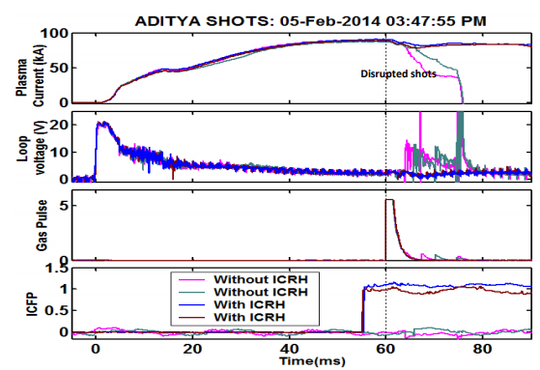
ICRF Experiments on ADITYA
Disruption avoidance through ICRF injection in ADITYA
Tanna et. al, NF 2015
Deliberate disruption is induced by applying H2 gas puff at edge.
ICRF power is applied in pre-programmed mode just before gas puff.
Disruption (current quench) is successfully avoided with ICRF
Plasma current is sustained for longer discharge.
ICRF Power used 50 - 70 kW, 24.8 MHz
ICRF induced radial electric field near edge could be a reason to enhance shear flow ➔ leads to suppression of MHD growth.

Slide 23
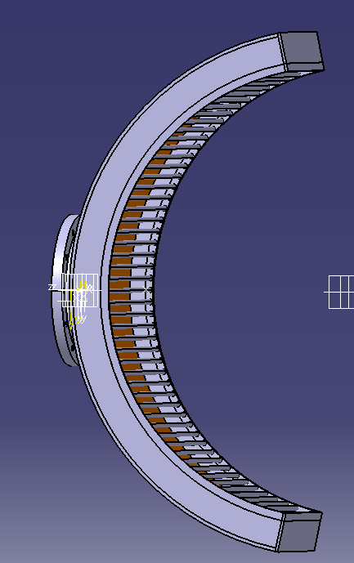
ICRF Experiments on ADITYA
New Centre-fed ICRF antenna : Coming soon
Antenna-Plasma loading is low typically < 0.3 Ω
This leads to a very high vswr.
Large antenna-LCFS distance due to thick tiles.
Voltage node arcing and multipactor arcing in constrained space inside VTL
Poloidal asymmetry of radiated electric field towards the resonance layer due to its shape.
An increase in 2.5 times the radiating area, thus expected to enhance the power (~ 300 kW) injected.
A symmetric co and counter poloidal currents, that stabilizes edge poloidal modes in front of antenna.
More lensing effect of radiated electric field directed towards centre.
Increase in loading resistance by reducing strap-plasma distance.
Novel private plasma production mechanism inside antenna box.

Slide 24
SUMMARY: Experimental Achievements so far
Experiment | Achievement
E C R H
1st Harmonic O-mode at ADITYA 1st Harmonic O-mode at ADITYA-U | Plasma breakdown & low loop voltage start-up
2nd Harmonic X-mode at ADITYA 2nd Harmonic X-mode at ADITYA-U | Only plasma breakdown, start-up partial success
L H C D
Low B_{T} (~ 1 KG) | Plasma breakdown
Normal BT (~ 0.75 T $ 1.2 T) | Partial current drive
I C R H
Fast wave IC launch through single strap | Direct Electron heating through ELD + TTMP
ICRF injection in ADITYA | ICRF only Plasma formation
 | ICRF Plasma assisted low loop voltage start-up in ADITYA
 | Disruption avoidance

Slide 25
SUMMARY: Future Plan
ECRH
  Heating through 2nd Harmonic X-mode
  Look for current drive (a steering mirror)
LHCD
  Current drive with feedback control of IP & Ne
ICRH
  Center fed antenna to increase plasma coupling efficiency
  Two strap antenna for better control of antenna spectrum
Overall
  Experiments on coupling and/or propagation
  Experiments on absorption and thermalization
  Are we prepared: Human resource and Planning?

Slide 26
THANK YOU

Slide 27
1. Wave absorption at the fundamental resonant frequency (N=1)
2. Wave absorption at the harmonic frequency (N>1): Two ion species: Ion heating
3. Minority heating: Minority ion and then majority ions.
4. Mode-conversion can take place if several ion species co-exist in the plasma. Electron heating though Landau damping.
Both ion cyclotron absorption, by a resonating minority species and direct electron absorption result in electron heating.
However, the electron heating takes place on two different time-scales.
Electron heating via energy transfer from minority ions occurs after a high energy tail of the resonating ions has been formed. This is referred to as electron heating as indirect electron heating.
The indirect electron heating should saturate on the timescale of fast ions slowing down collisionally on electrons, which typically 0.2-1 s.
Electron is heating through ELD and TTMP, which we refer to as direct electron heating, takes place on the time-scale of electron-electron collisions, which is typically of the order of milliseconds.

