Slide 1



Lower Hybrid Current Drive System on ADITYA
P. K. Sharma
Institute for Plasma Research, Bhat, Gandhinagar-382428, Gujarat, INDIA.
National Symposium for Commemorating 30-Years of ADITYA Tokamak, 27th – 28th January 2020, IPR

Slide 2
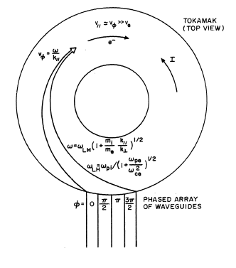
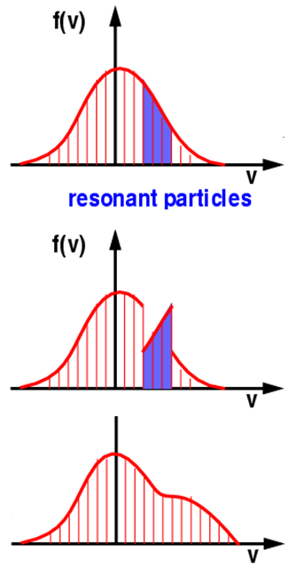
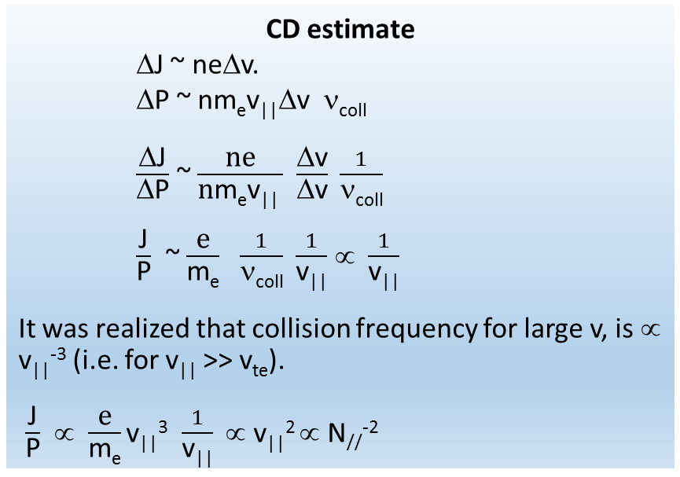
LHCD scheme –
Theoretical background
N// = ck///ω = c/f * 1/Δ * Φ/360º Here Δ is periodicity of antenna
Δ N// = N// /W
Here W is total width of antenna
CD estimate
ΔJ ~ neΔv.
ΔP ~ nm_{e}v||Δv ν_{coll}
$\frac{\text{Δ}\text{J}}{\text{Δ}\text{P}}$ ~ $\frac{\text{ne}}{\text{n}\text{m}\text{e}\text{v}\text{||} }$ $\frac{\text{Δ}\text{v}}{\text{Δ}\text{v}} \frac{1}{\text{ν}\text{coll}}$
$\frac{\text{J}}{\text{P}}$ ~ $\frac{\text{e}}{\text{m}\text{e}}$ $\frac{1}{\text{ν}\text{coll}}$ $\frac{1}{\text{v}\text{||}}$∝ $\frac{1}{\text{v}\text{||}}$
It was realized that collision frequency for large v, is ∝ v||⁻³ (i.e. for v|| >> v_{te}).
$\frac{\text{J}}{\text{P}}$ ∝ $\frac{\text{e}}{\text{m}\text{e}}$v||³$\frac{1}{\text{v}\text{||}}$ ∝ v||² ∝ N//⁻²
Collisionless wave damping
Collisional relaxation

Slide 3
Background
When SST1 was being designed, it was realized to have LHCD system on ADITYA machine to learn high power technologies associated with it and establish/demonstrate current drive in plasmas.
The first step towards it came in the form of testing and commissioning of high power klystron test bed in LHCD lab (lab developed at old workshop area and presently known as ICRH lab).

Slide 4
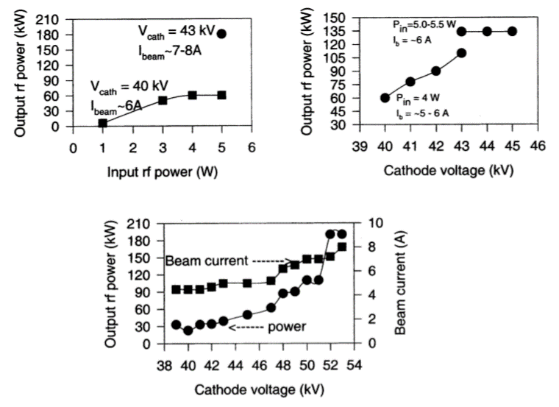
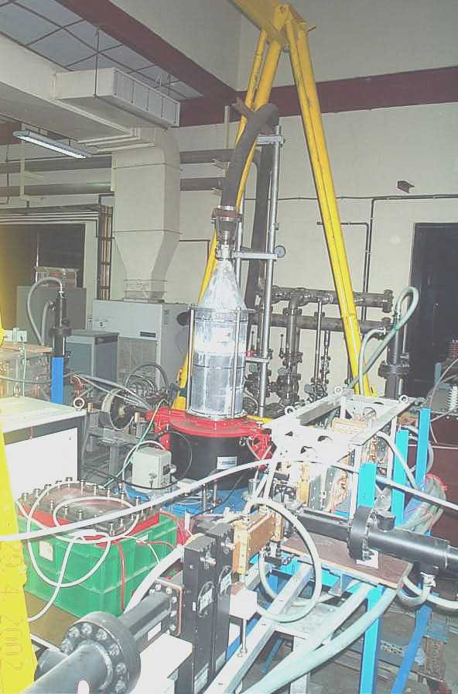
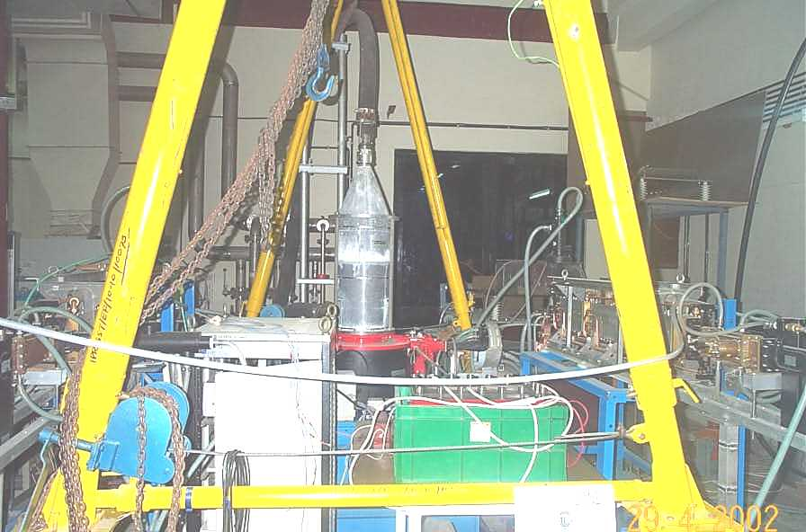
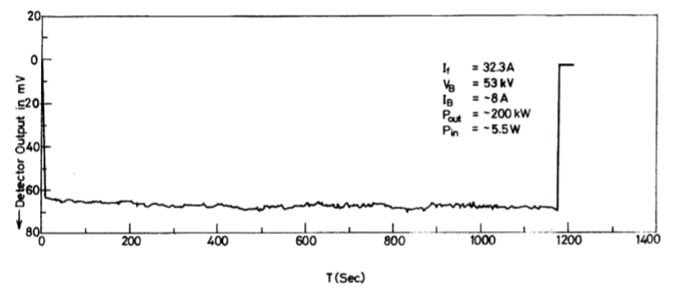
Klystron test bed feeding Aditya LHCD system
Bora, et. al., FED,2001

Slide 5
Challenges
ADITYA, when built in 1989, was not an RF machine.
A radial circular pumping port (R-14) was identified and modified to rectangular radial port to insert LHCD grill launcher through radial port no. 14.
The circular to rectangular enclosure was designed to adapt the LHCD system to existing circular port of ADITYA machine.
This resulted in long radial port (~2 mtrs.) because the orientation of the pump was changed and accommodated in this transition enclosure.
The circular nature of the port posed challenges in designing grill launcher and restricted our grill size to have only 4 waveguides, arranged in two rows.

Slide 6
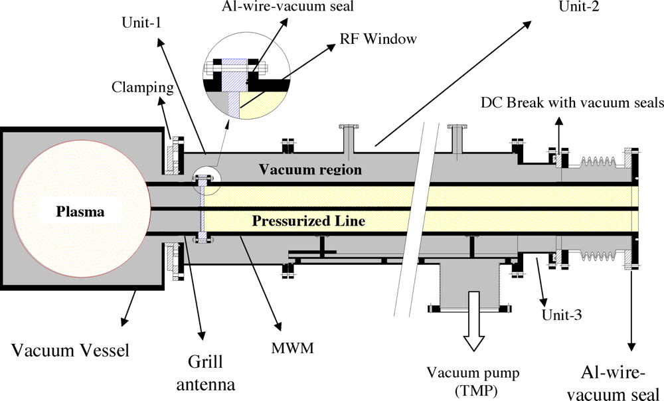
In-vessel description

Slide 7
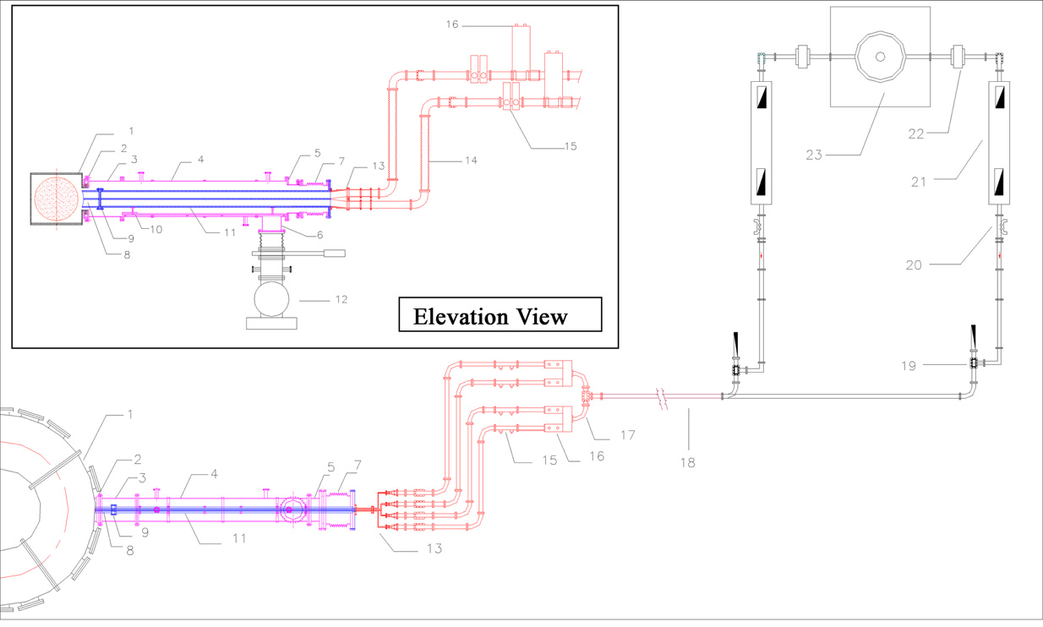
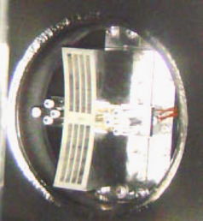
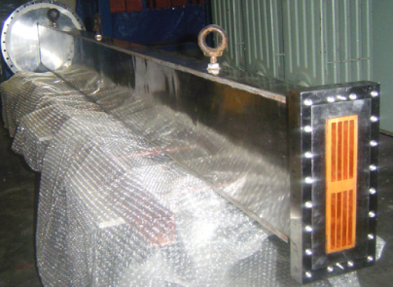
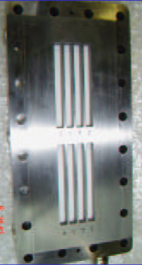
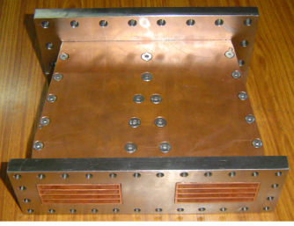
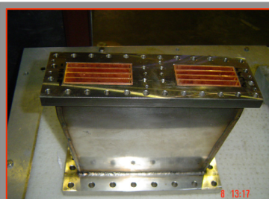
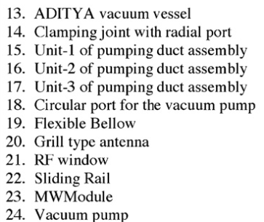
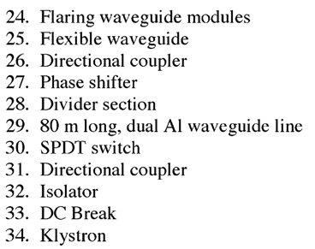
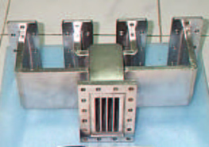
ADITYA-LH Layout
The transmission line (~100m) was laid from then LHCD lab up to ADITYA tokamak hall.

Slide 8
Technologies developed
Plate fit techniques were used to form radial rectangular transmission line
Wire cut technology was used to develop grill launcher.
RF window was designed and developed with the help of PPPL, Princeton lab employing high temperature vacuum brazing technique.
The horizontal/vertical flaring modules were developed using EDM techniques, plate welding techniques, etc.
WR284 waveguides were drawn from circular tubes with the help of local vendors.

Slide 9
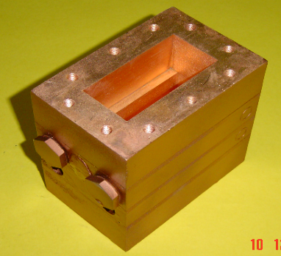
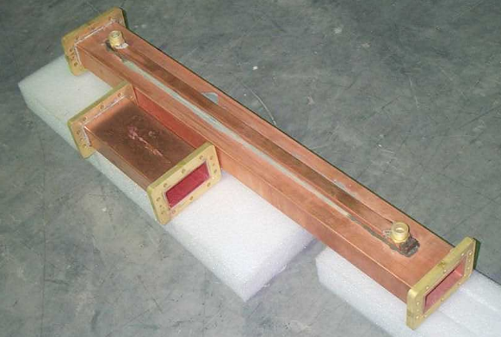
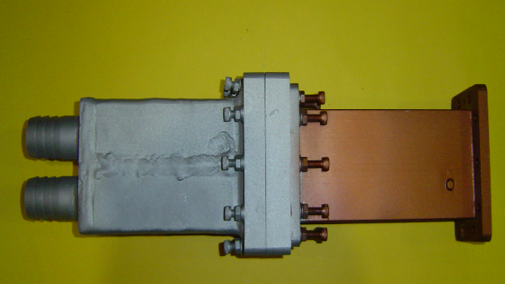
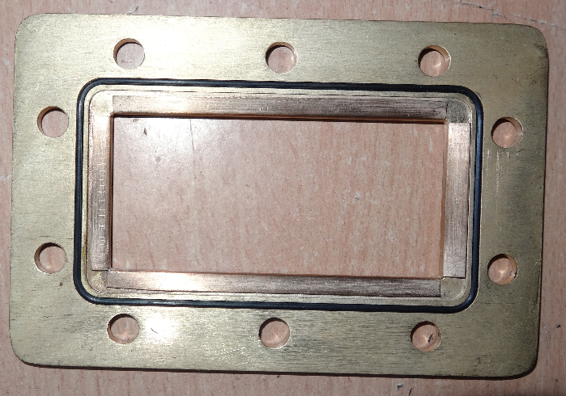
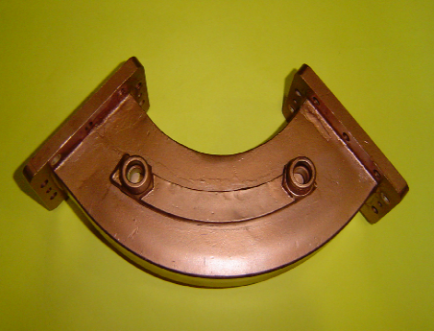
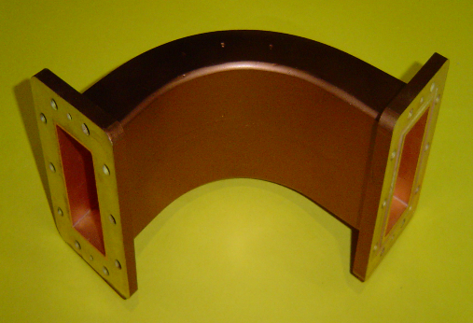
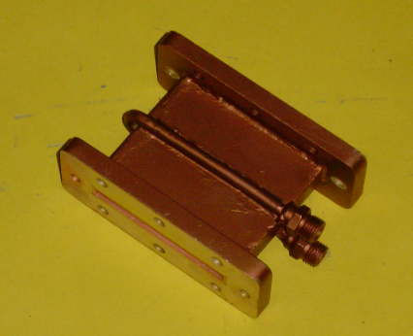
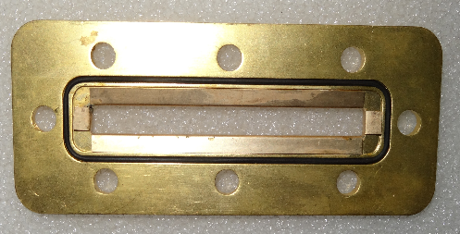
High power rf components developed
NWG Transformer
WR284 WG
High power Water Load
Waveguide seal
H-Bend
E-Bend
NWG

Slide 10
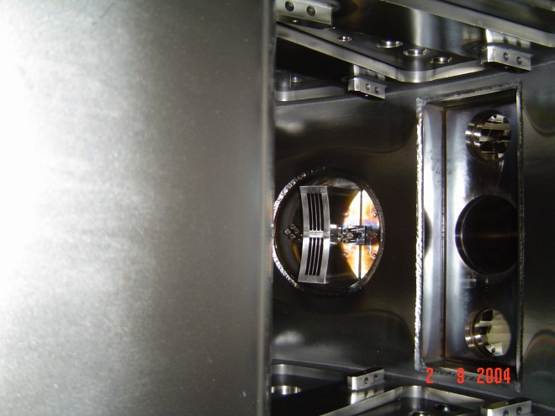
Grill Launcher
Parameter | ADITYA
<n_{e}> / <T_{e}> | 2 x 10¹³ cm⁻³ / ~400eV
B_{t} | 1.5 T
R / a | 0.75m/ 0.25m
I_{P} | 200kA
κ / δ | Circular
Gas | Hydrogen
Configuration | ---
f_{o} / Power | 3.7 GHz / 120 kW-1s
Antenna type | Conventional grill
No. of elements | 4nos. X 2 rows (8 elements)
Periodicity | 9 mm
Element size | 76 mm x 7 mm
Septa thickness | 2 mm
Δϕ | 60º – 160º
N// | 1.5 – 4.0
Power flux | 3 kW/cm² (1MW)

Slide 11
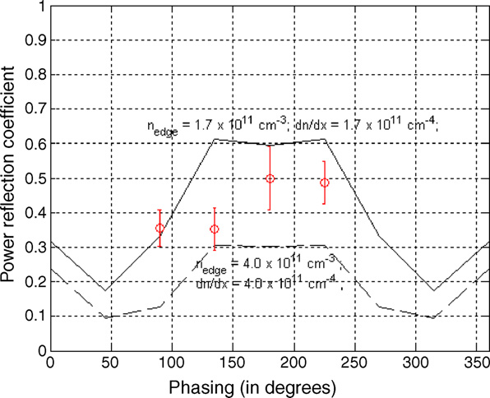
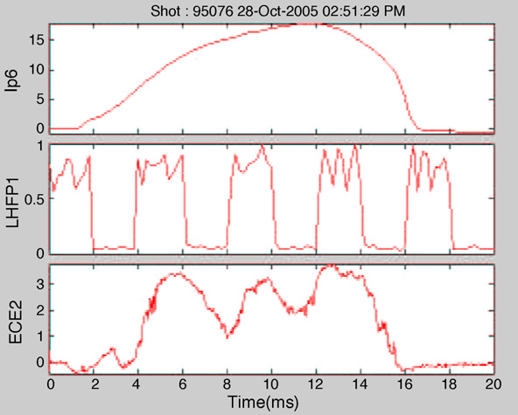
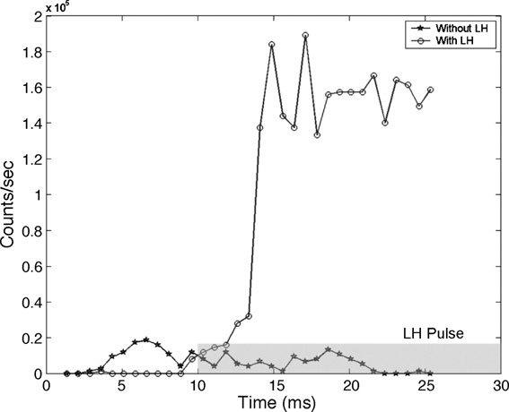
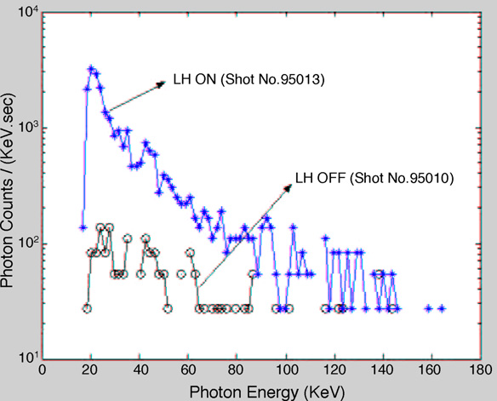
Plasma response to LH power
Sharma, et. al., FED, 2007
Capacitor bank discharge plasma.

Slide 12
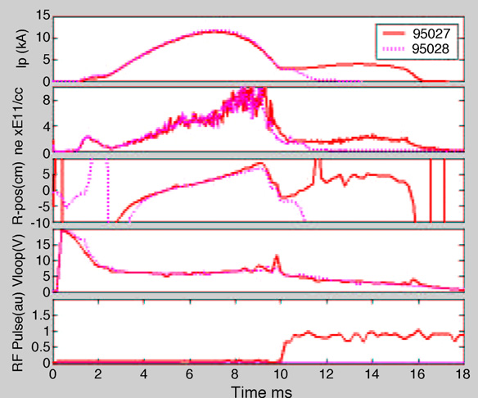
More power needed ….

Slide 13
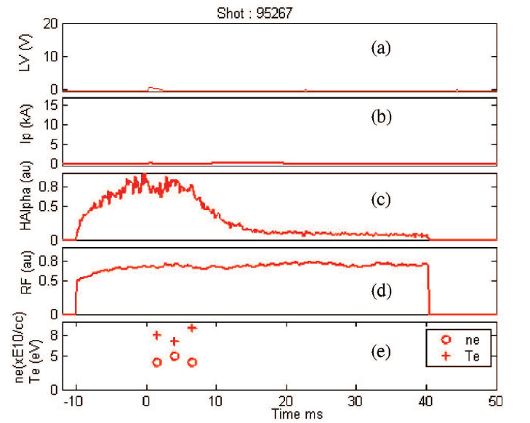
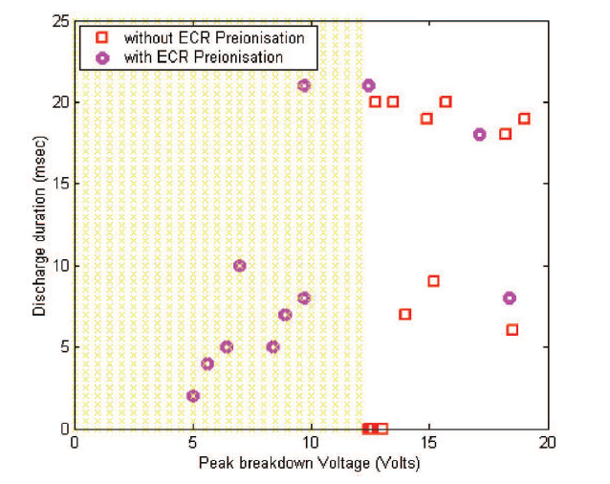
LHCD system used for ECR breakdown studies at lower toroidal magnetic field

Slide 14
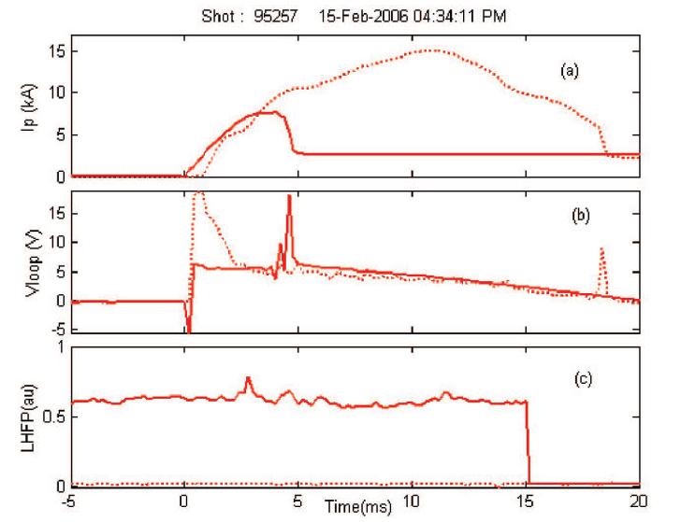
Comparison between ECR assisted/unassisted startup

Slide 15
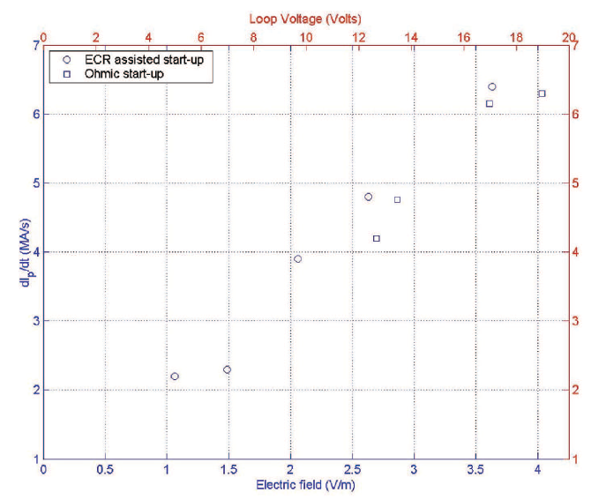
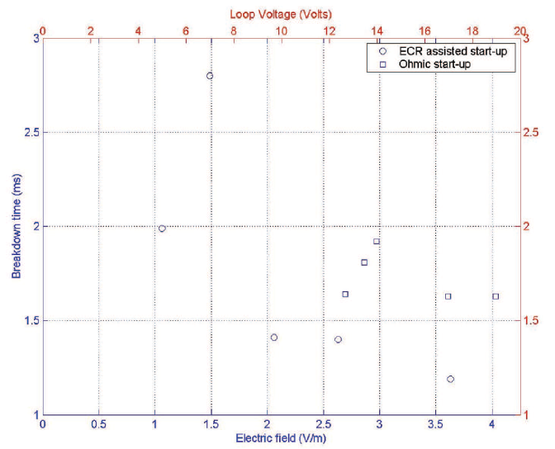
DI/dt and breakdown time
Slow ramp rate observed with low electric field discharges.
More BD time observed with low electric field

Slide 16
Klystron CW operation at rated power
Later klystrons were shifted to SST1 hall in LHCD area.
A new conventional HVDCPS (70kV, 22A – CW) was procured, installed and commissioned.
The earlier crowbar systems (based on rail-gap techniques and parallel ignitron based scheme) which was inhibiting klystron operation at rated voltage was replaced by new solid state based (thyristor based) crow-bar system.
The HVDCPS system connected to klystron was qualified by wire-burn test up to the rated voltage and subsequently high power CW operation of klystrons were carried out successfully.

Slide 17
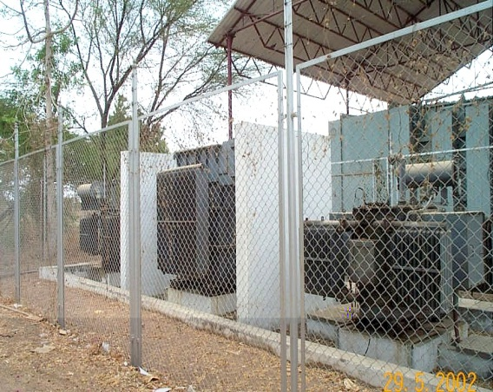
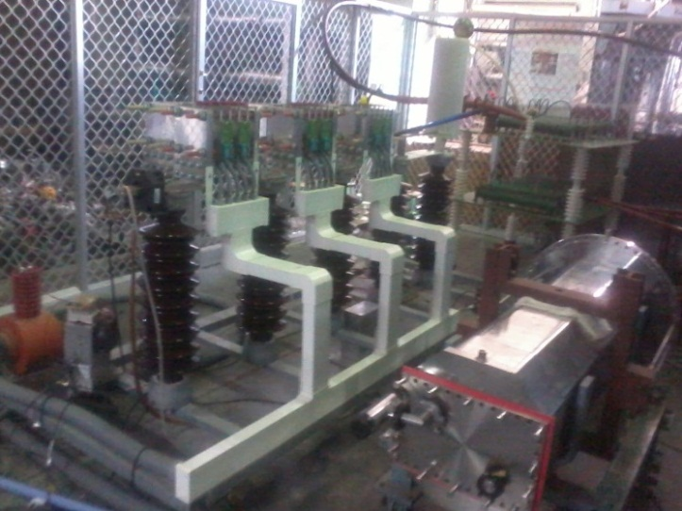
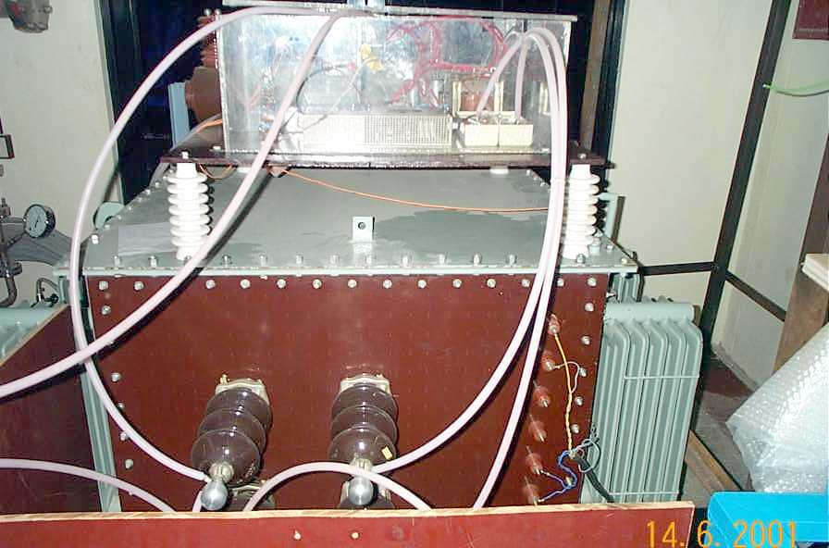
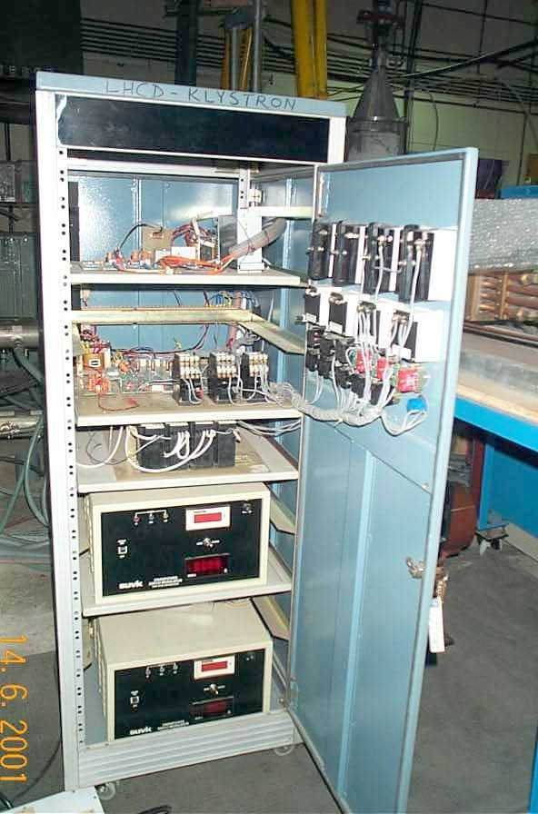
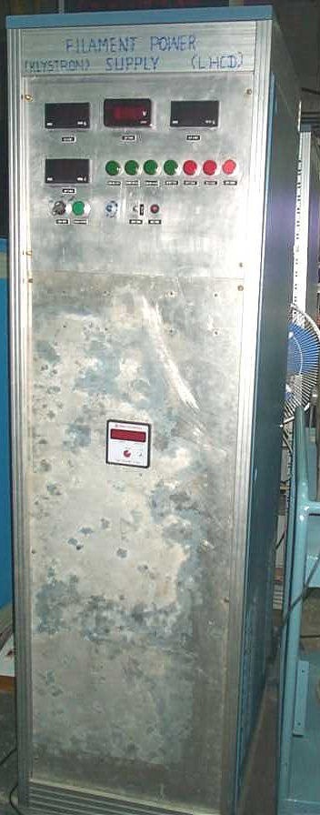
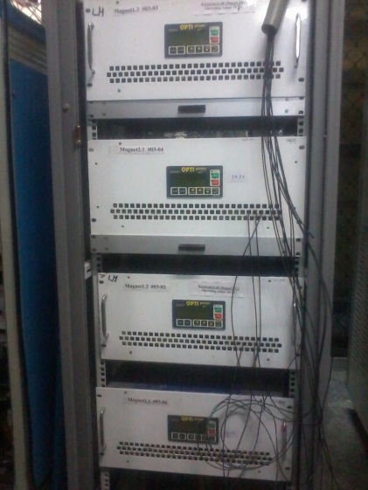
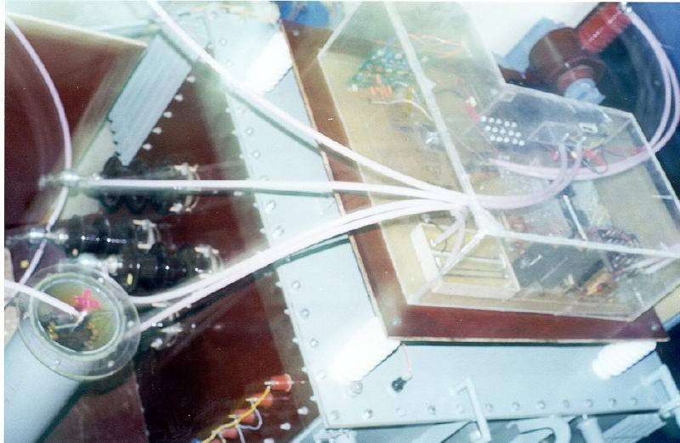
Auxiliary PS
11kV (ac) Voltage Variation system: It varies input ac voltage for HV DC PS.
YU155 tetrode based AMPS (0-60kV, 50ms–1000s). Remote control & monitoring.
Solid state based crow bar system (Thyristor based)
2kV, 100mA Bias Voltage PS: It is used to suppress dark current that flows when anode pulse is absent. This power supply is designed to float at 120kV DC.
AMPS Control Panel: For synchronization if necessary and controls Tetrode, operating in its linear range.
Filament PS: 12V, 50A, Soft Start 130kV DC Isolation Over Voltage & Over Current Protection.
Magnet PS: Provides beam collimation.

Slide 18
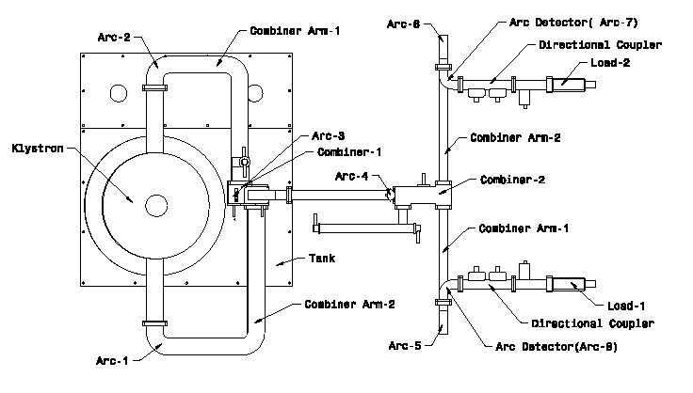
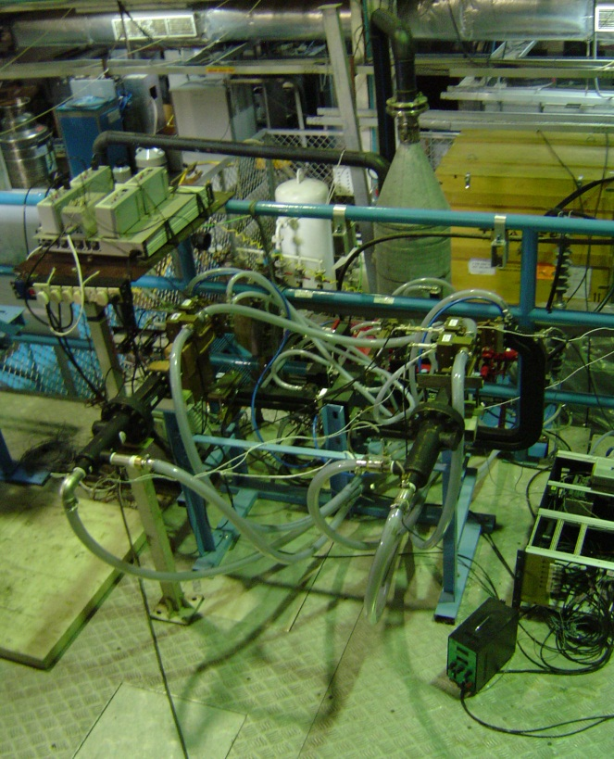
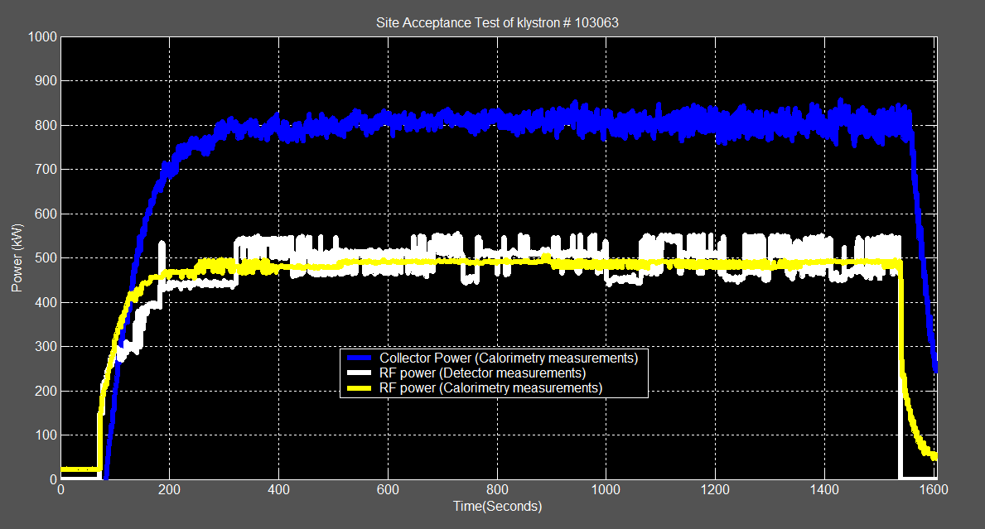
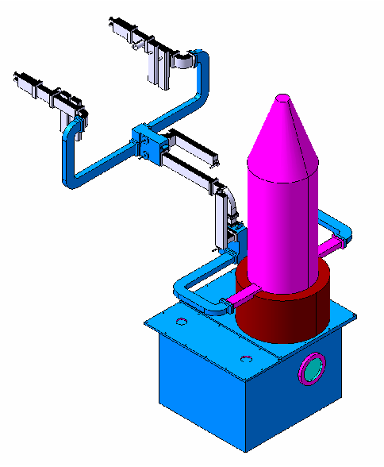
High Power Klystron
Full power CW operation
* Immediate response during HP operation
* Steady & efficient thermal management

Slide 19
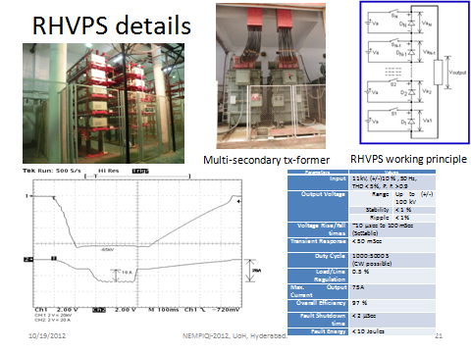

Slide 20
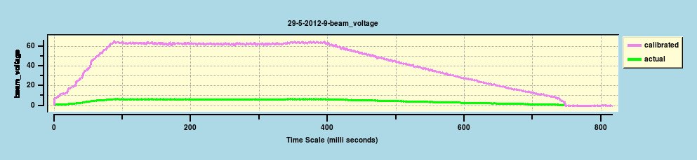
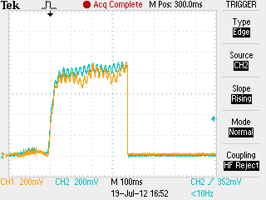


Short pulse (0.2s) operation
Typical rf output @ 50kV

Slide 21

Four klystron parallel operation

Slide 22

Coupling issues
During LH experiments large reflections were observed and hence LH power could not be coupled to plasma.
It was attributed to poor edge plasma condition which resulted in weak coupling of LH power.
Gas puff experiments were tried out in ADITYA machine to understand the coupling issues.
A new gas injection system was installed at the (electron) side of grill antenna.
The idea was to inject neutrals from the electron flowing side to improve edge density with LH power and improve coupling of LH power to plasma.
Gas puffing system

Slide 23

LH coupling improved with edge gas puffing

Slide 24

Optimization for multiple gas puffing
15ms
10ms
* The RC increases before the second pulse is injected.
* Hence the gap between the pulses were reduced.

Slide 25
Long pulse CDX on ADITYA
During the campaign, plasma current was kept low (~80 kA) and toroidal magnetic field was kept at 1.125T.
A decrease in reflection coefficient (RC) of LH power is observed with gas puff, which clearly indicates improvement in coupling of LH power to plasma.
Good coupling or improved RC is obtained even with grill antenna, being placed up to 7mm behind the limiter position.

Slide 26

Long discharges supported by LHCD in ADITYA
B_{t} – 1.125T
10ms
10ms
* Short and frequent gas puff produced better coupling and thus longer discharge.
* In this case the current in the OH coil was reduced to lowest level ~7kA (20kA gives 0.6V-s) so that long discharges cannot be obtained with OH alone.

Slide 27


What is PAM
Same essence of grill/multijunction but use an alternating active/passive waveguide in which passive waveguides are fed by cross-coupling through plasma.
Efficient coupling at low density (near cutoff), permitting to place antenna where thermal loads are smaller.
PW, whose depth is mere quarter wavelength, allow the insertion of an efficient water cooling system at its back.
Also provides neutron shielding.
90
180
270
0
=180
PAM @ Tore-Supra
<n_{e}> <T_{e}> | ~5 x 10¹³ cm⁻³ ~5 keV | f_{o} / Power | 3.7 GHz / 7.0 MW-CW
I_{P} B_{t} | 1 MA 3.8 T | Antenna type | Multi-junction & PAM
R/a | 2.5m /0.8m | N// | 1.7 - 2.0
Actively cooled launcher. ITER-relevant launcher design
Ekedahl, et. al., NF, 2010

Slide 28


Coupling behaviour
Sharma, et. al., EPS, 2010
Ekedahl, et. al., NF, 2010
* Experimental reflection coefficient (RC) follows coupling code ALOHA.
* Supersonic molecular beam injection (SMBI) mimics ELM-like perturbations.

Slide 29



Full CD experiments
High power operation
* V_{LOOP} = 0 during 50s (feedback controlled).
* Modelling reproduces well the driven current and hard x-rays
* 2.7 MW, 78s flat-top, 220MJ.
* RC < 2% @ 10cm distance

Slide 30







PAM Design/Simulation studies for ADITYA-U
Low reflection co-efficient near cut-off density
$$\int_{−∞}^{∞}{\left(\frac{dP}{dn}\right)}.dn=P$$

Slide 31





Fabrication details

Slide 32




Mode convertor
Two profile plates are machined using VMC. An 8 mm plate is welded between the two profile plates to form two mode convertors

Slide 33






Front end of PAM
Gas relieving holes are inserted at the top and bottom of the plates
Two types of plates are machined using VMC. One plate has 90º step phase shifters while the other plate has straight waveguides
Stacked plate fit section with alternate 90° and 0° plates
Alternate passive & active waveguides

Slide 34


Baking results
The complete launcher is subjected to ~24 hour baking cycle and a vacuum of 1 x 10⁻⁷ mbar is achieved.

Slide 35

Low power characterization of MC
Return Loss = 25 dB (estimated 26 dB)
Insertion Loss = 0.11 dB (estimated 0.08 dB)
Mode converter section

Slide 36

Low power characterization of MC/PAM
Return Loss = ~27 dB
(estimated ~32 dB)
Insertion Loss = ~0.4 dB.
(1/6 division ~7.9 dB)
(estimated ~0.2 dB)

Slide 37


Window development activities
Simulated in COMSOL Multiphysics, EM Waves, Frequency Domain (emw) module.
Analysed for an input power of 500 kW/CW at 3.7GHz
Jain, et. al., under publication

Slide 38


Vacuum window development
RF vacuum windows, a very important part of LHCD system is designed, developed & tested at IPR.
Pill box type rf vacuum window, comprising of ceramic material (Al₂O₃) and different materials like copper and SS is developed successfully.
Vacuum brazing of ceramic and two dissimilar material (SS & Cu) is carried out successfully in-house.
The window showed an insertion loss of about 0.15 dB with a return loss of better than 25 dB
HP testing of pill-box RF window
Vacuum brazing of two dissimilar metal (SS & Cu) and alumina together.

Slide 39

The ADITYA experience contributed immensely in recent SST1 campaign (2019)
Long discharge of ~650 msec.

Slide 40

Nearly zero voltage CD in SST1

Slide 41
Conclusions
120 kW-pulsed (1 sec.) LHCD system was designed, developed and installed on ADITYA machine.
  Coupling of LH power to plasma was improved by gas puffing. It provided optimum edge plasma condition near the grill mouth and resulted in lower reflection co-efficient.
  Measurements obtained from various diagnostics (CdTe signal, 2nd ECE signal, etc.) confirmed generation of suprathermal electrons when LHCD power is injected in to the plasma.
  Long pulse (up to 210 msec.) LHCD assisted discharges was obtained in ADITYA machine.
  The ECR produced plasma was formed with LHCD system at reduced toroidal magnetic field suggesting an option for discharge cleaning.
It contributed significantly towards technological development of LHCD related high power rf components.
The positive results from ADITYA LHCD system raised the confidence and provided added advantage in the success story of SST1-LHCD system where long pulse discharges up to 650ms could be obtained.
New PAM launcher for ADITYA-U has been designed, developed and tested and is expected to be put in the machine sson.

Slide 42
Thank you for your kind attention.

