Slide 1
Tuning Voltage Setup and Data Processing for FMCW Reflectometer
A. Amalin Prince, Department of EEE
National Symposium for Commemorating 30-years of ADITYA Tokamak,
27-28 January 2020

Slide 2
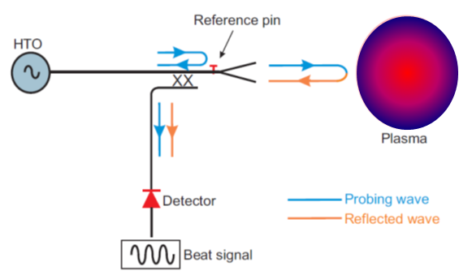
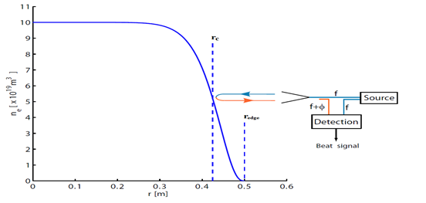
FMCW Reflectometer: Background
Microwave diagnostic technique:
Complete electron density profile (ne(r)) in the Tokamak
$η_{O}^{2}=1−\frac{ω_{pe}^{2}}{ω^{2}}$ ; $ω_{pe}=\frac{ne^{2}}{ε_{0}m}$
$δφ= δ\left(L_{a}(t)−L_{r}\right)\frac{ω}{c} + \left(L_{a}(t)−L_{r}\right)\frac{δω}{c}$
The reflected wave will experience a phase change a) change in path length and b) change in probing frequency
Fixed Freq. for Fluctuation meas.
Swept Freq. for Density Profile
Notes:
is a microwave diagnostic technique which is capable of measuring the complete electron density profile (n_{e}(r)) with minimal access requirements
works on the principle that an em wave is totally reflected from a point in plasma where its frequency becomes equal or greater than the plasma frequency.
microwave frequencies are reflected from various cut-off layers of the plasma which leads to measurement of the electron density profile in the tokamak.

Slide 3
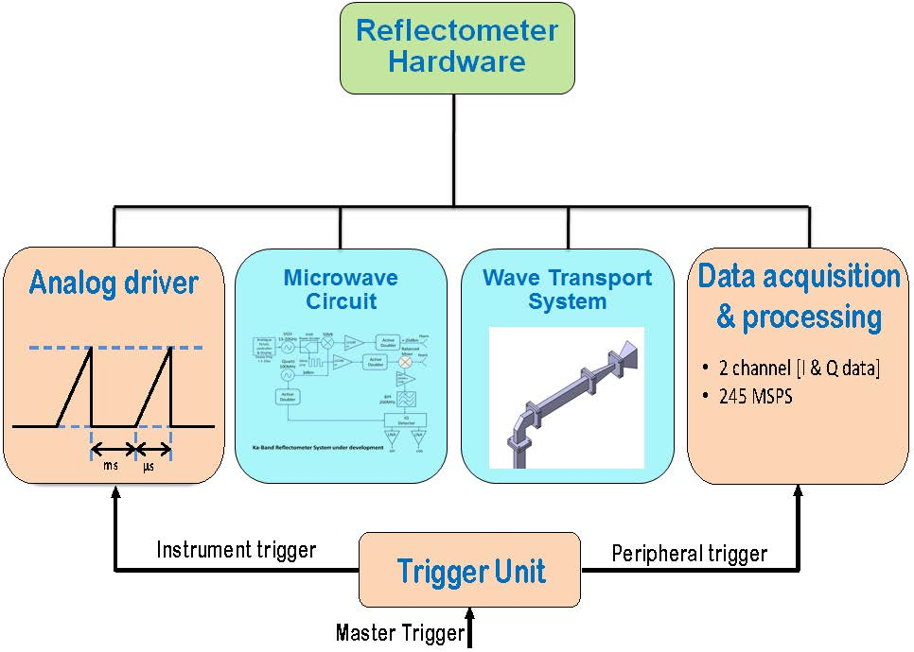
Reflectometer Setup: IPR
Ka-band (26.5 to 40 GHz)
Electron density
0.875 - 1.9 e ¹⁹ m⁻³
Requirements: MW source
Wideband
Cover wideband in short time
Linear frequency response
Tuning Voltage Setup
Challenges: Tuning Voltage Setup
Nonlinear tuning voltage ramp to drive VCO linearly
Enable easy configuration of the ramp parameters
Multimode trigger support
Remote configurability
Multimode trigger unit
Multi-trigger input sources
Multi-trigger outputs
Pre-trigger and post-trigger delay (1 to 4)
Multiple modes
Remote configurability

Slide 4
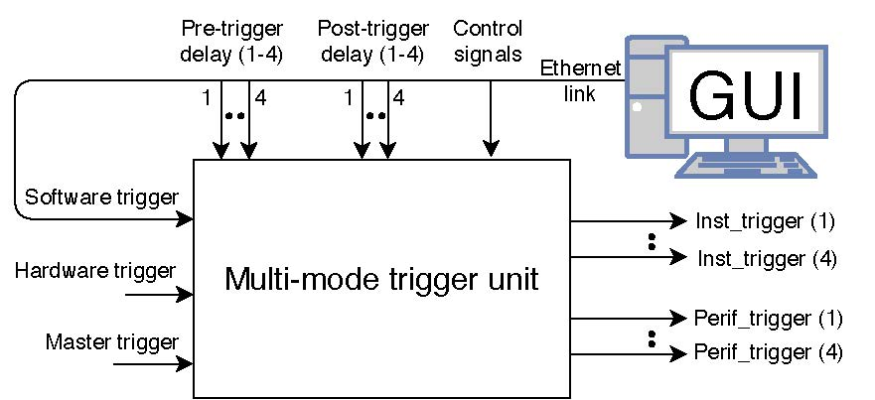
Reflectometer: Tuning Voltage Setup
Aditya control room
Pre-trigger delay
1
Non linear
Ramp voltage
2
3
4
N
T_{ON}
T_{OFF}
Post-trigger delay
Four modes
Mode 0: Single trigger mode
Mode 1: Continuous trigger mode
Mode 2: Trigger pattern mode
Mode 3: Continuous trigger pattern mode

Slide 5
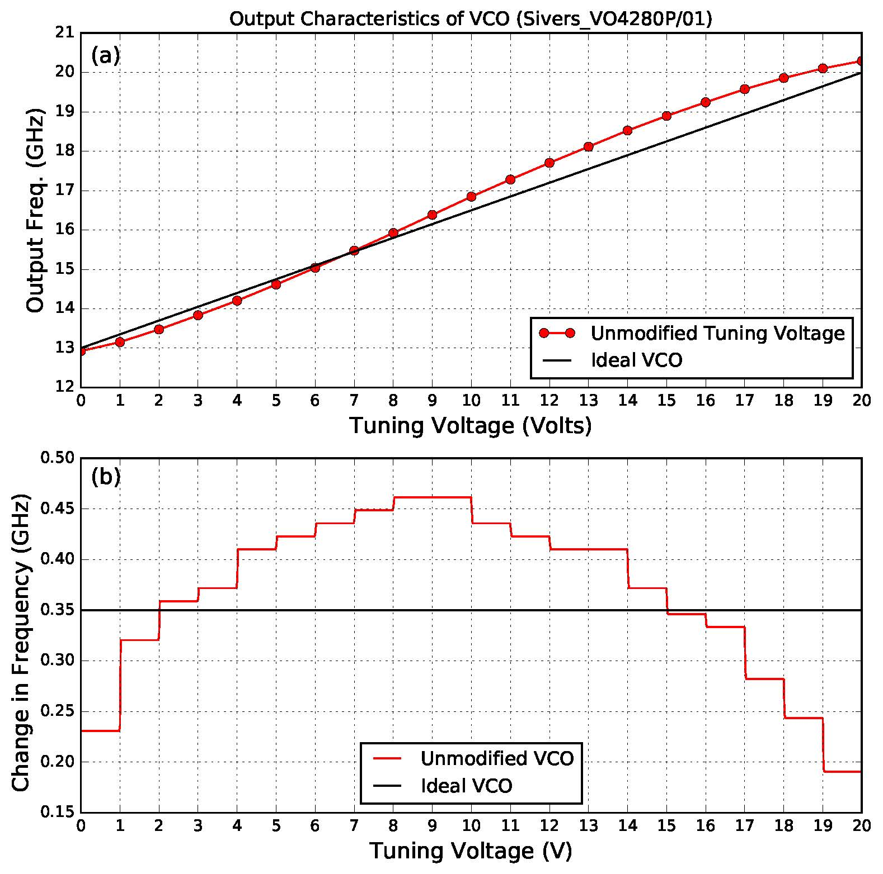
Frequency Source and Its Characteristics
For our study
Ultrawideband VCO, (Make: SliversIMA, Model: VO4280P/01)
Sweeping range: 13.25 to 20 GHz
Modified and unmodified tuning voltages to drive the VCO
Output of VCO to turning voltage.
(a) Frequency. (b) Change in frequency

Slide 6
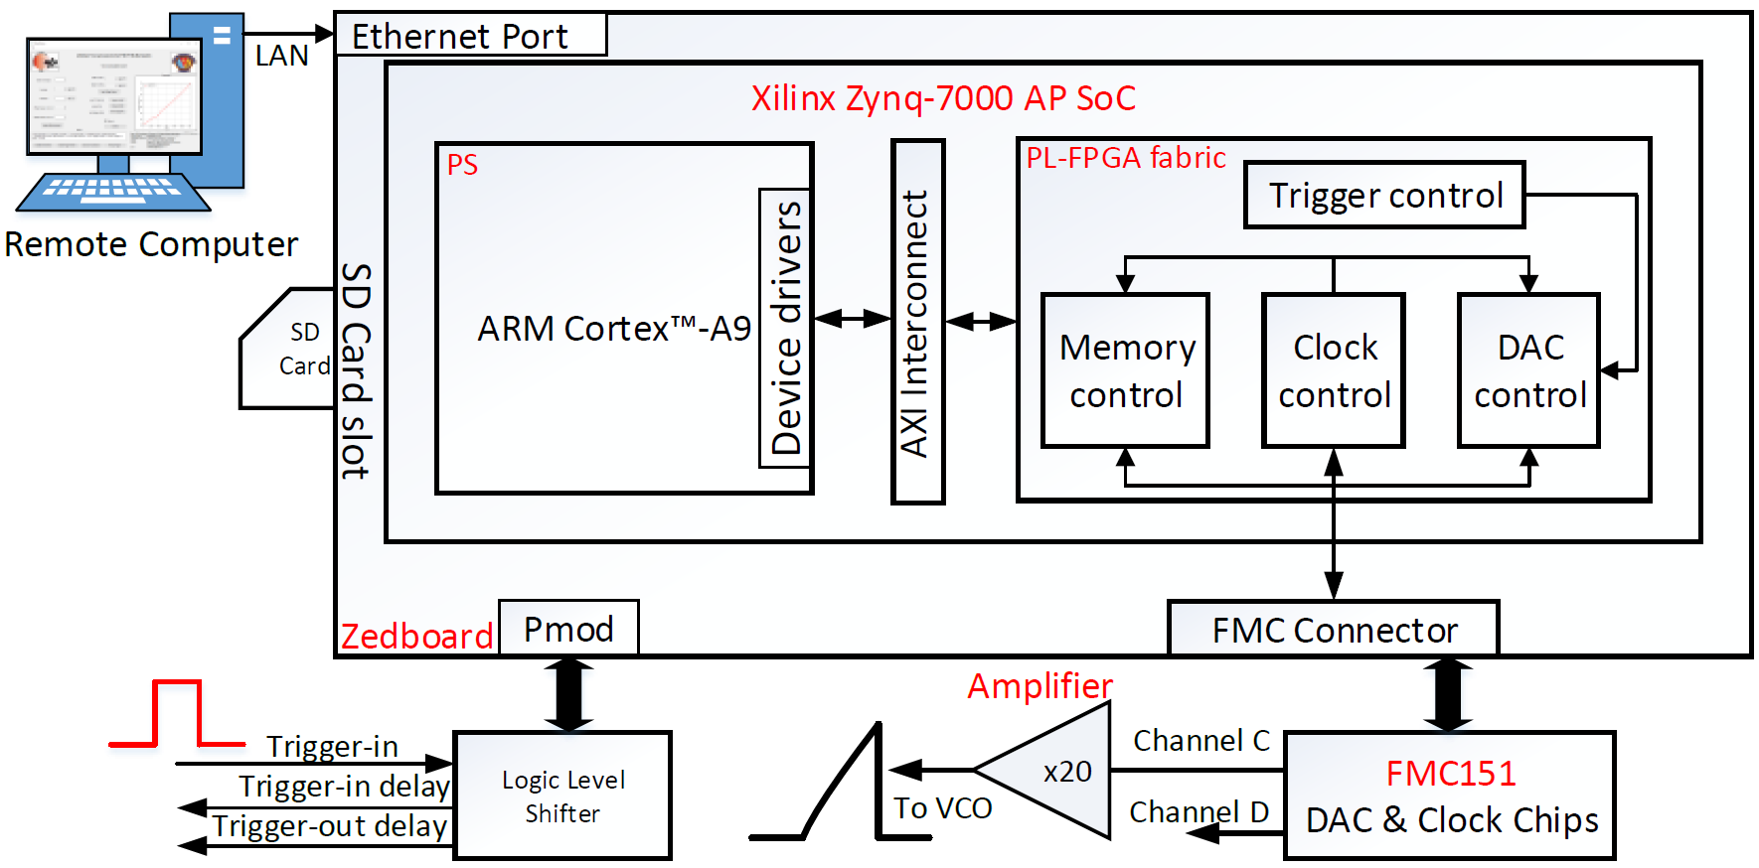
System Architecture
Hardware-Software Architecture

Slide 7
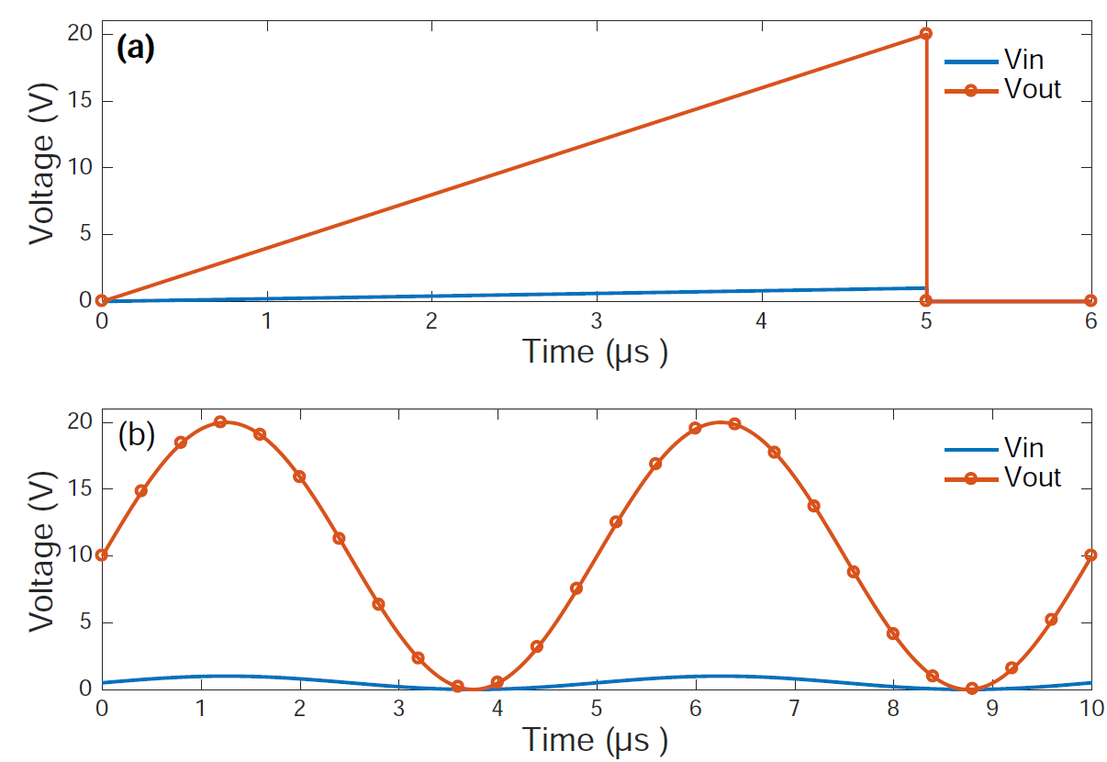
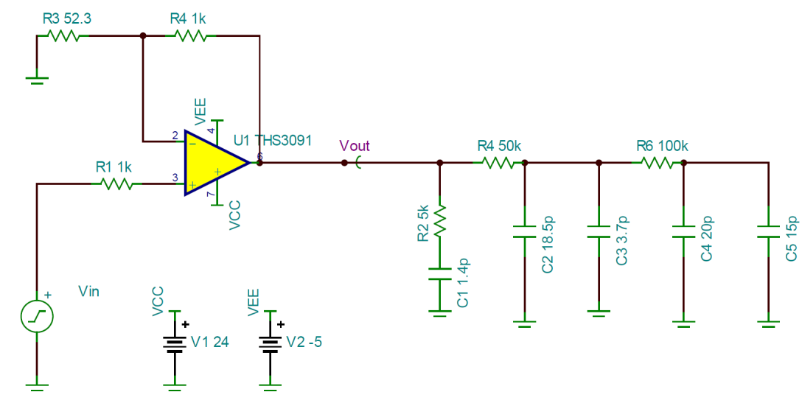
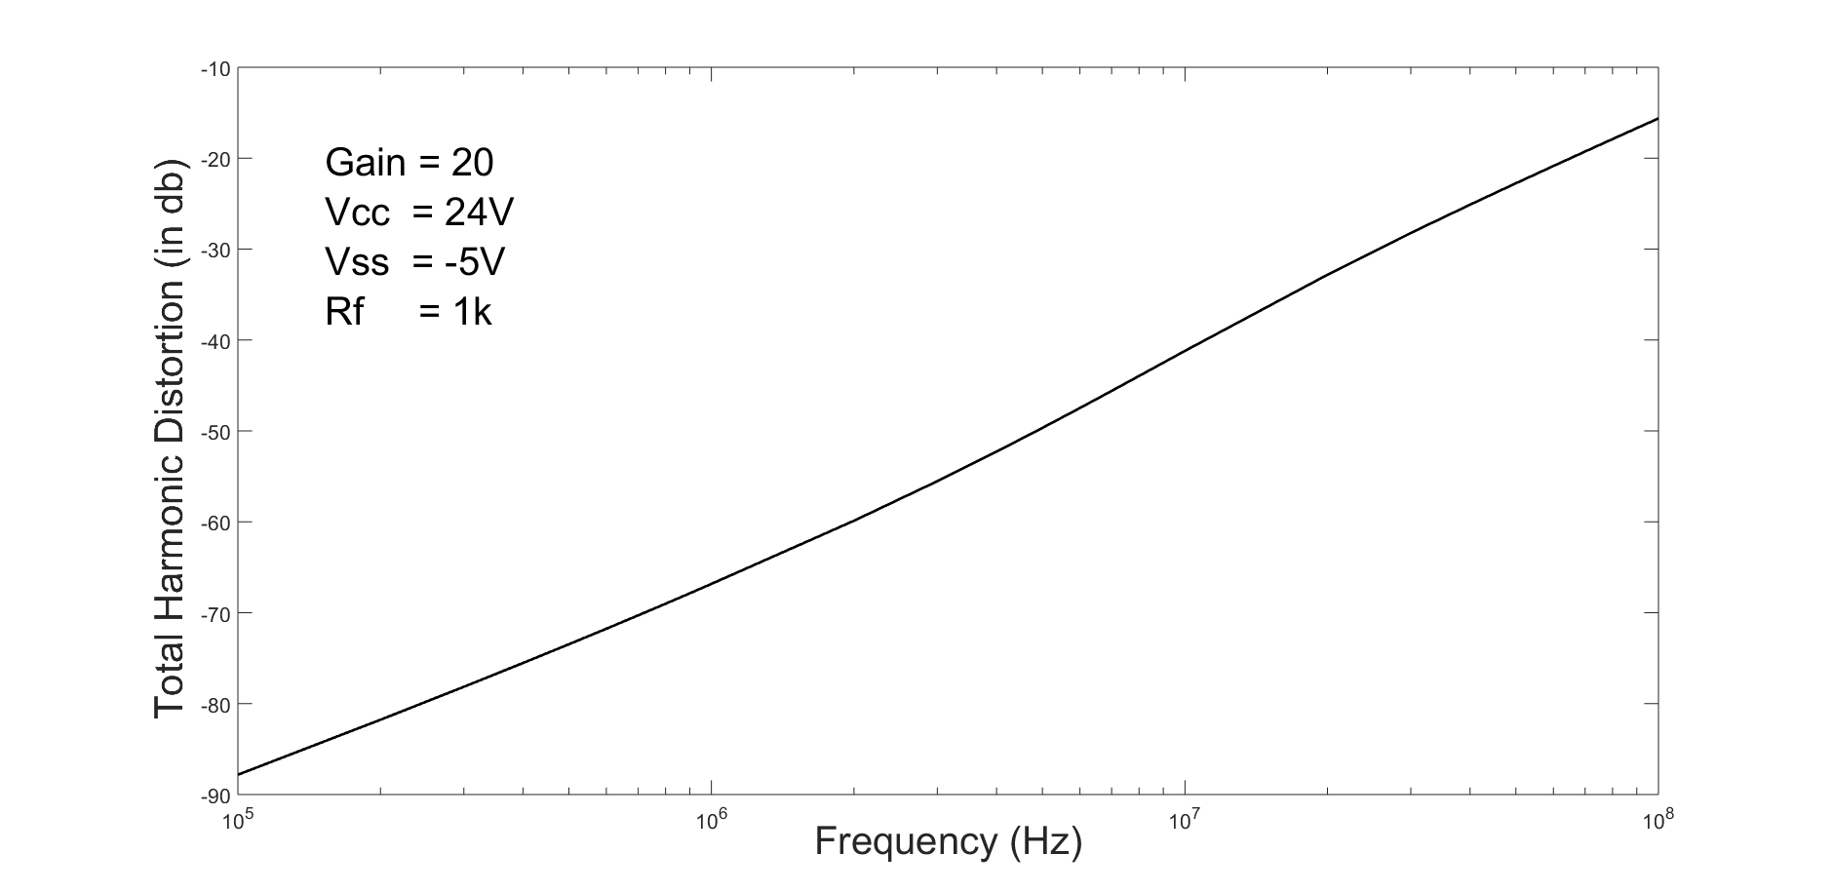
Amplifier Circuit
High-speed op-amp driver for VCO
Simulation results of amplifier
THD versus frequency

Slide 8
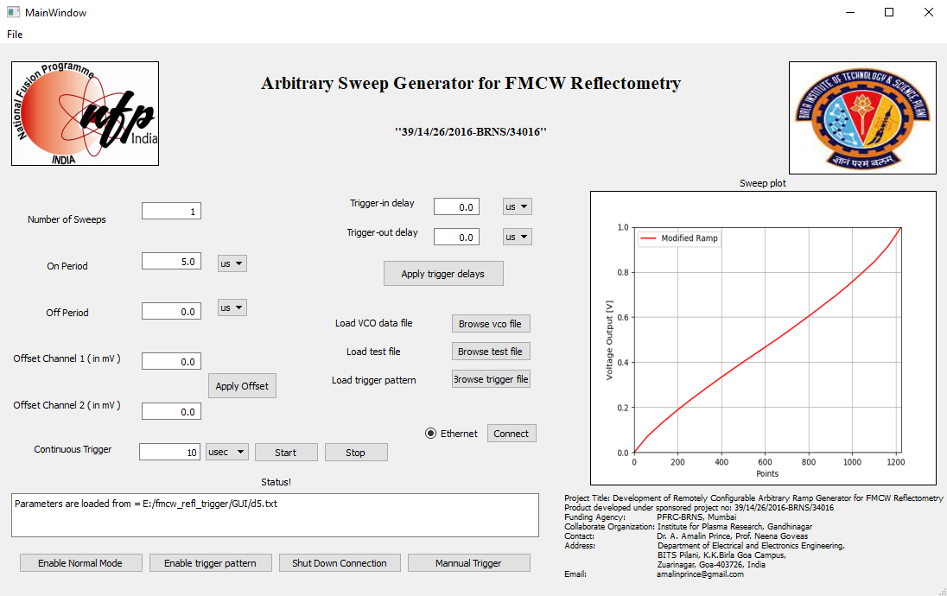
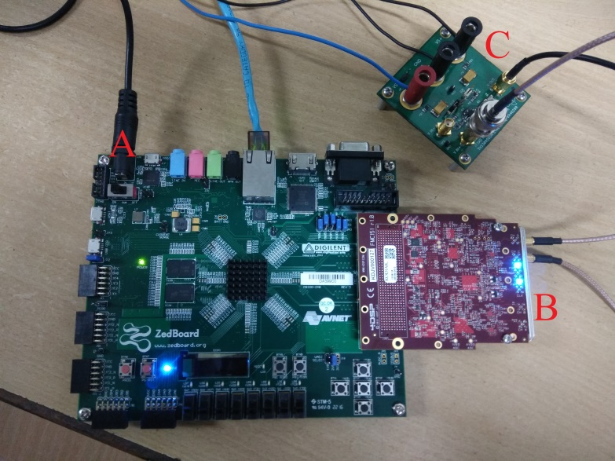
Integration
Components used
Graphical user interface
2U rack standard chassis

Slide 9
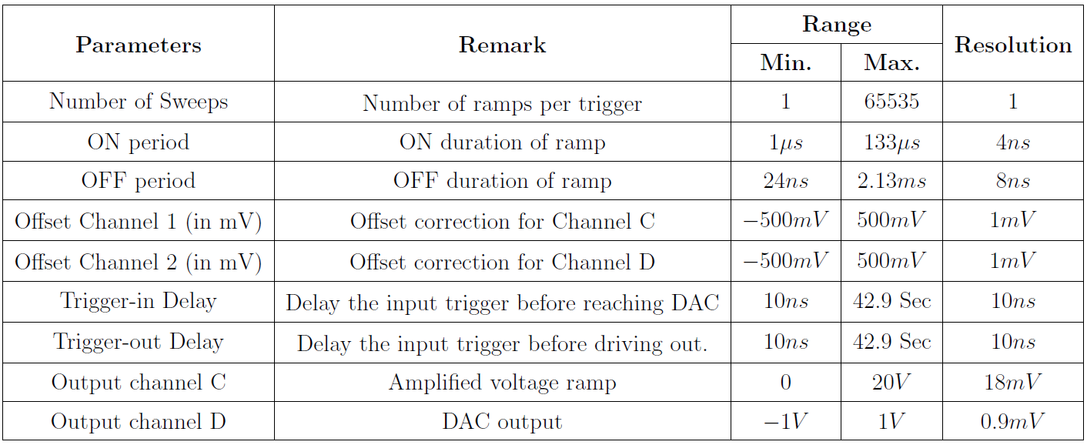
Specifications
Ramp specifications
Trigger specifications

Slide 10
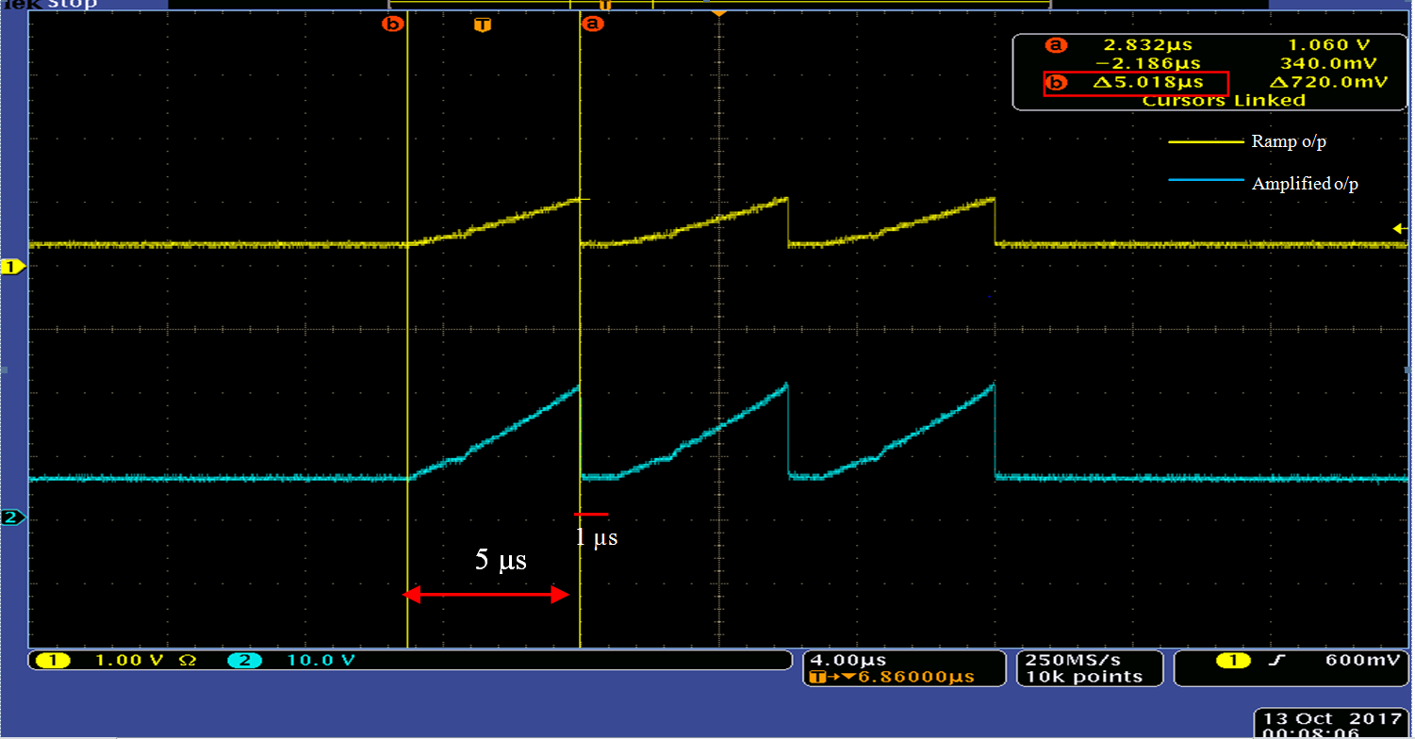
Sample Output: Normal Mode

Slide 11
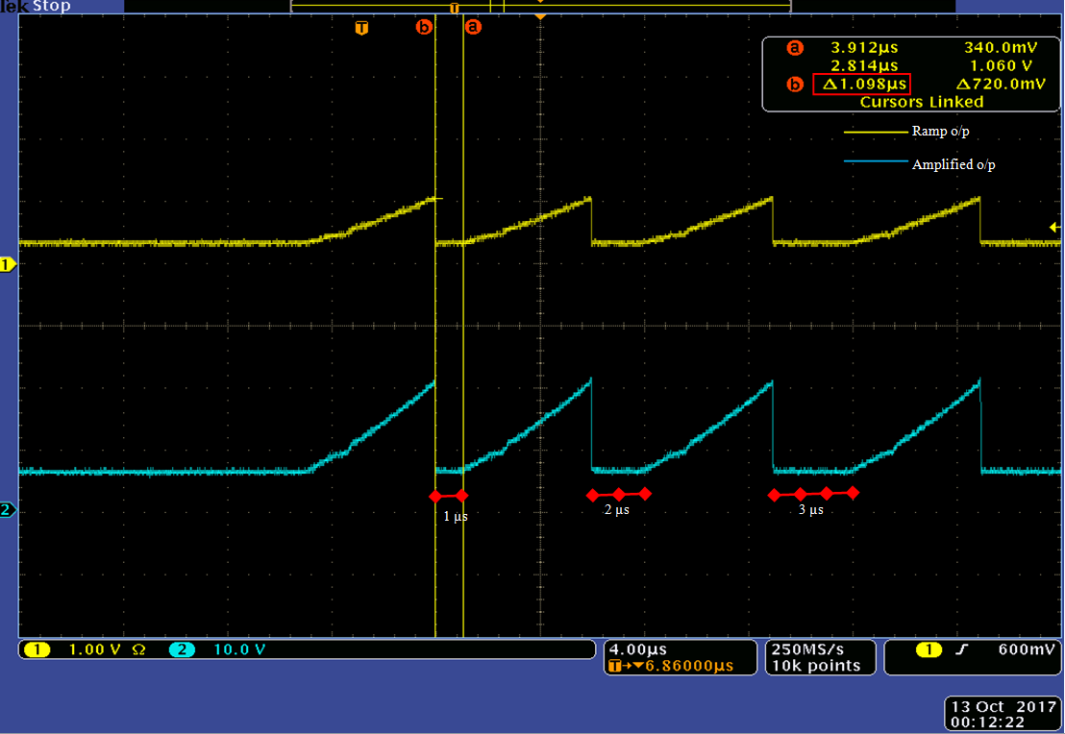
Sample Output: Pattern Mode

Slide 12
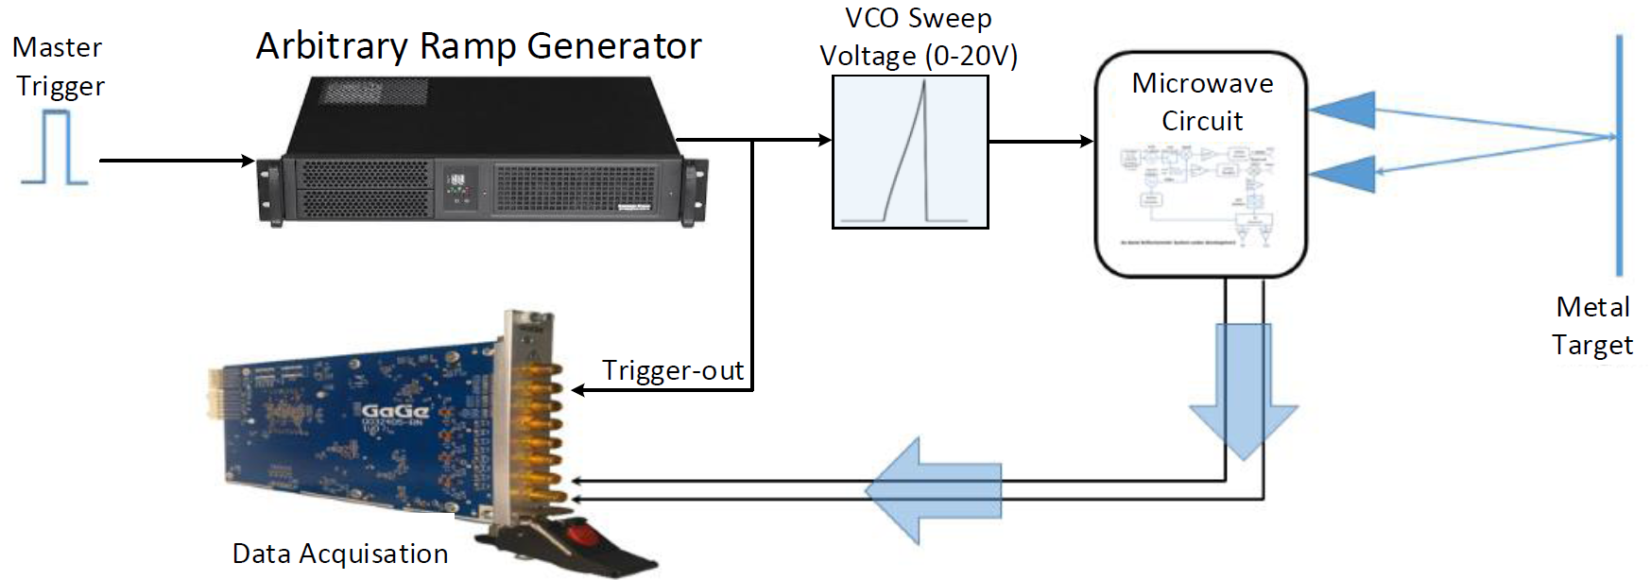
Characteristics of Tuning Voltage Setup
Tuning Voltage Setup
Experimental setup

Slide 13
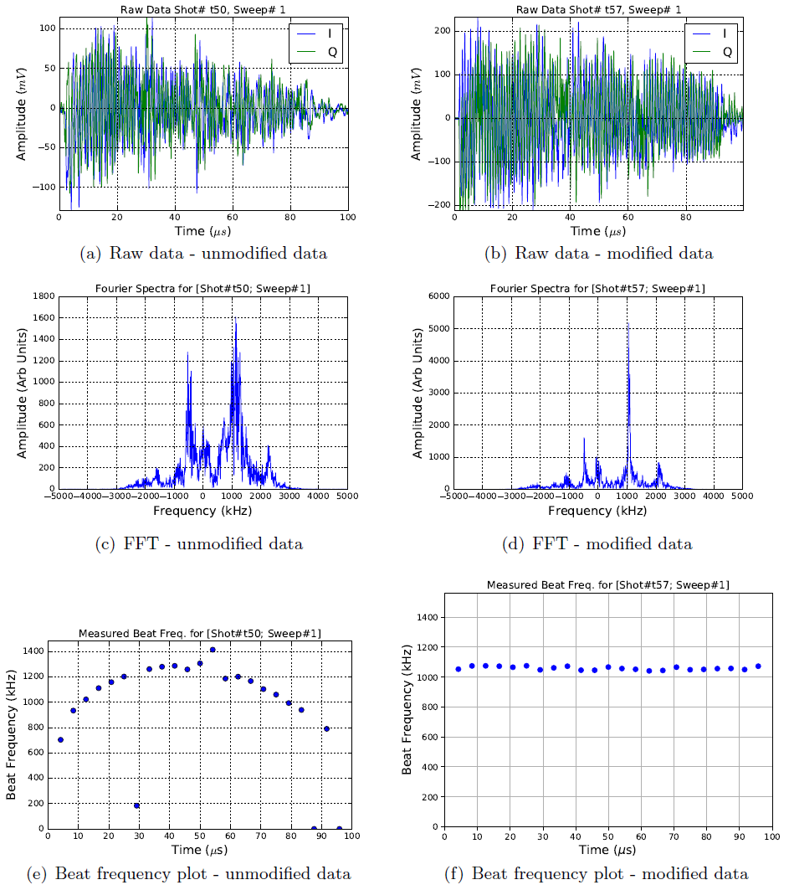
Characteristics of Tuning Voltage Setup
Modified:
~30 kHz
Reduction by 40 times
Unmodified:
200 kHz to 1400 kHz

Slide 14
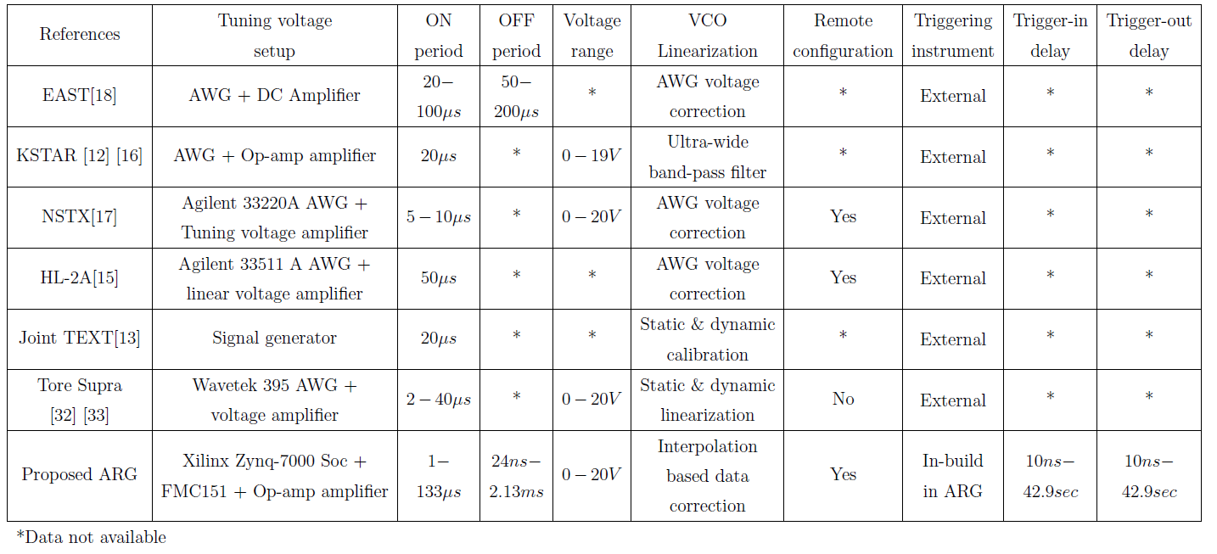
Comparison
Our Setup
ARG

Slide 15
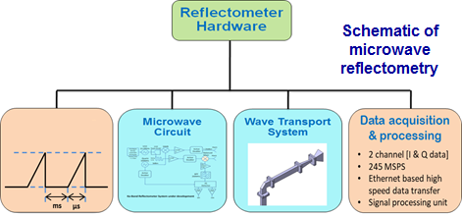
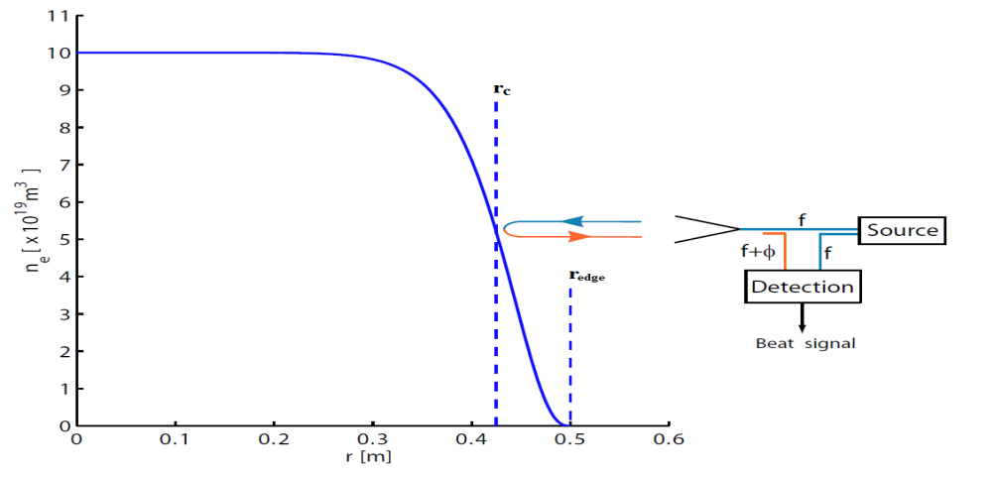
Ongoing Work: Automated Digital Signal Processing
Schematic of FMCW Reflectometry
Principle of Operation
Tuning Voltage Setup

Slide 16
Acknowledgement
Publications:
Gibin C. G., Bittu N, JJU Buch, Prince A.A.*, Neena G., and Surya P, (2019) ‘Characteristics of Arbitrary Ramp Generator: A tuning voltage setup for the FMCW Reflectometer’, IEEE Transactions on Instrumentation and Measurement, DOI: 10.1109/TIM.2019.2939933 [early access].
Gibin C. G., Abhishek M., Sriyash C., Prince A.A. *, JJU Buch, and Surya P, (2019) ‘A Novel and efficient hardware accelerator architecture for signal normalization’, Circuits, Systems & Signal Processing, DOI: https://doi.org/10.1007/s00034-019-01262-3 [early access].
Gibin C.G., JJU Buch, Prince A.A. * and Pathak S., (2019) ‘Design of configurable multi-mode trigger unit’, Elsevier Measurement, vol. 139, pp. 482-489.
Collaborators:
Dr. Surya Pathak and Mr. JJU Buch, Microwave and ECE Diagnostics Division, Institute for Plasma Research, Gandhinagar.
Funding:
BRFST and BRNS through National Fusion Program (NFP)

