Slide 1
Overview of Data Acquisition and Central Control System of Steady state Superconducting Tokamak (SST-1)
S. Pradhan*, K. Mahajan, H. K. Gulati, M. Sharma, A. Kumar, K. Patel, H. Masand, I. Mansuri, J. Dhongde, M. Bhandarkar and H. Chudasama
Institute for Plasma Research, Gandhinagar, Gujarat, INDIA
*pradhan@ipr.res.in
10th IAEA Technical Meeting on Control, Data Acquisition and Remote Participation for Fusion Research 20-24 April 2015 at IPR India

Slide 2
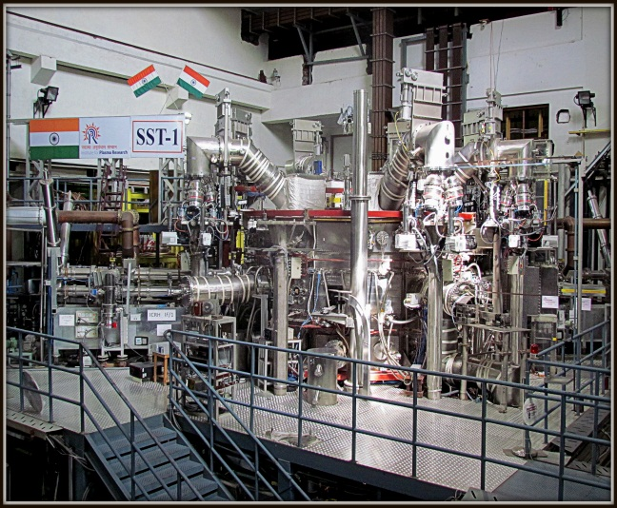
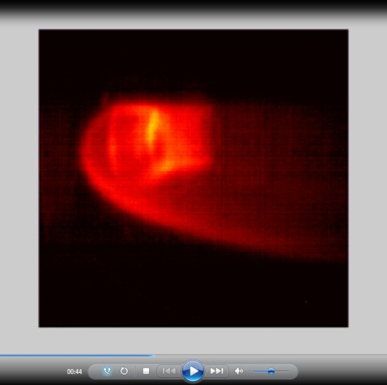
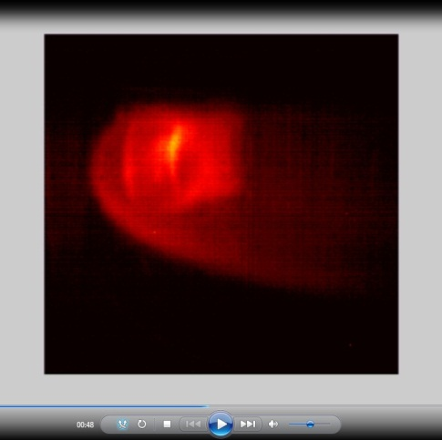
Steady State Superconducting Tokamak (SST-1)

Slide 3
Introduction
SST-1 Data Acquisition (DAQ) and Central Control System (CCS) Features:
Lossless, Continuous Acquisition
10KSPS to 1MSPS Sampling Frequency
Distributed & Hierarchal
Event Driven
Controls & Monitors Remotely
Supports Heterogeneous Sub-systems
CCS consists of
Network Infrastructure
Control Room Infrastructure
Machine and Experiment Control
Plasma Control and Timing System,
GPS based Time Synchronization
Storage Area Network
Audio/Video Systems
DAQ consists of
Slow Data Acquisition Systems
Fast Data Acquisition
CAMAC based Systems
PXI based Systems
MATLAB based Data Analysis Utilities
023/P, 0268)
025/P, 026/P, 027/P,030/P, 049/P, 050/P, 062/P,069/P)

Slide 4
Central Control System (CCS) Configuration
100Mbps Conventional
Time Synchronization
Real-time Deterministic Data transfer
Clock Synchronization

Slide 5
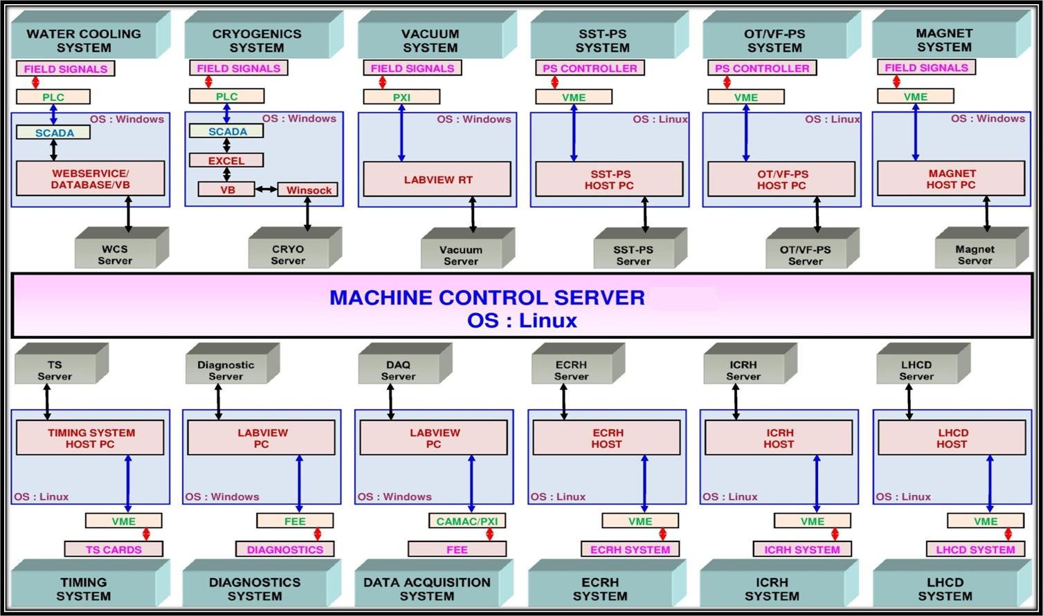
Interfacing of SST-1 various Sub-Systems with MCS

Slide 6
Plasma Control System Configuration
VME Bus
ADC
ADC
ADC
Timing Sys
APC I/F
PCI Bus
VME SBC
RFM
DSP
Clock
FPDP Bus
To APC Power supply
Ethernet
Realtime Data Network
Timing System Network
ADC : Pentek 6802, 96 (32*3) channels, 24bit, sampling 10KSPS
DSP : TSC-43, Quad Tiger-shark TS101 DSP on a PMC board having FPDP interface
RFM : VMIC 5579, Memory of 64MB, sustained link speed of 13.4 Mbytes/s
Timing system
VME Processor: SBS VG4, Processor PPC 750, 400Mhz with VxWorks 5.5 as RTOS

Slide 7
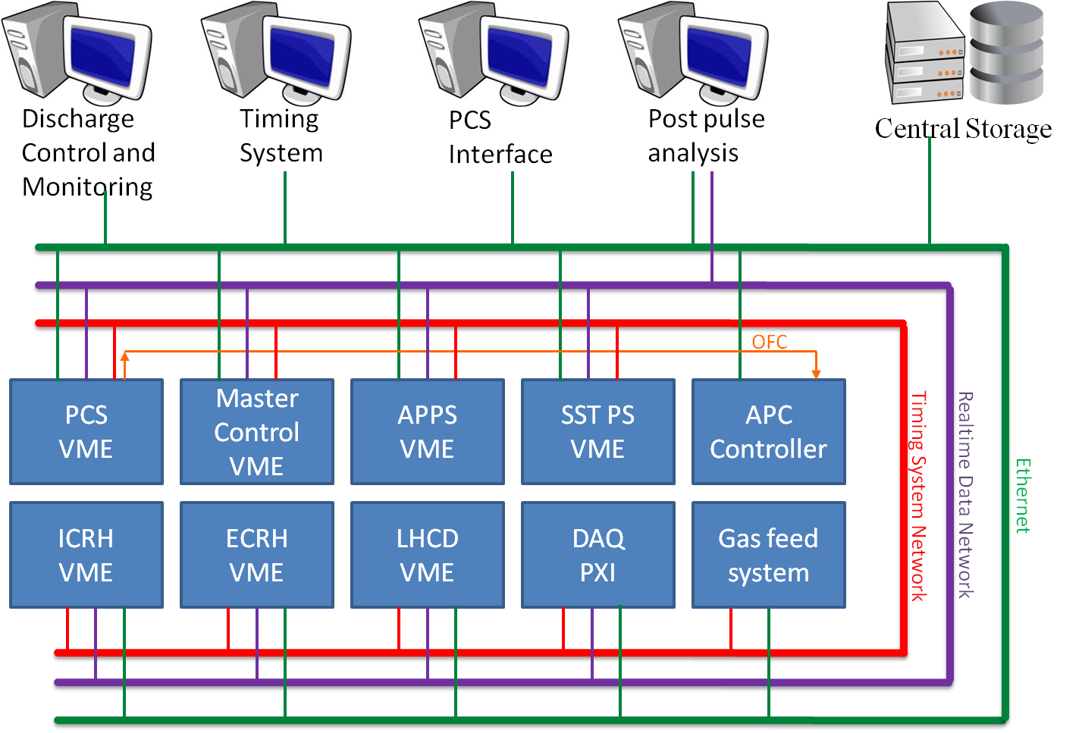
Existing Overall PCS connectivity

Slide 8
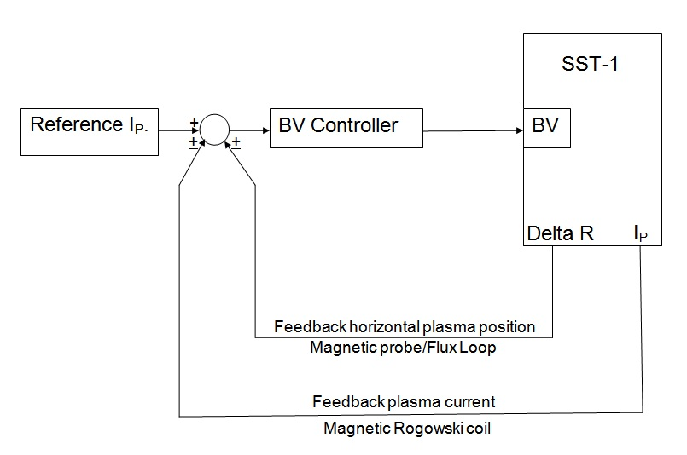
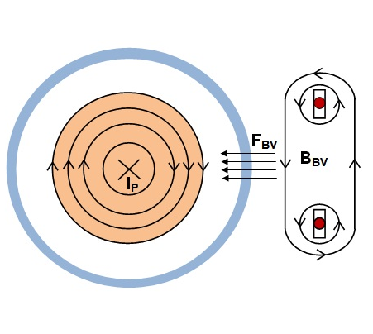
Horizontal Plasma Position Control Loop
I_{BV}
Schematic way for Vertical Field(B_{BV} ) generated & resulting force (F_{BV})
Schematic of B_{V} Feedback Loop
Feedback loop uses – I_{P} , Delta R as feedback signal and manipulated variable as I_{BV}
Discharge starts with Feed Forward Loop
Active Feedback starts after discharge by few ms i.e. once Plasma column is completely formed
Loop time ~ 2.0ms

Slide 9
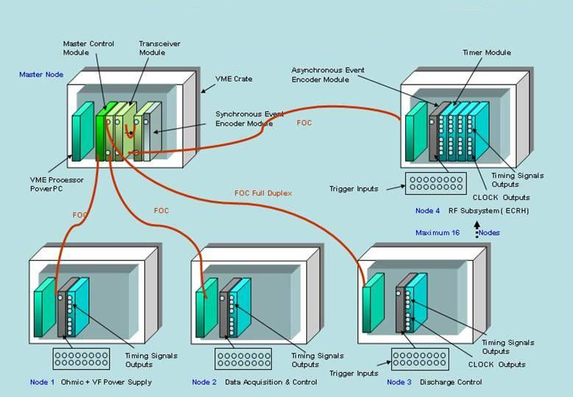
SST-1 Timing System

Slide 10
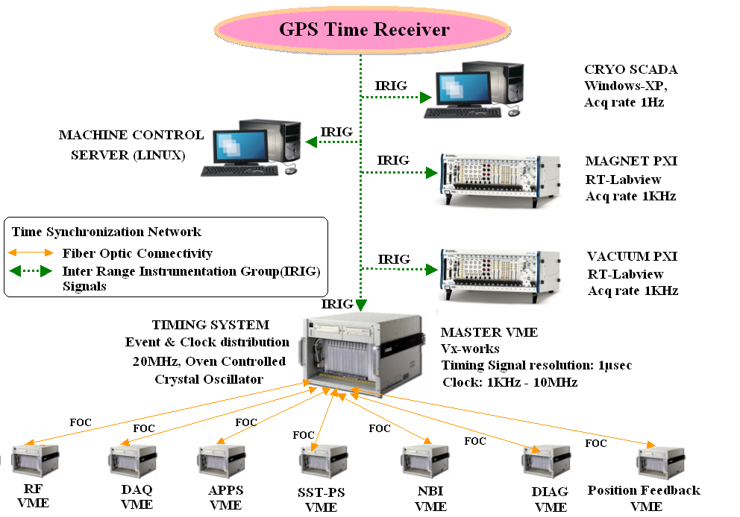
GPS Based Time Synchronization System

Slide 11
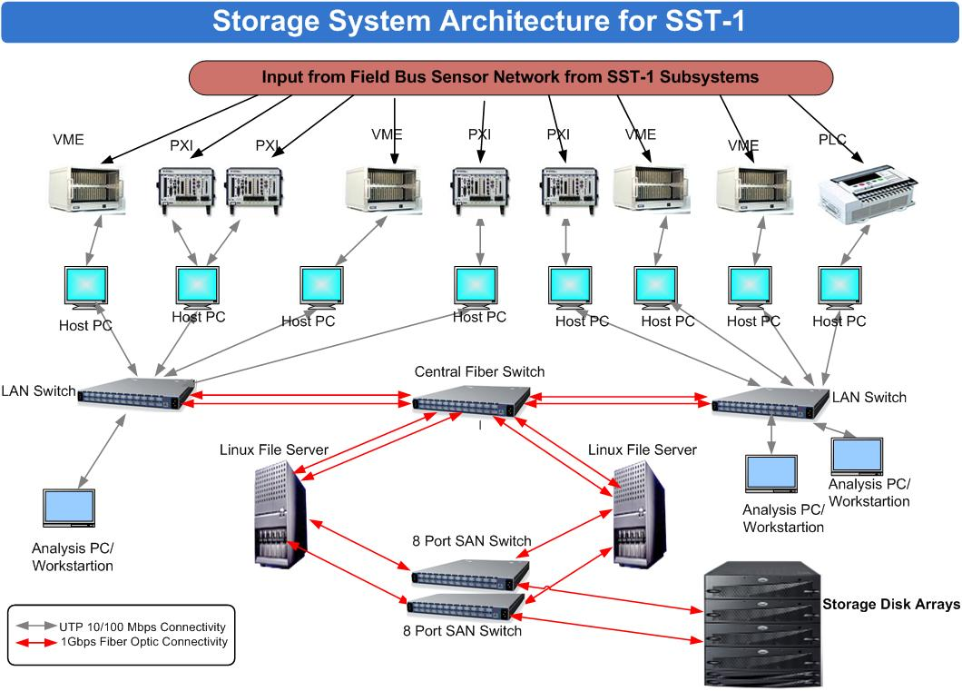
SAN Based Centralized Storage System
10TB capacity

Slide 12
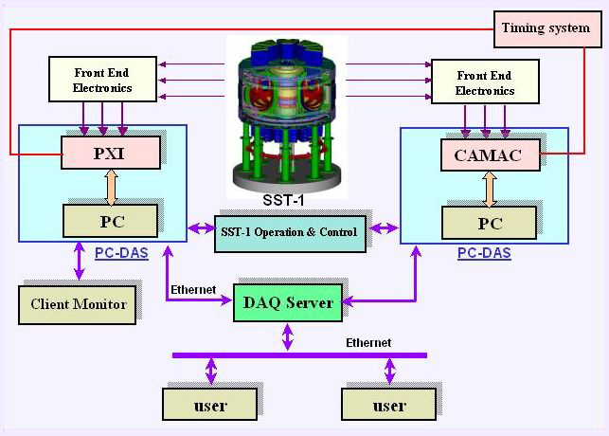
Overview of SST-1 Data Acquisition System
Major Tasks
Centralized Data Acquisition for SST-1 diagnostics
Centralized Data Storage Server for Archival And Retrieval.
Data Analysis at different Network nodes (Client/Server).
Communication interface with SST-1 Central Control System.
~ 150 slow (100 KSPS) , 20 Fast (MSPS) in PXI/CAMAC platform operating now

Slide 13
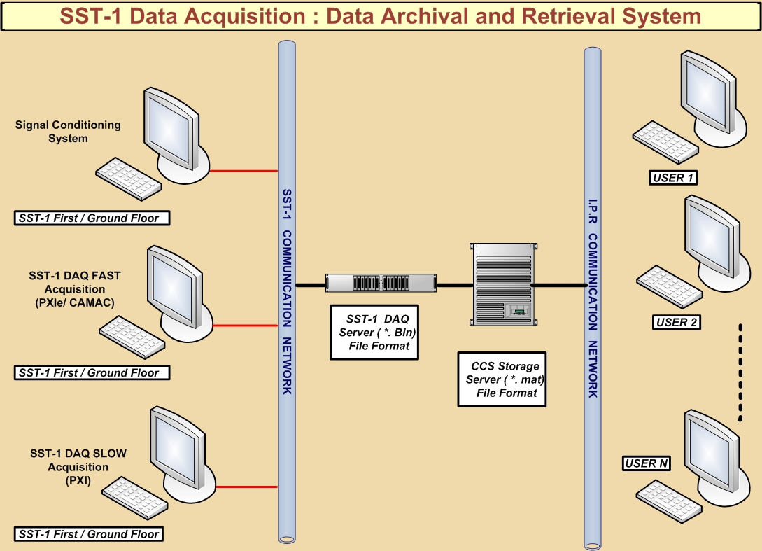
SST-1 Data Archival and Retrieval System

Slide 14
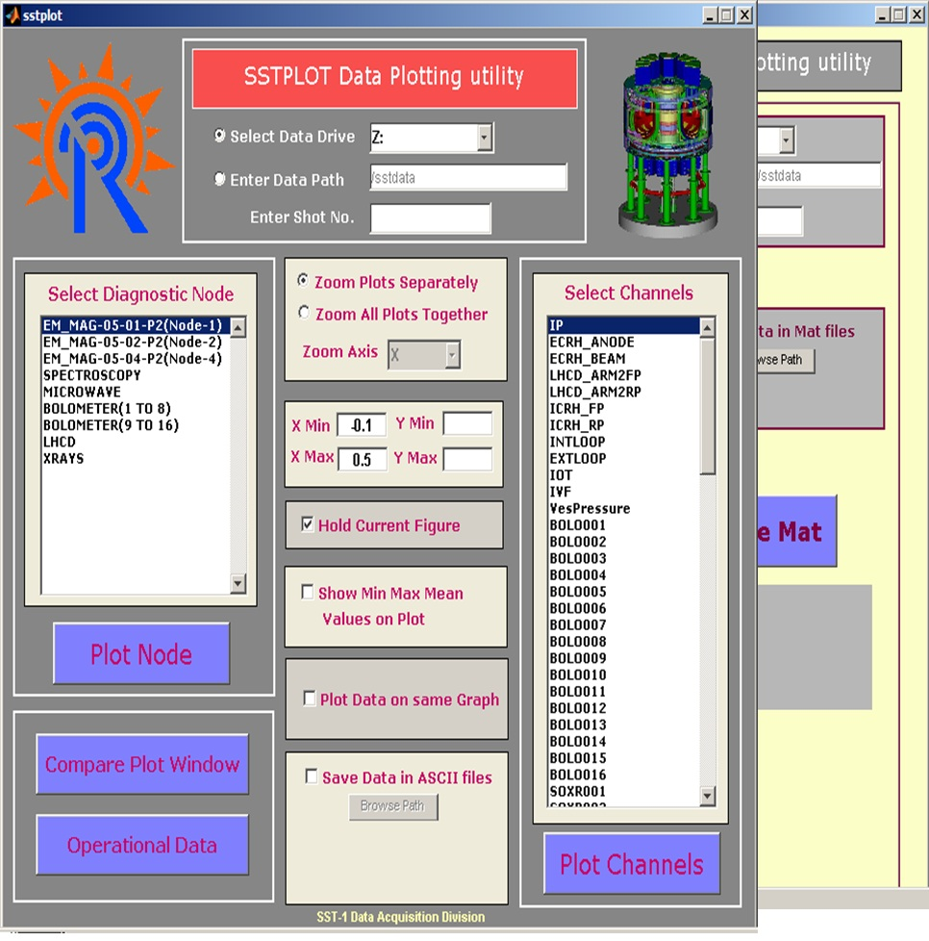
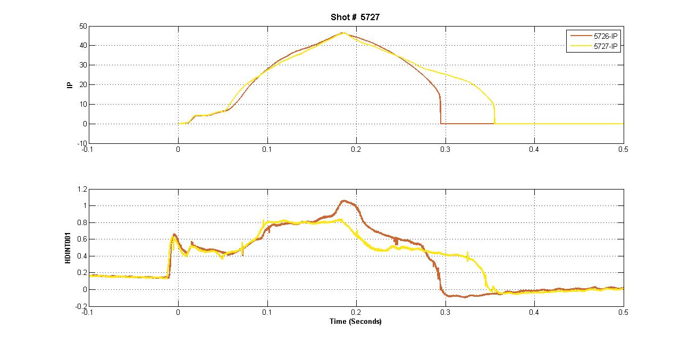
Matlab based Data Conversion & Plotting
Data Conversion Utility
Matlab GUI Based SSTPLOT Data Plotting with various features
Plotted Data Fig

Slide 15
Experimental Data Analysis Utility is developed in Matlab
&
Some results of recently carried out SST-1 Experiments

Slide 17
Comparison between Magnetic Probe, Flux loop & Analytical methods for Horizontal Shift Measurement - Shot No.6065

Slide 18
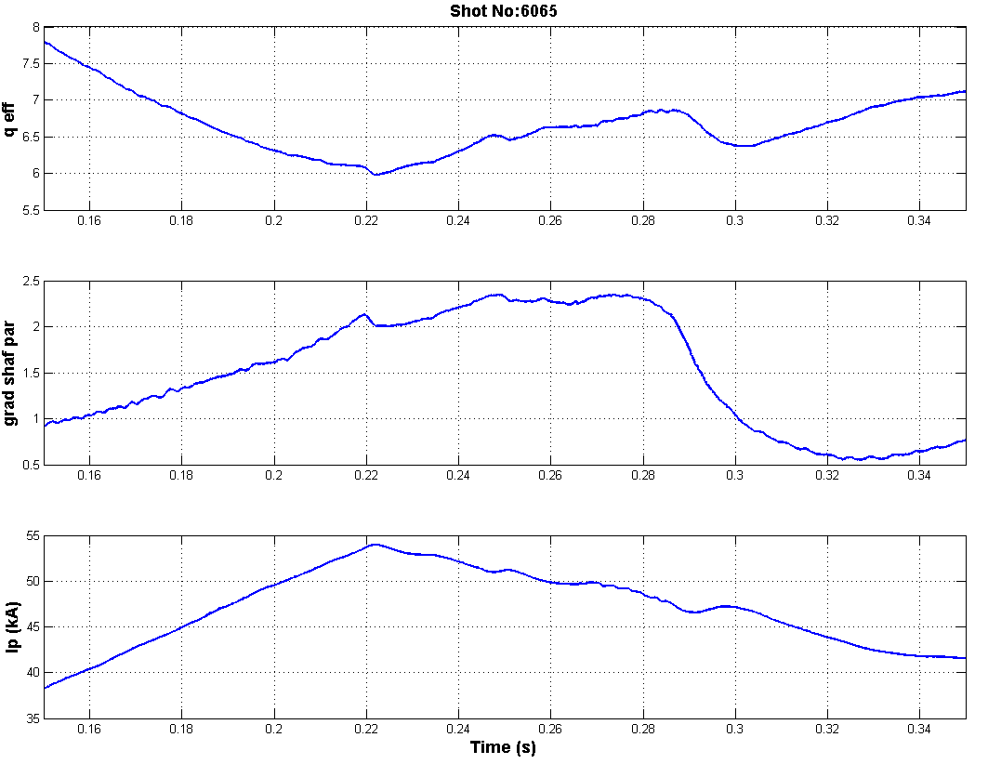
Effective edge safety factor and Grad- Shafranov parameter for shot No- 6065

Slide 19
Data Acquisition and Control System Upgrade plan

Slide 20
Planned 10Gbps Network Architecture for SST-1
NBI
(8 Node)
APPS
RF Lab
(4 Node)
(4 Node)
Utility Building
190 meter
300 meter
(8 Node)
300 meter
Central Control Room
RF Bay
Water Cooling
(8 Node)
(72 Node)
300 meter
(8 Node)
150 meter
150 meter
Cryo Hall
150 meter
(8 Node)
50 meter
80 meter
Diagnostic Hall
250 meter
(18 Node)
Computer Center
Office Corridor
(18 Node)
10G User
12 Core Single Mode Fiber
Core Switch
10G Access Switch
24 Core Single Mode Fiber
LIU
Patchcord
1G Access Switch
Stacking

Slide 21
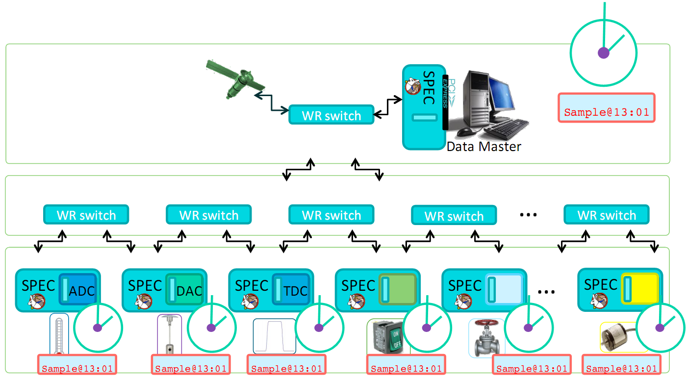
Evaluation of White Rabbit Technology using evaluation kit from Seven-solution Spain
Single solution for real-time Data transfer, Trigger and Time
Open source
Low Cost
Heterogeneous Platform support

Slide 22
SST-1 Diagnostics DAQ Hardware Upgradation Plan
Slow Channels : Sampling rate < 100-250 KSPS
Fast Channels : Sampling rate = 1MSPS or more
Sampling Rate | Current DAQ Card | Upgrade DAQ Module | Channels Catered/ Future Plan | Current Acquisition time | Future Acq. time
1 MSPS | CAMAC 2-Ch card | PXIe 6366 | 12 / 21 | 512 ms | 4 sec
10 MSPS | N.A. | PXI 6115 | 00 / 08 | N.A. | 4 sec
10 KSPS | PXI-6071 | No change | 36 / 84 | 3 sec | Continuous mode
100 KSPS | PXI-6143 | No Change | 58 / 189 | 3 sec | Continuous mode

Slide 23
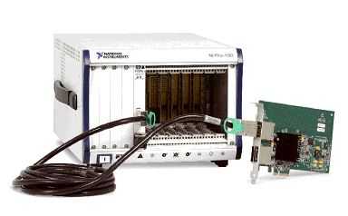
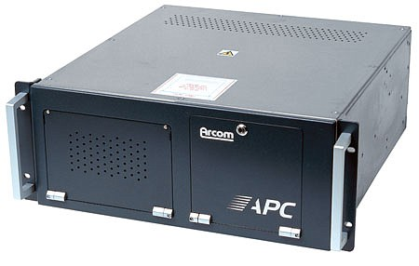
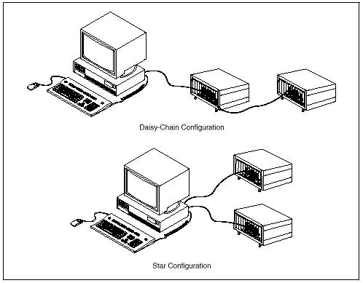
New Proposed Configuration for PCS Hardware
Use PC based controllers
Keep separate the controllers and IO chassis
PC and IO connect with PCIe bus link
Replace/upgrade PC whenever required
Industrial PC
MXI link
Multiple IO chassis configurations

Slide 24
Conclusion
Central Control System (CCS) is distributed, modular & scalable
Integrates all heterogeneous SST-1 subsystems
CCS is indigenously designed, developed, implemented, tested and validated for the operational since 2008.
CCS is built-on well proven technologies like
vxWorks RTOS for deterministic control,
VME, PXI, FPGA for hardware implementation,
Fiber optics for network backbone,
DSP for real-time computation &
Reflective memory for high-speed data transfer etc.
CCS architecture is being upgraded to fulfill the today’s requirements of SST-1 using cutting edge technologies

Slide 25
Please be welcome & find the details during the poster sessions
Sr No. | Abstract ID | Abstract Title | Author
1 | 028/P | SST-1 CAMAC based Data Acquisition System for fast plasma diagnostics and future up gradation plan | Imran Mansuri
2 | 023/P | Overview of Data Acquisition System for SST-1 Diagnostics | Manika Sharma
3 | 069/P | Overview of Time Synchronization System of Steady State Superconducting Tokamak SST-1 | Aveg Kumar
4 | 050/P | Archiving and retrieval of experimental data using SAN based centralized storage system for SST-1 | Manisha Bhandarkar
5 | 049/P | Design, architecture and operational experience of Machine Control System [MCS] for SST-1 | Harish Masand
6 | 030/P | Current status and upgrade plan for Networking System of Steady State Super conducting Tokamak SST-1 | Hitesh Gulati
7 | 027/P | SST--1 Central Control Infrastructure: An Overview | Jasraj Dhongde
8 | 025/P | Present Status and Future Plan for SST-1 Real Time Network | Kirti Mahajan
9 | 026/P | Audio Visual system for SST-1 operations | Hitesh Chudasama
10 | 062/P | Design and Architecture of SST-1 basic plasma control system | Kirit Patel
11 | 031/O | Overview of data acquisition and central control system of steady state superconducting tokamak (SST-1) | Subrata Pradhan

Slide 26
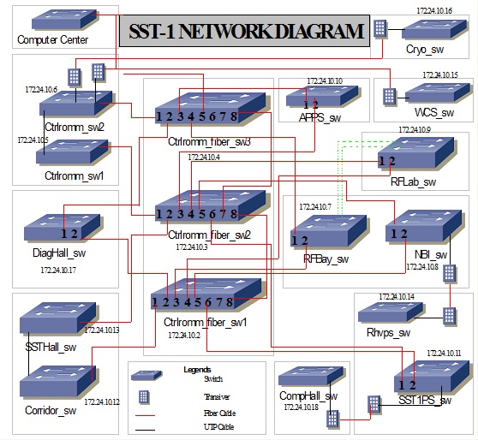
SST-1 Existing Network (Schematic)

