Slide 1

Enhancement of EAST plasma control capabilities
10th IAEA Technical Meeting on “Control, Data Acquisition, and Remote Participation for Fusion Research”
20 - 24 April 2015, Ahmedabad, India
Bingjia Xiao^{1,2}, Qiping Yuan¹, Zhengping Luo¹, Yao Huang¹, Lei Liu¹,
Yong Guo¹, Xiaofang Pei¹, Shuliang Chen¹, D.A. Humphreys³, A.W. Hyatt³, Dennis Mueller⁴, G. Calabró⁵, F. Crisanti⁵, R. Albanese⁶, R. Ambrosino⁶
¹ Institute of Plasma Physics, Chinese Academy of Sciences, Hefei, China
² School of Nuclear Science and Technology University of Science and Technology of China, Hefei, China
³ General Atomics, P.O. Box 85608, San Diego, CA 92186-5608, United States
⁴ Princeton Plasma Physics Laboratory, Princeton, NJ, United States
⁵ ENEA Unità Tecnica Fusione, C.R. Frascati, Via E. Fermi 45, 00044 Frascati, Roma Italy
⁶ CREATE, Università di Napoli Federicao II, Università di Cassino and Università di Napoli Parthenope, Via Claudio 19, 80125 Napoli, Italy

Slide 2
OUTLINE
PEFIT/ISOFLUX plasma shape control
Quasi-snowflake plasma shape
Upgraded vertical control
Summary

Slide 3
OUTLINE
PEFIT/ISOFLUX plasma shape control
  Also see, Yao Huang, “parallel Plasma Equilibrium Reconstruction Based on GPU in EAST and DIII-D”, Thursday noon
Quasi-snowflake plasma shape
Upgraded vertical control
Summary

Slide 4
Real-time PEFIT Flowchart
CPU
GPU
PEFIT: 65*65 grid, 1 iteration 300us
RTEFIT: 33*33 grid, fast loop 250us
slow loop 2ms
4

Slide 5
Real-time PEFIT comparison with RTEFIT
error on control points:PEFIT(Red) & RTEFIT (Black)
5

Slide 6
ISOFLUX/PEFIT shape control
Shot 51044:
6

Slide 7
OUTLINE
PEFIT/ISOFLUX plasma shape control
Quasi-snowflake plasma shape
  SNF, second order of null for the flux derivative at X point, potential for divertor heat reduction to order of ½ - 1/10 in comparison to conventional divertor plasma
Upgraded vertical control
Summary

Slide 8
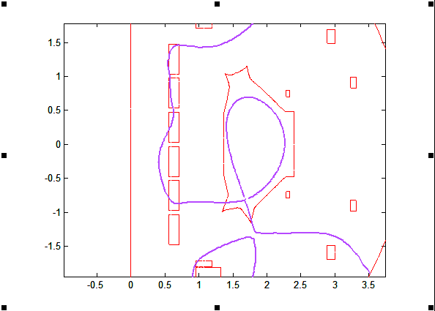
Designed EAST QSF
Ip = 250kA
PF currents:
PS | I [kA]
1 | -1.2759
2 | -10.0000
3 | -0.6449
4 | -5.3435
5 | -2.6879
6 | 6.9672
7 | -2.4746
8 | -2.1300
9 | 2.7822
10 | 3.7070
11 | -7.1329
12 | -10.0000
Designed Equilibrium for EAST 1st QSF Experiment
Betap ~ 0.4 l_{i}~1.2

Slide 9
QSF Exp. by RZIp control
1.6s
3.75s
1.6s
3.75s
limited
QSF
limited
QSF

Slide 10
QSF Exp. by RZIp control
QSF shape of Shot 47660 at 3.75s, 4.5s & 5.25 calculated by EFIT

Slide 11
QSF Exp. by RZIp control
Main magnetic geometry for QSF and SN
 | QSF #48971@4.5s | SN #47038@4.5s
SOL Volume [m³] | 0.389 | 0.260
Connection Length [m] | 189.91 | 144.38
Magnetic flux expansion at outer SP f_{m,out} | 8.22 | 2.01
Magnetic field angle at outer SP α_{out} [deg] | 0.33 | 1.22
Magnetic flux expansion at inner SP f_{m,in} | 4.71 | 2.34
Magnetic field angle at inner SP α_{in} [deg] | 0.90 | 1.29
Plasma boundary of #47038 (LSN, black) vs. #48971 (QSF, red) 在at 4.5s

Slide 12
EAST QSF Exp.
Spatio-temporal profiles of ion saturation current density j_{SAT} for SN (#47038) and QSF discharge (#48971). Once QSF configuration becomes stable, the peak of j_{SAT} is observed to drastically drop indicating a possible heat flux reduction
Time evolution of main plasma quantities for SN (#47038) and QSF (#48971)

Slide 13
Peak Head reduced by a factor of > 2.
Infrared camera measured (SNexp & QSFexp)and simulated power density (SN & QSF) at the lower outer target.

Slide 14
Isoflux/snf implemented on PCS and tested
Shot 52416 verified the control algorithm, but controllers (M and PID) not well adjusted due to limited experiment time and conditions

Slide 15
OUTLINE
PEFIT/ISOFLUX plasma shape control
Quasi-snowflake plasma shape
Upgraded vertical control
Summary

Slide 16
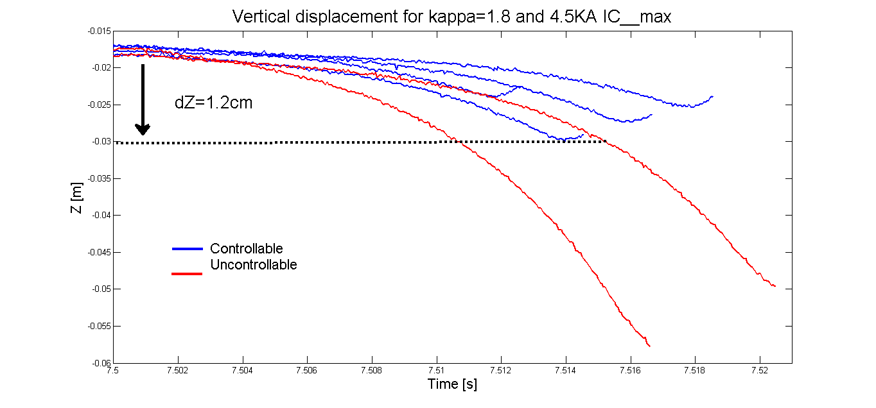
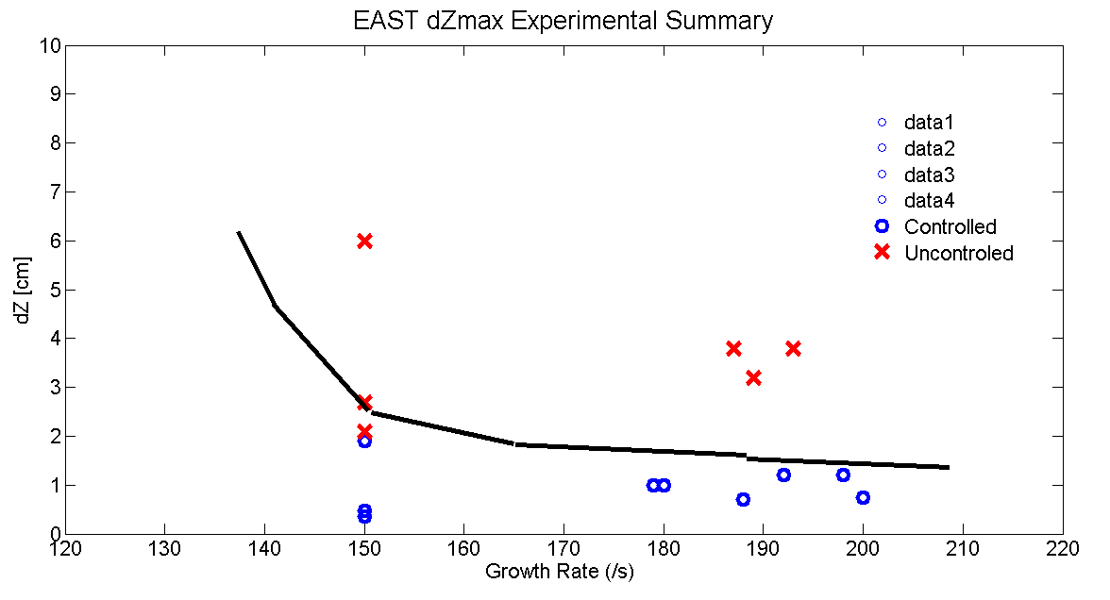
EAST Vertical Controllability (- 2012)
Release and Catch experiments:
  Control turned off to trigger unstable vertical displacement
  Control restored at varying times to determine maximum controllable displacement
In-vessel Cu coils used for vertical control:
  Shielding effect by passive plates is significant
  dZmax limited by PS current limit and power (300 V, 5 kA)
Dzmax : ~ 1.2 cm (Ip ~ 400 kA, k ~ 1.8, gamma~ 300/s)

Slide 17
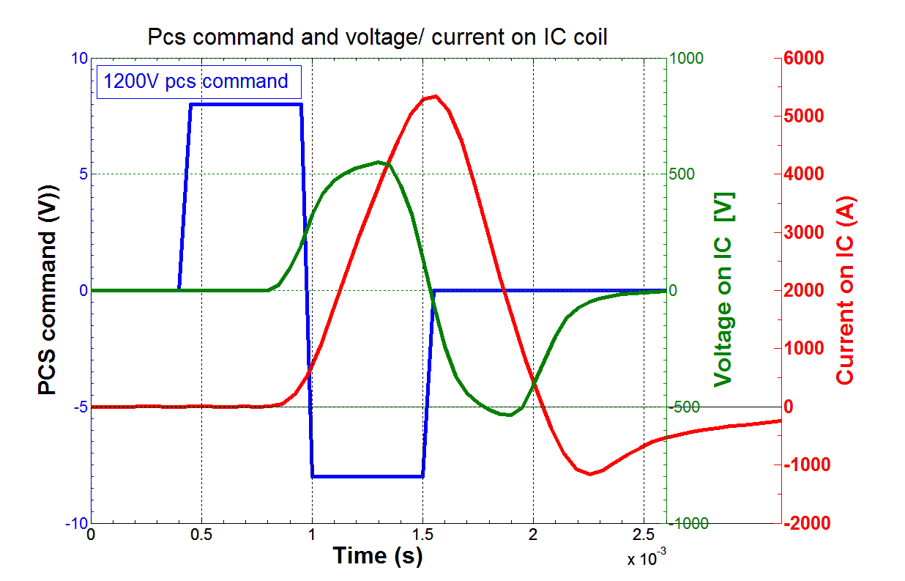
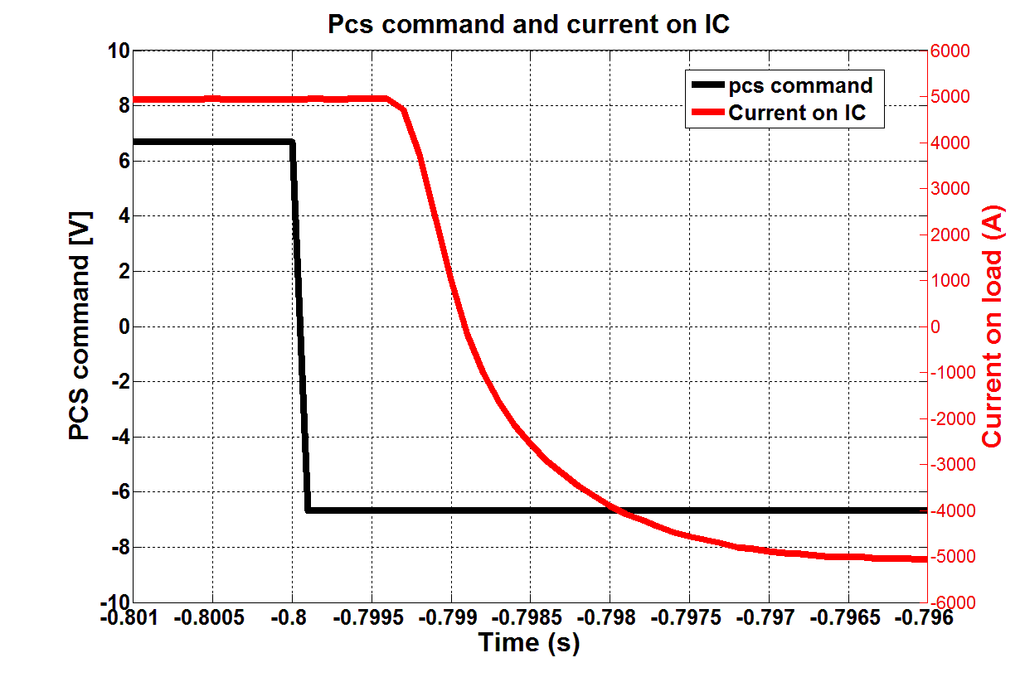
Upgrade IC Power Supply
Voltage mode：
1200V (1600) output，
Voltage on IC :~550V
communication delay: ~550us
current rising time:0A >+ 5.4KA ~600us
Current mode：
-6(10)KA->+6(10)KA command
-5.1KA~+5.1KA output
communication delay: ~600us
current rising time :-5.1KA->+5.1KA ~2ms
17

Slide 18
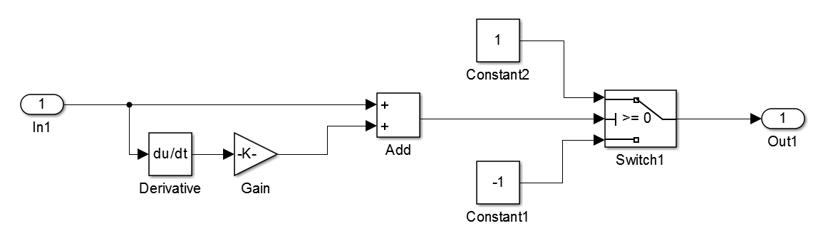
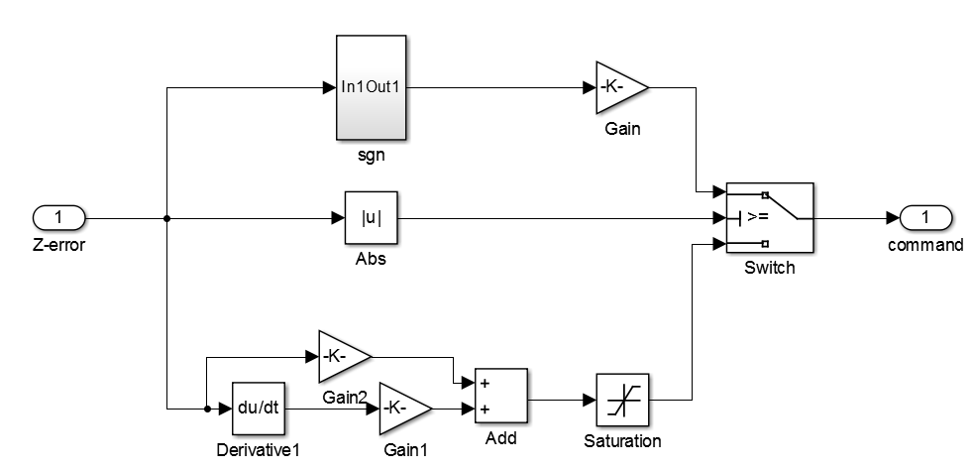
Bangbang + PID control (114 , by Wang)
Bangbang control for larger dz drift
PID control for smaller dz drfit
Details of BangBang control “sgn” block
18

Slide 19
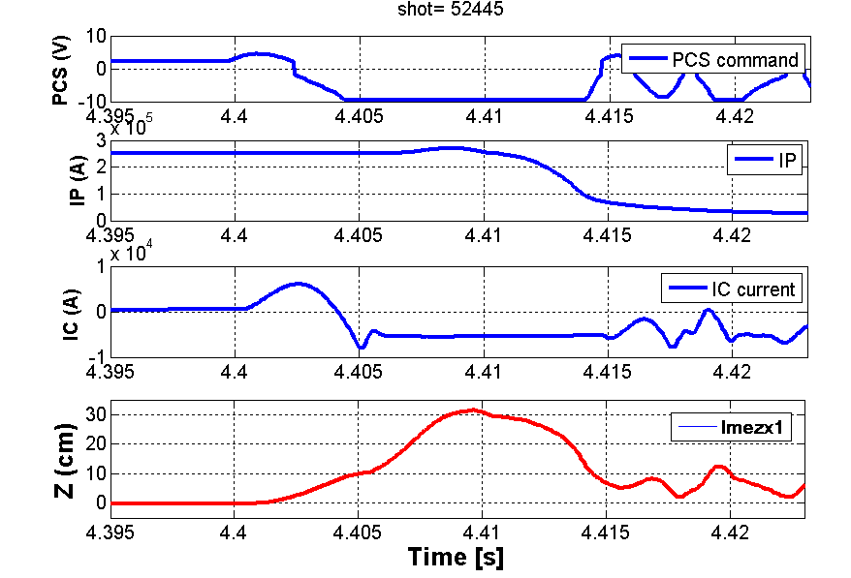
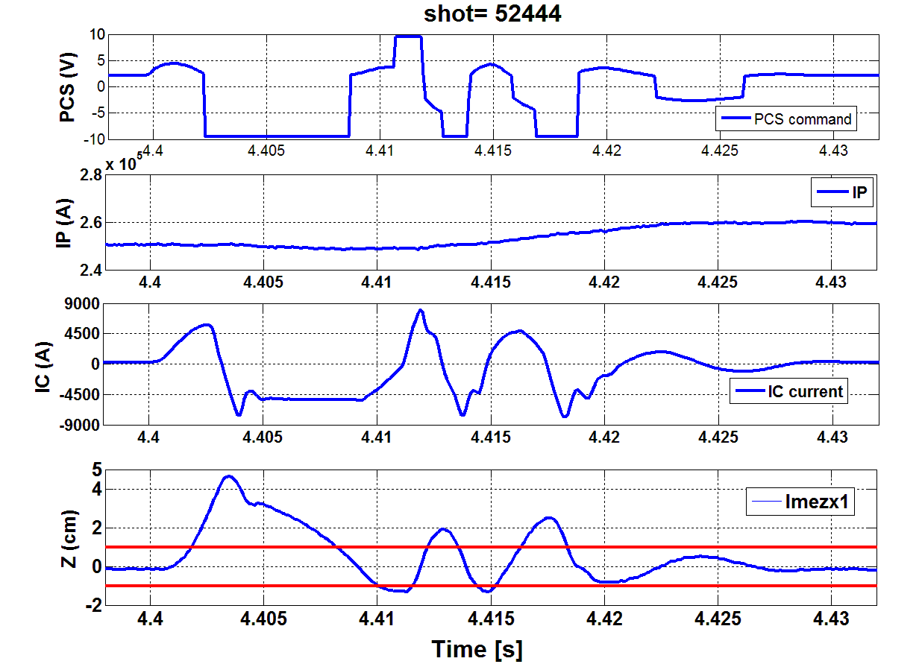
Result: Bangbang+PID vs. PID
Snowflake shape， disturbance by IC 500V/4ms at 4.4s to trigger VDE
Time ：4.4s , Ip：250KA， elongation : 1.72, li: 1.55 , ne: 1.0 ，VDE growth rate : ~530/s
Trigger
PID
Trigger
Bang
bang
Max IC current
4.6cm
Bangbang+PID voltage mode
PID voltage mode
The same discharge setup， 4.4s trigger VDE，lost z control
dz>=1cm，bangbang control, max ±voltage output
dz<1cm ，PID control: U=Gp*zerror+Gd*dZerror/dt
Bangbang and PID switch control works
dzmax ~ 4.6cm, vs. dzmax ~ 1.2cm in 2012 Exp. (PID, current mode)
19

Slide 20
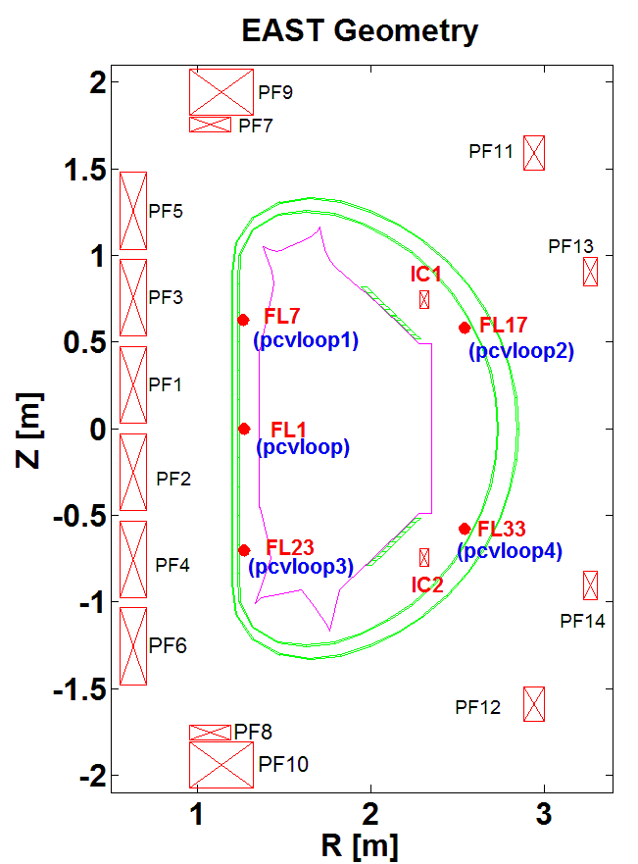
Differential Voltage Loops for dZ_{c}/dt
Voltage Loops (pcvloop) used for dZc/dt：
20

Slide 21
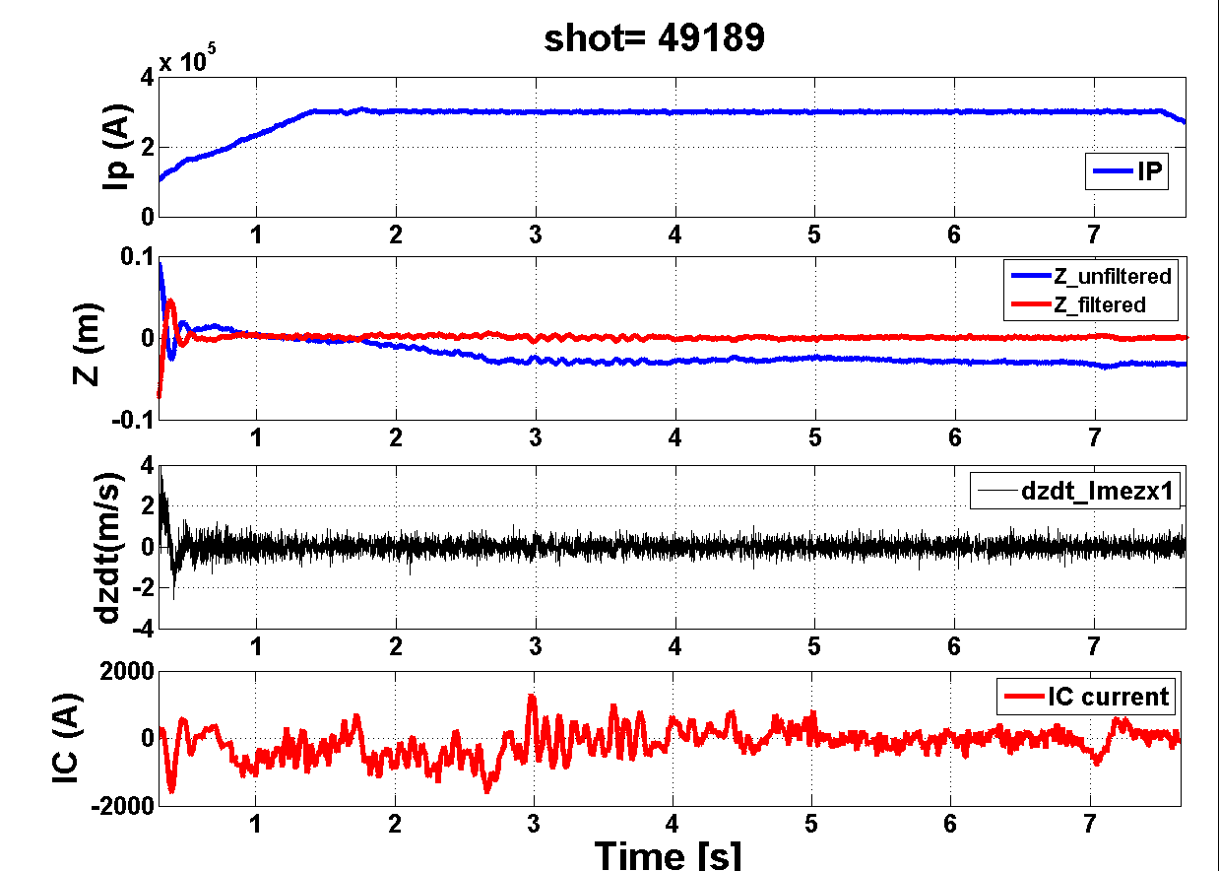
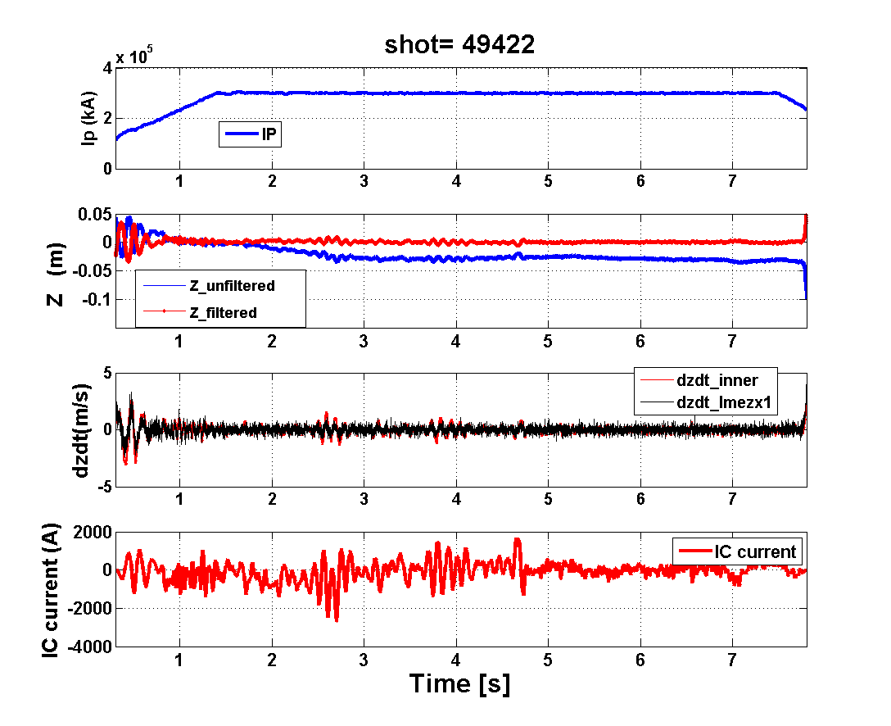
S/N improved for dZ_{c}/dt using DFLs
d(lmsz)/dt for dZc/dt
Loop voltage for dZc/dt
EAST uses a large number of Bp sensors to form the Z_{c} signal (lmsz signal) in routine exp.
Even a single pair of loop voltage signals has better signal-to-noise than differentiation of Z_{c}
It remains to quantify the improvement (or not) of vertical control in EAST
21

Slide 22
Summary
PEFIT has been verified its accuracy and real-time behavior to be used for real-time control. Routine operation is feasible and can be extended for more advanced control such profile, kinetic and advanced shape control… and finer grids for data analysis…
Quasi-snowflake shape has been demonstrated on EAST using an RZIP control algorithm, shape feedback has been implemented in PCS.
Vertical control has been improved using the new PS and new algorithms.
More plasma control activities
  RMP current, Beta, various gas puff, preliminary NTM control…

Slide 23
Thanks for your attention!
23

