Slide 1
The design of remote participation platform for EAST plasma control
Q.P. Yuan ¹, B.J. Xiao^{1, 2}, R.R. Zhang¹, W.T. Chai^{1, 2},
J. Liu^{1, 2}, R. Xiao ^{1, 2}, X.F. Pei^{1 , 2}
¹ Institute of Plasma Physics, Chinese Academy of Sciences, Hefei, China
² University of Science & Technology of China , Hefei, China

Slide 2
Outline
Motivation
conceptual design
Web based user interface
Gatekeeper system
Real time control service
Discharge scenario management
Summary

Slide 3
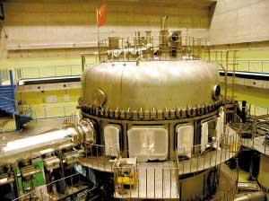
Motivation
PPPL, DIIID, MIT, LLNL, Univ. Texas
CEA（FRANCE）
ITER
W7-X, ASDEX
NIFS, JAEA, Univ. Tokyo
First fully superconducting tokamak
SWIP (Southwestern Institute of Physics)
USTC
Univ. Beijing
HUST (Huazhong University of Science and Technology)
Achievement：
>30s H-mode
>400s long pluse
2014, person days for international participation > 5,000

Slide 4
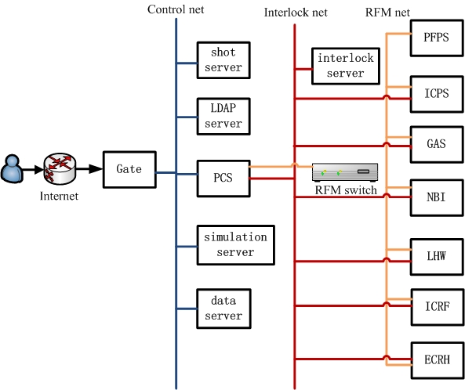
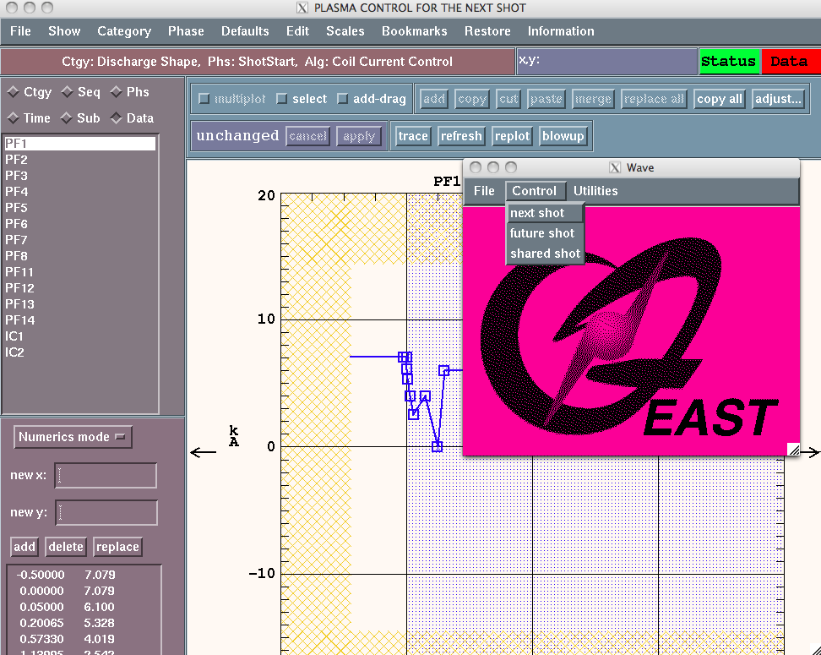
Motivation
login to PCS host through gate server
slow IDL interface refresh (>5 min for transnational access)
interface not adaptive

Slide 5
Outline
Motivation
conceptual design
Web based user interface
Gatekeeper system
Real time control service
Discharge scenario management
Summary

Slide 6
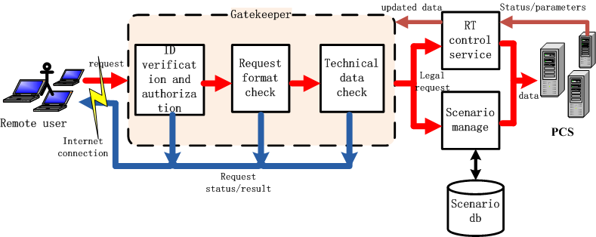
Design of remote participation platform
A web-based user interface: cross platform, no plug-in, user friendly
Safe operation : user’s ID verification, permission authorization, data check
Two functions: real time control service, scenario management

Slide 7
Outline
Motivation
conceptual design
Web based user interface
Gatekeeper system
Real time control service
Discharge scenario management
Summary

Slide 8
Web based user interface
Client: HTML/JavaScript/jQuery UI/Flot
Server:
PHP/MySQL
NO plug-in installation
Support mobile device
Transnational access for initial interface <10s
WebPCS based on B/S structure
(R.R. Zhang, B.J. Xiao, Q.P. Yuan, F. Yang, Y. Zhang, R.D. Johnson, B.G. Penaflor, The web-based user interface for EAST plasma control system, Fusion Engineering and Design, vol 5, No.89, 2014, p558-562)

Slide 9
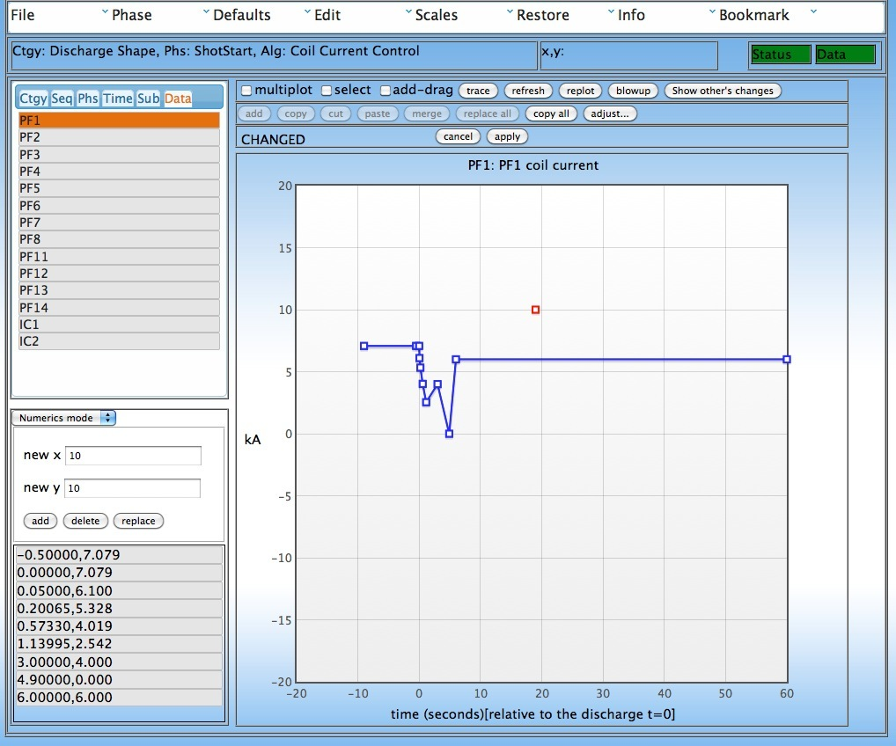
Web based user interface
Client: HTML/JavaScript/jQuery UI/Flot
Server:
PHP/MySQL
NO plug-in installation
Support mobile device
Transnational access for initial interface <10s

Slide 10
Outline
Motivation
conceptual design
Web based user interface
Gatekeeper system
Real time control service
Discharge scenario management
Summary

Slide 11
Gatekeeper system

Slide 12
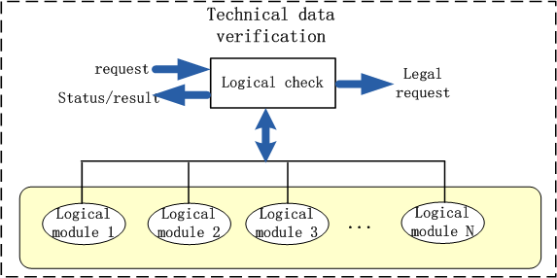
Gatekeeper system
system | Item | Limit
PFPS | PS1~PS6 | 350V
 | PS7,PS8 | 1100V
 | …
ICPS | IC current | 9KA
GAS | VJHPEV4 | 5V
 | VLDL1 | 10V

Slide 13
Outline
Motivation
conceptual design
Web based user interface
Gatekeeper system
Real time control service
Discharge scenario management
Summary

Slide 14
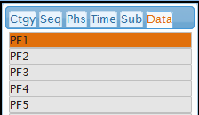
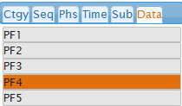
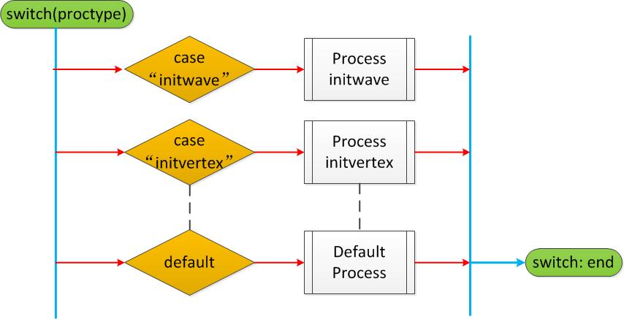
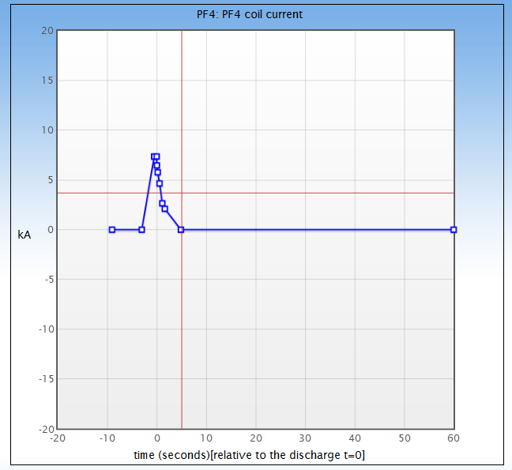
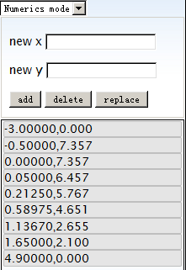
Real time control service
Client in Web Browser
Server written in PHP
PCS waveform server
return_vertex_set()
Display PF4 waveform
属性 | 定义 | 值
message_type | DATA_REQUEST | 1
data_type | VERTEX_SET | 5
identifier1 | category | 1
identifier2 | algorithm | 2
identifier3 | subset | 1
identifier4 | windex | 3
identifier5 | phase | 1
Socket
Plot waveform and display vertex value
Data flow for real time control request

Slide 15
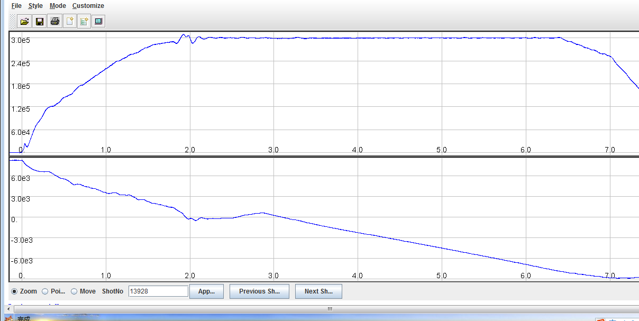
Real time control assistant tool
EAST Web Portal
EAST Logbook
EAST VOD
EAST Webscope
EAST Logbook

Slide 16
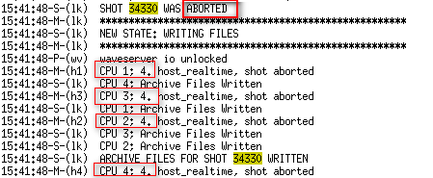
Real time control assistant tool
PCS log system

Slide 17
Real time control assistant tool

Slide 18
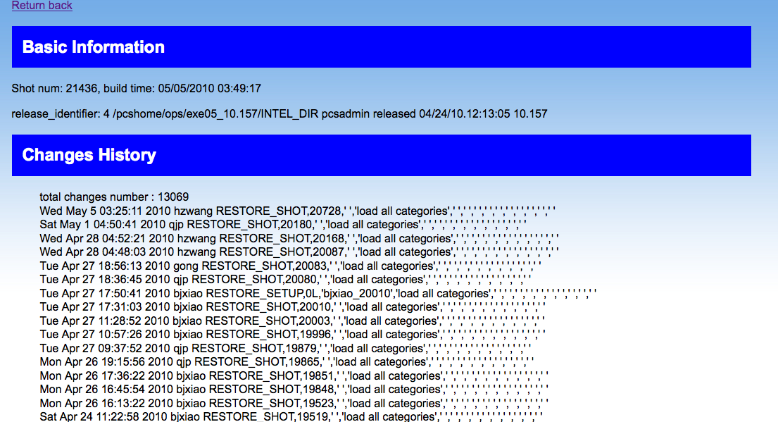
Real time control assistant tool
PCS log system
Mdsplus tree
operation database

Slide 19
Outline
Motivation
conceptual design
Web based user interface
Gatekeeper system
Real time control service
Discharge scenario management
Summary

Slide 20
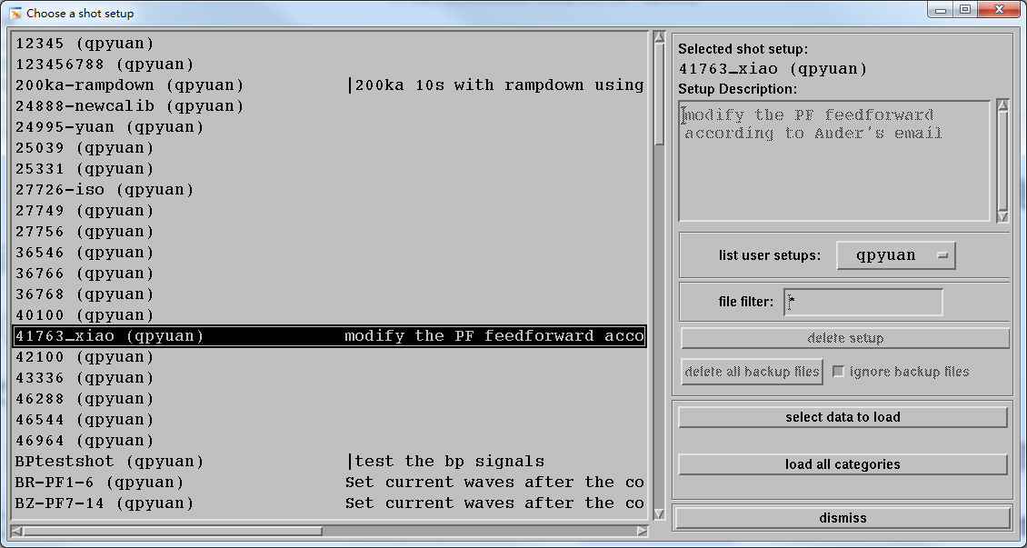
Scenario management
PCS future shot
files in /link/ops/archive_v10/
PCS future shot can be used for discharge scenarios making. Scenarios are saved in files. Need efficient way to manage the files.

Slide 21
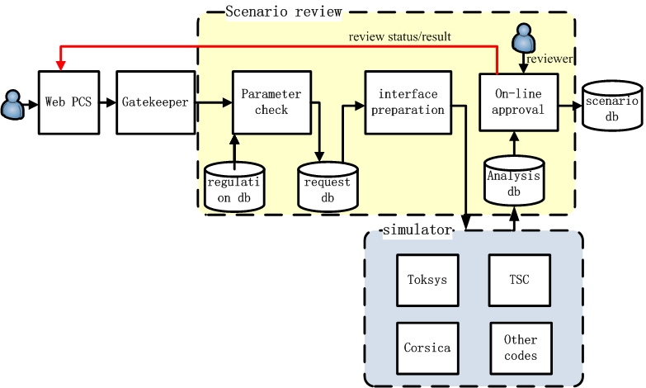
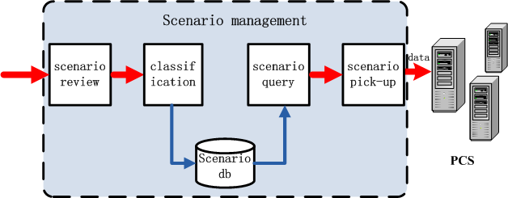
Scenario management

Slide 22
Scenario management
Scenario classification
archive
ID
title
user
name
type
user
IP
density
shape
pulse
Discharge type
shape
ID
shape
Discharge type
ID
type
…
(See day3 poster with ID 119:The design of remote discharge scenarios management system on EAST)

Slide 23
Scenario management
Scenario query

Slide 24
Outline
Motivation
conceptual design
Web based user interface
Gatekeeper system
Real time control service
Discharge scenario management
Summary

Slide 25
Summary
The remote participation platform for EAST plasma control is composed of web based interface, gatekeeper system, real time control service and scenario management.
The web based interface has been developed for supporting remote participation .
The first step implementation has been realized and assistant tools have been developed.
Next, we will implement the full functions and enhance the security of webpcs.

Slide 26
Thank you for your attention

