Slide 1
Fast development of real-time applications using MDSplus and MARTe frameworks
G.Manduchi¹, T.Fredian²⁾, J.Stillerman²⁾, A. Neto³⁾, F. Sartori³⁾
1) Consorzio RFX, Euratom-ENEA Association, Corso Stati Uniti 4, Padova 35127, Italy
2) Massachusetts Institute of Technology, 175 Albany Street, Cambridge, MA 02139, United States
3) Fusion for Energy, Barcelona, Spain
Notes:
*

Slide 2
Why Using Frameworks
A framework represents a generic solution to a given problem
Not usable as it is, but can be adapted to the specific application by configuration and/or by implementing specific components
Frameworks enhance software quality, encourage software re-use and reduce time-to-target time
Several frameworks exist in Fusion community
Avoid re-inventing the wheel!!
Notes:
*

Slide 3
The MARTe Framework
Originally developed at JET and currently used in several other fusion devices
It provides an abstraction of the underlying OS
Makes it portable across different platforms
Separates data flow management from computation components
User code for real-time computation is embedded into Generic Application Modules (GAMs)
The computation model is represented by a set of Real-Time Threads which cyclically execute the assigned set of GAMs
Notes:
*

Slide 4
The MDSplus Framework
A framework for data management
It provides a unified view to a large variety of data types via the concept of Expressions
Everything is an expression!!
Provides fast, streamed data acquisition in a Multi-reader – Multi-writer environment
Provides a multilanguage API for both and remote data access
Represents the standard de facto for data exchange in fusion community
Notes:
*

Slide 5
Why Integrating MARTe and MDSplus
The overlap in provided functions between MARTe and MDSplus is minimal
MARTe addresses control execution
MDSplus addresses data
However the union of the provided functions covers most requirements for integrated control and data acquisition
Therefore there is no ambiguity when integrating the two frameworks
MARTe
MDSplus
Notes:
*

Slide 6
Integration of MARTe and MDSplus
Based on the modular organization of MARTe
Implemented in the MARTe side only by adding new MARTe components
Nothing has changed in the code of both frameworks
Marte is a client of MDSplus
Implemented in the MDSplus side by defining a new MDSplus device
Devices in MDSplus carry out the description of sets of related data items
MDSplus is client of MARTe
Notes:
*

Slide 7
Purpose of the integration
Two main tasks: Configuration and Data Storage
Configuration refers on the initial setting of the MARTe component parameters, typically performed at the beginning of the experiment sequence
Configuration data will be stored in the MDSplus experiment model
Data Storage refers on the streamed storage on disk of data produced in MARTe both acquired from sensors and internally computed
Notes:
*

Slide 8
The new MARTe components
MARTe defines three main classes of components
Generic Acquisition Modules (GAMs) hosting user provided computation components
Generic Drivers (GACQMs) which represent generic drivers and are associated to Input and output GAMs to represent the origin and sinks of data in the
Services carrying out activity not related to real-time execution, such as Web server to export component configuration
The integration is provided by a MDSplus aware GACQM and a MDSplus Service
Notes:
*

Slide 9
The new MARTe components (Cont.)
The MDSplus GACQM represents the “Driver” within MARTe for connecting input and output data streams to MDSplus pulse files
Input data from MDSPlus is represented by reference waveforms used in real-time control
Output data to MDSplus is represented by the signals both acquired and computed in real-time
The MDSplus Service provides the required support “behind the curtains”
Activates two threads for streaming output data and for listening to new configurations
Notes:
*

Slide 10
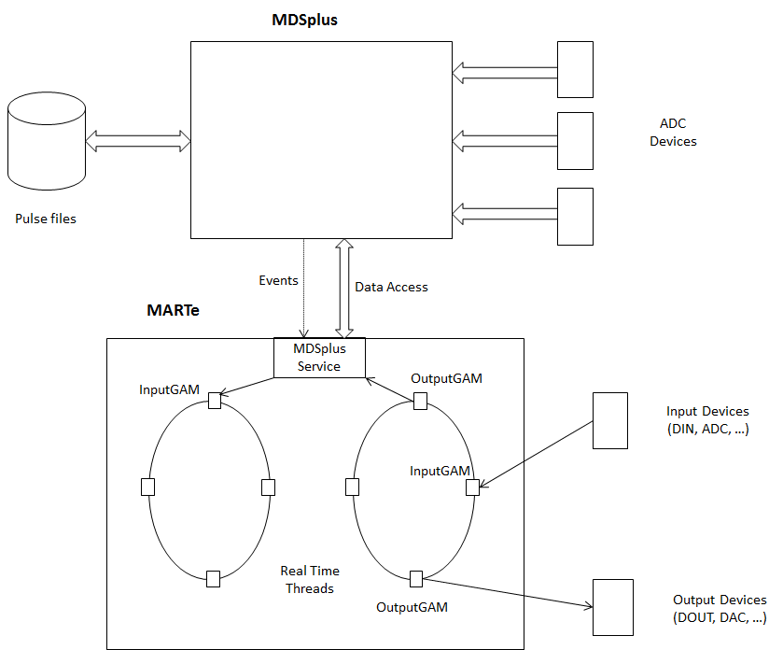
The resulting schema
Measurements
Notes:
*

Slide 11
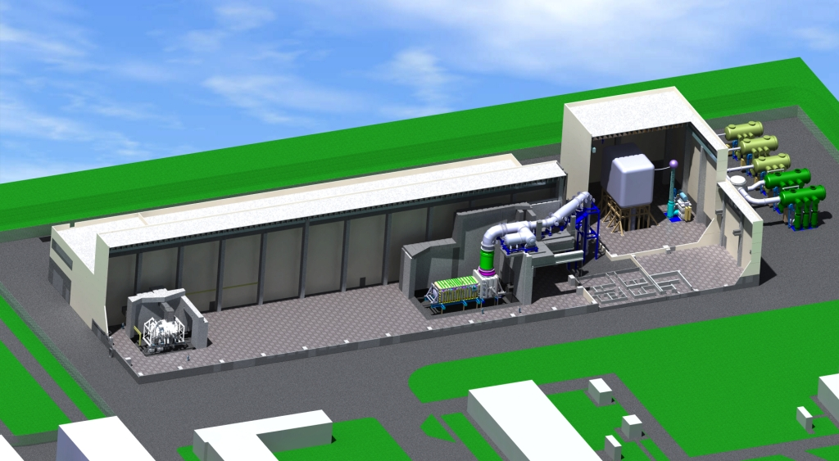
A case study: the integrated control and data acquisition of the SPIDER experiment in the ITER Neutral Beam Test facility
Neutral Beam Test Facility will be located in Padova, Italy
It will comprise two experiments:
ITER Full-size Ion Source (called SPIDER) – op. 2016
ITER Full-size HNB (called MITICA)
Notes:
*

Slide 12
Control and Data Acquisition in SPIDER
MDSplus is used to provide streamed data acquisition
In SPIDER the beam generation can last up to one hour
Continuous total throughput of 130MB/s (signals and cameras)
MARTe is required for the fast management of grid breakdown in the beam generation
Requires turning off for a while the generation of the reference waveforms to the power supply and then increasing references through a pre-defined pattern to reach initial conditions, also continuously
Reference waveforms are stored in MDSplus experiment model along with the configuration of other MARTe components
It is uploaded to MARTe before beam generation
Only one GAM has been developed to account for the management of reference generation under breakdown events
Notes:
*

Slide 13
Conclusions
The integration of the two framework covers most requirements in control and data acquisition, that is:
User interface: for system configuration and visualization of acquired data (MDSplus)
Pulse scheduling: to carry out the states in a pulse discharge sequence (MDSplus in step with MARTe)
Data distribution: to let configuration data be available in any system participating to control and data acquisition (MDSplus + MARTe-MDSplus integration components)
Real-time computation: to carry out active experiment control and other real-time activities (MARTe)
Data acquisition streaming: to carry out the continuous acquisition and display of data generated by devices not involved in real-time control (MDSplus)
Real-time data streaming: to carry out the continuous acquisition of data produced by real-time control components (MDSplus + MARTe – MDSplus integration components)
Notes:
*

