Slide 1
The demonstration of Lustre in EAST data system
F.Wang¹, Y.Chen¹, S.Li¹, F.Yang^{1, 3}, B.J.Xiao^{1, 2}
¹Institute of Plasma Physics, Chinese Academy of Sciences, Hefei, China
²School of nuclear science and technology, University of Science and Technology of China
³Department of Computer Science , Anhui Medical University, Hefei, China

Slide 2
OUTLINE
1. Introduction
2. System Design & Implementation
3. Test Results
4. Summary

Slide 3
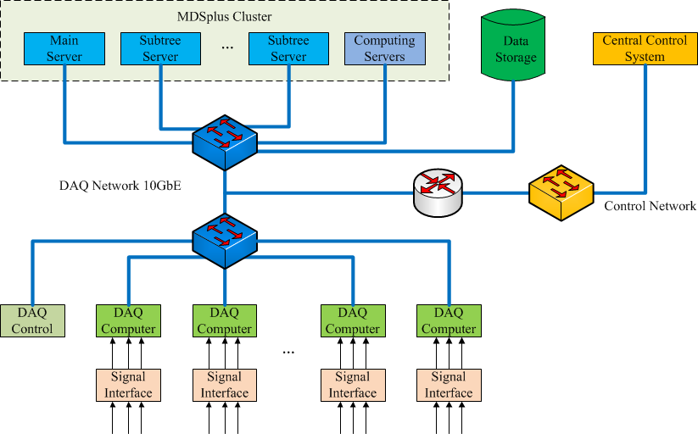
1. Introduction
EAST Distributed and Continuous Data Acquisition System
DAQ Nodes: >40
Channels: >2500
Sampling: 1Hz~60MHz
Bus: PCI/PXI/PXIe
Stream: 2GB/s
Data: 100TB (2014)
Database: MDSplus

Slide 4
High-speed Data Acquisition
DAQ for microwave reflectometry
National Instruments PXIe-5122
4 channels x 60M/s
~500MB/s
~500GB/1000s shot
DAQ for polarimeter interferometer
National Instruments PXI-5105
8 channels x 10M/s
~160MB/s
~160GB/1000s shot
It takes much time to access these high sampling rate data in case of long-term discharge, and the current data storage system become the bottleneck of whole data system.

Slide 5
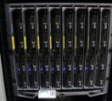
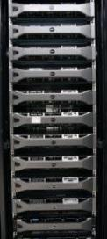
Data Storage System
MDSplus new shot data storage
DELL M820 blade servers: 8
Local raid storage: 2TB x 8
Write data speed: 250MB/s x 8
Network bandwidth: 10GbE x 2
MDSplus history shot data storage
DELL MD3200 SAS Storage
Total capacity: 300TB
Write data speed: 300MB/s
Network bandwidth: 10GbE x 2
The new shot data have to been moved to history shot data storage in several days;
The local data storage is not easy to manage, and consumes much CPU and RAM resources;
DELL M820
DELL MD3200

Slide 6
Requirements
A new data storage system is necessary for the continuous data acquisition of EAST tokamak
Duration: 1000s
Large capacity: 500TB
High performance: 2GB/s continuous write
Easy to use by Linux servers
Easy to manage data
Online upgrade capability
Scalability: capacity & performance
Reliability: redundancy, raid, backup
…

Slide 7
OUTLINE
1. Introduction
2. System Design & Implementation
3. Test Results
4. Summary

Slide 8
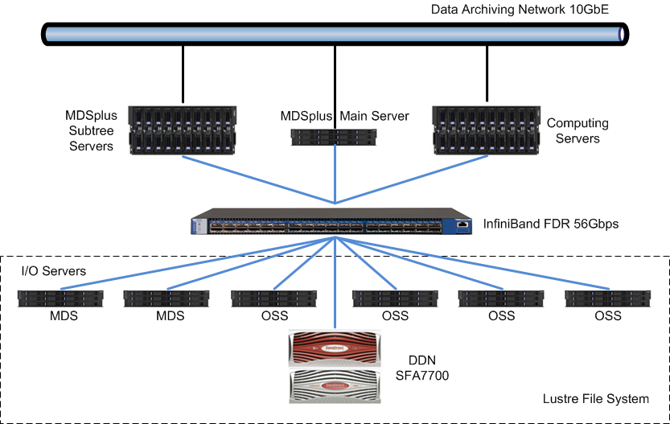
2. System Design
System architecture of data storage system based on Lustre

Slide 9
Lustre File System
The Lustre file system is an open-source, high performance, parallel file system that supports many requirements of leadership class HPC simulation environments.
Performance
Scalability
POSIX standard compliance
High-availability
DDN EXAScaler, is a next generation parallel file storage system appliance that combines DDN award-winning HPC storage technology with the open-source Lustre file system.
MDSplus data will be stored on the Lustre file system, and shared with computing servers.
Lustre Software Release 2.x Operations Manual

Slide 10
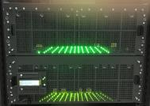
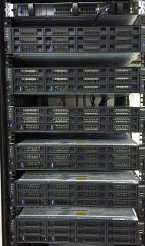
System Configuration
InfiniBand 56Gbps FDR switch
DDN SFA7700: 60 x 6TB SAS drive
DDN SS8460: 84 x 6TB SAS drive
Raw capacity: 860TB
Raid Level: 8+2 raid6
Available capacity: 600TB
Lustre: DDN EXAScaler-2.1.1
I/O Server nodes: 6
2 MDS: SUGON I620
4 OSS: SUGON I620

Slide 11
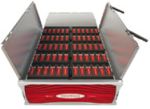
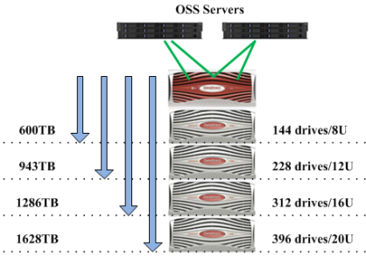
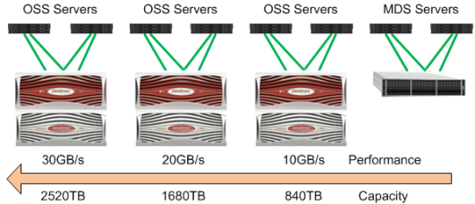
DDN SFA7700
DDN SFA7700 is a high performance raid for big data storage and HPC data storage.
High performance: 10GB/s
Active-Active RAID Controller
Advanced Cache Optimize
High density Expansion Enclosure
Horizontal (Scale-out)
Vertical (Scale-up)

Slide 12
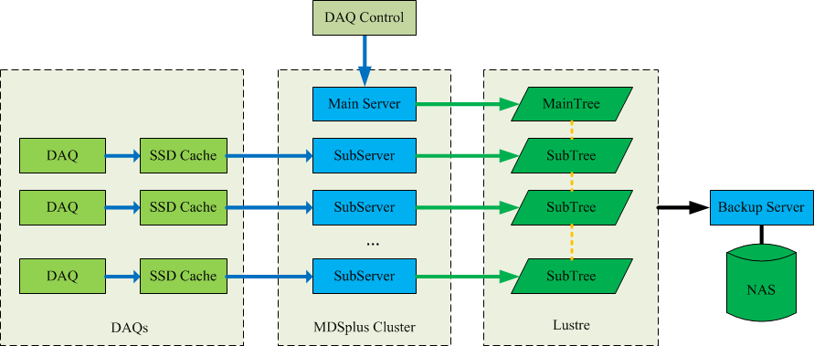
Data Flow
3
1
2
4
1. The acquired data are cached in local SSD;
2. Every 5s slice data are sent to server by TCP socket;
3. The slice data are saved into mdsplus on Lustre;
4. The shot data are synchronized to backup server;

Slide 13
OUTLINE
1. Introduction
2. System Design & Implementation
3. Test Results
4. Summary

Slide 14
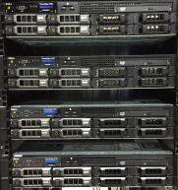
3. Test Results
Hardware
Storage DDN SFA 7700 + SS8460
MDS server SUGON I620 server ＊2
OSS server SUGON I620 server ＊4
Client DELL R720 server ＊4
CPU E5-2650 v2 / 32GB RAM
Software
OS CentOS 6.5 X64
OFED OFED2.3
EXAScaler 2.1.1 (Lustre 2.5.19)
Tools
IOZONE-3-414
MDSplus-6.1-83

Slide 15
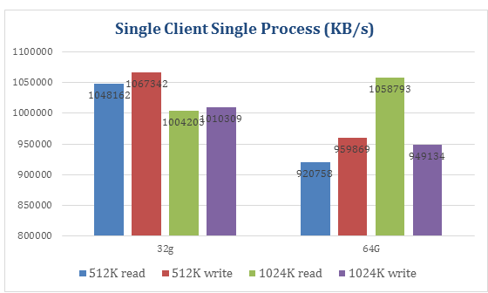
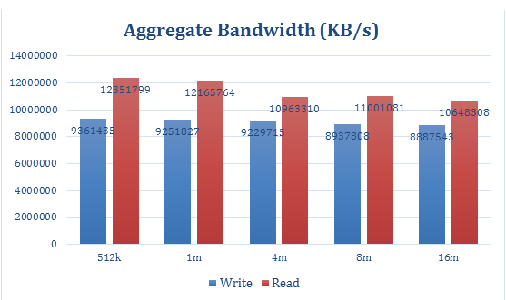
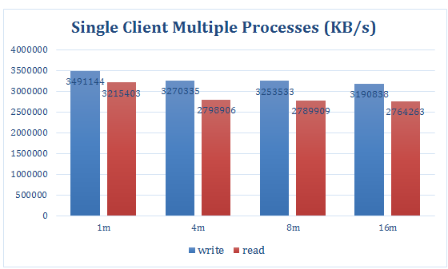
IOZONE Test
Client: 1, Process: 1
Client: 4, Process: 4 x 10
Client | Process | Read | Write
1 | 1 | 0.9GB/s | 1GB/s
1 | 10 | 2.8GB/s | 3.2GB/s
4 | 40 | 9.0GB/s | 10.0GB/s
Client: 1, Process: 8

Slide 16
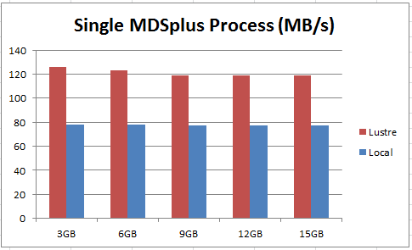
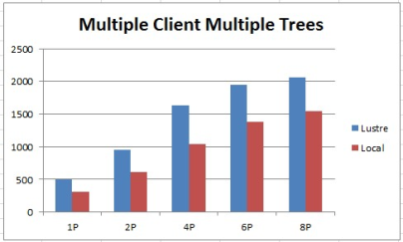
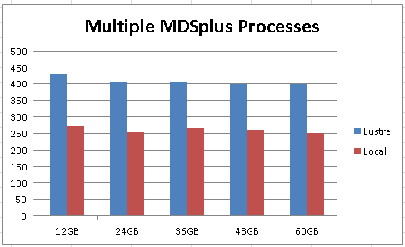
MDSplus Test
1 mdsplus client to 1 mdsplus tree
4 mdsplus client to 4 mdsplus tree
Client | Process | Tree | Local | Lustre
1 | 1 | 1 | 80MB/s | 120MB/s
1 | 4 | 1 | 260MB/s | 400MB/s
4 | 8 | 4 | 1500MB/s | 2000MB/s
4 mdsplus processes to 1 mdsplus tree

Slide 17
OUTLINE
1. Introduction
2. System Design & Implementation
3. Test Results
4. Summary

Slide 18
4. Summary
A new data storage system based on Lustre and InfiniBand has been designed and implemented to meet the requirement of large amount of data storage for EAST;
The new data storage system has good performance and scalability, and it can be used as either mdsplus data storage or video/image data storage;
The new data storage system will be used in the next campaign of EAST tokamak experiment.

Slide 19
Thanks for your attentions!

