Slide 1
12-luchetta-RFX-3-O Integrating Supervision, Control and Data Acquisition – The Neutral Beam Test Facility Experience
A. Luchetta, G. Manduchi, C.Taliercio
Consorzio RFX, Corso Stati Uniti 4, Padova 35127, Italy
Notes:
*

Slide 2
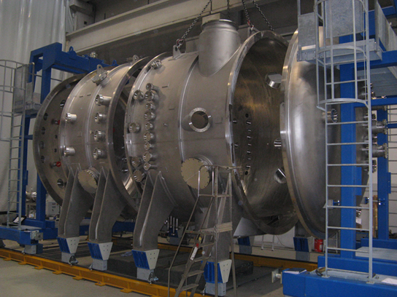
Outline
ITER Neutral Beam Injectors
Neutral Beam
Test Facility
SPIDER I&C
MITICA I&C
Conclusions
Fig. 1. Installation of
SPIDER Vacuum Vessel

Slide 3
ITER Neutral Beam Injectors
Several large neutral beam injectors are in operation in fusion devices or under development for future use
ITER Heating Neutral Beam Injectors (HNB) require a step forward in terms of performance and technology
Experiment | HNB Injector No. | Neg./Pos. Ions | Energy H/D (keV) | Power (MW) | Pulse Length (s)
JET | 2 (8+8 PINI) | + | 125 | 34 | 20
JT-60 SA | 3 | +/- | 500 | 20/10 | 100
LHD | 5 | 2+/3- | 180/360 | 15 | 10
ITER | 2 (+1) | - | 870/1000 | 33 (50) | 3600
ELISE* | Ion source | - | 60 | 1.2 | 3600
*ELISE = ITER half-size ion source operating at IPP -Garching

Slide 4
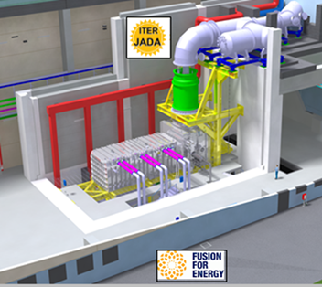
Neutral Beam Test Facility
R&D to develop and test the ITER full-size Heating NB at nominal performance
Under construction in Padova, Italy
Will host two experiments
SPIDER - ITER full-size ion source (no neutralization)
MITICA - ITER full-size Heating NB prototype
Fig. 2. MITICA CAD View
Experiment | Energy H/D (keV) | Power (MW) | Pulse Length (s) | Operation | Status
SPIDER | 100 | 6 | 3600 | 2016 | Installation
MITICA | 870/1000 | 16.5 | 3600 | 2019 | Constr.

Slide 5
NB Test Facility I&C Requirements
Experiment | Data through. MB/s | Annual Data amount TB/y | Fast control cycle time μs | Fast interlock reaction time μs | No. Plant Units
SPIDER | 130* | 50 | 500 | 10 | 20
MITICA | 50** | 30 | 500 | 10 | 25
* rich set of diagnostics to optimize operation
** reduced set of diagnostics to maximize reliability

Slide 6
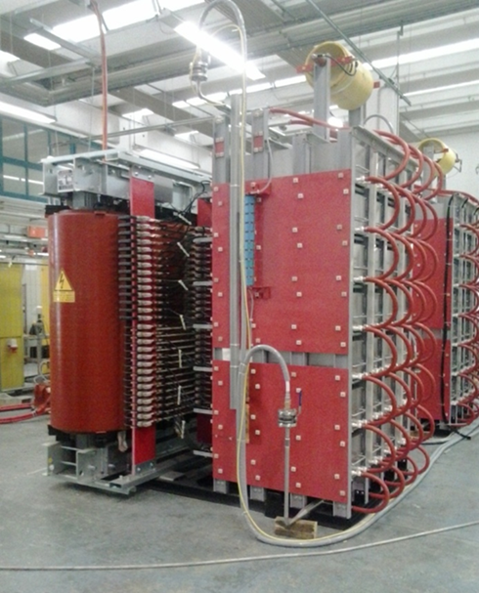
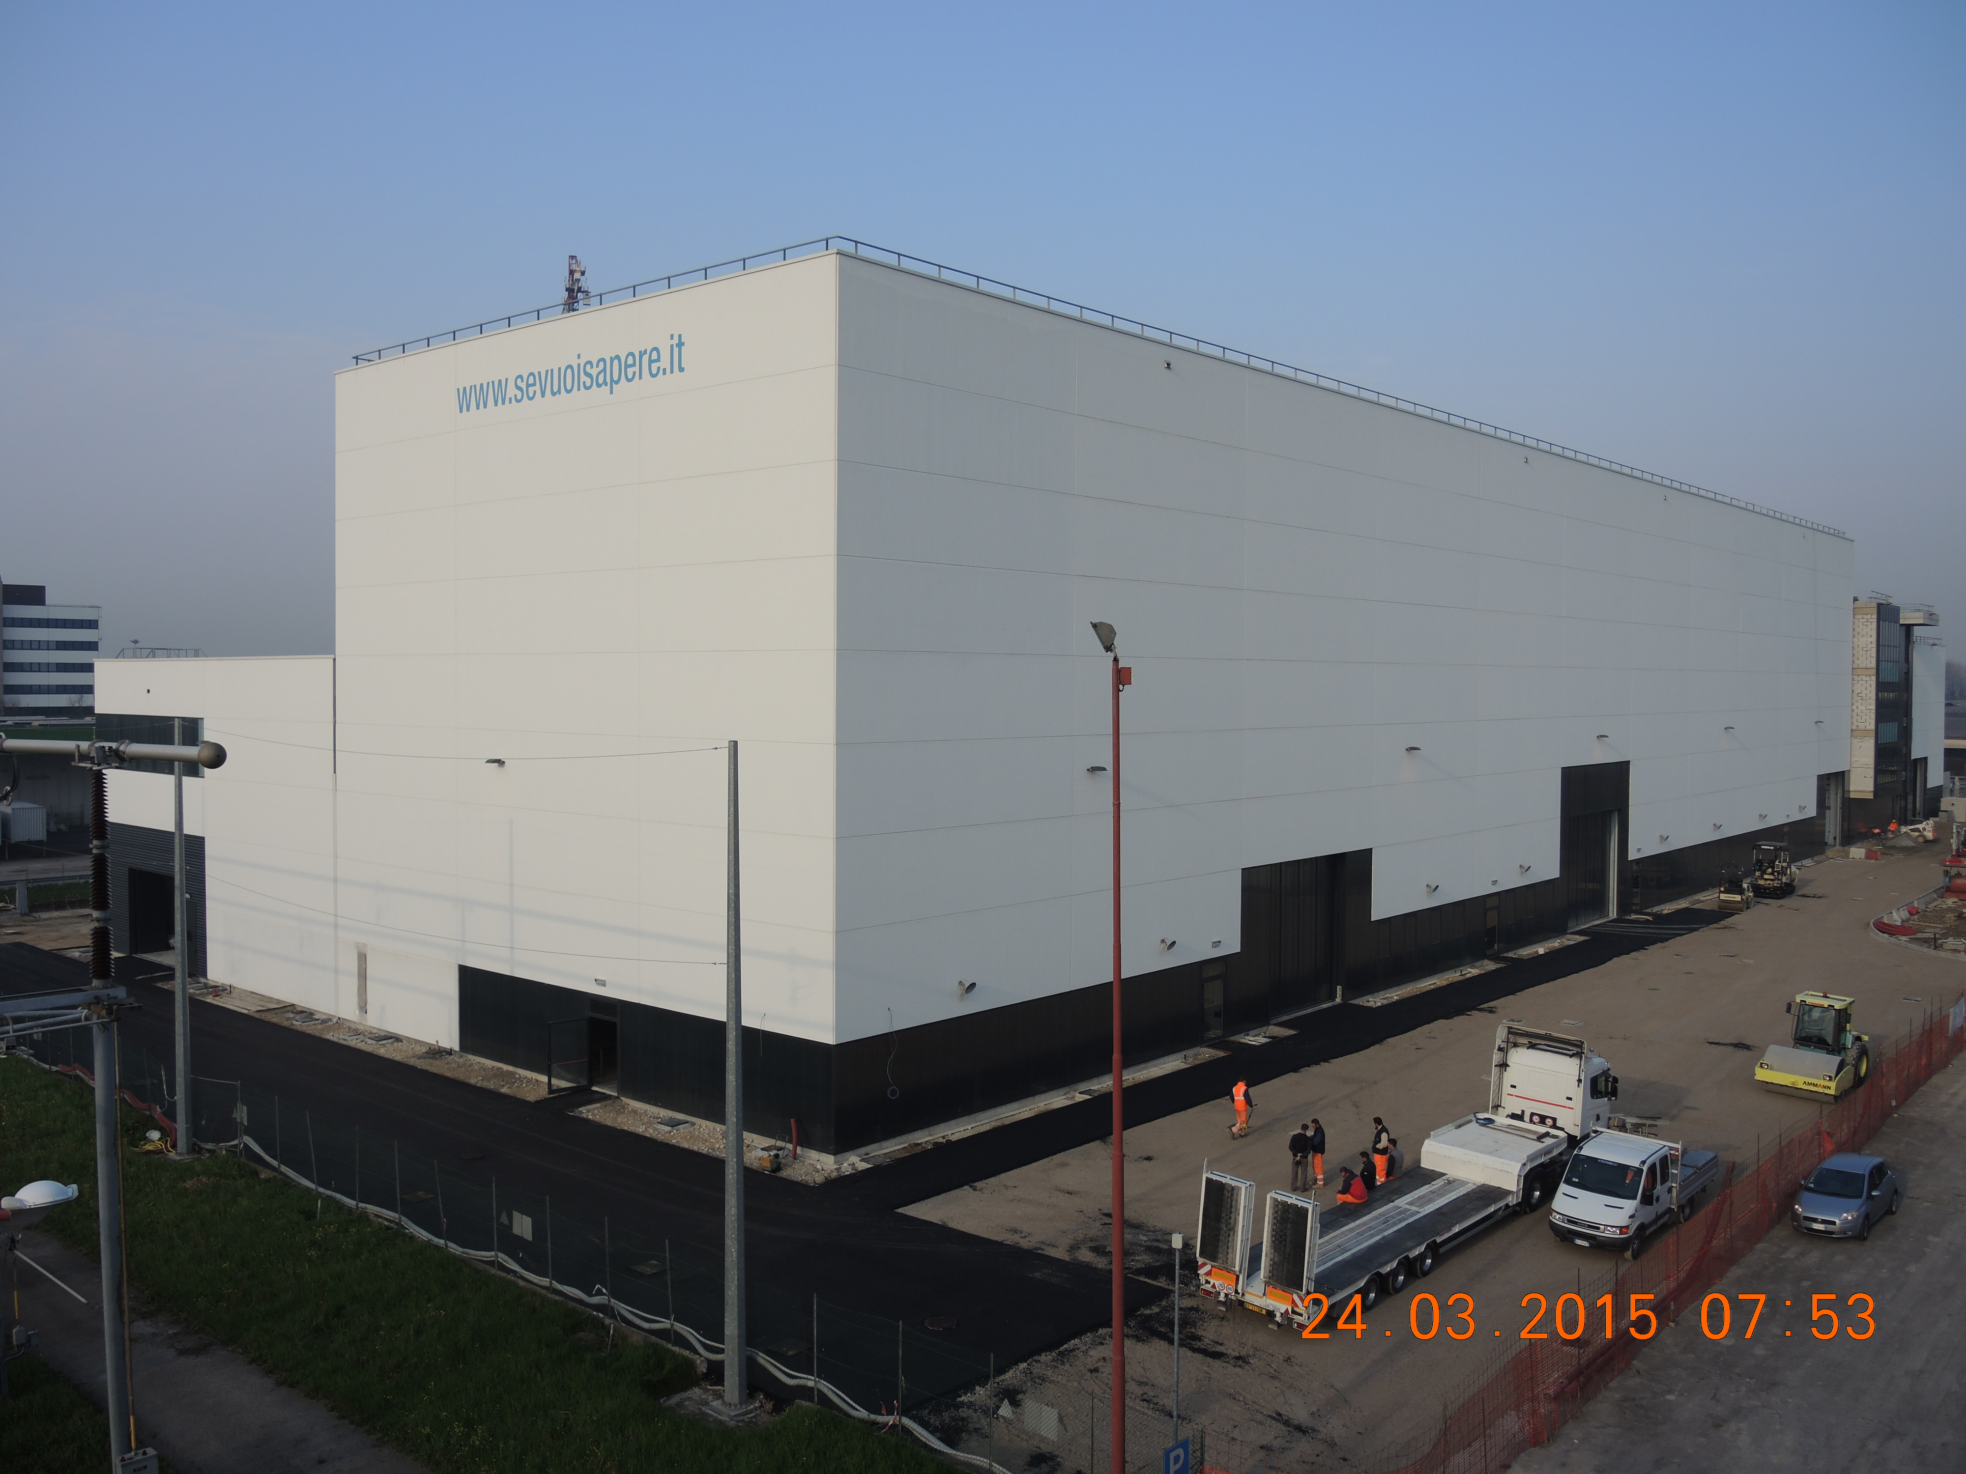
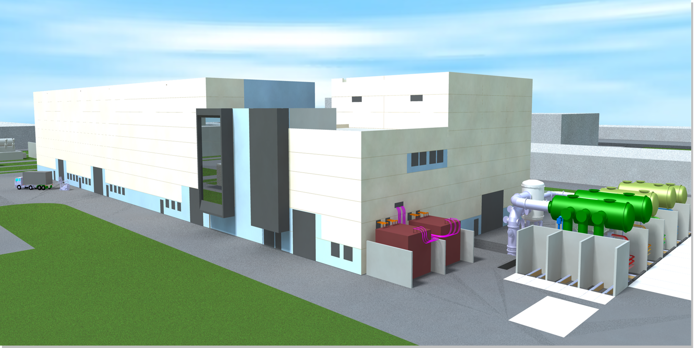
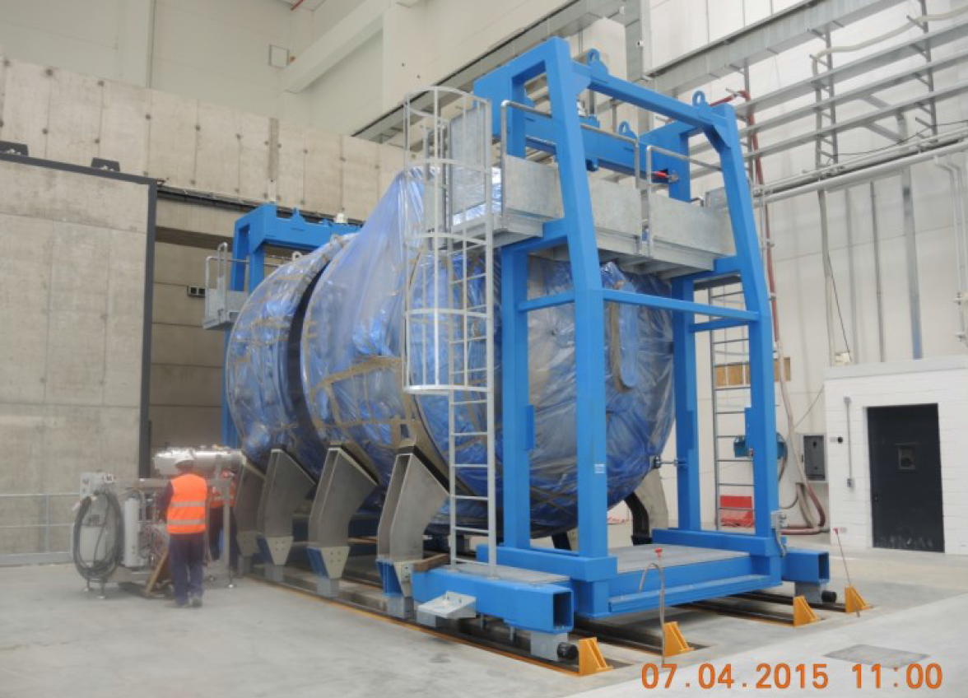
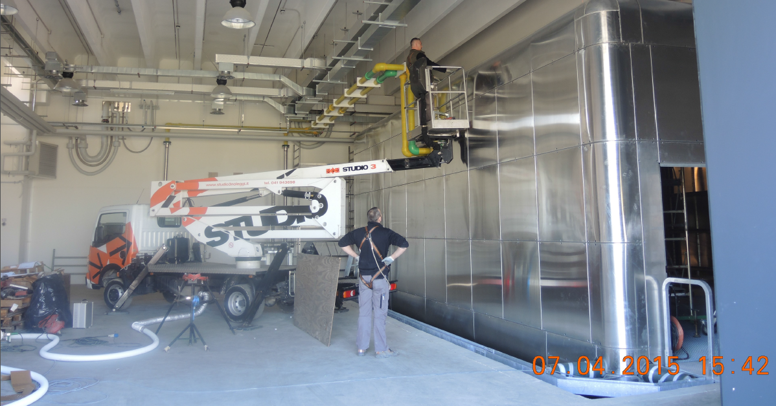
Neutral Beam Test Facility- Status
Fig. 4. SPIDER Ion Source and Extractor Power Supply – FAT - May 2014
Fig. 3. Buildings - March 2015
Fig. 6. SPIDER High Voltage Deck –
-100kV – April 2015
Fig. 5. SPIDER Vessel - April 2015

Slide 7
Neutral Beam Test Facility I&C
SPIDER is not an ITER plant system, thus PCDH does not apply
Free to choose architecture and technologies
Wise to remain on the CODAC trail to reuse efforts in MITICA and HNB
CODAC Core System v.2, Fast Control, Data Archive, and HPN undefined
IAEA 2011 - SPIDER system architecture
IAEA 2013 - SPIDER fast control and data acquisition
MITICA will be the prototype of an ITER plant system and, thus, PCDH partly applies
MITICA
More complex than HNB plant sysyem as MITICA includes auxiliaries such as cooling, gas and vacuum, cryogenic system, CODAS, CIS, CSS, and diagnostics
Central I&C
HNB
PS
AUX
PS
DIA
PS
Fig. 7. MITICA I&C 2-layer Architecture

Slide 8
SPIDER I&C – Framework Integration
Slow control - EPICS
Siemens PLC, EPICS, CSS – PCDH compliant
Fast Control - MARTe
Hardware: PICMG 1.3 (PCIe), PXI PXIe – PCDH compliant (nearly)
Software: Linux, EPICS not suitable (see Barbalace, Trans. Nucl. Sci., 2011, pp. 3162 – 3166, Performance comparison EPICS – MARTe)
what to do? Waiting for ITER fast control software framework?
External Constraint not acceptable
MARTe (Multithreaded Application Real Time executor, JET)
Data Acquisition and Management - MDSplus
Hardware: PCDH compliant - NI PXI 6259, PXIe 6368
Software: EPICS not suitable for high speed data acquisition
Waiting for ITER solution? (Now exists, DAN API and HDF-5)
Usage of MDSplus - native in RFX – work to integrate MDSplus with EPICS channel access
)

Slide 9
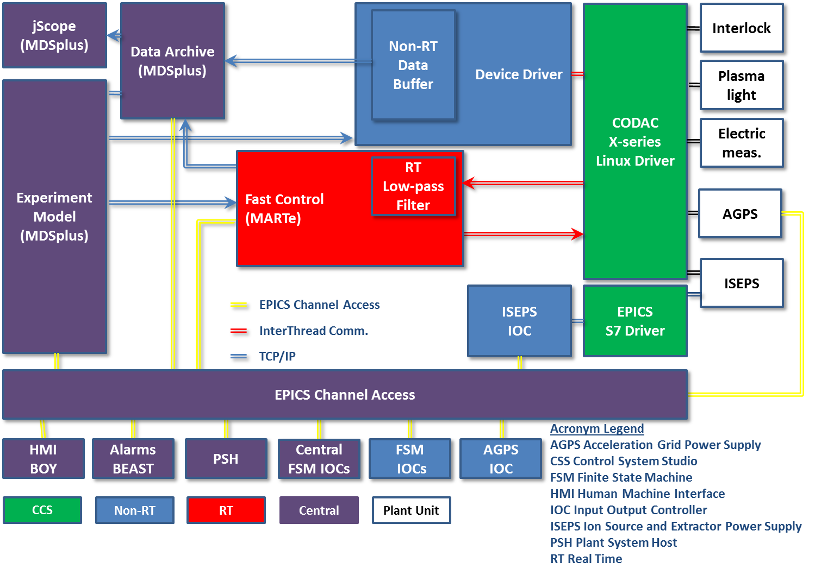
SPIDER CODAS - Framework Integration
Fig. 8. Power Supply Plant System Functional Diagram

Slide 10
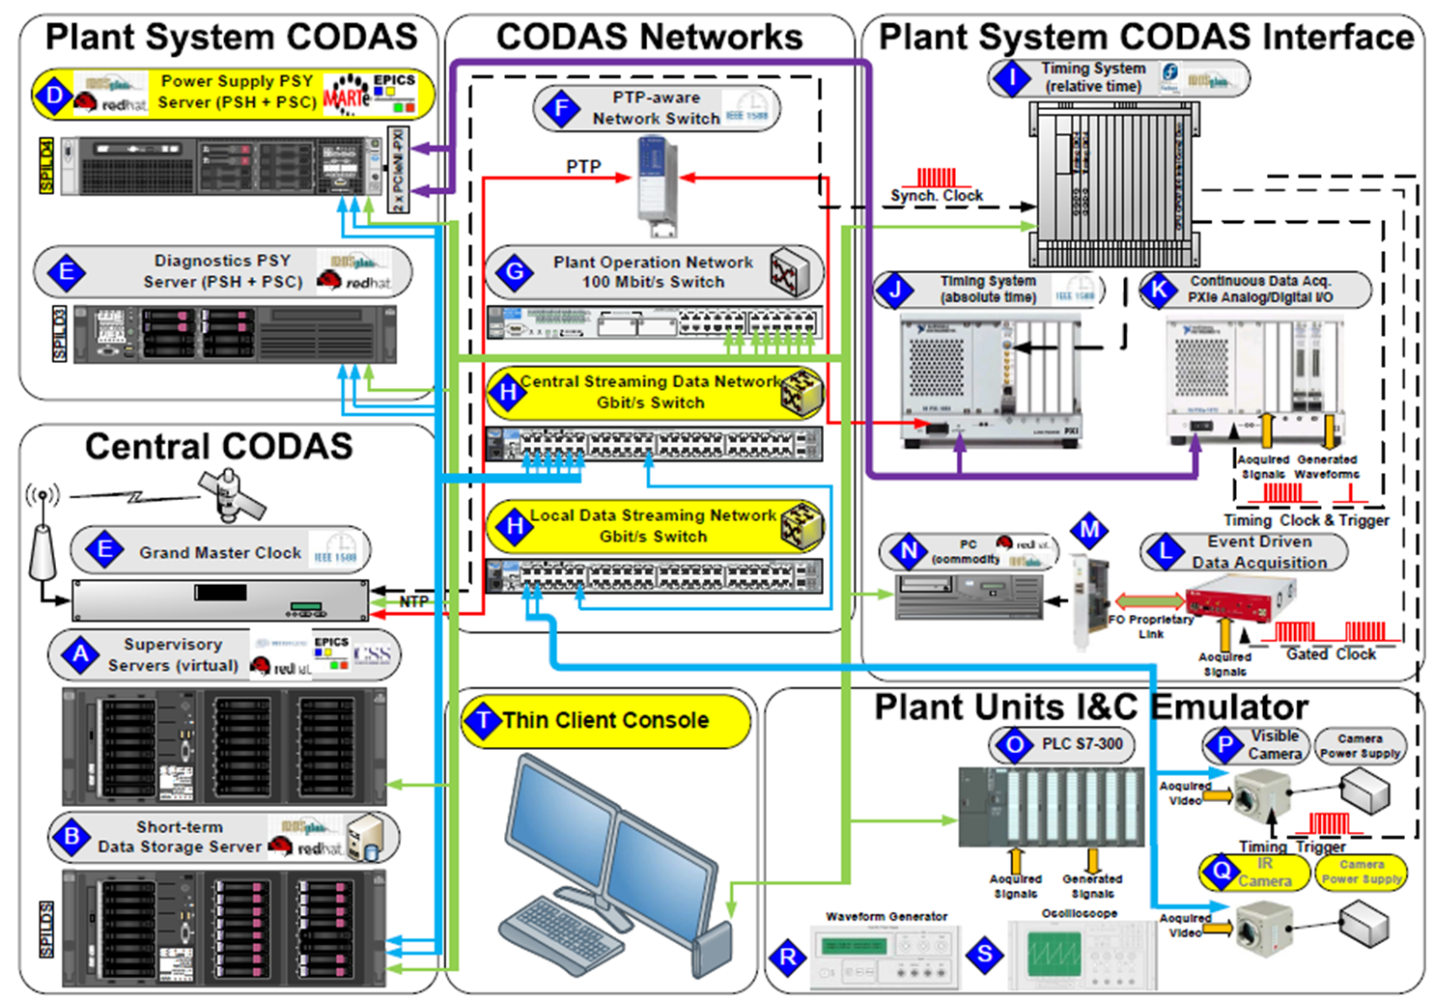
SPIDER CODAS Prototype (2013)
Fig. 9. SPIDER CODAS Prototype

Slide 11
MITICA I&C - Integration Dilemma
RFX adopts systems and solutions not necessarily shared with ITER CODAC
knowledge and gained expertise provide a fast track to implement I&C
However the final product (HNB PS) must adhere to ITER CODAC integration directives
How to deliver ITER compliant systems and at the same time taking advantage of well know techniques not necessarily supported by ITER?

Slide 12
MITICA I&C - Interfaces
Take the example of data archiving
SPIDER/MITICA will use MDSplus data archiving
ITER is providing its data archiving system (HDF5)
How can we combine the two different implementations?
MDSplus data archiving can be plugged into the DAN publish/subscriber framework
When the HNB Plant System is delivered, the replacement of the data archiving component will be transparent to the application
What is important is an early, stable definition of the API, rather than the implementation of the actual service

Slide 13
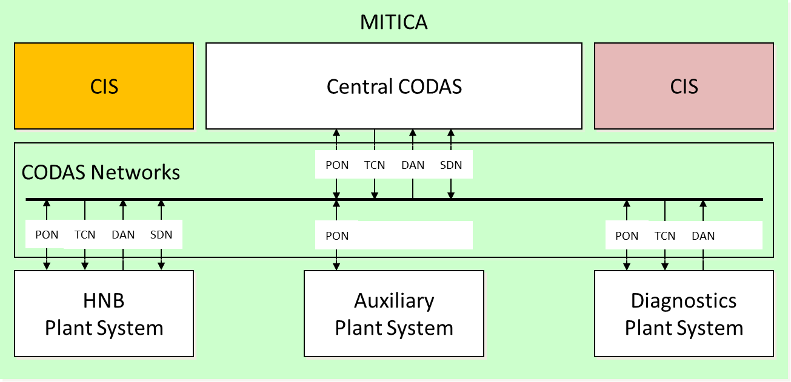
MITICA I&C design
Preliminary design has just started
Collection of control requirements
PBS has been defined
Control functions have been defined
FMEA was executed
Fig. 10. MITICA I&C Two-layer Architecture

Slide 14
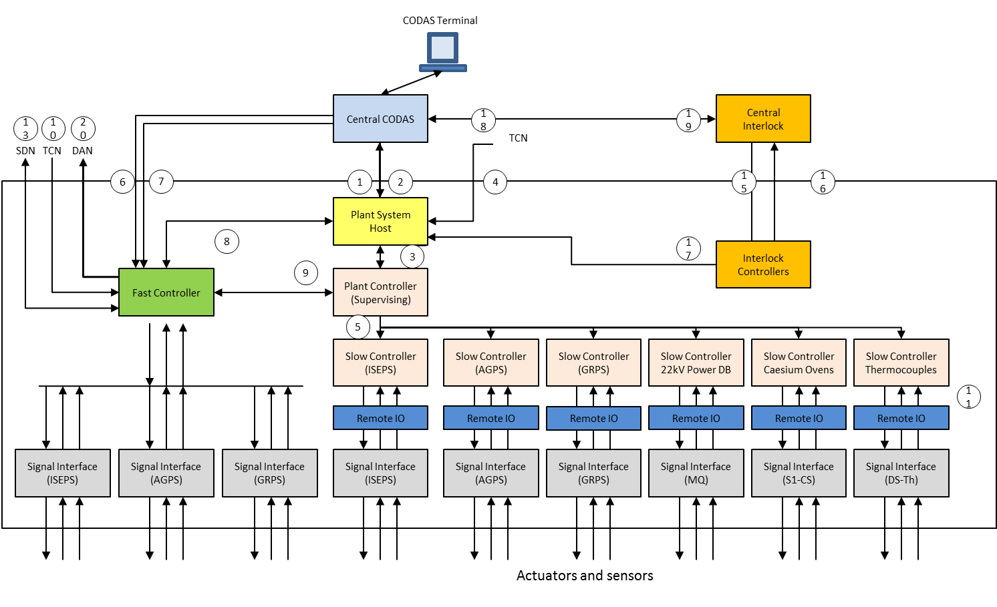
MITICA – HNB Plant System
Fig. 11. Functional Architecture and Data Flow

Slide 15
Conclusions
SPIDER CODAS is under construction
EPICS-MDSplus-MARTe integration
prototype demonstrated meeting of all requirements
SAT in 2015 for SPIDER components
integrated commissioning early 2016
MITICA CODAS is under design and will take advantage of well established software frameworks (EPICS-MDSplus-MARTe)
HNB Plant System will adhere to ITER CODAC prescriptions, using an interface-based approach for a seamless transition of HNB from MITICA to ITER CODAC

Slide 16
Acknowledgments
Thanks for your attention
The work presented has been funded partially by Fusion for Energy under the contracts F4E-RFX-PMS_A-WP-2014 and F4E-OFC-280.
The views and opinions expressed herein do not necessarily reflect those of Fusion for Energy and the ITER Organization.

