Slide 1
Overview of the LHD Central Control Room Data Monitoring Environment
EMOTO Masahiko
National institute for fusion science

Slide 2
Introduction
During the LHD experiment, scientists and technical staff gather in the LHD control room to operate the experiment. They are engaging in managing to control the LHD sub-systems and diagnostics devices. Also, many researchers based outside NIFS are participating in the experiment remotely. Because the plasma discharge experiment is executed every three minutes, it is important to share the recent information of the experiment quickly. In this presentation, the data monitoring environments in the LHD control room are introduced.
Notes:
During the LHD experiment, scientists and technical staff gather in the LHD central control room to operate the experiment.
They are engaging in managing to control the LHD sub-systems and diagnostics devices.
Also, many researchers based outside NIFS are participating in the experiment remotely.
Because the plasma discharge experiment is executed every three minutes,
it is important to share the recent information of the experiment quickly.
In this presentation, the data monitoring environments in the LHD control room are introduced.

Slide 3
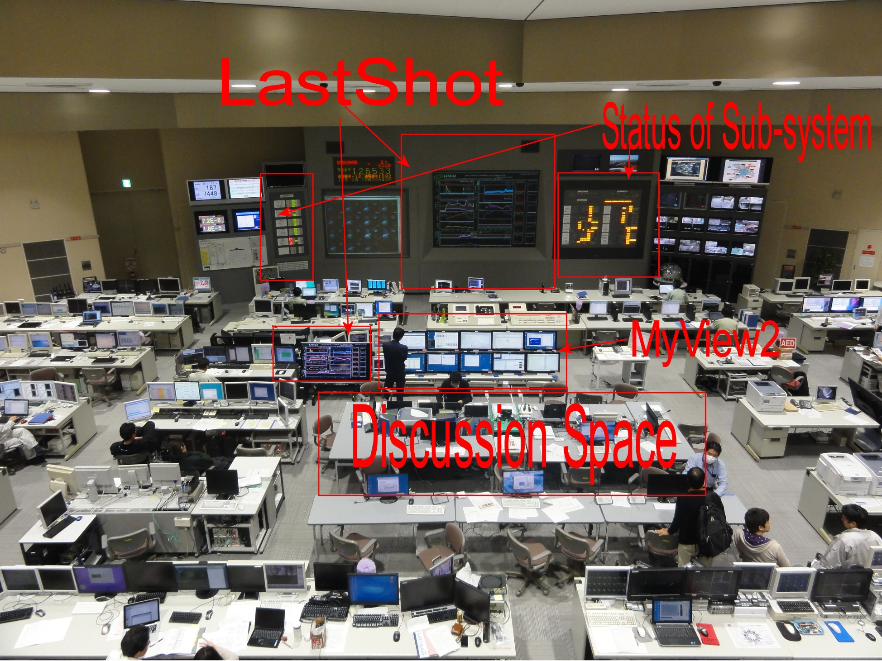
Notes:
This picture shows the overview of the LHD control room.
At the front, there are two main panels in which the summary graphs, and plasma movie are displaying.
Both side of the main panel, status of the LHD sub systems are displayed.
At the center of the picture, there is a discussion space.
The experiment coordinator is sitting here to orchestrates the experiment.
He has to decide the subsequent experiment plan.
To help his decision, the summary graphs of the last plasma shot,
And various analyses graphs are displayed around the space.

Slide 4
Notes:
There are several sources input into the projector.
While plasma discharge experiment is going.
The summary graph and the plasma monitor video is automatically changed.
When the experimental sequence begins plasma monitor is displayed, then when the plasma discharge
finishes, the input source is changed to the summary graph.

Slide 5
Overview of Data Flow
Notes:
Here is the overview of the data flow in the LHD control room.
Let’s look at the graph in detail.

Slide 6
LHD Data Archiving Systems
There are two systems used to store the LHD experimental data. LABCOM System manages the raw signal data, while Analyzed Data Server (Kaiseki Server) manages the physical data. To maintain the consistence among the physical data, AutoAna system is used.
Notes:
There are two systems are used to store the LHD experimental data.
LABCOM System manages the raw signal data, while Analyzed Data Server (Kaiseki Server) manages the physical data.
To maintain the consistence among the physical data, AutoAna system is used.

Slide 7
nion_6
Data Dependency
AutoAna calculates automatically to maintain the consistence among the physical data
Notes:
There are dependencies among the physical data.
For example dytrans is calculated from fit3d_sd, and firt3d_sd is calculated from ermap and cxsmap, and so on.
AutoAna calculate the physical data automatically to maintain consistence in the analyzed data server.

Slide 8
Autoana
When a new physical data is registered into the Analyzed Data Server, it sends IP-multicast packet to notify the user of new data registration.
Then, AutoAna receives the packet, it runs the calculation program of dependent data to keep the consistence.
Notes:
When a new physical data is registered into the Analyzed Data Server, it sends IP-multicast packet to notify the user of new data registration.
Then, AutoAna receives the packet, it runs the calculation program of dependent data to keep the consistence.

Slide 9
Summary Data
LastShot draws the raw signal data while MyView2 shows the analyzed data. Both images are sent to the virtual printer and converted into PDF files.
Notes:
The summary graph are visualized by two applications
LastShot and MyView2.
LastShot draws the raw signal data while MyView2 shows the analyzed data.
Both images are sent to the virtual printer and converted into PDF files. Served by the web server.

Slide 10
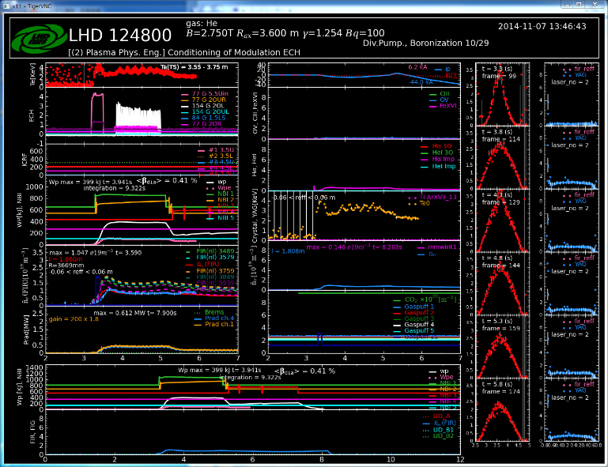
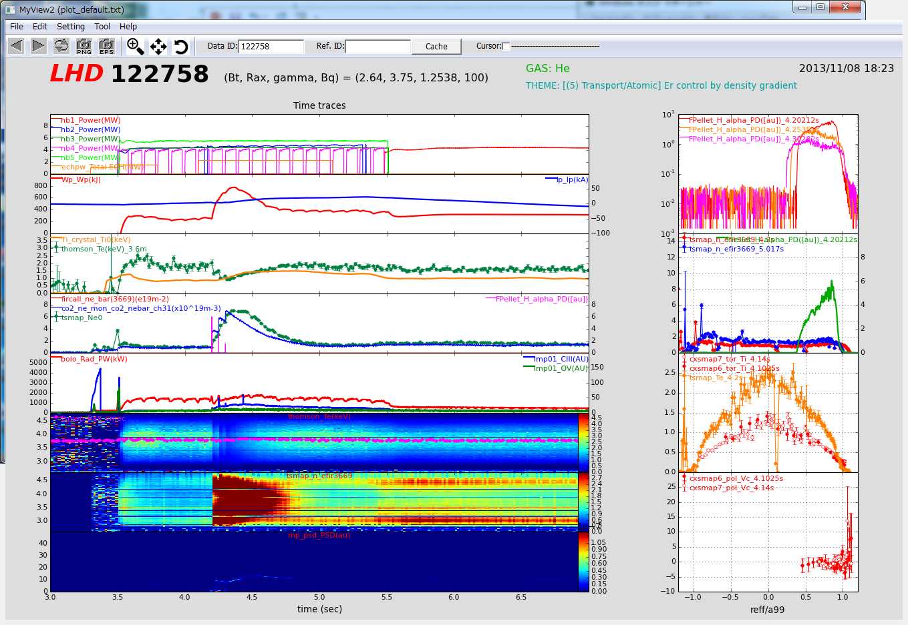
Summary Graph
LastShot
MyView2
Specially developed to draw the most recent summary graph quickly
Multi-purpose and multi-platform visualization tool. Easy to use for visitors
Notes:
Here is the comparison between the two applications.
Lastshot is specialized to draw the most recent summary graph quickly.
MyView2 is developed as a multi-purpose and multiplatform visualization tool
Especially for the visitors

Slide 11
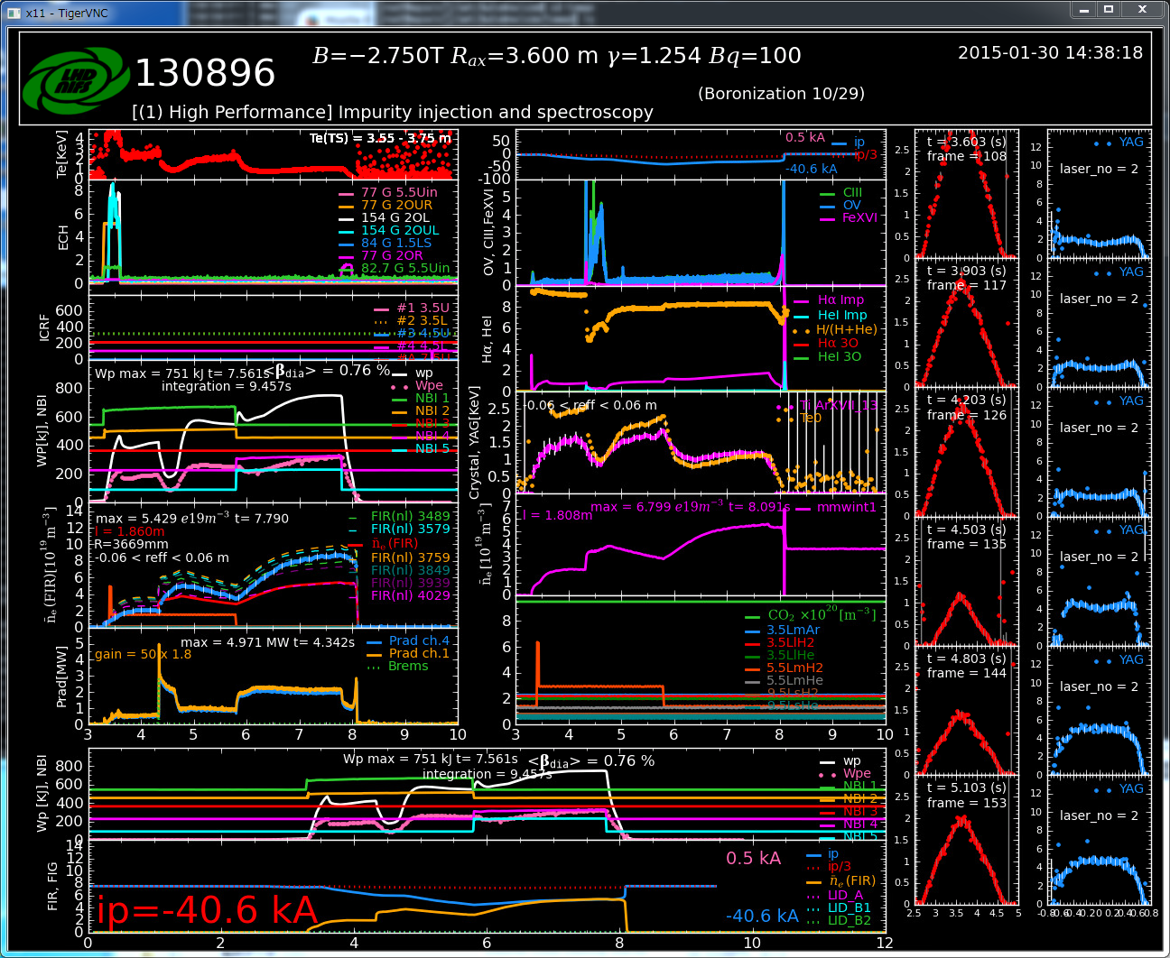
Notes:
This figure is an example of LastShot
It displays the ECH, NBI, and so on.
The main purpose of the LastShot is to confirm the health of the experiment, and the absolute value is not so import.
For example, it is used to check if plasma current is within the range, NBI is injected or not, and so on.
In this graph, it warns that the plasma current is out of range.

Slide 12
LastShot
Python-based Application
Specially customized to draw the summary data quickly.
To check the health of the experiment (Plasma Current is OK, Gas is puffed, NBI is injected or not)
Mainly draw the raw signal data
Displayed in the main screen of the control room.
Notes:
Here is the main features of LastShot.
LastShot is a python-based application.
It is specially customized to draw the summary graph quickly.
The main purpose of this application is to check the health of the experiment.
It deals mainly with the raw signal data.
The LaystShot is sisplayed in the main screen of the control room.

Slide 13
Notes:
In order to draw the most recent plasma data as soon as possible,
LastShot uses the following technique.
When the discharge begins, LastShot creates multiple retriever process to get the raw signal data.
Retriever processes requests LABCOM system to get the raw signal data.
This request sleeps until the raw signal data is ready.
Therefore, when the raw signal is registered into LABCOM system,
LastShot can draws its graph at once.

Slide 14
Notes:
Here is an example of MyView2.
Different from LastShot, MyView2 is developed to draw mainly the analyzed data.
Such as the electron temperature distribution on the unified coordinate as the color map.

Slide 15
MyView2
Python-based Application
multipurpose and multi-platform (Windows, MacOS, and Linux) visualization tool.
To view and retrieve the analyzed data using user-friendly operation, especially for the visitors.
Displayed in the each users’ computer.
Server mode and Batch modes; using batch mode, computers near the discussion space display various aspects of the recent plasma automatically.
Notes:
Here is the main features of MyView2.
It is also python-based application, but it is a multi-purpose and multi-platform visualization tool,
Currently supports Windows, MacOS and Linux.
It is developed to view and retrieve analyzed data using user-friendly operation, especially for visitors.
Therefore, it is basically run in each users’ computer.
It has Server mode and Batch modes; using batch mode, computers near the discussion space display various aspects of the recent plasma automatically.

Slide 16
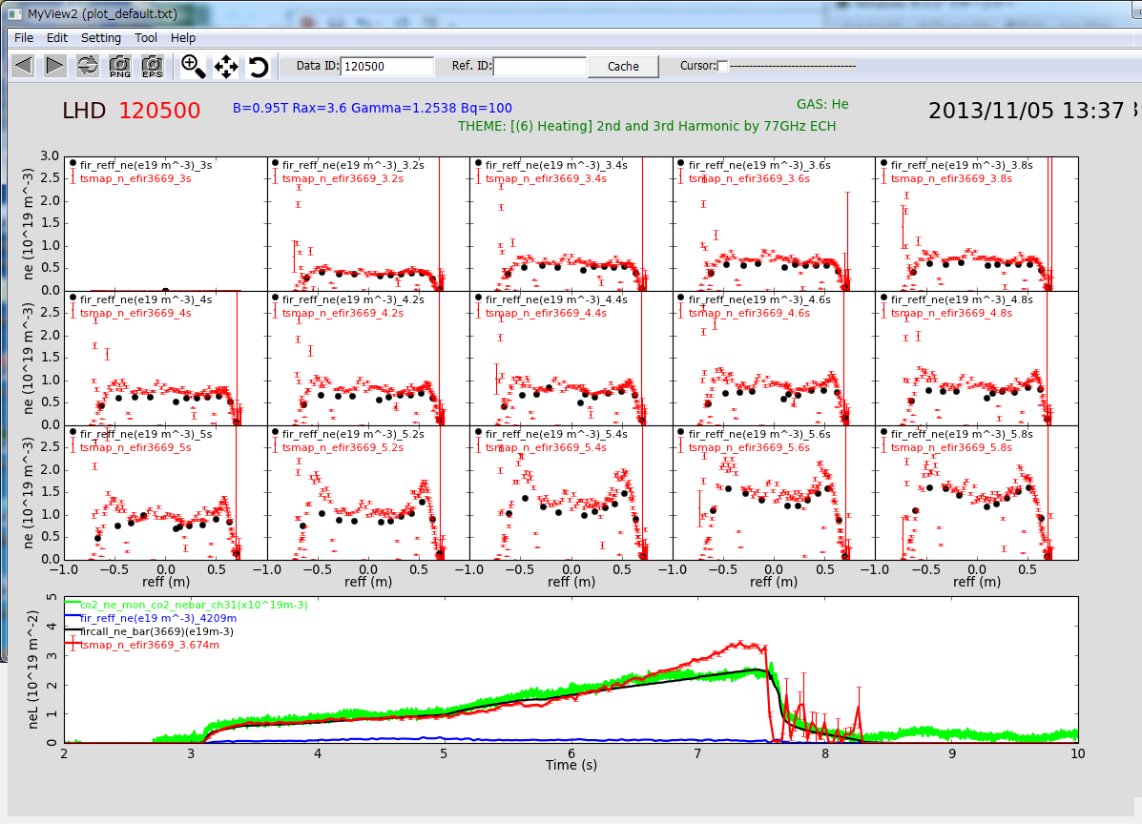
Notes:
The layout and the data source can be flexibly customized using GUI operation.
This figure shows another example of MyView2.
These configuration files are provided by the file server, and the visitors can use the prepared configurations to see
Various analyzed data without difficulties.

Slide 17
Virtual Printer
The final images of LastShot and MyView2 are sent as postscript files to the virtual printer
The virtual printer redirects them to the page printer, as well as converts them into PDF, and JPEG files.
The converted files are served by the Web server
The PDF files of the same day are compiled into single PDF file.
Notes:
As I mentioned, The final images of LastShot and MyView2 are sent as postscript files to the virtual printer
The virtual printer redirects them to the page printer, as well as, it converts them into PDF, and JPEG files.
The converted files are served by the Web server
The PDF files of the same day are compiled into single PDF file.

Slide 18
Remote Participation
The summary graph sent to the virtual printer, and the user can see the graph by the web browser. He can see the real-time image of LastShot by VNC viewer and real-time video displayed in the projector by VLC (Video LAN Client).
Notes:
This diagram shows how remote users can see the summary data.
The summary graph are sent to the virtual printer, and the user can see the graph by the web browser.
He can also see the real-time image of LastShot by VNC viewer and real-time video displayed in the projector by VLC (Video LAN Client).

Slide 19
Notes:
The video signals input into the projector is captured by the sever using Epiphan’s VGA2PCI
Video capturing board.
The captured image is served by VLC (Video LAN Client) as MPEG-4 video stream.

Slide 20
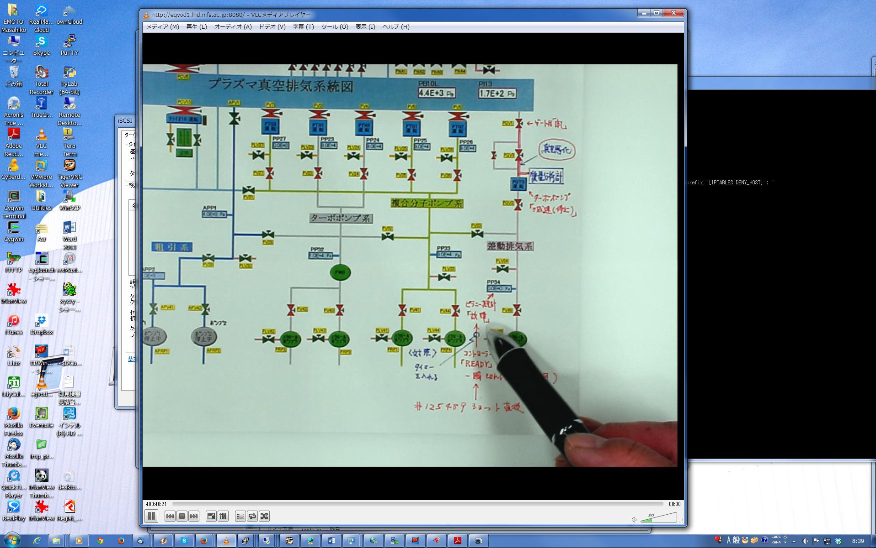
Notes:
This is an example that the remote user is viewing the presenter's material displayed in the main screen.

Slide 21
Real-time Images for remote users
RealServer
  Bird’s eye view of the LHD control room
VNC Reflector
  The screen of LastShot
VLC (MPEG-4 Streaming)
  Main Screen (LastShot, Plasma Movie, etc.)
MPEG1/Flash Movie
  Plasma monitoring videos
Notes:
This list shows the real-time images for remote uers.
Realserver provides the Bird’s eye view of the LHD control room.
The remote users can use VNC Viewer to see LastShot screen, and VLC to watch the main projector screen.
Also, plasma movie are served by web servers as MPEG-1 and flash movies.

Slide 22
Conclusion
The authors have introduced the data monitoring environment for the LHD project. The systems mentioned here help the researchers in the control room as well as the remote user share the information of the current experiment. Also, MyView2 enables the visitors to see the various experiment data without difficulty. The authors believe the system promotes the collaboration of the LHD experiment.
Notes:
The authors have introduced the data monitoring environment for the LHD project.
The systems mentioned here help the researchers in the room as well as the remote user share the information of the current experiment. Also, MyView2 enables the visitors to see the various experiment data without difficulty. The authors believe the system promotes the collaboration of the LHD experiment.

