Slide 1
The 10th IAEA-TM on Control, Data Acquisition,
and Remote Participation for Fusion Research
April 20-24, 2015, Ahmedabad, Gujarat, India
Fast Network Technology and its Application
April 24, 2015
Long distance fast data transfer experiments for the ITER Remote Experiment
K.YAMANAKA¹, H.NAKANISHI², T.OZEKI³, S.ABE¹, S.URUSHIDANI¹, T.YAMAMOTO², Y.NAGAYAMA², H.OHTSU³, N.NAKAJIMA²
¹National Institute of Informatics (NII), Japan
²National Institute of Fusion Science (NIFS), Japan
³Japan Atomic Energy Agency (JAEA), Japan
Notes:
Thank you chairman.
I would like to present “Long distance fast data transfer experiments for the ITER Remote Experiment”.

Slide 2
Outline
ITER Remote Experiment Center (REC)
Fast data transfer experiments and results
  Pacing Method
  MMCFTP (Massively Multi-Connection FTP)
Next step of fast data transfer experiments
Renewal plan of Japanese academic network (SINET)
Conclusion
Notes:
This is an outline.

Slide 3
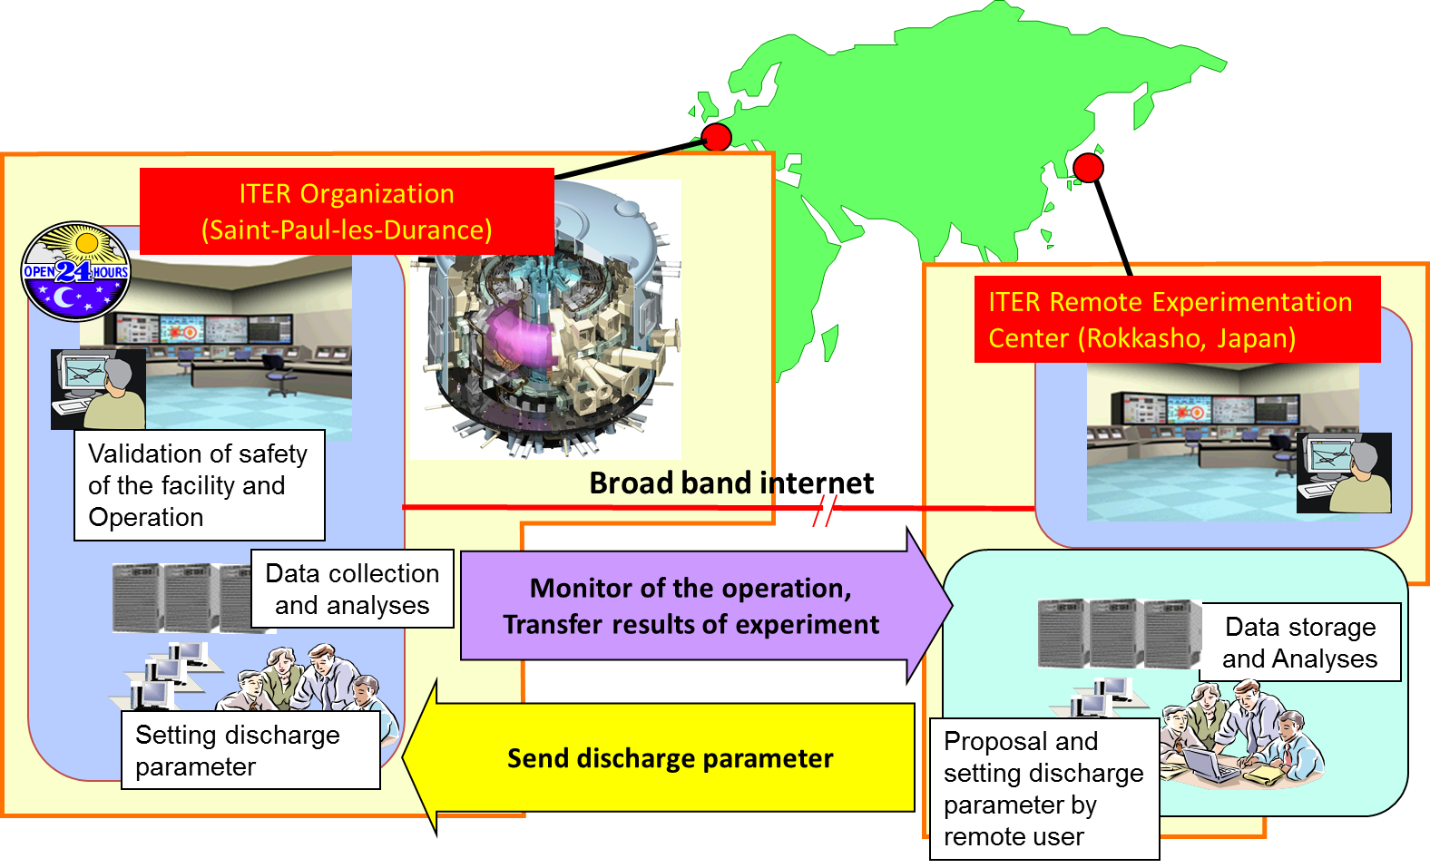
ITER Remote Experimentation Center (REC)
The ITER remote experimentation center will be made to participate the experiment remotely, where the experimental proposal and data collection and analyses will be done through the broad band network.
Notes:
As presented by Professor Nakanishi,
The ITER remote experimentation center (REC) will be made to participate the experiment remotely, where the experimental proposal and data collection and analyses will be done through the broad band network.
In the remote experiment center, build in Rokkasho, Japan,
the remote user will propose and set the discharge parameter.
The discharge parameter will be sent to the on-site facility of ITER, and the experiment will be executed after the validation of this discharge parameter.
After the execution of the experiment, the experiment data will be sent to the remote site and the data will be stored and analyzed.

Slide 4
Challenge and Goal
Challenge
  In ITER, the amount of measured data will be more than 1TB per discharge.
  TCP/IP has a limitation on performance when it is used for data transfer over long fat network (LFN).
  Efficient transfer methods between ITER and REC are needed.
Goal
  Our target speeds between ITER and REC are as follows:
  Over 8 Gbps until Broader Approach end (2017),
  Over 80 Gbps until ITER start (2020).
Notes:
Challenge
In ITER, the amount of measured data will be more than 1TB per discharge.
TCP/IP has a limitation on performance when it is used for data transfer over long fat network (LFN).
Efficient transfer methods between ITER and REC are needed.
Goal
Our target speeds between ITER and REC are as follows:
Over 8 Gbps until Broader Approach end (2017),
Over 80 Gbps until ITER start (2020).

Slide 5
Data transfer methods for LFNs
Three approaches for fast data transfer
  Developing a higher level protocol which uses multiple TCP connections, e.g. GridFTP, bbFTP, FDT, etc.
  Improvement of TCP
    - Improvement of congestion control algorithm: BIC, FAST, HSTCP, etc.
    - Multipath TCP (MPTCP)
  Developing an alternative transport protocol on UDP, e.g. UDT, FASP (by Aspera, an IBM company), etc.
Investigated transfer methods
  Pacing method: A kind of Type 2. (Prof. Nakanishi)
  MMCFTP: Type 1. (Yamanaka)
Notes:
Three approaches for fast data transfer
Developing a higher level protocol which uses multiple TCP connections, e.g. GridFTP, bbFTP, FDT, etc.
Improvement of TCP
Improvement of congestion control algorithm: BIC, FAST, HSTCP, etc.
Multipath TCP (MPTCP)
Developing an alternative transport protocol on UDP, e.g. UDT, FASP (by Aspera, an IBM company), etc.
Investigated transfer methods
Pacing method: A kind of Type 2. (Prof. Nakanishi)
MMCFTP: Type 1. (Yamanaka)

Slide 6
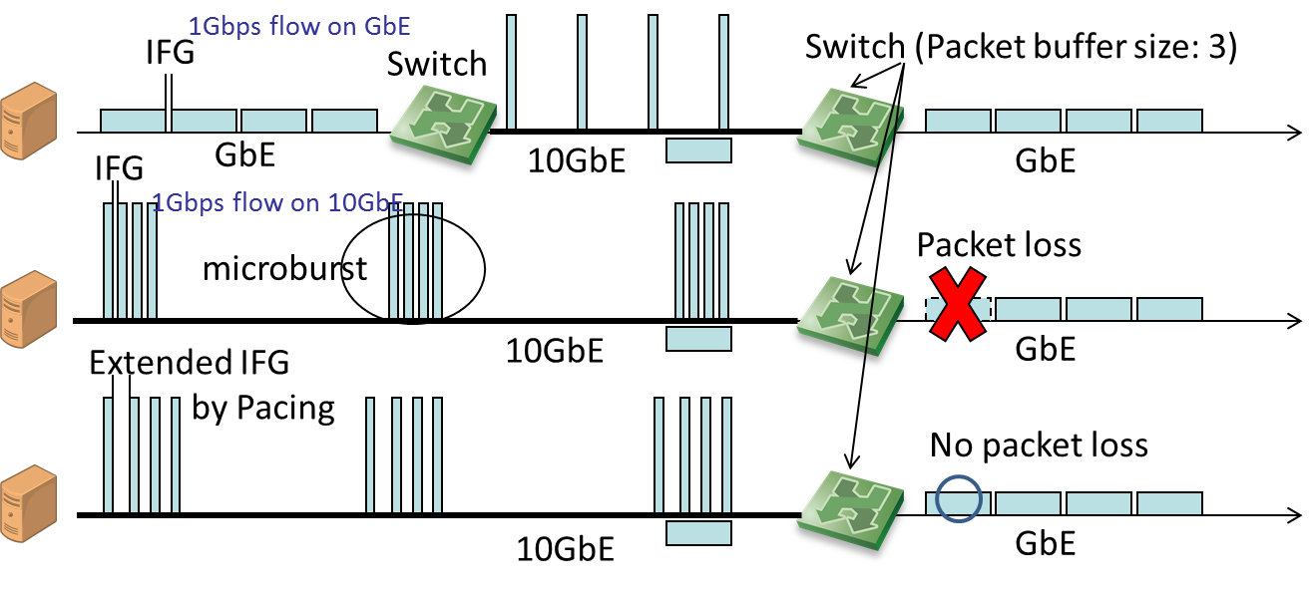
Pacing method - Overview -
Pacing Method:
  Developed by Prof. Hiraki, Tokyo University, and used the experiment that established the world record of bandwidth-delay product, in 2006.
  Extends Inter Frame Gap (IFG) to prevent packet losses by the microburst on switches that have small packet buffer.
Because packet losses on LFNs damage TCP performance, pacing method is useful for long distance fast data transfer.
Notes:
Pacing Method was developed by Prof. Hiraki, Tokyo University, and used the experiment that established the world record of bandwidth-delay product, in 2006.
Pacing Method extends Inter Frame Gap (IFG) to prevent packet losses by the microburst on switches that have small packet buffer.
figure
Because packet losses on LFNs damage TCP performance, pacing method is useful for long distance fast data transfer.

Slide 7
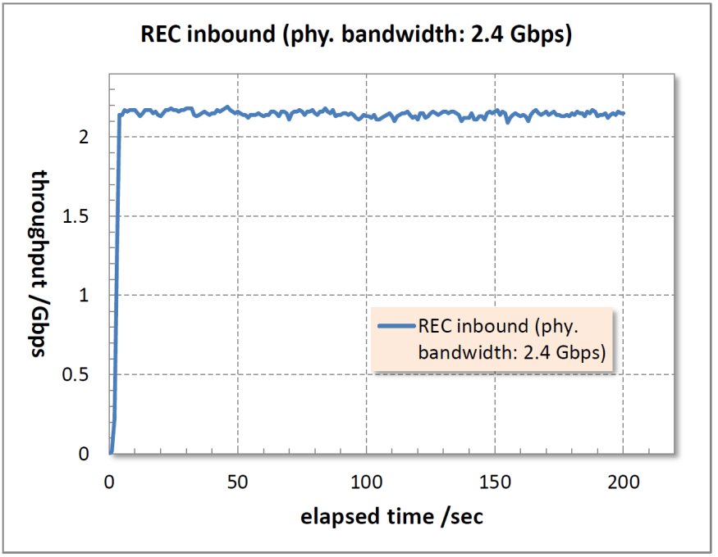
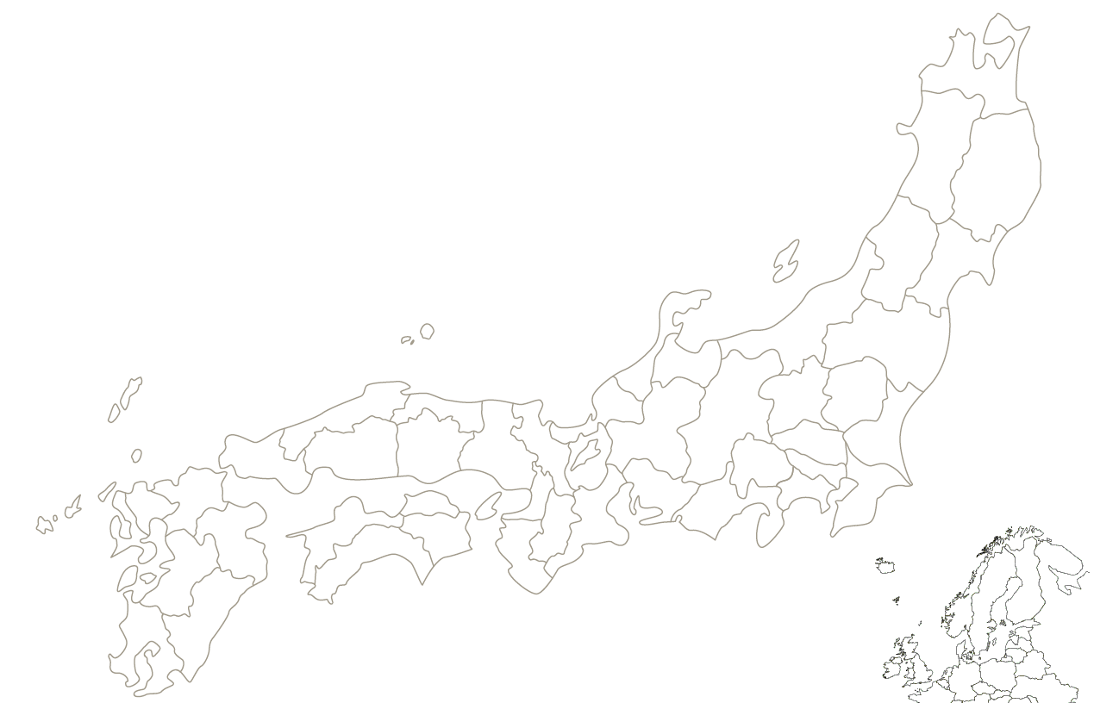

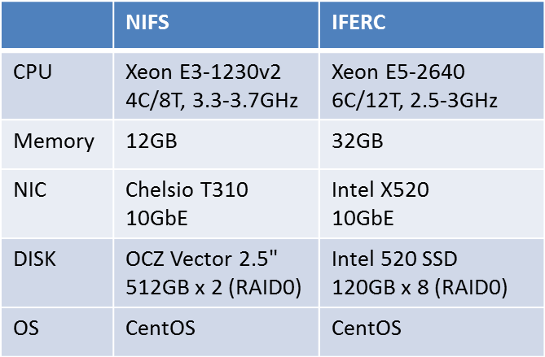
Pacing Method: Experiment Result
Measuring method:
Iperf3
TCP 1 Connection
IFERC (Rokkasho)
Packet loss: 0
Throughput was decreased
when pacing rate < 60%.
10Gbps
2.4Gbps
NIFS (Toki)
Specification of test machines
10Gbps
40Gbps
Notes:
This slide shows the result of Pacing experiment.
Pacing

Slide 8
MMCFTP(Massively Multi-Connection FTP) - Overview-
TCP limitation
  Maximum Window Size: 1GB
  RTT between ITER and IFERC/REC: 300ms
  Maximum speed of 1 TCP connection: 1GB/300ms = 26 Gbps
  To achieve over 80 Gbps transfer, we need an additional solution.
MMCFTP
  A higher level protocol which uses multiple TCP connections (Type 1).
  Traditional type 1 protocols: Maximize TCP speed and restrict number of TCP connections.
  MMCFTP: Restrict TCP speed and use many TCP connections.
  Number of TCP connections are controlled dynamically, based on network condition and transfer speed which user requests.
  The detail of MMCFTP was presented in the last meeting, 9th IAEA TM on Control, Data Acquisition, and Remote Participation for Fusion Research, held in ASIPP, Hefei, China in 2013.
  Important progress from 9th IAEA TM: Linux support
  Experiments were executed using Linux version of MMCFTP.
Notes:
TCP limitation
Maximum Window Size: 1GB
RTT between ITER and IFERC/REC: 300ms
Maximum speed of 1 TCP connection: 1GB/300ms = 26 Gbps
To achieve over 80 Gbps transfer, we need an additional solution.
MMCFTP
A higher level protocol which uses multiple TCP connections (Type 1).
Traditional type 1 protocols: Maximize TCP speed and restrict number of TCP connections.
MMCFTP: Restrict TCP speed and use many TCP connections.
Number of TCP connections are controlled dynamically, based on network condition and transfer speed which user requests.
The detail of MMCFTP was presented in the last meeting, 9th IAEA TM on Control, Data Acquisition, and Remote Participation for Fusion Research, held in ASIPP, Hefei, China in 2013.
Important progress from 9th IAEA TM: Linux support
Experiments were executed using Linux version of MMCFTP.

Slide 9
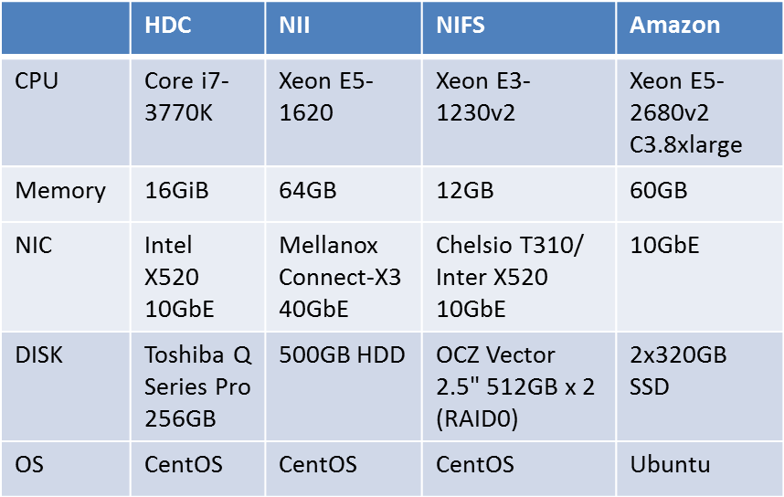
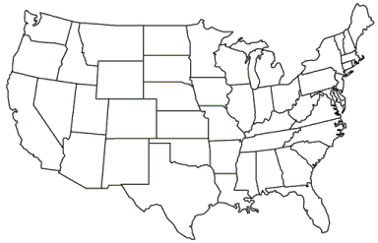
MMCFTP: Experiment Results - Summary -
From | To | RTT | Goodput(*)
NII | HDC | 17ms | 8.46 Gbps | Memory to Memory (*2)
NIFS | HDC | 33ms | 7.82 Gbps | Memory to Memory (*2)
NIFS | NII | 17ms | 8.05 Gbps | Memory to Memory
HDC | Amazon | 295ms | 2.60 Gbps | Memory to Memory (*2)
NIFS | Amazon | 276ms | 2.56 Gbps | Disk to Memory
NII | Amazon | 271ms | 2.42 Gbps | Disk to Memory
IFERC (Rokkasho)
HDC (Hirosaki DC)
10Gbps
10Gbps
NIFS (Toki)
Specification of test machines
40Gbps
40Gbps
NII (Tokyo)
Osaka
10Gbps
40Gbps
Washington DC
Amazon AWS
Dublin, Ireland
10Gbps
(*) Goodput: Application layer throughput. Goodput = L2 throughput - packet header overhead & retransmit overhead
(*2) These experiments were executed as acceptance tests of the 10 Gbps line between Tokyo DC and Hirosaki DC.
There was no traffic except MMCFTP experiments. This 10Gbps line is operated as a dedicated line for IFERC, now.

Slide 10
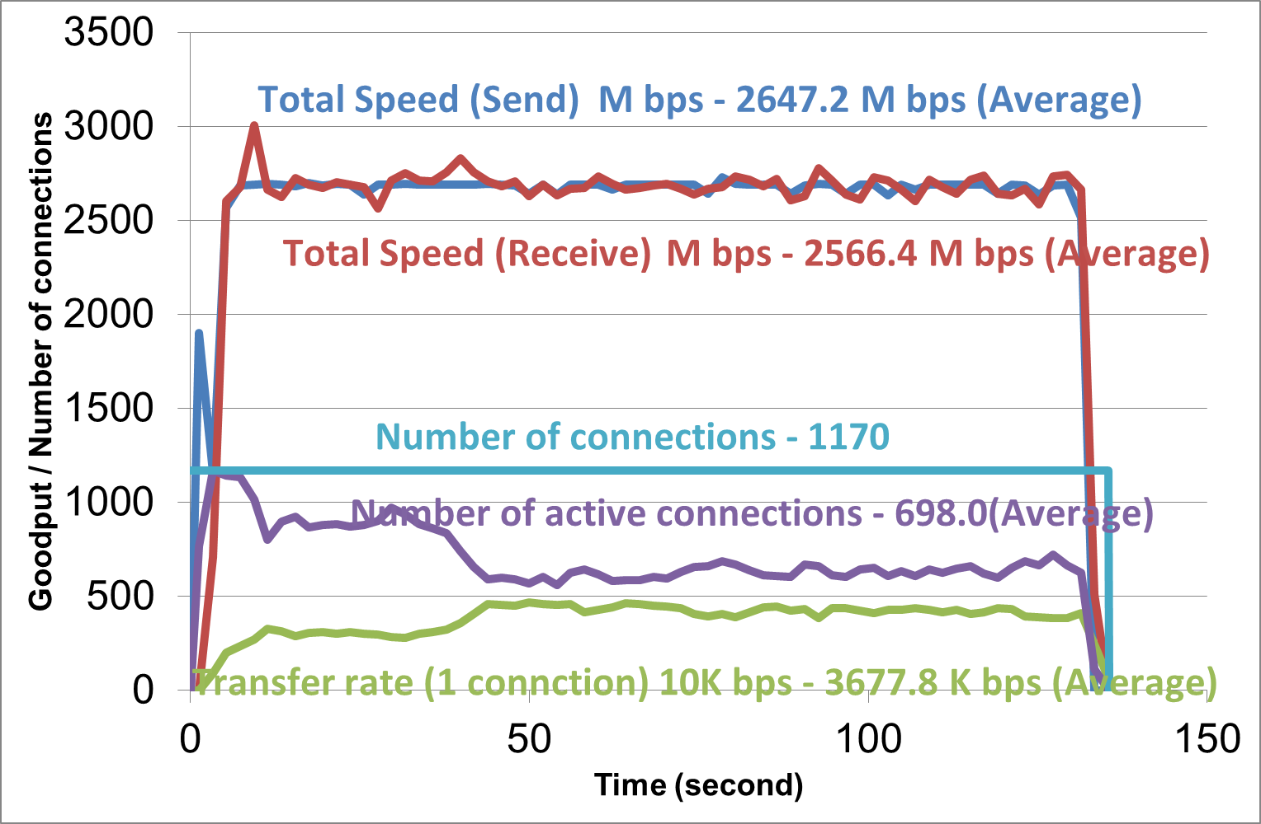
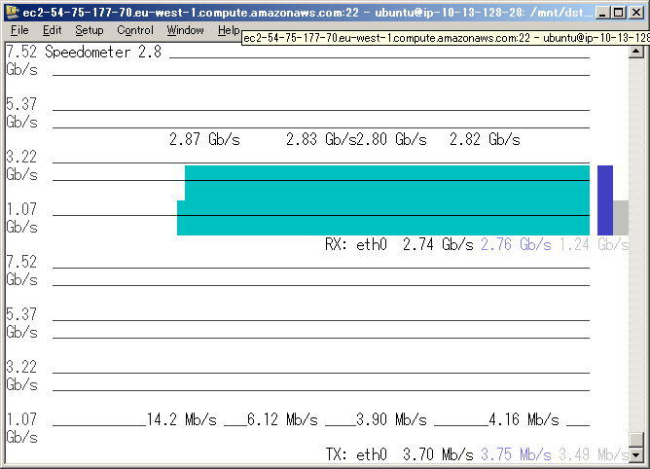
Experiment Results - MMCFTP detail -
From | To | RTT | Goodput | Data Size | Transfer Time
NIFS | Amazon | 276ms | 2.56 Gbps | 43GB | 2 min 15 sec
Speed Bottleneck: Bandwidth limit set by AWS (3Gbps, estimated)
Goodput: 2.56Gbps
43GB: 2min 15sec
Throughput: 2.74Gbps

Slide 11
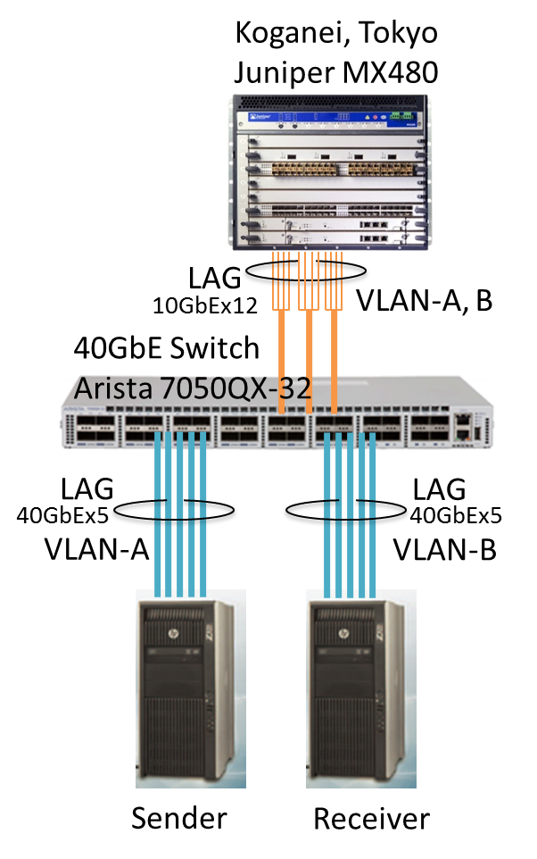
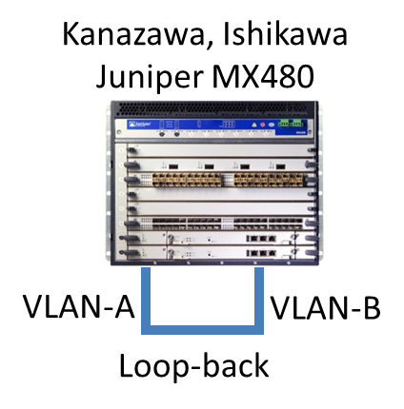

MMCFTP: Experiment on JGN-X
A data transfer experiment on a 100GbE network was executed. Link aggregation technique (LAG) was used for getting over 100 Gbps bandwidth from 40GbE and 10GbE.
Because MMCFTP uses massively multi-connection, traffic are distributed evenly into LAG lines. MMCFTP enables fast data transfer on link aggregated networks.
100GbE
LAG: Link Aggregation
100GbE
100GbE
JGN-X is a Testbed Environment for R&D to realize and broaden the New Generation Network Technologies. It is operated by National Institute of Information and Communications Technology (NICT).

Slide 12
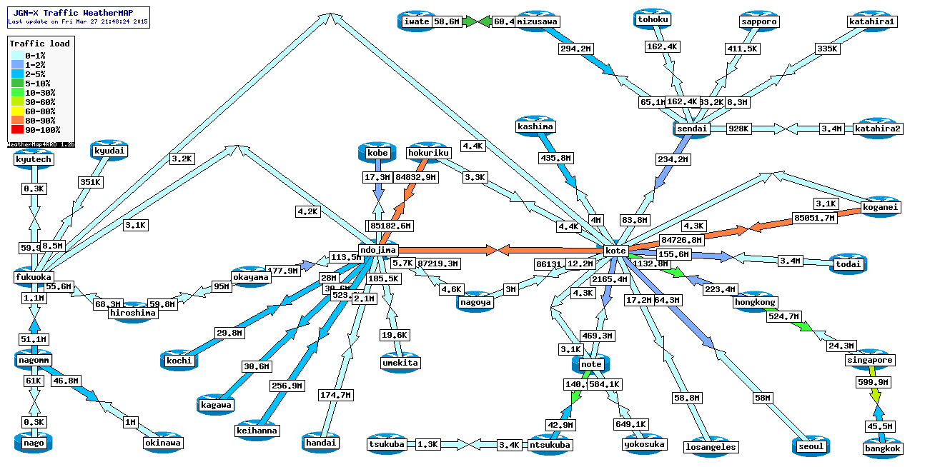
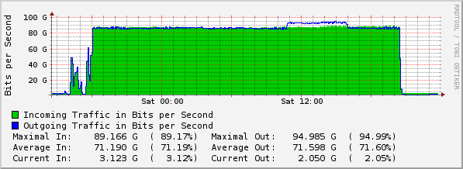
MMCFTP: Experiment Result on JGN-X
RTT | Goodput | Data Size | Transfer Time
25.7ms | 83.7 Gbps | 1PB | 26h 31m 55s
21:48
# of active connections | 2,273
Maximum # of connections | 6,632
Transfer rate per connection | 37.4 Mbps

Slide 13
Outline
ITER Remote Experiment Center (REC)
Fast data transfer experiments and results
  Pacing Method
  MMCFTP (Massively Multi-Connection FTP)
Next step of fast data transfer experiments
  Data transfer experiments under security requirements will be executed as an next step.
Renewal plan of Japanese academic network (SINET)
Conclusion

Slide 14
Detail of Experiment environment
In the current experiment environment,
security consideration is minimum.
Security is important as much as performance.
In the next step, we will test data transfer between the ITER organization and IFERC/REC in more secure network environment:
1: network protected by firewall
2: L2/L3 VPN
SINET4
IFERC (Rokkasho)
L2SW
Firewall
10Gbps
IFERC/
CSC
SINET4
2.4Gbps
L2SW
10Gbps
Firewall
SINET4
NIFS
IPS (*)
NIFS (Toki)
Firewall
10Gbps
40Gbps
NII (Tokyo)
40Gbps
10Gbps
(*) Traffic between IFERC and NII and between NIFS and NII are excluded from inspections by Intrusion Prevention System (IPS). If inspection is enabled, maximum transfer speed become 4 Gbps, because of IPS’ performance limit.
Amazon AWS
Dublin, Ireland
10Gbps

Slide 15

Next step 1: Experiment on network protected by firewall
SINET4
IFERC (Rokkasho)
Fast file transfer tests between hosts behind firewalls
  To demonstrate influence of network security equipment to performance
  Target speed: 4 Gbps between IFERC and ITER.org.
L2SW
Firewall
10Gbps
IFERC/
CSC
10Gbps
GÉANT/RENATER
Firewall
40Gbps
10Gbps
ITER.org
10Gbps

Slide 16
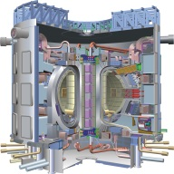
Next step 2: Experiment on L2/L3 VPN
Faster file transfer tests between hosts in L2/L3-VPN
  Faster data transfers will require for ITER remote experiments, and firewalls prevent faster data transfers.
  Advanced research projects often use L2/L3-VPN to meet both of security and performance requirements.
  E.g. LHCone for LHC, SNET for LHD.
  This test will demonstrate the necessity of L2/L3-VPN for ITER remote experiments.
  Target speed: Over 8 Gbps between IFERC and NIFS.
SINET4
IFERC (Rokkasho)
VLAN multiplexing
L2SW
Firewall
10Gbps
IFERC/
CSC
FW
SINET4
VLAN multiplexing
2.4Gbps
L2SW
10Gbps
Firewall
SINET4
NIFS
FW
L2SW
NIFS (Toki)
Firewall
40Gbps
NII
10Gbps
FW
NII (Tokyo)
40Gbps
In the future
100Gbps
: L2/L3VPN

Slide 17
Outline
ITER Remote Experiment Center (REC)
Fast data transfer experiments and results
  Pacing Method
  MMCFTP (Massively Multi-Connection FTP)
Next step of fast data transfer experiments
Renewal plan of Japanese academic network (SINET)
  New SINET will provide a 100Gbps line between USA and Japan
  New SINET will provide two of 10Gbps lines between EU and Japan
Conclusion

Slide 18
Science Information Network (SINET4)
SINET is a Japanese academic backbone network (NREN) for more than 800 universities and research institutions, and current version, SINET4, started in 2011.
  SINET4 covers all 47 prefectures.
  SINET4 covers 100% of national, 71% of public, and 53% of private universities
  Approximately 2 million users, including researchers and students.
(As of March 2014)
 | National Universities | Public Universities | Private Universities | Junior Colleges | Colleges of Technology | Inter-Univ. Research Institutes | Others | Total
Number of Organizations | 86 | 68 | 333 | 60 | 55 | 16 | 184 | 802
： Core Node
： Edge Node
： Core Line (40 Gbps)
： Core Line (10 Gbps)
： Edge Line (40 Gbps)
： Edge Line (10 Gbps)
： Edge Line (2.4 Gbps)
To Los Angeles
To New York
To Washington D.C.
To Singapore
Notes:
Science Information Network, SINET, is a Japanese academic backbone network for more than 800 universities and research institutions. It is now being used by more than 2 million users and its traffic volume has been growing.
Current version, SINET4, which was launched in 2011, places the access nodes in all 47 prefectures and has 40-Gbps lines as the maximum speed lines.
SINET4 covers 100% of national, 71% of public, and 53% of private universities.

Slide 19
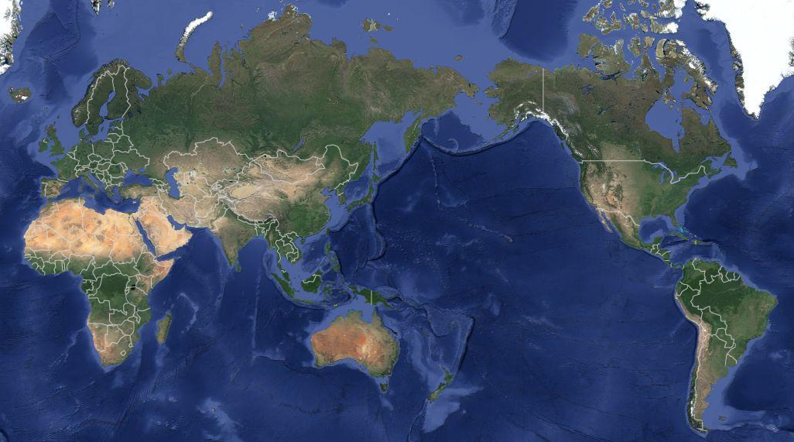
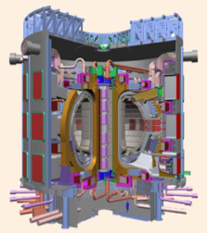
Infrastructure for International Collaboration
SINET4 currently has four international 10-Gbps lines since April 2013 for international research collaboration.
It is connected to GÉANT and European academic networks by the peering at MANLAN in New York and WIX in Washington D.C and via TEIN4.
NORDUnet
SURFnet
CAnet4
CalREN
ESnet
New York
GÉANT
ITER
(Remote Site)
MAN
LAN
Pacific
Wave
Internet2
RENATER
TEIN
WIX
(*)
Los Angeles
Washington DC
ITER
(France)
Singapore
RedCLARA
AARnet
REUNA
： SINET International Line (10Gbps)
(*) One of 10Gbps lines is operated by GÉANT as a dedicated line for ITER
© Google map
Notes:
SINET4 also supports many international research projects between foreign countries and Japan by its international lines, currently three 10-Gbps USA lines to Los Angeles, New York, and Washington D.C, and a 10-Gbps Singapore line.
Through these international lines, researchers in Japan use outside facilities of joint projects, such as LHC and ALMA, enable foreign researchers to use domestic facilities, such as Belle II and ITER computer, or combine domestic and foreign facilities, such as eVLBI.
We are very grateful for the cooperation of our partners, such as Internet2, GÉANT, TEIN, and so on, because international collaboration can not be achieved without their support.

Slide 20
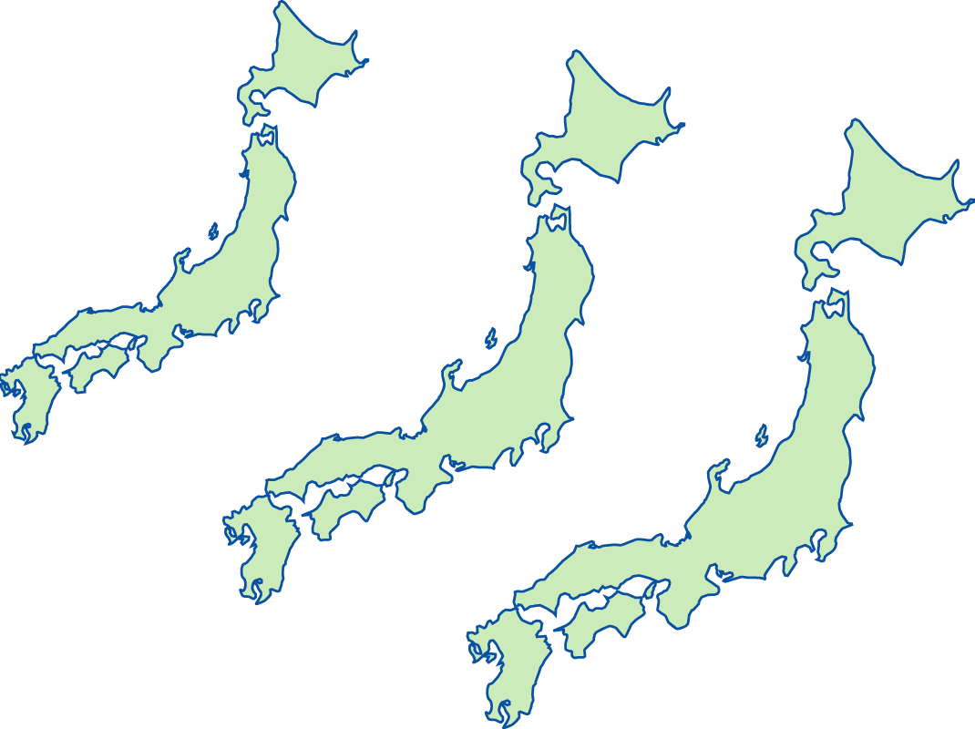
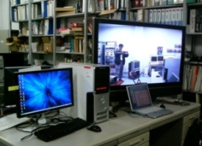
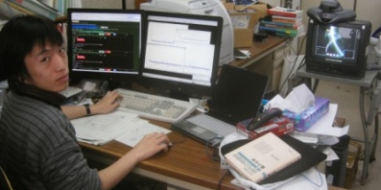
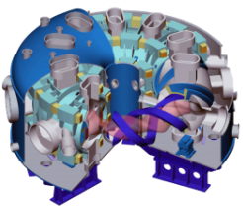
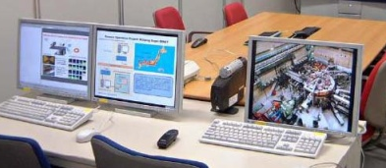
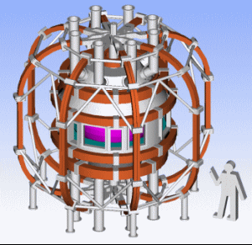
Usage Example in Nuclear Fusion Science
Large Helical Device (LHD) and its measured data are shared among universities and NIFS through SINET VPN, and the data volume has been increasing.
Rokkasho-mura, the remote site of ITER, is open for supercomputer simulations from Europe.
Source: National Institute for Fusion Science (NIFS)
2002
2005
2020
LHD data
ITER
Tokyo Univ.
ITER remote site
(Rokkasho-mura)
Kyoto Univ.
Large Helical Device (LHD)
ITER data
L3VPN/VPLS
QUEST data
Kyushu Univ.
NIFS’s data collection system for LHD
QUEST (Q-shuUniv. Exp. with Steady- State Spherical Tokamak)
ITER in France
Notes:
In nuclear fusion research, they also have the huge experimental devices such as Large Helical Device (LHD) in Toki, QUEST in Fukuoka, and ITER which is now under construction in France.
As for LHD and QUEST, they use L3VPN and VPLS in order to share the data measured at the devices and video communication between them.
About the ITER, the full operation will start in around 2019. But Rokkash-mura, the remote site of ITER, is open and supercomputer funded by EU was installed in 2012, and European countries are using this supercomputer for some pre-simulations.

Slide 21
Fiber Network Topology of SINET5
SINET5 will use nationwide dark fibers which connect data centers with redundant routes.
Each data center has a SINET node, and WDM-based ROADM and MPLS-TP devices connect these SINET nodes.
Data center
SINET Node
SINET Node
SINET Node
ROADM
+MPLS-TP
ROADM
+MPLS-TP
ROADM
+MPLS-TP
: Dark Fiber
: Wavelength Path
: MPLS-TP Path
Europe
: Dark Fiber
: Leased Line
: Data Center
USA
Asia
Notes:
From this slide, I would like to explain our new network, SINET5, which will be launched in 2016.
SINET5 will use dark fibers which are illustrated by orange lines in this slide, cover all prefectures excepting Okinawa, and have redundancy.
It has the same number of access points, 50 access points, to SINET4, each of which accommodates access lines of universities in the prefecture and has a WDM-based transport system.

Slide 22
Network Bandwidth of SINET5
Each line speed will be at least 100 Gbps, and each line speed of major route between Sapporo to Fukuoka will be 200-Gbps or more.
Each line speed can be increased on a 100-Gbps basis and upgraded by using emerging 400-Gbps or more interfaces in the near future.
：10 Gbps
：100 Gbps
：200 Gbps or more
Europe
USA
Asia
Notes:
This slide shows the bandwidth of SINET5.
Green lines have at least 100-Gbps bandwidth, and red lines, which are along the major routes of our network, have 200Gbps to 1Tbps bandwidth.
We will install WDM-based systems which enable us to introduce 400 Gigabit Ethernet technologies in the near future.

Slide 23
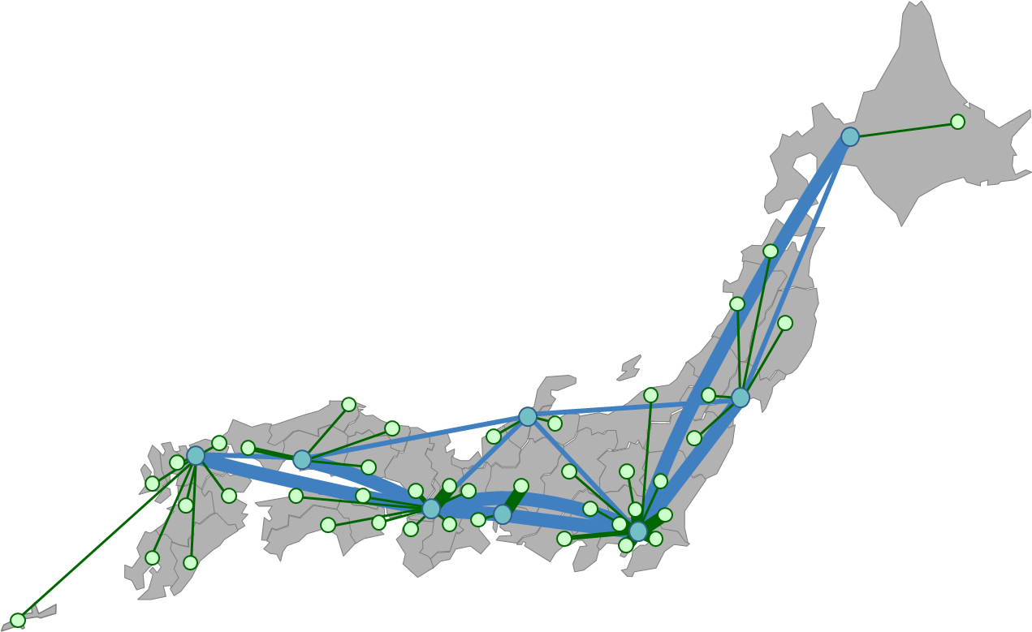
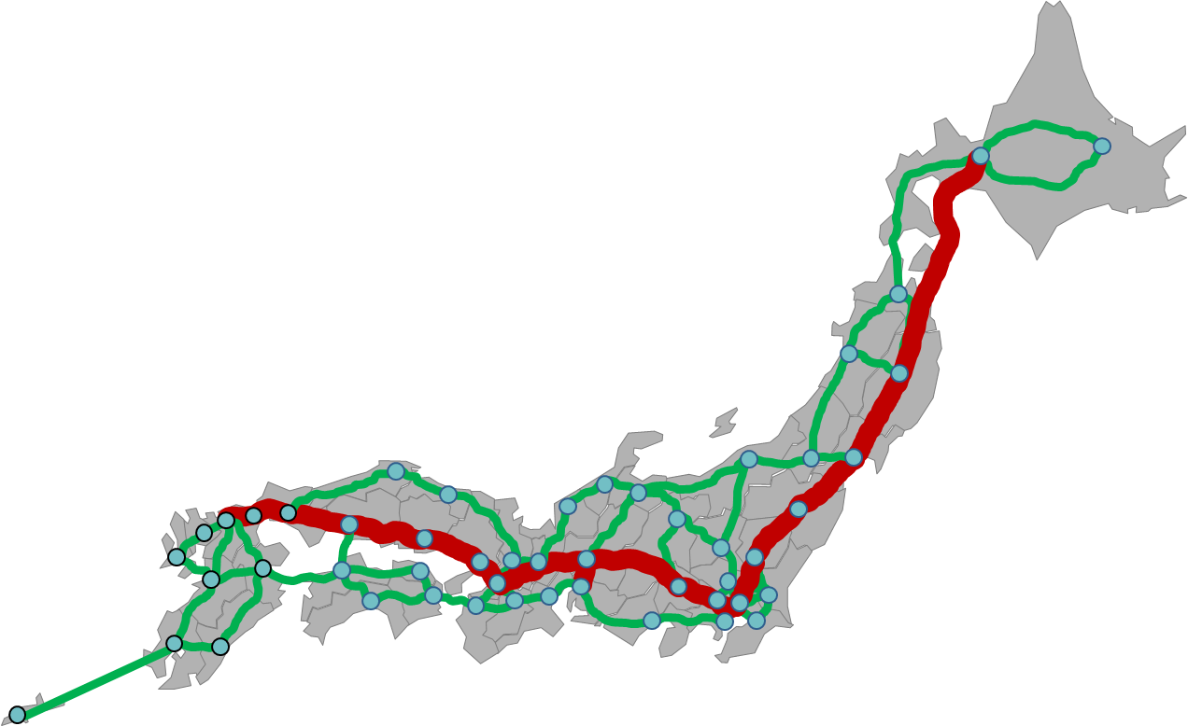
Minimized Latency and Enhanced Reliability
SINET5 connects all the SINET nodes in a fully-meshed topology and minimizes the latency between every pair of the nodes.
MPLS-TP devices connect a pair of the nodes by primary and secondary MPLS-TP paths.
SINET4
SINET5
Connects nodes in a star-like topology
Secondary circuits of leased lines need dedicated resources
Connects all the nodes in a fully-meshed topology with redundant paths
Secondary paths do not consume resources
: Leased Line (Primary Circuit)
: MPLS-TP Path (Primary)
: Leased Line (Secondary Circuit)
: MPLS-TP Path (Secondary)
Edge
Edge
GW
Edge
Node
Node
GW
Node
Edge
Core
Edge
Node
Node
Core
Core
Edge
Edge
Node
Node
Edge
Edge
Edge
Node
Node
Node

Slide 24
International Lines of SINET5
SINET will have a 100-Gbps line to U.S. West Coast in April 2016 and will keep a 10-Gbps line to U.S. East Coast.
SINET will have two direct 10-Gbps lines to Europe in April 2016, exploring the possibility of a 100-Gbps line in the near future.
SINET will keep a 10-Gbps line to Singapore in April 2016.
NORDUnet
SURFnet
CAnet4
10Gbps x 2 in April 2016
(100Gbps in 201X)
CalREN
ESnet
New York
GÉANT
ITER
(Remote Site)
MAN
LAN
Pacific
Wave
Internet2
RENATER
TEIN
100Gbps in April 2016
WIX
Los Angeles
Washington DC
ITER
(France)
10Gbps x1
in April 2016
10Gbps
Singapore
RedCLARA
AARnet
REUNA
© Google map
Notes:
NII also plans to upgrade the international lines in response to the increase of expected international traffic.
As for the traffic to North and South America, we are considering the upgrade of the West Coast line from 10Gbps to 100Gbps in April 2016 and will keep the East Coast line of 10Gbps.
As for the traffic to European countries, although we currently use the East Coast line for the purpose, but we will have a direct line instead in response to the increase of the traffic. Its bandwidth is 20Gbps, in April 2016.

Slide 25
Schedule for SINET5
NII plans to start full-scale operation of SINET5 in April 2016, and International lines should be operational at the same time.
2013 |  |  |  | 2014 |  |  |  | 2015 |  |  |  | 2016 |  |  |  | 2017
SINET4
Procurements
Migration
Nationwide 100Gbps or more
100Gbps International Lines
SDN and Cloud Services
Domestic Network Construction
International Lines
SINET5
▲Full-Scale Operation
Today
Notes:
This is the time line. NII will launch SINET5 in April 2016, and its procurement already started. The new international lines will be operational at the same time.

Slide 26
Conclusion
Fast data transfer between ITER and REC is feasible, technically.
Networks for over 10 Gbps transfer between ITER and REC will be available next year (April 2016).
Data transfer experiments under security requirements will be executed as an next step.
Notes:
Fast data transfer between ITER and REC is feasible, technically.
Networks for over 10 Gbps transfer between ITER and REC will be available next year (April 2016).
Data transfer experiments under security requirements will be executed as an next step.

Slide 27
Thank you very much!

