Slide 1
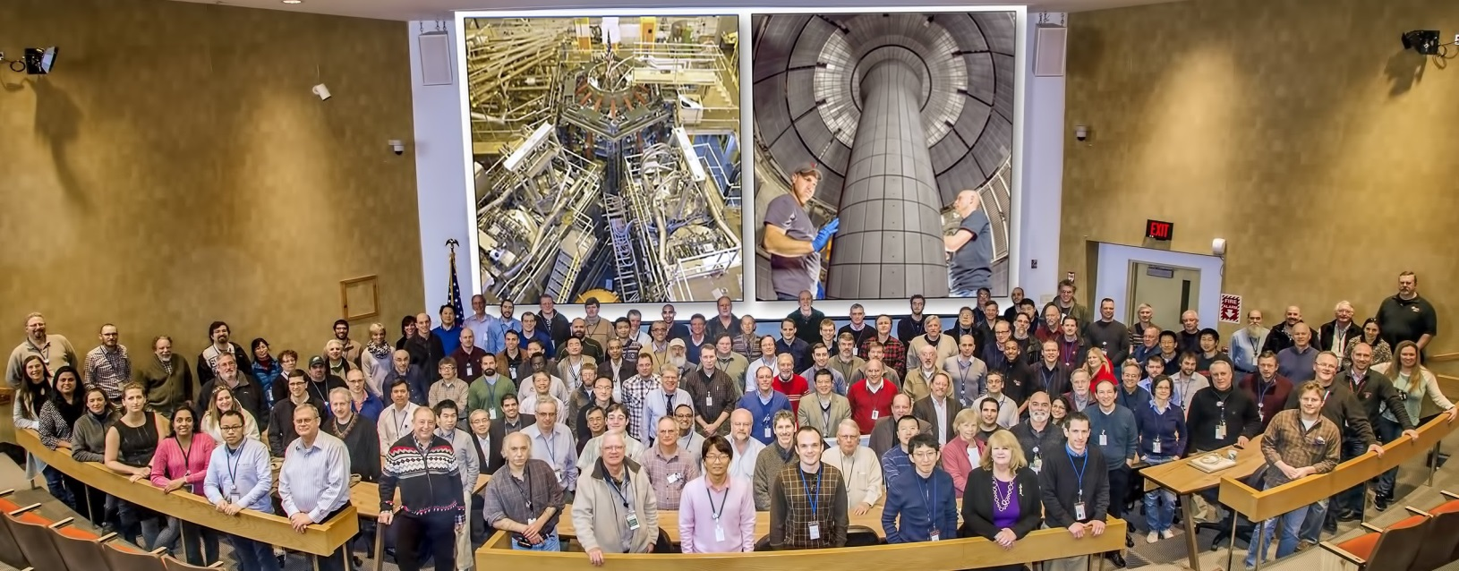
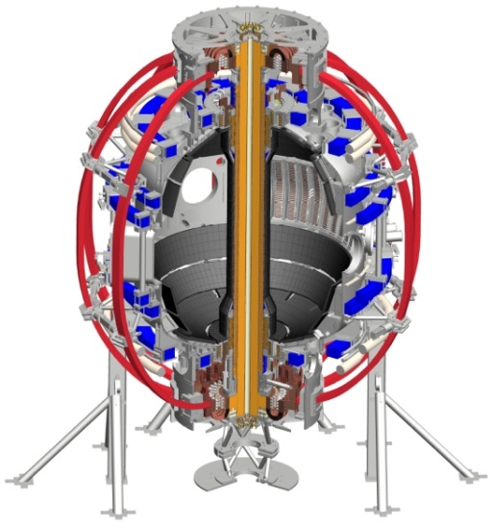
NSTX-U
Supported by
Control and Data Acquisition Upgrades
for NSTX-U
W.M. Davis
G. J. Tchilinguirian, T. Carroll, K. G. Erickson, S. P. Gerhardt, P. Henderson, S. H. Kampel, P. Sichta, G. N. Zimmer
and the NSTX-U Research Team
Tenth IAEA Technical Meeting on Control, Data Acquisition, and Remote Participation for Fusion Research
20-24 April 2015, Ahmedabad, Gujarat, India.
Abstract Number 146

Slide 2
Overview
Overview of NSTX-U
Major computer-related upgrades
Increased use of IR and Fast 2-D cameras
Configuration changes
Event-serving enhancements

Slide 3
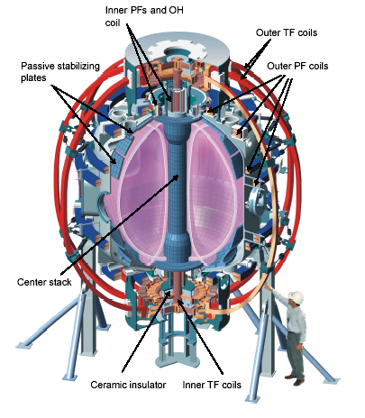
NSTX upgraded to NSTX-U
NSTX, a medium sized Spherical Tokamak, ran from 1999 to 2011.
US$94M upgrade over 3 years just about complete
Toroidal field strength will go from 0.55 T to 1 T
Neutral Beam heating power will go from 6 MW to 12 MW (HHFW remains at 6 MW)
The maximum pulse length will increase from 1.5 s to 5 s.
The maximum plasma current will increase from 1 MA to 2 MA

Slide 4
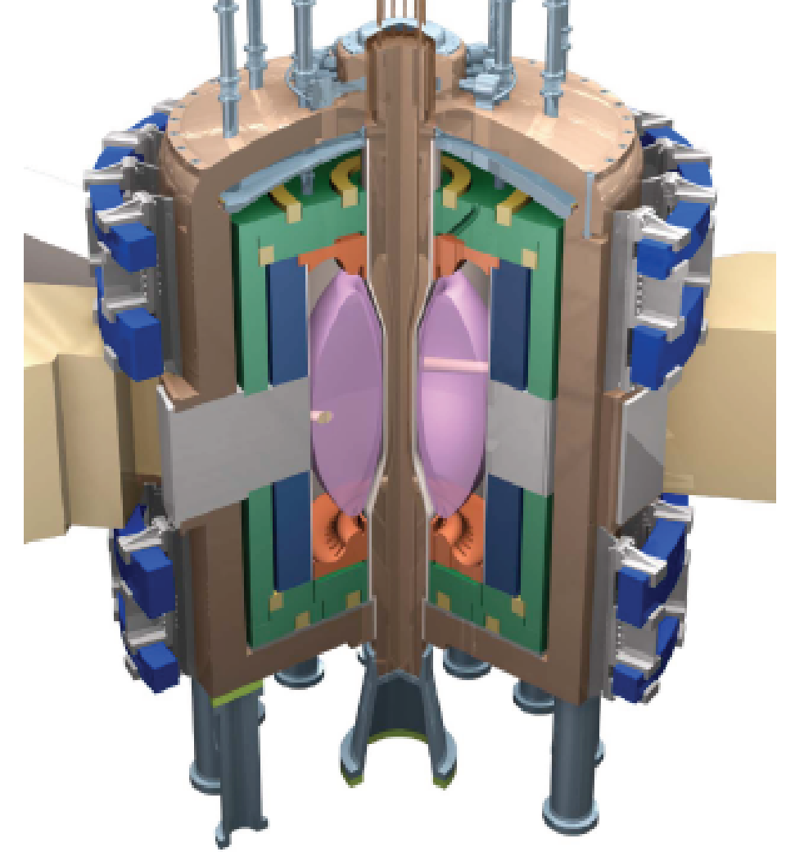
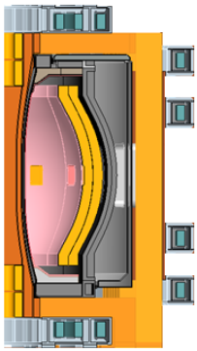
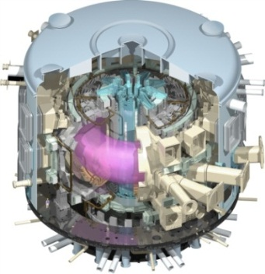
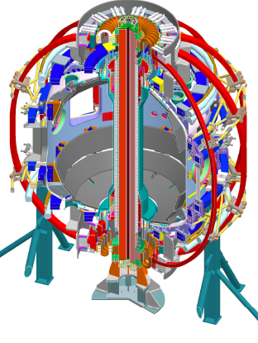
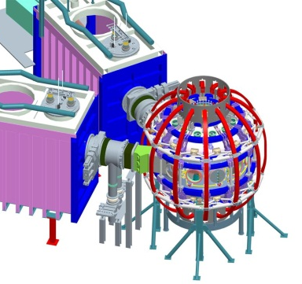
NSTX-U research targets predictive physics understanding needed for fusion energy development facilities
Enable key ST applications
Move toward steady-state ST FNSF, pilot plant
Close key gaps to DEMO
Extend understanding to tokamak / ITER
Leverage ST to develop predictive capability
Fusion Nuclear Science Facility (FNSF)
ST Pilot Plant
Present Research
Develop key physics understanding to be tested in unexplored, hotter ST plasmas
Study high beta plasma transport and stability at reduced collisionality, extended pulse
Prototype methods to mitigate very high heat/particle flux
Move toward fully non-inductive operation
ITER
NSTX-U
Menard, IAEA FEC Meeting, 2012
New center-stack
2nd Neutral Beam
Notes:
The spherical tokamak (ST) is a leading candidate for a Fusion Nuclear Science Facility (FNSF) due to its compact size and modular configuration.

Slide 5
NSTX-U Heating Systems
HHFW
System
1st NBI
2nd NBI

Slide 6
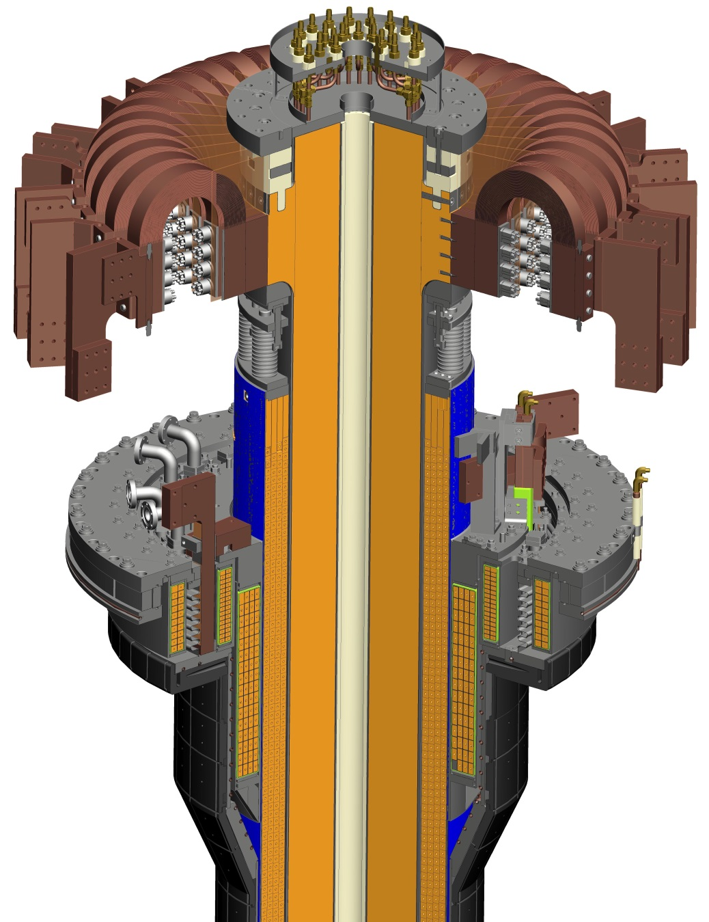
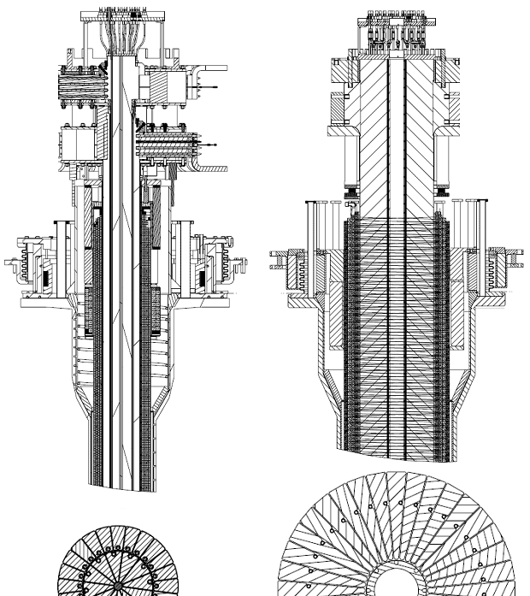
Center Stack Upgrade
Old
Center Stack
New
Center Stack

Slide 7
Major computer-related upgrades for NSTX-U
Digital Coil Protection System¹, a new real-time system
Network trunks increased from 1 Gb/s to 10 Gb/s.
300 TB added to our Hitachi SAN array
Expecting a 2x increase in conventional signal data
Expecting a 4x increase in Fast 2-D and IR Camera data
4x increase in between-shot processing power, plus the ability to get results from TRANSP code between shots
After the construction phase is certified (DoE Critical Decision 4):
Upgrade to version 6 of MDSplus
Upgrade to RHEL 6
Upgrade MDSplus server host
Reconfigure internal VLANs to avoid Internal Firewall
1 – see K. Erickson presentation, abstract 157

Slide 8
Increasing quantities of data, users, and computer resources from NSTX to NSTX-U
 | NSTX 2010 run | NSTX-U 2015 est. | NSTX-U 2018 est.
Max pulse length (sec) | 1.5 | 3.5 | 5
Fast Camera data/sec (GB) | 2.5 | 10 | 40
IR Camera data/sec (GB) | 0.1 | 2 | 8
Conventional Signal data/sec (GB) | 2.5 | 5 | 20
Total GB for typical pulse | 5 | 17 | 68
Total GB for max pulse | 8 | 60 | 340
run days/year | 100 | 75 | 75
pulses of interest | 4000 | 3000 | 2025
Concurrent users | 50 | 60 | 80
Diagnostic systems | 45 | 52 | 65
Linux CPU cores for between shot processing | 58 | 194 | 776
Cores for Real-time processing | 8 | 64

Slide 9
Camera-based diagnostics are increasing
Fast 2-D Camera data is an important source of understanding the plasma behaviour
macroscopically (full vessel view)
edge turbulence
Lithium and Divertor studies
IR camera data is increasing on NSTX-U
Understanding heat transport is critical for confinement and plasma-material interface (PMI) issues in ITER and beyond
The ST is well suited for these studies
NSTX-U plans new lithium studies and divertor technology

Slide 10
Camera types contributing the most data
Camera Type | Typical MB/pulse | Max MB/pulse | Mega Pix/sec | Max. Resol. | Bits/ pixel
Phantom 7.3 (2@) | 1000 | 4000 | 3000 | 800x600 | 14
Phantom 710 (2@) | 1000 | 10000 | 7000 | 1280x800 | 12
Phantom v1211 | 2000 | 12000 | 12000 | 1280x800 | 12
Miro 4 | 350 | 1000 | 600 | 800x600 | 12
Miro 2 | 50 | 2000 | 300 | 640x480 | 12
SBF 161 (2@) | 500 | 750 | 26 | 128x128 | 14
FLIR Tau 2 (2@) | 110 | 110 | 20 | 640x512 | 14
IDS UI-5240CP-NIR | 43 | 43 | 60 | 1280x1024 | 10
Dalsa GigE Vision Spyder 3 (8@) | 75 | 75 | 40 | 1024 | 12
Princeton Instruments ProEM GigE 1600x400 | 28 | 28 | 380 | 1600x400 | 16
Princeton Instruments ProEM GigE 1600x200 | 20 | 20 | 370 | 1600x200 | 16
Princeton Instruments CCD w/PCI Spec-10 | 27 | 27 | 130 | 1340x100 | 16

Slide 11
Camera Types used by NSTX-U Diagnostic
DIAGNOSTIC | CAMERA | ACQUISITION SOFTWARE
lower divertor fast IR | Santa Barbara Focalplane SBF 161
upper divertor fast IR | Santa Barbara Focalplane SBF 161
wide-angle, lower divertor IRTV | FLIR Tau 2
Tangential RF Antenna IRTV | FLIR Tau 2
Bay F - lower divertor tangential camera | Phantom73-8032 | LabView
Multi-Point Thomson Scattering | IDS UI-5240CP-NIR GigE Camera | Visual Basic
Bay E - top divertor camera | Vision Research Phantom 710 | LabView
Bay J - top divertor camera | Vision Research Phantom 7.3 | LabView
Bay H - bottom divertor camera | Vision Research Miro 4 | LabView
Bay I - top TWICE camera | ThermoScientific CID Camera | Python, already developed and tested on LTX
Bay L / Bay I- midplane camera - TBD | ThermoScientific CID Camera | Python, already developed and tested on LTX
Bay G - midplane ENDD camera | DALSA Camera | LabView
New LLNL Phantom camera | Vision Research Phantom v1211 | LabView
1D CCD arrays | Dalsa GigE Vision Spyder 3 camera | Need to develop, Python + ActiveGigE
Divertor SPRED (VUV spectrometer) | Princeton Instruments ProEM GigE 1600x200 | Winspec+LabView, need to modify, consider Python
Divertor Control Spectrometer | Princeton Instruments ProEM GigE 1600x400 | Winspec+LabView, need to modify, consider Python
DIMS (Divertor UV-VIS imaging spectrometer) | Princeton Instruments ProEM GigE 512x512 | Winspec+LabView, need to modify, consider Python
VIPS2 (Survey UV-VIS spectrometer) | Princeton Instruments CCD w/PCI Spec-10 | Winspec+LabView, need to modify, consider Python
Loweus EUV spectrometer | Princeeton Instruments CCD w/USB2 Pixis XO 100B | Winspec+LabView, need to modify, consider Python
Xeus EUV spectrometer | Princeeton Instruments CCD w/USB2 Pixis XO 100B | Winspec+LabView, need to modify, consider Python
MonaLisa EUV spectrometer | Princeeton Instruments CCD w/USB2 Pixis XO 100B | Winspec+LabView, need to modify, consider Python
Upper Divertor UV-VIS-NIR (survey spectrometer) | Princeton Instruments ProEM CCD
Gas Puff Imaging | Vision Research Phantom 710 | LabView
Plasma TV (full vessel) | Phantom Miro 2 | LabView

Slide 12
Computer enhancements
# of cores for between-shot processing doubles every 2 years
Real-time processing power increasing even faster
32-core system added for between-shot TRANSP
MDSplus data server upgrade planned:
Dell PowerEdge R530
Dual Intel® Xeon® E5-2450 2.10 GHz, 20M Cache, 8.0GT/s QPI, Turbo, 8C
2 200 GB SSD RAID0 System disks.
32 GB RAM
X6 10 GB Ethernet ports
QLogic 2562, Dual Port 8Gb Optical Fibre Channel HBA
4 PCIe x16 ports on riser
PCIe Intel P3700 2TB SSD RAID Card

Slide 13
Configuration changes planned
Change from a single 10 gigabit connection to pass all inter-VLAN traffic to grouping “safe” VLANs in an “iScience” enclave
Offload MDSplus event serving to a separate server and support the use of both UDP and TCP/IP events
Develop Event Repeater to ensure all events delivered regardless of protocol
Rewrite shot cycle control in C++ (currently in IDL)
Distribute data load across connections

Slide 14
In the current PPPL network all inter-VLAN traffic goes through the iFw

Slide 15
Creating an iScience Network can reduce iFw traffic

Slide 16
MDSplus Event Serving enhancements
NSTX-U uses events heavily; perhaps beyond design limits
To synchronize post-processing steps
To pass small amounts of data, like shot numbers
To provide information to monitoring tools
During NSTX operations, event handling could become unreliable after many days of heavy use, requiring a reboot of our MDSplus event (and data) server.
We will distribute our event serving for NSTX-U
Will use UDP events for common, non-critical signaling
Will use the more mature, “guaranteed” TCP/IP events for others, including “legacy” systems that cannot use UDP
Some relaying of events between UDP and TCP/IP may be necessary

Slide 17
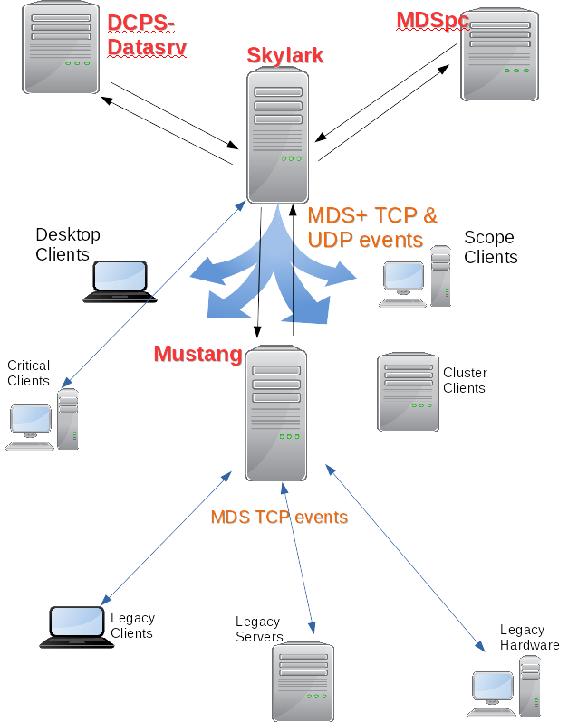

Slide 18
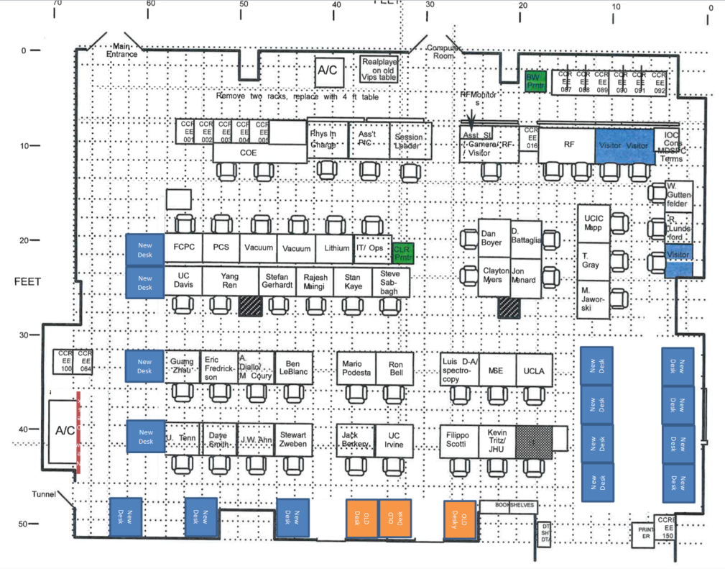
15 new desk locations identified in the NSTX-U Control Room
Blue spaces are new seats

Slide 19
Future possibilities
Investigate Red Hat High Availability (HA) cluster for MDSplus data serving.
System designed with scalability in mind: adding Linux servers to distribute data- and event-serving, and between-shot processing.

Slide 20
Summary
NSTX Upgrade (NSTX-U) Project almost complete
3-years and US$94M
Doubling the toroidal field strength (to 1T) and the Neutral Beam heating power (to 12MW), and increasing the maximum pulse length from 1.5 s to 5 s
Most data loads and computing requirements are increasing with Moore’s Law
Signal data will increase from 2.5 to 5 GB per second of pulse
2-D Fast Camera data is expected to go from 2.5 GB/shot to 10, and
another 2 GB/shot is expected from new IR cameras
New processing power is required
DCPS for real-time coil protection
Between-shot TRANSP for better analysis of plasma performance

Slide 21
Questions?
Bill Davis, bdavis@pppl.gov
Princeton Plasma Physics Laboratory
P.O. Box 451, Princeton, NJ, 08543, USA
Supported by DOE Contract DE-AC02-09CH11466

Slide 22
BACKUP SLIDES FOLLOW

Slide 23
Orders for stations using Macintoshes
# |  | cost @ | Total
4 | 2.6 GHz Mac mini (no monitor) | $700 | $2,800
8 | 27" iMac 3.2 GHz | $1,800 | $14,400
3 | 27" iMac 3.4 GHz | $2,000 | $6,000
1 | 21.5" iMac 2.9 GHz + 1GB Vid memory | $1,500 | $1,500
5 | 27" Thunderbolt display | $1,000 | $5,000
 |  | SubTotal: | $29,700
#
5 | Dell 27" Ultrasharp monitor | $650 | $3,250
3 | Dell Dual 24" Ultrasharp monitors | $700 | $2,100
 |  | SubTotal: | $5,350
 |  | Grand Total: | $35,890

Slide 24
References
J.A. Stillerman, T.W. Fredian, K.A. Klare, G. Manduchi, “MDSplus Data Acquisition System”. Rev. of Sci. Instrum. 68 (1) January 1997, p. 939.
EPICS - Experimental Physics and Industrial Control System, http://www.aps.anl.gov/epics/
S. Kaye, M. Ono, Y.-K.M.Peng, D.B. Batchelor, M.D. Carter, W. Choe, et al., “The Physics Design of the National Spherical Torus Experiment”. Fusion Technology, 36, July 1999, p. 16, or http://nstx.pppl.gov/
J. E. Menard, S. Gerhardt, M. Bell, J. Bialek, A. Brooks, J. Canik, J. Chrzanowski, M. Denault, L. Dudek, D. A. Gates, N. Gorelenkov, W. Guttenfelder, “Overview of the physics and engineering design of NSTX upgrade”, NUCL FUSION, vol. 52, no. 8, 2012 DOI: 10.1088/0029-5515/52/8/083015
P. Sichta, J. Dong, G. Oliaro, P. Roney, “Overview of the NSTX Control System”, 8th ICALEPCS – International Conference on Accelerator and Large Experimental Physics and Control Systems, San Jose, CA . (2001)
W. Davis, P. Roney, T. Carroll, T. Gibney, D. Mastrovito, “The use of MDSplus on NSTX at PPPL”, Fusion Eng. Des. 60 (2002), 247-251..
F. Scotti, A. L. Roquemore, V.A. Soukhanovskii, “Full toroidal imaging of non-axisymmetric plasma material interaction in the NSTX divertor”, Rev. Sci. Instrum. 83 (2012), p10E532.
J.-W. Ahn, R. Maingi, D. Mastrovito, and A. L. Roquemore, “High speed infrared camera diagnostic for heat flux measurement in NSTX”, Rev. Sci. Instrum. 81 (2010) 023501
Erickson, K.G., Tchilinguirian, G.J., Hatcher, R.J., Davis, W.M., “NSTX-U digital coil protection system software detailed design” IEEE TRANS. ON PLASMA SCIENCE 42 1811 (June 2014)
Erickson, K.G., “NSTX-U Real-time Coil Protection and Power Supply Control” (this conference)

