Slide 1
Configuration Management for ASDEX Upgrade
Gregor Neu, Alex Gräter, Christopher J. Rapson, Gerhard Raupp, Wolfgang Treutterer, Dietrich Zasche, Thomas Zehetbauer and the ASDEX Upgrade Team
Max-Planck-Institut für Plasmaphysik
Boltzmannstrasse 2, 85748 Garching, Germany

Slide 2
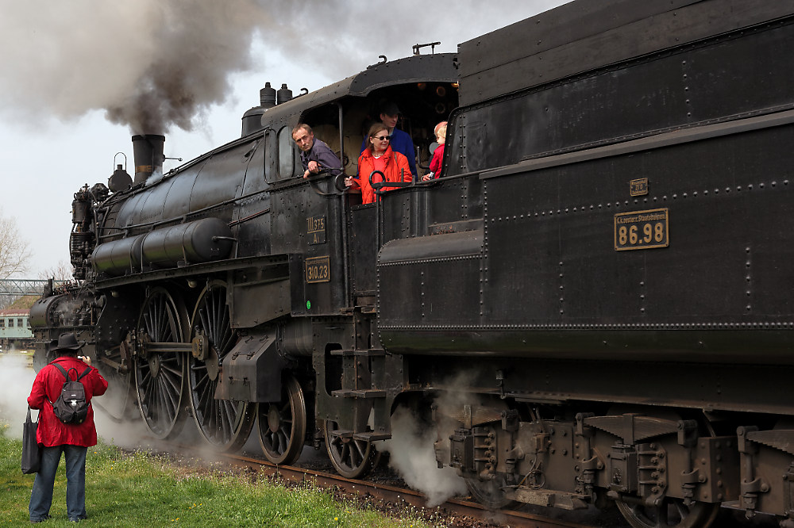
A child’s dream …
http://fc-foto.de/30777310

Slide 3
An youngster’s dream …
http://www.digitaltrends.com/mobile/faa-orders-airlines-to-replace-cockpit-displays-in-1300-jets-over-wi-fi-interference/

Slide 4
A man’s dream
http://cdn.bmwblog.com/wp-content/uploads/bmw-active-cruise-control-1.jpg

Slide 5
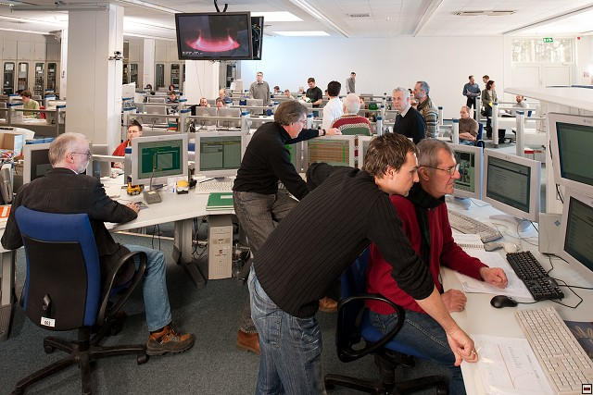
A fusion researcher’s dream ?

Slide 6
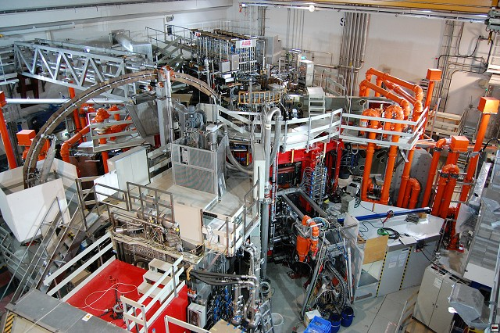
A CODAC officer’s nightmare
Controller algorithms, mode transition policy, gains, input signals, actuator choices, output clipping limits, control error monitor
DCN Laser Interferometer LOS geometry, filtering, optical correction
ECRH gyrotron cathode voltage, frequency, temperature, polarisation angle,, poloidal/toroidal mirror angle
ECE frequencies
NBI gas species, power, source priority, acceleration voltage, beam inclination angle, beam focussing voltage, pre-vaccum
ICRH frequency, power, generator voltage, line terminating tuning, arc detection threshold, recovery time
Power supply voltages, current limits, controller gains, flywheel generator speed
Cooling water pressure, temperature, valve settings
thyristor firing angle characteristics, crowbar resistivities/triggering thresholds
ECRH gyrotron cathode voltage, frequency, temperature, polarisation angle,, poloidal/toroidal mirror angle
All these parameters
must be set prior to operation
change never, occasionally, or in each discharge
How ???
can be dependent on others
need to be checked for correctness and consistency
ICRH frequency, power, generator voltage, line terminating tuning, arc detection threshold, recovery time
pellet material,size, speed, frequency
Main/divertor chamber gas valve/species mapping, flow characteristics
Magnetic pickup coil sensitivities
Coil current limits, force limits, max. temperature, max. strain
Locked mode alarm threshold
Perturbation coils patch panel setting, voltage, polarity, frequency
NBI gas species, power, source priority, acceleration voltage, beam inclination angle, beam focussing voltage, pre-vaccum
Toroidal field
Midplane manipulator injection/extraction positions, speed, temperature threshold
Detachment alarm threshold
Planned triangularity
Flattop plasma current

Slide 7
Overview
What is configuration (management) ?
The ideal way ...
... and why it won´t work
The practice on ASDEX Upgrade ...
... not ideal, but working
Types of configuration data
Tools for managing the configuration process
Policies to manage experiment evolution and parameter dependencies
Notes:
Experiment: operation space
Reactor: Operation point
Physics scenario: (defined here as a time-ordered set of target equilibria and time sequences of other plasma states that define an intended discharge history over time)
Control scenario: (defined here as the actuator waveforms needed to produce the physics scenario, as well as the definition of control algorithms used at specific times during the discharge)
Configuration are the parameters in a system that make it perform in the desired way
Limited resources: if systems could always provide their full range of functionalities (unlimited resources) there would be no need to configure them!
range of plant functionality is provided by plant system hardware/firmware (by plant system designers)
applicable functionality is defined and specifics tuned by set parameters (plant system operators)
Diagnostic channels
Heating

Slide 8
General task : General solution ?
General task: Provide a complete and consistent set of parameters
Various si_{m}ilªr approaches
JET: Level 1
DIII-D: Pulse Schedule File
W7-X: Experiment Program
ASDEX Upgrade: Discharge Program
ITER: Pulse Schedule
...
many similarities / many differences
in content and generation workflow
-
depending on system scope, operation procedures / responsibilities, ...
Notes:
Experiment: operation space
Reactor: Operation point
Physics scenario: (defined here as a time-ordered set of target equilibria and time sequences of other plasma states that define an intended discharge history over time)
Control scenario: (defined here as the actuator waveforms needed to produce the physics scenario, as well as the definition of control algorithms used at specific times during the discharge)
Configuration are the parameters in a system that make it perform in the desired way
Limited resources: if systems could always provide their full range of functionalities (unlimited resources) there would be no need to configure them!
range of plant functionality is provided by plant system hardware/firmware (by plant system designers)
applicable functionality is defined and specifics tuned by set parameters (plant system operators)
Diagnostic channels
Heating

Slide 9
Example: ITER Pulse Schedule
Level 4:
operational
limits
Pulse metadata, e. g. pulse number, physics goal, type of pulse etc.
Campaign info
metadata such as operational limits, pulse number, physics goal, audit trail etc.
Segment 1
Segment 2
Segment 3
Segment 4
Segment n
Level 3:
all necessary pulse control waveforms/parameters/etc (segmented)
PCS configuration
Level 2:
PCS configuration (algorithms and architecture, not parameters)
Level 1:
Configuration objects for necessary plant systems
Contains the configuration data which remains constant during a pulse or will change event based, e.g. two sets of configuration parameters which may depend on an event to trigger change
ECH
ICH
NBI
CPSS
Plant Sys N
Diag 1
Diag N
Cryo
Courtesy A. Winter
"Pulse schedule composed of building blocks"
Notes:
Level 0: configuration objects for necessary plant systems
Contains the configuration data which remains constant during a pulse or will change event based, e.g. two sets of configuration parameters which may depend on an event to trigger change
CPSS (coil power supply system)
Level 1: PCS configuration (algorithms and architecture, not parameters) → RTF config schema
Level 2: segment information with all necessary parameters/waveforms/etc.
Level 3: metadata such as operational limits, pulse number, physics goal, audit trail etc.
Pulse schedule composed of building blocks

Slide 10
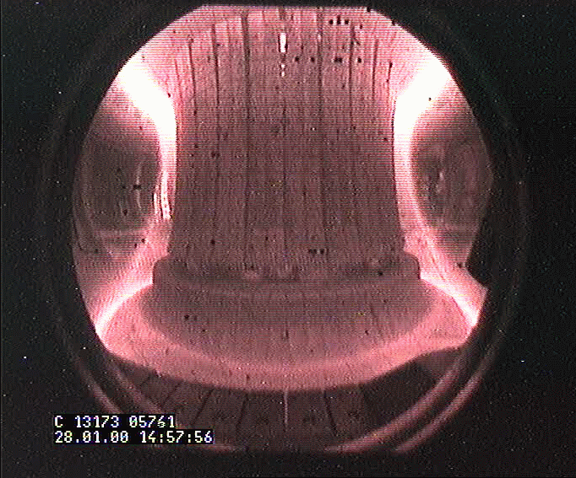
The Ideal Way to Configure Experiments ...
Defining the configuration for a specific pulse is a process
Plasma Control
Execution
Diagnos. Systems
Actuator Systems
9

Slide 11
The Ideal Way to Configure Experiments ...
Defining the configuration for a specific pulse is a process :
Describe an idea with key parameters.
Express in physics quantities.
Translate into control relevant quantities
Detail required technical settings
engineering aspects
machine parameters
Each level is an abstraction
Keep focus on relevant parameters
Hide implementation details
Idea
Experiment Desc.
Experiment Proposal
idea description
key plasma states
technical parameters
physics model
physics model
Physics Scenario
plasma regime description
evolution of major plasma quantities
Physics Waveforms
control model
Control Scenario
choice of control functions
evolution of controlled technical (FF) / physical (FB) quantities
Control Waveforms
engineering model
Control Configuration
Plant and Control Systems Settings
controller characteristics
plant system characteristics
Plant Sys. Configuration
Plasma Control
Execution
Diagnos. Systems
Actuator Systems
10

Slide 12
... only exists in theory (1): Ambiguity challenge
Multiple transformation options
Boundary conditions narrow the variety of choices
Operation windows
Parameter dependencies
No guaranteed unique solution ➔ additional soft requirements
Model/plant optimization aspects
Experience and intuition
Operational state of plant
Resilience: mimimize changes
Idea
Experiment Desc.
Experiment Proposal
idea description
key plasma states
technical parameters
physics model
physics model
physics model
1 > k
Physics Scenario
plasma regime description
evolution of major plasma quantities
Physics Waveforms
Physics Waveforms
control model
physics model
physics model
k > m
Control Scenario
choice of control functions
evolution of controlled technical (FF) / physical (FB) quantities
Control Waveforms
Control Waveforms
Control Waveforms
physics model
physics model
engineering model
physics model
physics model
m > n
Control Configuration
Control Configuration
Plant and Control Systems Settings
controller characteristics
plant system characteristics
Control Configuration
Control Configuration
Control Configuration
Plant Sys. Configuration
Plant Sys. Configuration
Plant Sys. Configuration
Plant Sys. Configuration
Plasma Control
Execution
Diagnos. Systems
Actuator Systems
11

Slide 13
... only exists in theory (2): Dependency challenge
Exp. Goal Constraint
Idea
Experiment Desc.
Experiment Proposal
idea description
key plasma states
technical parameters
Plasma Shape Constraint
physics model
physics model
Coil Current Command Limit
Physics Scenario
plasma regime description
evolution of major plasma quantities
Physics Waveforms
Iteration loops : Typical optimization problem with side-conditions
control model
Coil Current Operation Limit
Control Scenario
choice of control functions
evolution of controlled technical (FF) / physical (FB) quantities
Control Waveforms
Coil Current Protection Limit
engineering model
Control Configuration
Plant and Control Systems Settings
controller characteristics
plant system characteristics
Coil Suspension Force Limit
Plant Sys. Configuration
Plasma Control
Coil Current Machine Limit
Power Supply Current Limit
Execution
Diagnos. Systems
Actuator Systems
12

Slide 14
... only exists in theory (3): Evolution challenge
Sources of evolution
Better physics understanding ➔ refined physics model
Smarter controllers ➔ more/different waveforms ➔ changed parameter set
Plant system upgrade (actuator/diagnostic) ➔ new settings
Each evolutionary modification
introduces or obsoletes configuration parameters
may change parameter dependencies
Idea
Experiment Desc.
Experiment Proposal
idea description
key plasma states
technical parameters
physics model
physics model
Physics Waveforms
Physics Scenario
plasma regime description
evolution of major plasma quantities
Physics Waveforms
control model
Control Scenario
choice of control functions
evolution of controlled technical (FF) / physical (FB) quantities
Control Waveforms
Control Waveforms
Control Waveforms
engineering model
Control Configuration
Control Configuration
Plant and Control Systems Settings
controller characteristics
plant system characteristics
Control Configuration
Control Configuration
Control Configuration
Plant Sys. Configuration
Plant Sys. Configuration
Plant Sys. Configuration
Plant Sys. Configuration
Plasma Control
Execution
Diagnos. Systems
Actuator Systems
13

Slide 15
... only exists in theory (4): Human challenge
Men-in-the-loop
Human experience and intuition substituted(s) missing models
Plant operators responsible for safety want to retain authority on plant settings
… communicate orally ➔ risk of misunderstanding
… edit parts of configuration concurrently ➔ risk of inconsistency
Idea
Experiment Desc.
Experiment Proposal
idea description
key plasma states
technical parameters
physics model
physics model
Physics Scenario
plasma regime description
evolution of major plasma quantities
Physics Waveforms
control model
Control Scenario
choice of control functions
evolution of controlled technical (FF) / physical (FB) quantities
Control Waveforms
engineering model
Control Configuration
Plant and Control Systems Settings
controller characteristics
plant system characteristics
Plant Sys. Configuration
Plasma Control
Execution
Diagnos. Systems
Actuator Systems
14

Slide 16
ASDEX Upgrade: Types of configuration data
Shot Request Database
key plasma and plant parameters
links to experiment proposal
links to executed discharges
Discharge Program
waveforms for
control methods
control references
actuator feedforward commands
segmented structure
transition rules for segments
Plasma Control System Release
supported control algorithms
process descriptors
I/O descriptors
Plant Systems Recipes
ready-made named sets of consistent plant parameters
Shot Request DB
Experiment Proposal
Physics Scenario
Discharge Program (DP)
segmented
Control Scenario
Control System Release
+ process descriptors
Plant / Control Settings
Plant System Recipes
global base parameters + local tuning parameters
15
Notes:
DP must be consistent with provided resources.

Slide 17
ASDEX Upgrade: Configuration management tools
Planning
Wiki
Experiment Proposal
Shot Request DB
Modeling
Simulation
ShapeDesign, ASTRA, Simulink models
Physics Scenario
Verification
Flight Simulator (planned)
DP Editor
Discharge Program (DP)
segmented
Control Scenario
User Interface
Dependency rules Verification
Distribution
Automatization
Parameter Server
Control System Release
+ process descriptors
Plant / Control Settings
Plant gateway
Visualisation
Supervisory plant system
Plant System Recipes
global base parameters + local tuning parameters
16
Notes:
DP must be consistent with provided resources.

Slide 18
Discharge Program Editor
DP
repository
Parameter Server
Signal
property DB
Previous discharges
Standard segments
Exception handling rules
Control mode descriptors
Selected control settings Selected plant settings
Ranges Units
Bitgroups
Signal waveforms organised in segments
Table and plot panes
Dedicated control task views
User views with custom waveform selection
Waveform out-of-bound visualisation
DP comparison
Editor for dedicated control parameters

Slide 19
Managing Discharge Program Evolution
Discharge Program contains
Integral segments
dedicated exploratory pulse phases (e.g. plasma phase)
Linked segments
standardized phases (e.g. pre-/post plasma or ramp-down phases)
provided in a separate repository
links are resolved in final pulse preparation step
Evolution policies
Pulse-specific changes ➔ integral segments
Context-related changes ➔ linked segments
Incremental changes enabled by version control
Store Discharge Programs and Standard Segments
Re-use stored Discharge Programs as templates for new pulse setups
Discharge Program (DP)
segmented
provide
link
repository of standard segments
18
Notes:
DP must be consistent with provided resources.

Slide 20
Parameter Server
Eval-uator
Connects a multitude of parameter sources to applications (databases, PLC, conf. files)
Provides consistency for dependent parameters (clipping limits – operation limits)
Eval-uator
Con-troller
Actuator
Pulse Schedule
xml
Reference Generator
xml
xml
xml
Parameter Server
xml
xml
Parameter Database
Segment Scheduler
xml
xml
Con-troller
xml
PLC (S7) settings
DB
xml
Actuator
xml
xml
xml
Eval-uator
Con-troller
Eval-uator

Slide 21
Managing Parameter Dependencies
Parameter service
Web-service interface for client connection
Parameter values are looked up or computed on demand
Parameter definitions read from resources into layers
Start-up layer (built-in parameters, mostly for self-administration)
Initialization layer (default settings from parameter “database” XML files)
DP layer (optional pulse-dependent parameter variants)
Application layer (e.g. settings defined contributed by real-time diagnostics)
Parameter values defined in DP or Application layer take precedence
Parameter object types
Value parameters ➔ stored data (name/value pair)
Access parameters ➔ fetch data from external source
Function parameters ➔ rule-based computation (Ruby)
Derived parameters
Parameter verification and consistency checks

Slide 22
Summary
Configuration management is a complex optimization process
Parameter dependencies, system evolution and configuration consistence pose major challenges
Main pillars of ASDEX Upgrade configuration management
Discharge Program Editor
processes waveforms and pulse-specific parameters
supports to re-use standard segments and previous Discharge Programs
Parameter Server
resolves parameter dependencies
provides consistency checks
Flight Simulator (planned)
verifies the mapping of experiment goals to control and machine parameters
Process automation based on these tools is on-going
Better tool integration shall improve future user experience

Slide 23
Summary
ECRH gyrotron cathode voltage, frequency, temperature, polarisation angle,, poloidal/toroidal mirror angle
Configuration management is a complex optimization process
Parameter dependencies, system evolution and configuration consistence pose major challenges
Main pillars of ASDEX Upgrade configuration management
Discharge Program Editor
processes waveforms and pulse-specific parameters
supports to re-use standard segments and previous Discharge Programs
Parameter Server
resolves parameter dependencies
provides consistency checks
Flight Simulator (planned)
verifies the mapping of experiment goals to control and machine parameters
Process automation based on these tools is ongoing
Better tool integration shall improve future user experience
ECE frequencies
ICRH frequency, power, generator voltage, line terminating tuning, arc detection threshold, recovery time
Power supply voltages, current limits, controller gains, flywheel generator speed
Cooling water pressure, temperature, valve settings
thyristor firing angle characteristics, crowbar resistivities/triggering thresholds
ECRH gyrotron cathode voltage, frequency, temperature, polarisation angle,, poloidal/toroidal mirror angle
All these parameters
must be set prior to operation
change never, occasionally, or in each discharge
How ???
can be dependent on others
need to be checked for correctness and consistency
ICRH frequency, power, generator voltage, line terminating tuning, arc detection threshold, recovery time
pellet material,size, speed, frequency
Main/divertor chamber gas valve/species mapping, flow characteristics
Magnetic pickup coil sensitivities
Coil current limits, force limits, max. temperature, max. strain
Locked mode alarm threshold
Perturbation coils patch panel setting, voltage, polarity, frequency
NBI gas species, power, source priority, acceleration voltage, beam inclination angle, beam focussing voltage, pre-vaccum
Toroidal field
Midplane manipulator injection/extraction positions, speed, temperature threshold
Detachment alarm threshold
Planned triangularity
Flattop plasma current

