Slide 1
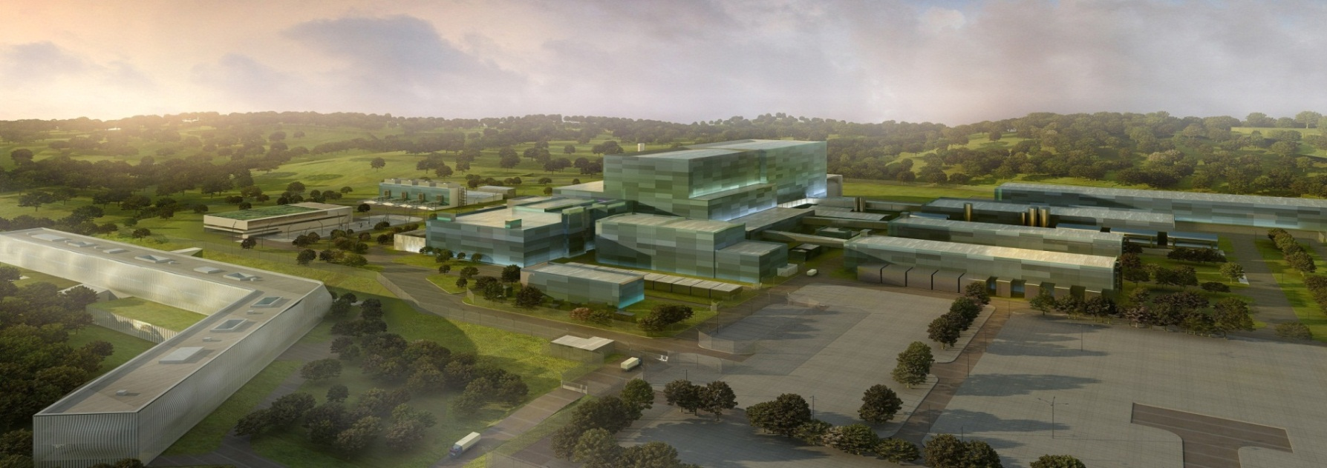
ITERDB current status
Lana ABADIE, Rodrigo Castro, Mariano Ruiz, Yury Makushok, Petri Makijarvi, Diego Sanz, Stefan Simrock, Mikyung Park, Anders Wallander
ITER/SOD/CSD/CDC
, UPM, CIEMAT, SGENIA, INDRA

Slide 2
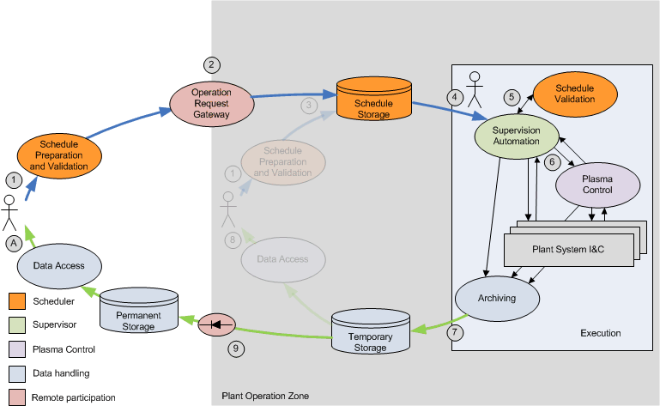
CODAC Operation Applications
Operation Applications
Pulse Scheduling System
Supervision & Automation
Plasma Control System
Data Management System
Remote Participation
Release of Op App
Annually delivered with different features according to the plant system & project phases.
Plant System FAT/SAT
Plant System Commissioning
Inter-Plant Commissioning
ITER Operation & Plasma Experiment
XPOZ
POZ

Slide 3
CODAC Core System is based on Open Source SW
Why?
No license fees
Free support
Shared development
Longevity (new requirements will appear as soon as ITER starts to operate)
= Reduced cost
The selected operating system is Red Hat Enterprise Linux for the x86-64 architecture (RHEL x86_64)
The infrastructure layer is EPICS (Experimental Physics and Industrial Control System) used in hundreds of large and small experimental physics projects world-wide: light sources, high energy physics, fusion (KSTAR, NSTX), telescopes
The CODAC services layer is Control System Studio used at many EPICS and other open source sites and including HMI, alarming, archiving etc.
ITER specific software such as configuration (self-description data), state handling, drivers, networking, etc.

Slide 4
CODAC Core System is based on Open Source SW
Use of Jenkins – Hudson for continuous build/integration
Use of Maven and rpms for packaging
Use of SVN as repository
Use of Bugzilla
User manuals are provided
CCS Training (on-site, at DAs and Online)
Codac-support@iter.org
APIs are documented via Doxygen
Use of Red Hat Satellite Server for rpms distribution
SEQA-45 – Software Engineering and Quality Assurance for CODAC https://user.iter.org/?uid=2NRS2K&version=v3.2&action=get_document

Slide 5
MAIN PARAMETERS
Parameter | Value
Total number of computers | 1.000
Total number of signals (wires) | 100.000
Total number of process variables | 1.000.000
Maximum sustained data flow on PON | 50 MB/s
Total PON archive rate | 25 MB/s
Total DAN archive rate (initial) | 2 GB/s
Total DAN archive rate (final) | 50 GB/s
Total archive capacity | 90-2200 TB/day
Accuracy of time synchronization | 50 ns RMS
Number of nodes on SDN | 100
Maximum latency asynchronous events | 1 ms
Maximum latency application to application (SDN) | 50 µs
Maximum sustained data flow on SDN | 25 MB/s
Pulse length | 3000 sec
Notes:
Large scale, different institutes, INB and research

Slide 6
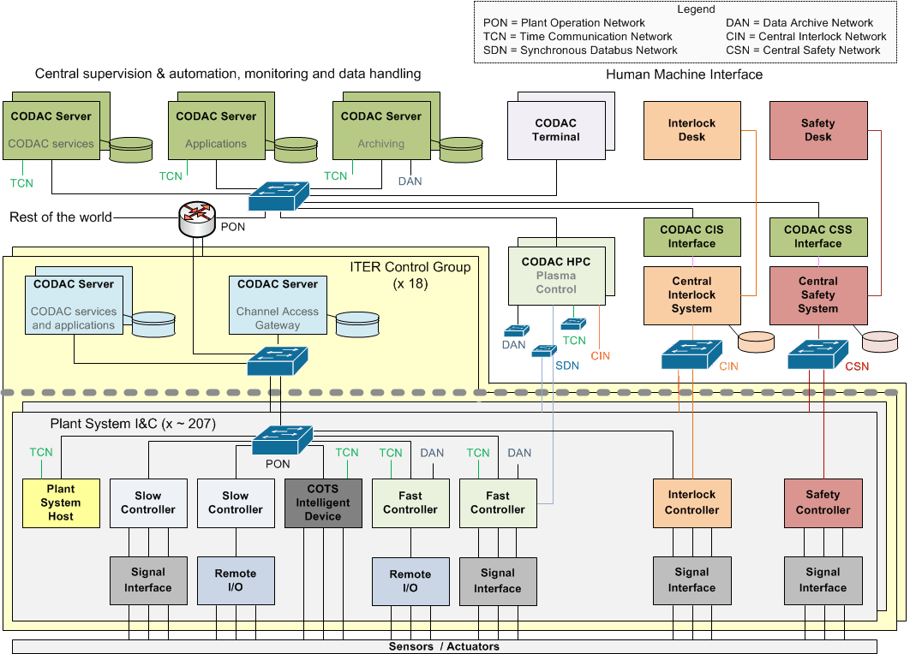
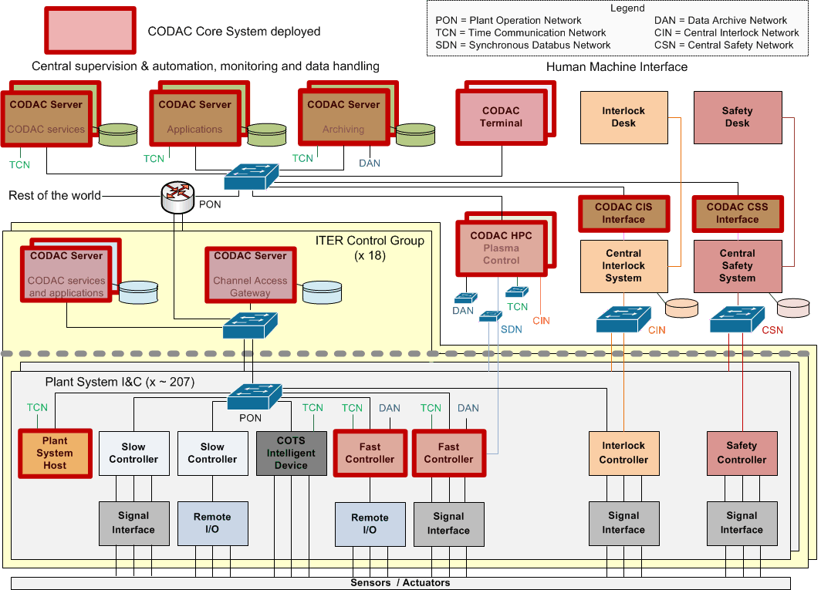
Deployment of CODAC Core System
Notes:
One of key actions to mitigate the risks is to provide CCS, mimick codac interface for the different networks – PON, SDN, DAN

Slide 7
Outline of data handling architecture
Pulse scheduling repo
Data required during the pulse (set of calibrations coef./necessary arch. data and its associated metadata)
ORG
Data repository :
Experimental &
Analyzed data
Physics analysis (e.g. IMAS)
PON archive engine - BEAUTY
PON archive back-end
DAN archive engine
DAN archive back-end
Client tools (MCR)
DATA ACCESS
Metadata
Metadata
Calibrations
Calibration
Client tools (X-POZ)
Mapping CBS to Physics model
POZ
X-POZ
ODG
ORG
Client can retrieve data and store back data upon approval (mechanism TBD)

Slide 8
Status
DAN
Currently focused on the interfaces with plant system I&Cs – highest priority
Loose coupling between the experimental data writer and data access
Release the first draft DAN API with CCS4.3 and is at production level with CCS5.0
Aims at coping different data rates from a few MB/sec to a few GB/sec (50 GB for 10 sec)
Aggregated throughput will gradually increase -> need to be scalable
Currently based on TCP for reliability purposes
Stable version with SDD integration will be provided with CCS 5.0
Data access is very simple for the moment
Use of CCS logging library for smooth integration with other libraries
Provide a low-level C++ API and Python API to retrieve data
Provide basic plotters based on Numpy and Matlplotlib
DAN API is thread-safe

Slide 9
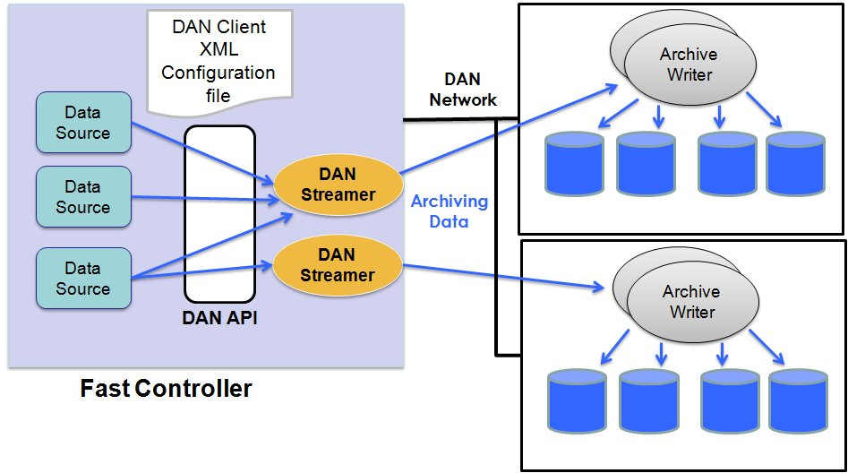
Data Handling System – DAN in CCS 5.0
Declare your hw and variables
SDD

Slide 10
How to use it
As plant system I&C developer, you need to code mainly the publisher part
DAN streamer and DAN archiver are generic and started automatically
Utilities to check that there is no loss of samples
Api to monitor buffer overflow
DAN Performance benchmark (on-going activity)
Users ask for DAN performance tests (more than 280 MB/sec sustained data rate)
Main goal is to avoid local archiving and transfer of data after the pulse
We tested DAN with various hw
PXI6259 : 32 AI channels, 1MS/s (all channels)
X-series: 32 AI channels, 2 MS/s (per channel)
FlexRio

Slide 11
How to use it
int main()
{
dan_DataCore dc; // Data Core reference
dan_Source ds; // Data Source reference
int x;
dc = dan_initLibrary(); // Init Library
ds = dan_publisher_publishSource_withDAQBuffer(dc, //Init data source
"TEST1", // Name of source
50000); // DAQ buff size in bytes.
// ----------------------------------
dan_publisher_openStream(ds,samplingRate,0);
//===========================================
MAIN LOOP
//===========================================
// ** CLOSE ALL STRUCTURES
}

Slide 12
while(!toterminate && (tcn_wait_until_hr(till,&tBase,0)== TCN_SUCCESS)) {
long pos;
char *data1, *data2;
int result,size1,size2;
result = dan_publisher_reserveDAQBuffer(ds,blockSize*sampleSize,&pos,&data1,&size1,&data2,&size2);
//populate data1 and if needed data2
// -- DATA BLOCK HEADER METADATA [OPTIONAL]----
blockHead.std_header.dim1=1; blockHead.std_header.dim2=1; blockHead.std_header.operational_mode=0; blockHead.std_header.sampling_rate=samplingRate;
blockHead.pos_x +=1;
blockHead.pos_y +=1;
result=dan_publisher_putBlockReference(ds, tBase+(sampleCounter * 1000000000 / samplingRate), blockSize*sampleSize, pos, (char *)&blockHead);
…}
Only neccesary in case of publisher with data copy

Slide 13
Data Handling System (experim. Data)
PON archive system
Characteristics
Continuous archive system : 24h/7 days
Stores EPICS PV
Data access – time series: (Variable Name, Time Window)
Data transfer POZ-XPOZ
Keep data for ITER lifetime
Implementation
BEAUTY : 1 archive engine/CBS + relational database
Upgrade to same technology as DAN archive system undergoing
DAN archive system
Characteristics
Runs for a shot or some consecutive days (for tests)
Stores high sampled structured data (SDN, buffer, etc)
Data access – time series : (Variable Name, Time Window/Shot number)
Data transfer POZ-XPOZ
Keep data for ITER lifetime
Implementation
DAN archive (buffer + write into a file). Number will depend on performance of single archive
Plan to provide a CSS plugin to allow data access of DAN and PON data
NOTE 1 : All SDN data are automatically archived via SDN-DAN gateway

Slide 14
Use cases for tests
Customized and very fast ADC (double channel, 1GBytes/sec per channel (or per two channels)) with large internal hardware buffer. It has been developed in Novosybirsk (both hardware itself and data processing FPGA code). Dedicated for the neutron diagnostic. Very interesting use case for plotters (first time we run it, we encounter out of memory) :
DAN and SDN integration use case : streaming of full data over DAN, sub-sampled over SDN, and average to PON for HMI plotting.
FlexRIO : image plotting. Use of NDS and DAN as plugin, full sample over DAN, sub-sampling imaging over PON.

Slide 15
FlexRio
With the PXie7966R and the NI1483 with the camera EOSENS3 : Maximum of 400MB/s acquired and archiving

Slide 16
POZ /XPOZ data transfer
Main challenge of data handling : no research machine with such tough requirements
Quality of the software in POZ is very crucial because of ITER’s nature
ITER shall be able to run without need of XPOZ (e.g. connection losses)
But ITER shall provide remote data access and monitoring
Security level is under investigation
Either firewall is accepted –
decent quasi –real time data rate can be transferred using one way protocol
Data integrity for archive will be required
Or it is not sufficient, special data transfer will be required (quasi real-time is then impossible)

Slide 17
Data Handling System – DAN in CCS 5.1/6.0
In next CCS version 5.1
Provide support for metadata declaration at sample level
Improve quality of the code (code review)
Preparing performance for tests
Provide a high level API for data access : use of standard technologies (MongoDB, REST, HDF5 server)
Basic idea, the client shall not be aware of the back-end
In CCS version 6.0
EPICS interface
First version of SUP will be provided in CCS
Interface with SUP for pulse management
Better handling of calibrations data (use case will be thermo-couples and Thomson scattering)
Provide different interfaces (Matlab, MDS+, etc)

Slide 18
Data Handling System – Interface with offline analysis/IMAG
Ok but what about processed data?
Implementation is foreseen for central systems
Define a valid use case
Simulate the production of experimental data
Start to run an offline analysis chain (e.g. EFIT)
Store the different results
Objectives
Evaluate the required metadata
Evaluate mapping between CBS/physics variables
Evaluate data access for offline analysis
POP (IMEG group) is leading the activity
CODAC will follow POP decision regarding offline analysis toolkit.

Slide 19
Data Handling System – Conclusion
Good progress on experimental data
Data acquisition is now at production level
First support of metadata
What need to be done
Performance tests (currently limited by hw – cannot buy fancy hw now as figures will be deprecated within a few years)
Improve the data error management (e.g. network issue)
Improve data access
Support for calibrations
Interface with offline analysis

Slide 20
BACK UP SLIDES

Slide 21
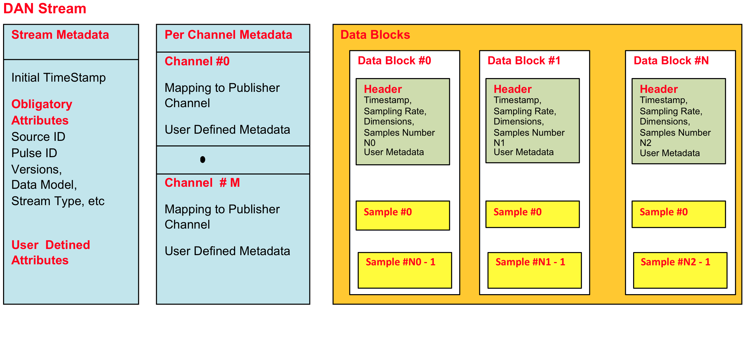
DAN HDF5 file structure
DAN Concepts

Slide 22
HDF5
DAN
Open file format
Designed for high volume or complex data
Open source software
Works with data in the format
A data model
Structures for data organization and specification
An HDF5 file is a container that holds data objects.
Group like Unix folder
Dataset is like file
Attributes can be associated at group and dataset level

Slide 23
Data access
DAN
HDF5 comes with a set of tools h5dump, h5diff useful for system admin and look quickly inside a file
HDF5 has many APIs (C/C++/ Python)
In CCS, we use a special flavour of HDF5 library SWMR to allow data access while being written
DAN archiver produces quite complex raw HDF5 files. For HDF5 experts, they can write their own programs to fetch data from these files. In next CCS, we will provide an API to allow local access data (i.e. file resides in shared filesystem or your local disk).

Slide 24
Functions
DAN API
Global
dan_initLibrary / dan_closeLibrary
DAN Publisher
dan_publisher_publishSource / dan_publisher_unpublishSource
dan_publisher_openStream / dan_publisher_closeStream
dan_publisher_putBlockReference
dan_publisher_ setStreamMetadata
dan_publisher_reserveDAQBuffer
dan_publisher_copyToDAQBuffer
Currently support for shmget and mmap
Only neccesary in case of publisher with data copy

Slide 25
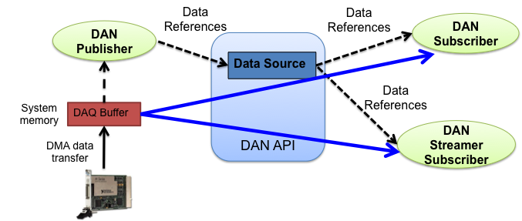
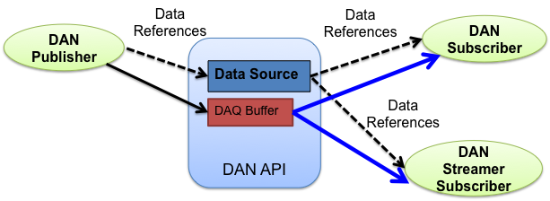
Data Source with own DAQ Buffer
DAN Concepts
DAQ Buffer provided by DAN API

Slide 26
Functions
DAN API
DAN Subscriber
dan_subscriber_subscribe / dan_subscriber_unsubscribe
dan_subscriber_getBlockReference
dan_subscriber_ackBlockReference_Source
dan_subscriber_getPointersToData
dan_subscriber_getPointerToBlockMetadata
dan_subscriber_getPointerToStreamMetadata

Slide 27
Functions
DAN API
DAN Status
dan_monitor_initMonitor / dan_monitor_freeMonitor
dan_monitor_queueFree
Number of block reference free in queue
dan_monitor_dataFree
Number of bytes free in DAQ Buffer

