Slide 1
The implementation of a data acquisition and service system based on HDF5 and EPICS
Y.Chen¹, B.J.Xiao^{1, 2}, F.Wang¹, S.Li¹, F.Yang^{1, 3}
¹Institute of Plasma Physics, Chinese Academy of Sciences, Hefei, China
²School of nuclear science and technology, University of Science and Technology of China ^{3.}Department of Computer Science , Anhui Medical University, China

Slide 2
OUTLINE
Introduction
System Architecture
Implementation
Conclusion

Slide 3
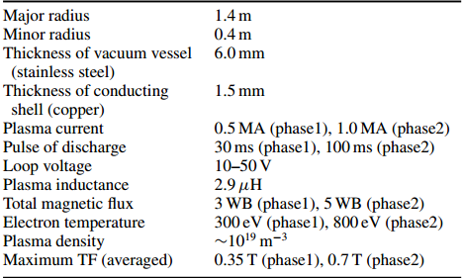
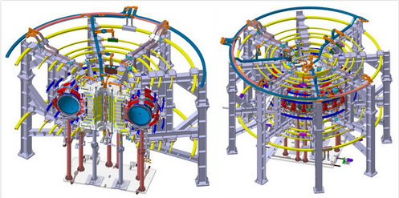
Introduction
KTX(Keda Torus for eXperiment) is a new Reversed Field Pinch (RFP) magnetic confinement device which is located at University of Science and Technology of China (USTC). It is designed by ASIPP and USTC.[1]
[1]. Wandong Liu, Wenzhe Mao, Hong Li, et al, Progress of the Keda Torus eXperiment Project in China: design and mission, Plasma Phys. Control. Fusion56(2014) 094009.

Slide 4
Introduction
This system is a data system containing data acquisition, data acquisition control, data storage and data service. It adopts HDF5 as its low-level data storage format.
Requirements
Shot ~100ms
~2000 channels
Sampling rates: 250KS/s to 10 MS/s
Communicate with central control system
Easy to access data after each shot

Slide 5
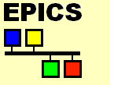
HDF5 and EPICS
HDF5 [2]
HDF5 is a data model, library, and file format for storing and managing data. It has been used worldwide in many scientific research field.
EPICS [3]
EPICS is a set of Open Source software tools, libraries and applications developed collaboratively. It has been used worldwide to create distributed soft real-time control systems for scientific instruments.
[2] HDF Group, http://www.hdfgroup.org/HDF5/
[3] EPICS, http://www.aps.anl.gov/epics

Slide 6
OUTLINE
Introduction
System Architecture
Implementation
Conclusion

Slide 7
System Architecture
The data system includes data acquisition control, data acquisition, data storage and data service. So according to the function, it can be divided into four components:
Data Acquisition Console
DAQ Nodes
Data Archive System
Data Service

Slide 8
System Architecture
Central Control System
request
response
Data Archive System
request
Data Acquisition Console
request
request
DAQ nodes
Administrator
data
response
Data Service Server
request
Data Access Clients
Data Pool
data
Users

Slide 9
OUTLINE
Introduction
System Architecture
Implementation
Conclusion

Slide 10
Data Acquisition Console
The data acquisition console is considered as a middleware between Central Control System (CCS) and DAQ nodes, and is responsible for transferring the commands from CCS to DAQ nodes and the status from DAQ nodes to CCS.
It includes two functions.
DAQ Management
monitors DAQ status and sets DAQ parameters.
DAQ Flow Control
controls the data acquisition flow.

Slide 11
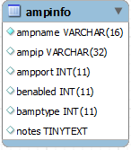
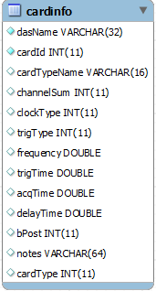
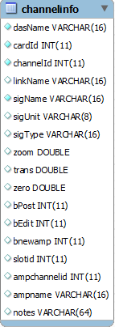
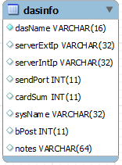
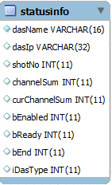
DAQ Management
DAQ Status Monitor
DAQ Parameter Setting
DAQ Flow Control
DAQ Status
DAQ Parameter
DAQ Status
DAQ Parameter

Slide 12
DAQ flow control
(1)Shot Command
(5) finish status
Central Control System
DAQ Parameter
(3)Parameter
DAQ nodes
DAQ Flow Control
(4) STOP
(5)finish
DAQ Status
(4) STOP
Data Archive System
(2)Shot Command
1、Receiving Shot Command from Central Control System when new discharge coming.
2、Sending Shot Command to Data Archive System.
3、Sending DAQ Parameter to each DAQ node.
4、Sending Stop Command if receiving Stop Command from Central Control System .
5、Reply DAQ finish status to Central Control System after all DAQ nodes have finished data acquisition successfully.

Slide 13
DAQ flow control
EPICS will be used:
Communication between DAQ flow control and Central Control System with EPCIS.
Monitoring each DAQ nodes status via EPICS.
Central Control System
DAQ flow control
DAQ nodes

Slide 15
DAQ Nodes
The DAQ nodes are responsible for acquiring diagnostic signals. It supports continuous data acquisition with different sampling rates which is divided into low and high level. It also supports long-pulse discharge.
The hardware includes signal condition device and data acquisition computer. Different sampling rates decide different data acquisition computer.
The software structure includes four kinds of threads.
Main Thread
DAQ Main Thread
DAQ Thread
Process Thread

Slide 16
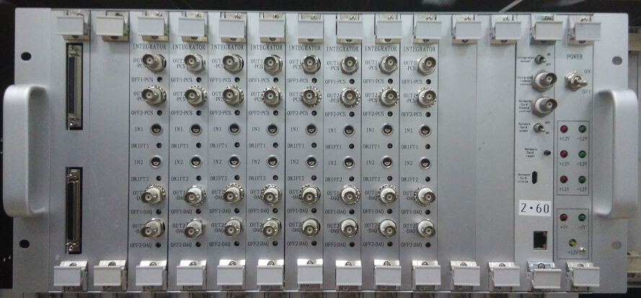
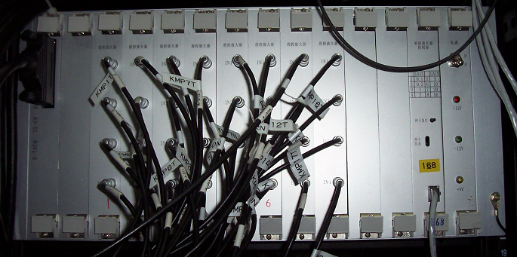
Signal Condition
Integrator system
The integrator system is developed by the EAST team.
Parameters: (1) Drift: 100 s drift < 0.1 mWb ( gain=1) (2) Gain: 0.5, 1, 2, 5 (3) Output Voltage Range: -10V～+10V
Gain-variable amplifier
The gain-variable amplifier is developed by the EAST team.
Parameters:
(1) Gains: 0.1, 0.5, 1, 2, 5, 10, 20, 50 (2) -3dB bandwidth: 500 kHz when gain=1 (3) Noise: less than 10 mV when gain=1 (4) Output range: -10 V to +10V
Notes:
（1）100s的积分飘移小于0.1毫韦伯
也可以用mVs

Slide 17
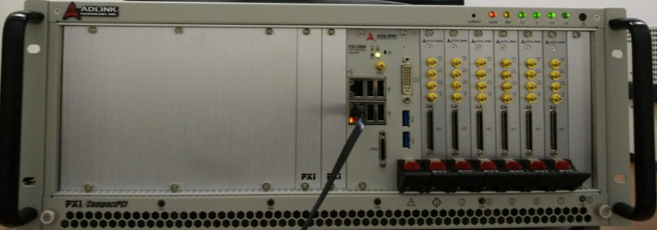
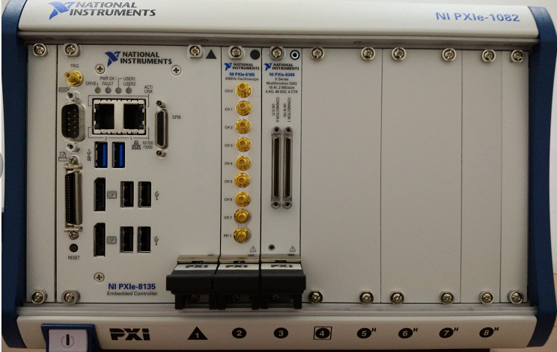
DAQ Hardware
250KS/s
>= 1MS/s
PXI-2022：
PXI specification Rev 2.2 compliant
16-CH differential analog inputs
Multiple cards synchronization through PXI trigger bus
16-bit A/D resolution
Bipolar analog input
Onboard 8 K-sample (16 KB) memory for data storage
4-CH TTL digital input/output
PXIe-6368
6 simultaneously sampled channels
16-bit vertical resolution
2 MS/s real-time sampling rate
PXIe-5105
8 simultaneously sampled channels
12-bit vertical resolution
60 MS/s real-time sampling rate
60 MHz analog bandwidth
Deep onboard memory up to 512 MB for long acquisition times

Slide 18
DAQ Software
Main Thread
Commands
CentOS 6 / gcc
Windows / LabVIEW
DAQ Main Thread
DAQ Thread
Process Thread
data
Data Archive System
data
data
Binary data files

Slide 19
Data Archive System
All experimental data will be remotely transferred to the data archive system. It adopts HDF5 as its low-level data storage format.
Server：DELL PowerEdge R730
CPU: 2 X Intel Xeon E5-2609v3
RAM: 16GB 1600MHz RDIMM
Disk: 8 X 4TB 7.2Kr/S NL-SAS，RAID5
RAID controller: PERC H730P
Network: 4 X Gigabit Ethernet
OS: CentOS release 6.6 (Final)
Development environment : gcc

Slide 20
Server
Data Acquisition Console
Main Thread
command
Server Thread
DAQ nodes
data
File Operation
Other Operation
Data Operation
data
HDF5
Data pool
Operation
CentOS 6 / gcc

Slide 21
Data Service
Users can get data service via Client/Server or Brower/Server.
Data
Server
Client
request
Main Thread
Server Thread
request
Client Plug-in
WebScope
data
data
HDF5
Data Pool
Analysis and Access Thread
request
Client Interface
Matlab
data
data

Slide 22
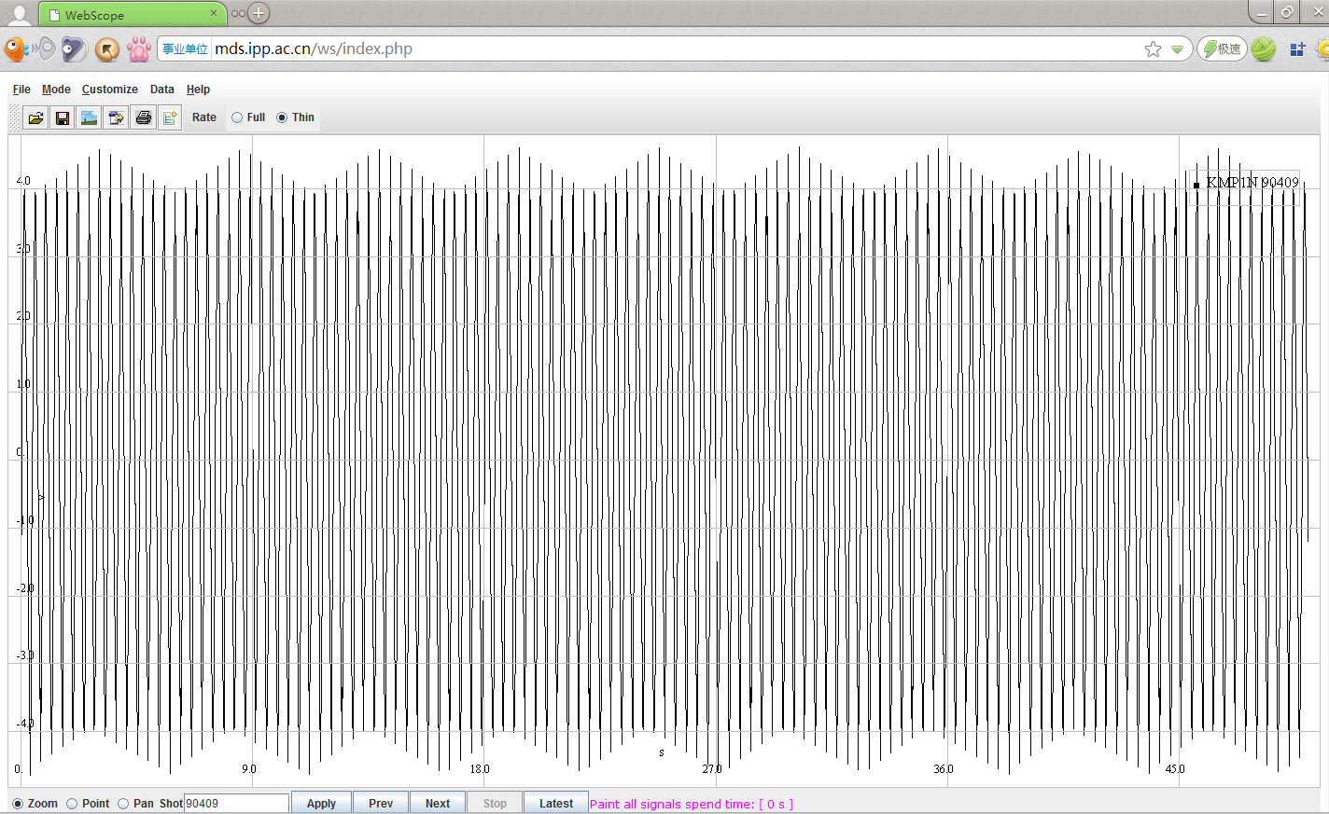
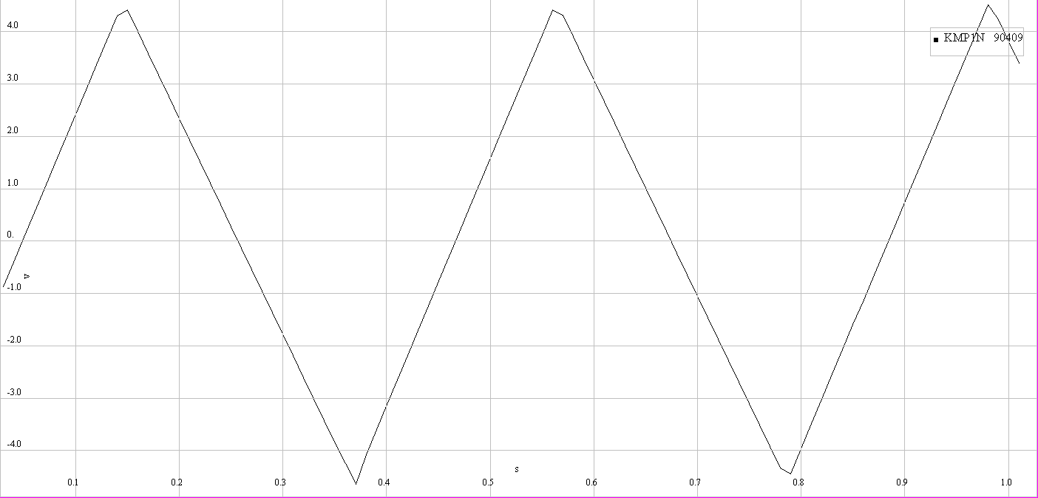
Data Service
A plug-in (by gcc) for WebScope (a web data analysis and visualization tool for EAST) has been developed to view HDF5 data. Users can view all data or part of data.
Sampling rate:100KS/s, acquisition time:50ms

Slide 23
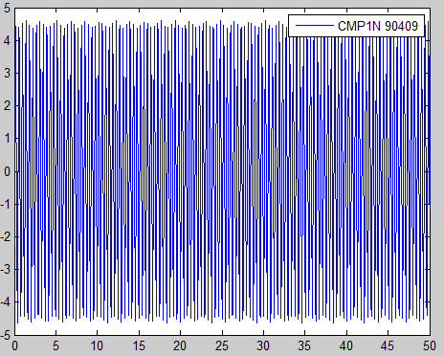
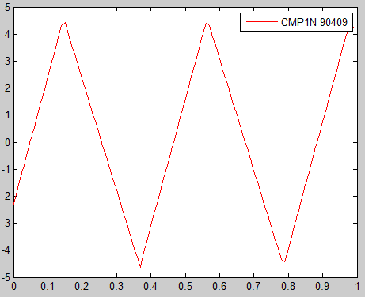
Data Service
A plug-in (by Visual C++) for MATLAB has been developed to access the data via the Data Service interface. Users can get all data or part of data.
Sampling rate:100KS/s, acquisition time:50ms

Slide 24
OUTLINE
Introduction
System Architecture
Implementation
Conclusion

Slide 25
Conclusion
A data acquisition and service system has been designed and implemented based on HDF5 and EPICS for KTX.
The data system can deal with different diagnostic acquisition requirement and the DAQ nodes are easily extensible.
Users can access experiment data via Client/Server or Brower/Server.
Distributed and parallel data service function will be developed in the future.

Slide 26
Thanks for your attentions!

