Slide 1
Instrumentation for status monitoring of SST-1 superconducting magnets
Dr. Subrata Pradhan
(Aashoo Sharma)
10th IAEA Technical Meeting on Control, Data Acquisition and Remote Participation for Fusion Research, 20-24 April 2015
Institute for Plasma research, Gandhinagar, India

Slide 2
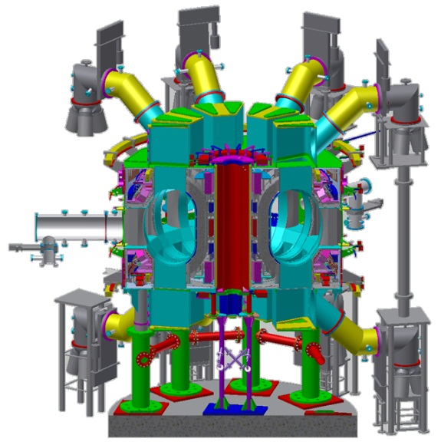
3-D Isometric View & assembled SST-1
MAJOR RADIUS : 1.1 m
MINOR RADIUS : 0.2 m
ELONGATION : 1.7-2
TRIANGULARITY : 0.4-0.7
TOROIDAL FIELD : 3T
PLASMA CURRENT : 220 kA.
ASPECT RATIO : 5.2
SAFETY FACTOR : 3
AVERAGE DENSITY : 1.0 × 10¹³ cm^{–3}
AVERAGE TEMP. : 1.5 keV
PLASMA SPECIES : HYDROGEN
PULSE LENGTH : 1000s
CONFIGURATION : DOUBLE NULL
: POLOIDAL DIVERTER
HEATING & CURRENT DRIVE:
LOWER HYBRID : 1.0 MW
NEUTRAL BEAM : 0.8 MW
ICRH : 1.0 MW
TOTAL INPUT POWER : 1.0 MW
FUELLING : GAS PUFFING
PF magnets
TF magnet
Central solenoid
Divertor pump
Pumping duct
Cryostat
Vacuum vessel
Thermal shield
Cold mass support
Machine support
Foundation

Slide 3
SST-1 Superconducting Magnet details
TF Magnet system:
Number of Coils : 16 (D-Shape)
Winding type : Double Pancake (6 DP, 9 turns each pancake)
Nominal Current: 10 kA, 5.1 T
Function:
Plasma confinement
PF Magnet system:
Number of Coils : 9 (PF1 to PF5)
Type : Double Pancake (DP)/ layer winding
Maximum current: 9.1 kA (PF3)
Function:
Plasma shaping and position control
1. Introduction

Slide 4
Status Monitoring critical ities in SST-1 Magnets
17.28 MAT (~56 MJ in TF magnet system), 38 Ton
Subjected to very high stresses (~300 Mpa) and displacements (~6 mm) during cool-down, warm-up and during current charging operations
Magnet structure behaviour monitoring is essential to Safety of Magnets & Machine.
2. Requirements

Slide 5
Monitoring facilitates
Feedback to operator to take decision about magnet operation
Initiation of control actions in events that require immediate magnet current dumps like loss of superconductivity in magnets (quench), vacuum failure or cryogenic failures etc.
The behaviour of the magnet structure during the life-time of the machine with respect to eventual fatigue effects under cyclic loading present in tokamak machines
2. Requirements

Slide 6
Instrumentation Strategy
Established sensor technologies chosen.
In-house procedures & protocols developed.
In-house modular multi-purpose signal conditioning system used
Avoidance of loss of data with redundancy
Protocols towards multiple level of cross checks at all stages.
3. Strategy

Slide 7
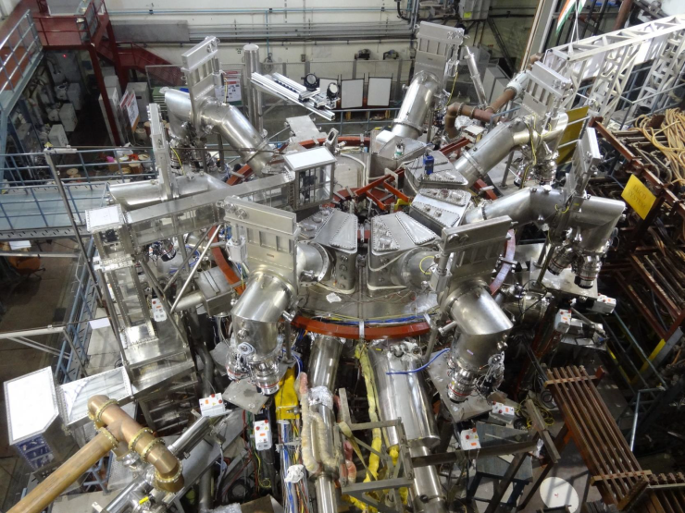
Different status monitoring instrumentation of SST-1
Mass flow rate
Pressure
Temperature
Magnetic field
Quench detection
Displacement
Joint resistance
Ground fault current
Strain
Meet the requirements of high vacuum, high magnetic field and cryogenic temperature environment
3. Strategy

Slide 8
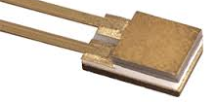
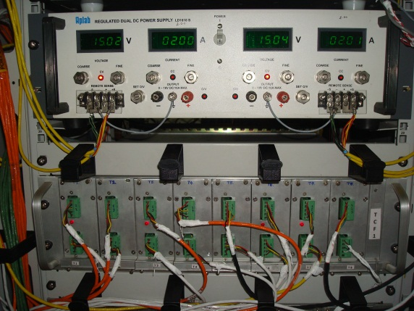
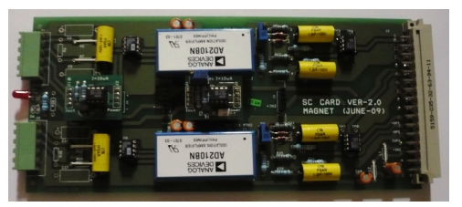
Temperature Sensors
128 (CernoxTM and CCSTM Compatible to 5T & calibrated at 4.2 K
Achieved measurement accuracy: ± 0.1 K
Installed at coil inlet & outlets, coil structures and joints
For tubings
In-house developed signal conditioning
For flat surfaces
4. Instrumentation Details

Slide 9
Displacement Sensor
12 no, in-house calibrated up to 10 K and 2T, measurement accuracy: ± 0.1 mm
Installed on TF coils and the cantilever rings.
Cryostat wall as reference
In-house developed signal conditioning
Installation for TF coil displacement measurement
Installation for cantilever ring displacement measurement
4. Instrumentation Details

Slide 10
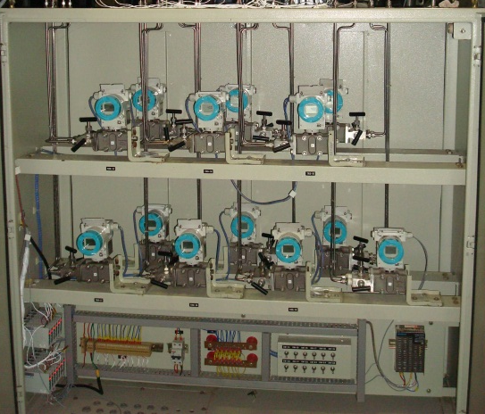
Mass flow and pressure measurement
32 Mass flow rate meters, differential and absolute pressure sensors
In-house designed, fabricated and calibrated venturi flow meters of 2 types to measure mass flow rates up to 20 g/s with accuracy of ± 3 %
Installed on coil outlets to avoid heat load to coil inlet from pressure tapings
In-house developed signal conditioning
Venturi meter at TF coil outlet
Abs Press sensors and differential Press tapings
Signal conditioning
4. Instrumentation Details

Slide 11
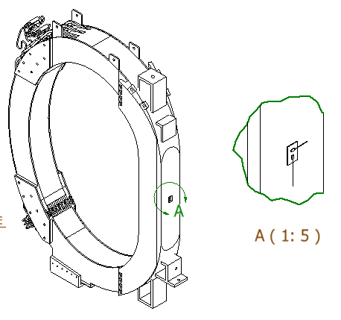
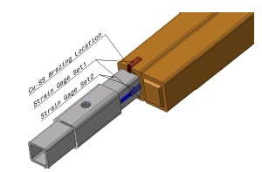
Strain Gages
8 strain gages of TF coil inboard and outboard leg structure
In-house developed signal conditioning system
Installation and measurement system validated in lab scale experiments and in single coil test experiments
Validation of stress measurement during single coil test
Installation on TF coil onboard leg
4. Instrumentation Details

Slide 12
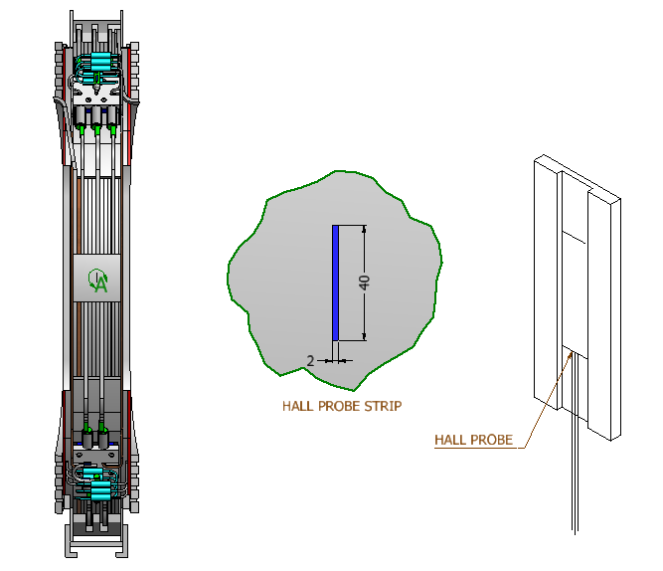
Hall Probes
16 Cryogenic grade Hall probes installed on TF and PF magnet system
In-house developed signal conditioning system giving ±0.1 % measurement accuracy
Installation methods and measurement system validated in lab scale experiments and in single coil test experiments
Hall probes on TF coil leg
Hall probes in PF1 coil bore
4. Instrumentation Details

Slide 13
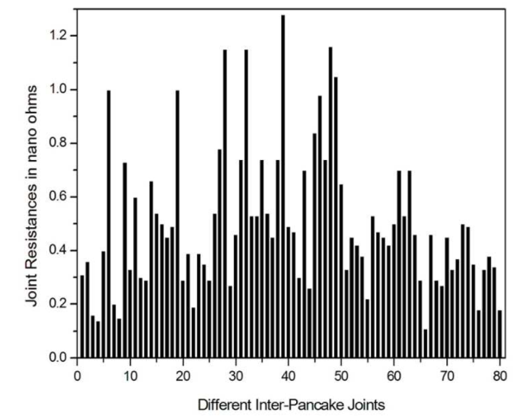
Joint Resistance Measurement
102 joint locations installed with voltage taps for resistance measurement and quench detection
Soldering on a pre-brazed copper block to reduce noise in low voltage measurements
Joint resistances were validated during single coil test and routinely measured before magnet charging to ensure superconducting phase transition of winding pack
Pre-brazed copper blocks for making soldered connection
Joints on TF winding pack
Joint resistance measurement results
4. Instrumentation Details

Slide 14
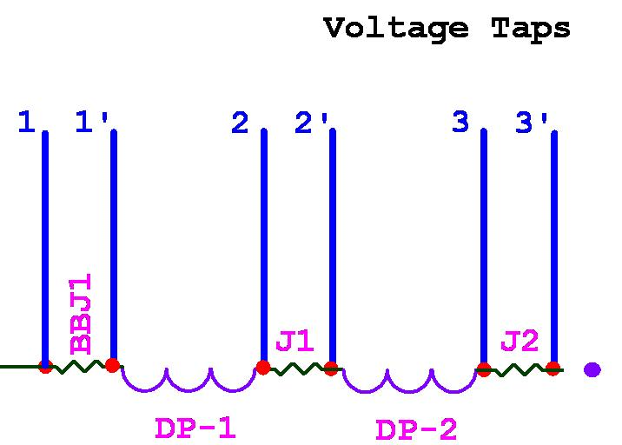
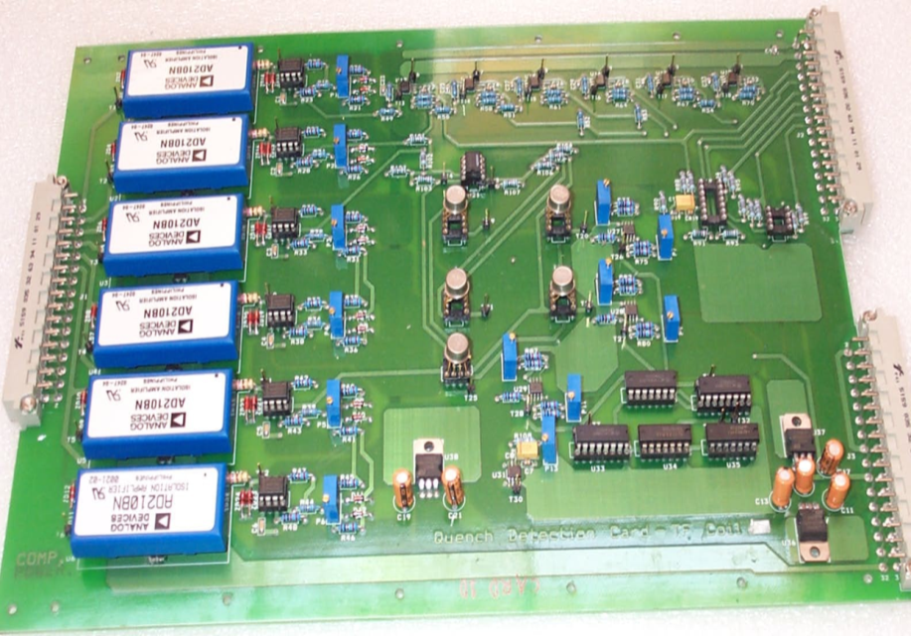
Quench Detection system
Each DP is compared in 2 different channels & in 2 different cards using Redundant Voltage taps (TOTAL 208 CHANNELS)
(Card 1)
DP1 – DP2, DP2 – DP3, DP3 – DP4
DP4 – DP5, DP5 – DP6, DP6 – DP1
(Card 2)
DP1’ – DP2’, DP2’ – DP3’, DP3’ – DP4’
DP4’ – DP5’, DP5’ – DP6’, DP6’ – DP1’
Voltage taps across joints used as redundant taps
4. Instrumentation Details

Slide 15
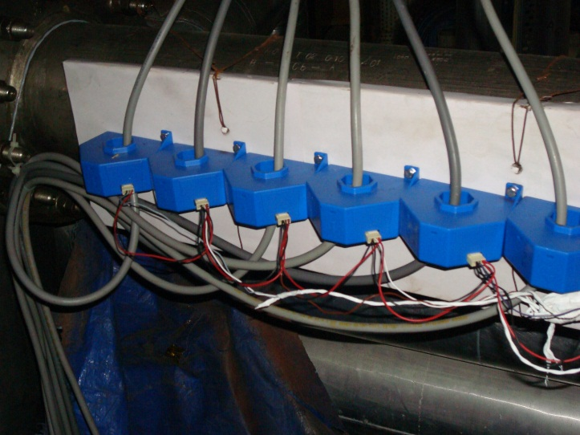
Ground fault current measurement
All magnet structure grounding connections taken out of cryostat and connected to common ground plane dedicated for magnet system.
Regular insulation check between structure and winding pack using these taping
Ground fault current monitoring by CTs (6 channels)
Grounding connections inside the cryostat
Ground fault current measurement set up outside the cryostat
4. Instrumentation Details

Slide 16
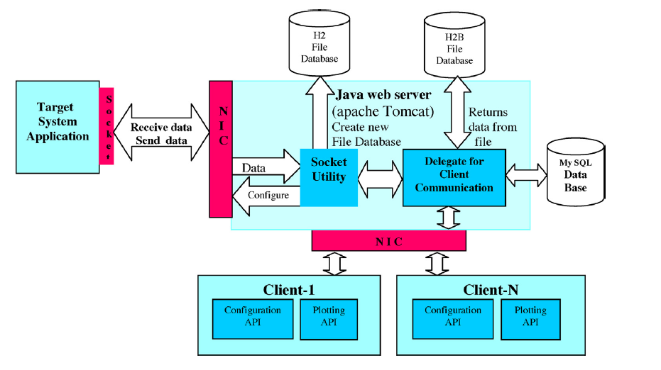
VME based Data Acquisition system
500 channels with online monitoring and post analysis capabilities
Channel settings as per the operational requirements of cool-down/warm-up or magnet current charging experiments
Time synchronization with SST-1 central control and data storage at central storage
Software architecture of Magnet Data Acquisition system
4. Instrumentation Details

Slide 17
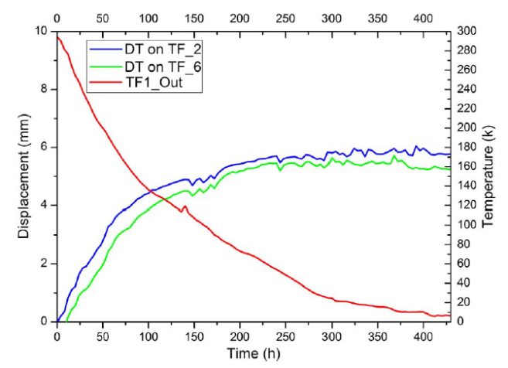
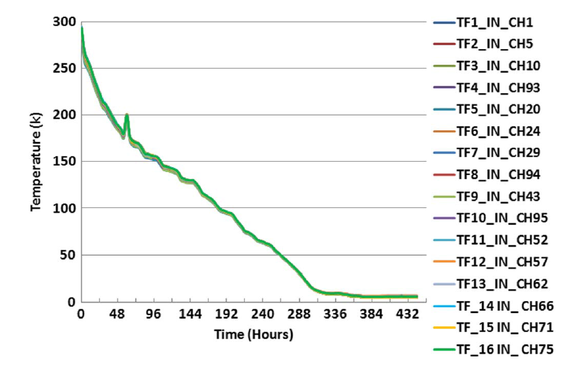
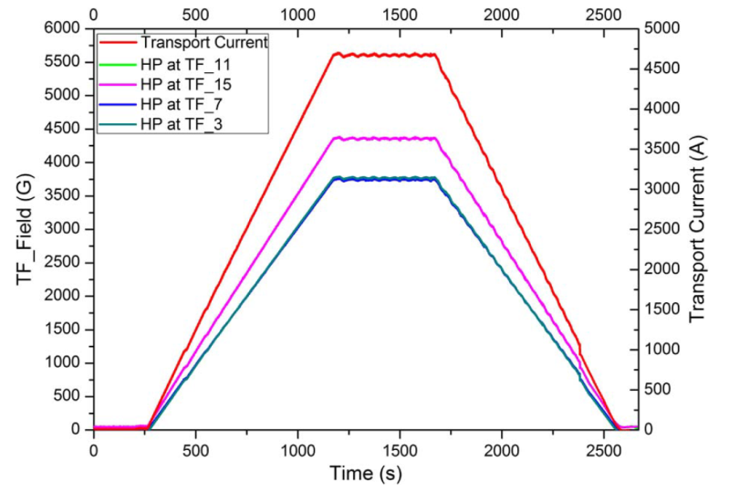
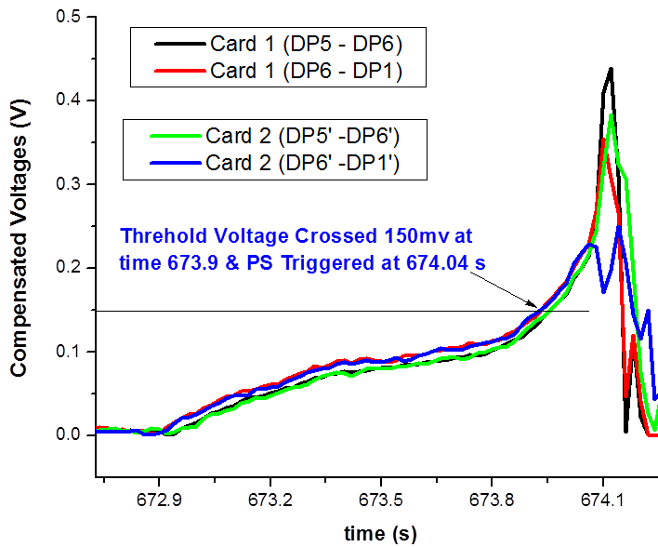
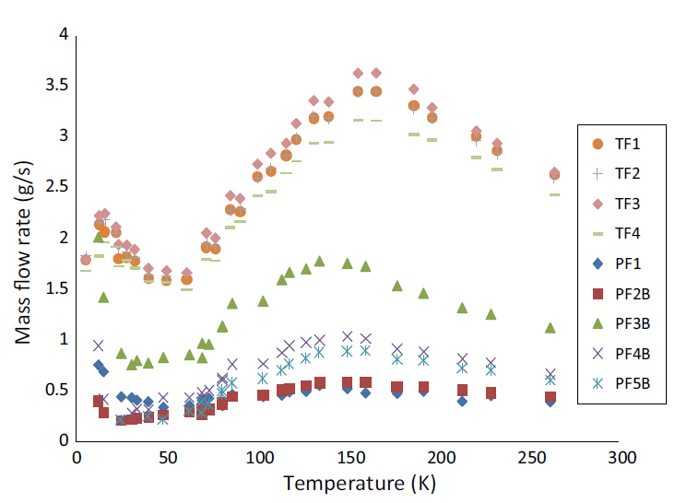
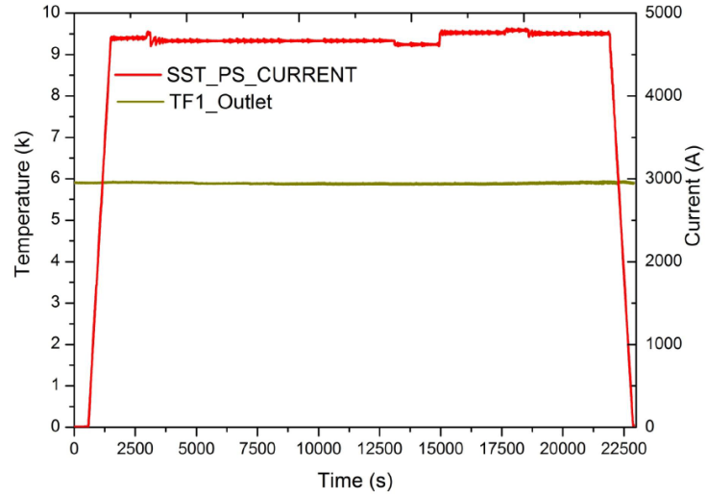
Some Results
Displacement
Temperature
Magnetic field
Quench detection
Mass flow measurement
Stable long operation
5. Results

Slide 18
Conclusion
Over 500 status monitoring and protection instrumentation installed on SSt-1 magnet system
In-house developed installation procedures, usage of in-house developed modular multi-purpose signal conditioning system and data acquisition system validated during several SST-1 plasma campaigns in last 3 years
> 99 % of instrumentations survived during SST-1 machine assembly, and performed satisfactorily during engineering commissioning and several plasma campaigns
Systematic up-gradation of existing instrumentation planned with latest technologies like optical fiber based systems
6. Conclusion

Slide 19
Thank you !

