Slide 1


Operation and Control of High Power Gyrotrons for ECRH systems in SST-1 and Aditya
B K Shukla, D. Bora, R. Jha, Jatin Patel, Rajan Babu, Harshida Patel, Pragnesh Dhoorajia and D Purohit
Institute for Plasma Research
Bhat, Gandhinagar
Shukla@ipr.res.in
10th IAEA-TM, Apr 20-24, 2015, IPR Gandhinagar, India

Slide 2
Plan of Talk
Introduction in short to ECRH in tokamak Plasma
  (ECR waves in plasma & its advantage)
Gyrotron system on a tokamak
  (Gyrotron, transmission line and launcher)
Operation and control of High Power Gyrotrons
42GHz Gyrotron system on SST-1 and Aditya
Experiment on SST-1
Summary
10th IAEA-TM, Apr 20-24, 2015, IPR Gandhinagar, India

Slide 3
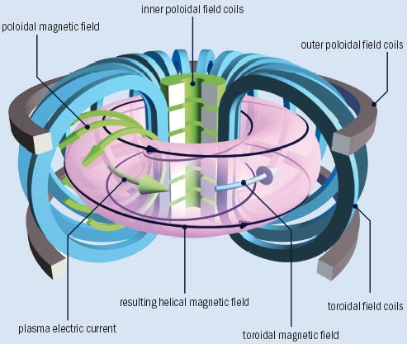
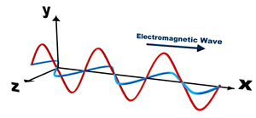
Tokamak and ECR waves
10th IAEA-TM, Apr 20-24, 2015, IPR Gandhinagar, India

Slide 4
Application / Benefits of ECRH
Start-up of tokamak
  Pre-ionization with ECRH
    Lower loop voltage start-up
    Saves volt-second consumption
    Widens the operating window
    Reliable tokamak start up even in the presence of error field
    Pre-ionization is necessary for super conducting tokamak
Heating
Current Drive
Suppression of NTM with ECRH and ECCD
10th IAEA-TM, Apr 20-24, 2015, IPR Gandhinagar, India

Slide 5
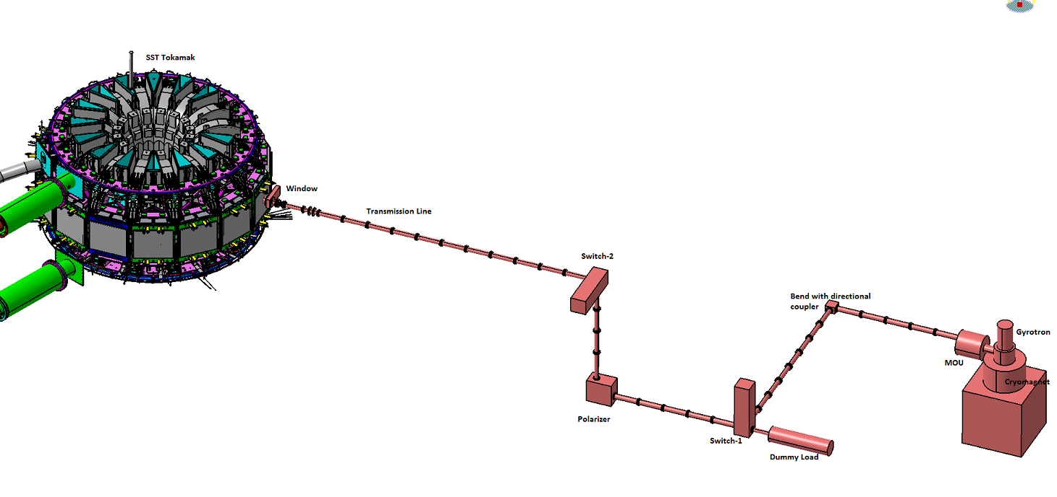
Standard ECRH System in a tokamak
10th IAEA-TM, Apr 20-24, 2015, IPR Gandhinagar, India

Slide 6
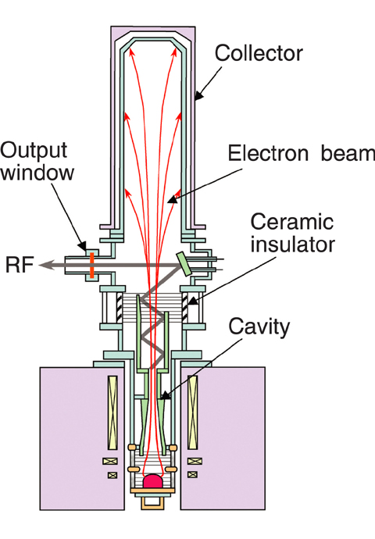
High Power Gyrotron
Typical Specs:
Frequency: 28GHz to 170GHz
Power: 25kW to 1000kW
Duration: Pulse to CW
Output mode: Gaussian
Magnet system: Cryo-cooled
Depressed collector type Gyrotron
Efficiency: ~ 50%
Typical operating voltages:
Beam: -(40-50)kV & 10-40A
Anode: +(10kV to 30kV)
10th IAEA-TM, Apr 20-24, 2015, IPR Gandhinagar, India

Slide 7
Subsystems of Gyrotron
Mechanical
Electrical
Magnet
Instrumentation
DAC
Microwave
Interlocks
10th IAEA-TM, Apr 20-24, 2015, IPR Gandhinagar, India

Slide 8
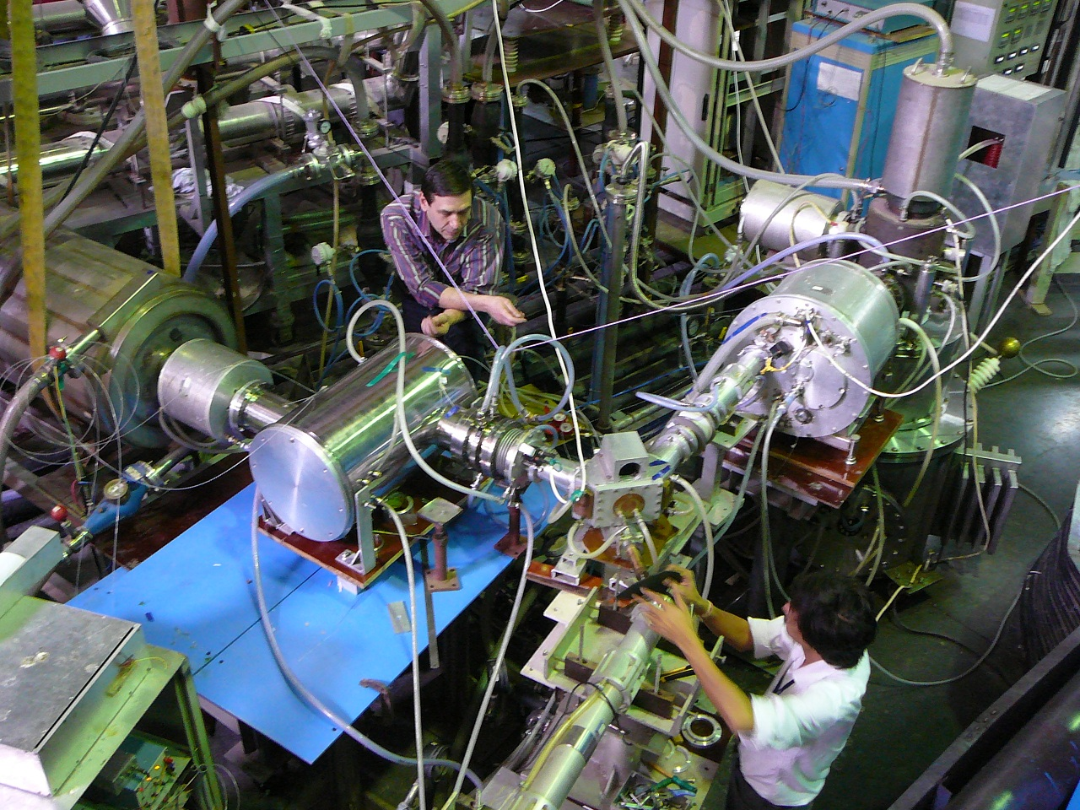
Gyrotron test set-up
10th IAEA-TM, Apr 20-24, 2015, IPR Gandhinagar, India

Slide 9
Operation of High Power Gyrotron requires……
Electrical layout
Mechanical layout
Calibration of electrical instrument
Calibration of microwave components
Commissioning of Cooling system
Test of DAC with dummy signal
Test with real field signal
HV connections to Gyrotron with professional wiring
Dedicated HV ground close to Gyrotron
10th IAEA-TM, Apr 20-24, 2015, IPR Gandhinagar, India

Slide 10
Interlocks and Protection of Gyrotron
Fast Interlocks
Slow Interlocks
Arc
Cooling (all)
Beam voltage
Filament
Beam current
Anode over current
Magnet currents
dI/dt
Waveguide (vac or Pr.)
Body current
Vac-ion current ?
HVPS Over voltage ?
10th IAEA-TM, Apr 20-24, 2015, IPR Gandhinagar, India

Slide 11
Most critical for Gyrotron……Its fault energy…..
In an event of fault, the fault energy to the Gyrotron
should not exceed its critical fault energy
known as critical crater energy
Demonstrate
10-Joule
Wire test
Remove high voltage
Fast enough i.e.
< 10µs
10th IAEA-TM, Apr 20-24, 2015, IPR Gandhinagar, India

Slide 12
Electrical layout of Gyrotron
10th IAEA-TM, Apr 20-24, 2015, IPR Gandhinagar, India

Slide 13
10J-Wire test prior to Gyrotron operation
Connect a wire at the place of Gyrotron, Generate manual fault
Detect the fault and trigger the crowbar, If wire safe, test successful
10th IAEA-TM, Apr 20-24, 2015, IPR Gandhinagar, India

Slide 14
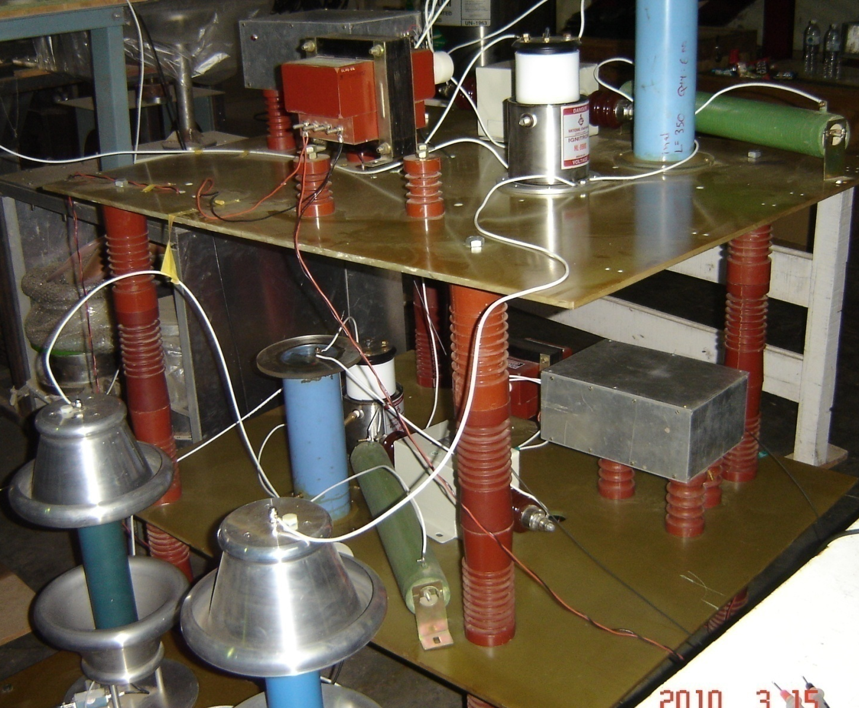
Crowbar protection
10th IAEA-TM, Apr 20-24, 2015, IPR Gandhinagar, India

Slide 15
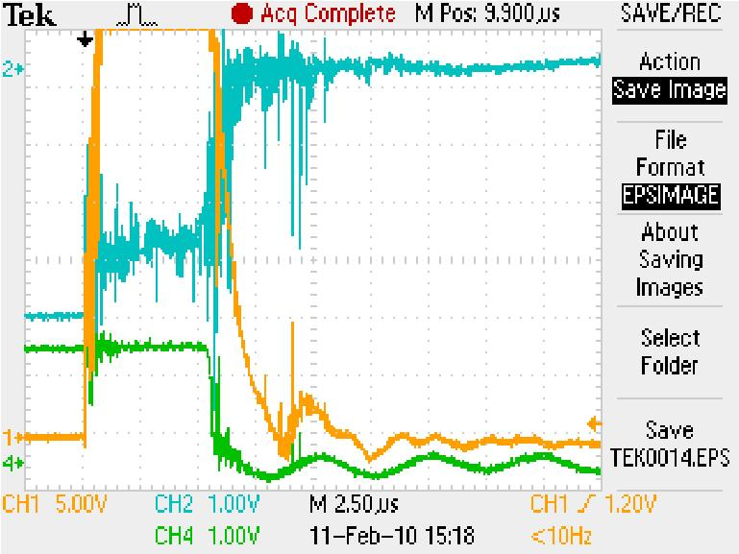
Integrated HV test
The integrated test to turn OFF HVPS (Voltage ~ - 43kV) and AMPS (Voltage ~ + 20kV) together is checked and it is found that both the power supplies switch OFF within 8 microseconds. During this test, 10Joule wire is used and it was safe during the HV shot.
10th IAEA-TM, Apr 20-24, 2015, IPR Gandhinagar, India

Slide 16
DAC Features
ECRH DAC System Features
# Acquire, analyze and present real-time system data ( Data acquisition rate : 160 µS / 1ms ) # System operation in Stand alone mode and Master / Slave mode with Central Control System. # Software interlocks activation/deactivation for different power supplies start/stop sequence and cooling sub system. # Data Export to MDS Plus Data structure and Visualization in JScope for future data analysis. # Fast Protection circuit ( < 10uS ) for Crowbar activation in fault conditions.
Operation of Gyrotron based ECRH system involves systematic operations of different auxiliary power supplies, crowbar unit and water cooling . It essentially requires real time signal monitoring, data acquisition and control with offline data analysis facility. ECRH system comprises with 32 Analog Inputs,16 analog outputs and 64 digital I/O. VME (Versa Module Europe – a high speed computer bus ) hardware based data acquisition and control system is designed keeping modular design approach in Hardware & Software.
Software development follows Client – Server model architecture . Interactive GUI developed using open source software Tcl-tk, GNU C,C++ compiler on Linux platform. Control software developed on VxWorks RTOS in C++ and deployed on target Motorola POWER PC (SBS-VG4, 400MHz) based VME system. Both Hardware and Software are successfully integrated, tested and commissioned with ECRH system
10th IAEA-TM, Apr 20-24, 2015, IPR Gandhinagar, India

Slide 17
VME based DAC system
VMEbus Based Hardware
    Chassis with VME64 backplane ( 6U -15 Slot)
    SBS - VG4 MPC407 PowerPC board
    AVME 9325 analog I/P board
    AVME 9660 Carrier card
    VMIVME 2825 Digital IO Board
    IP -220A Analog Output module
    IP-480 A Timer / Counter Module
  VxWorks 5.4 RTOS (Wind-river systems)
  Tornado 2.2 IDE for Target application development
  Console GUI – using Tcl -Tk on Linux Platform
DAC SYSTEM Features:
# Acquire, analyze and present real-time system data ( Data acquisition rate : 1ms)
# System operation in Local mode and Master / Slave mode with Central
Control System.
# Software interlocks activation/deactivation for different power supplies start/stop
sequence and cooling sub system.
# Data Export to MDS Plus Data structure and Visualization in JScope for data
analysis.
# Fast Protection circuit ( < 10µS ) for Crowbar activation in fault conditions.
10th IAEA-TM, Apr 20-24, 2015, IPR Gandhinagar, India

Slide 18
DAC Layout
10th IAEA-TM, Apr 20-24, 2015, IPR Gandhinagar, India

Slide 19
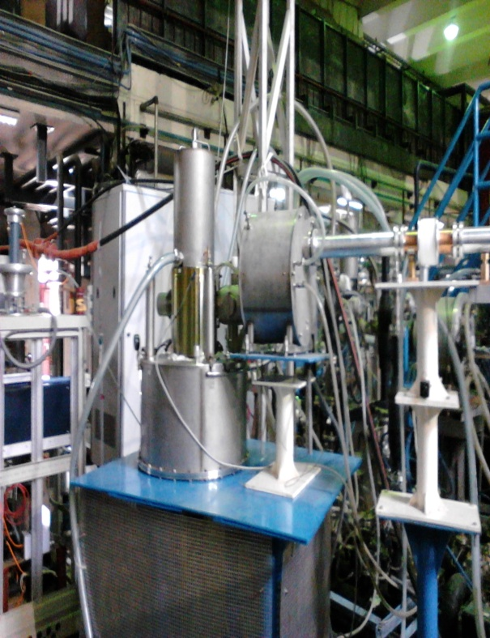
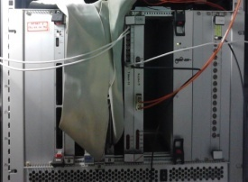

DAC system
42 GHz Gyrotron system (500kW,500ms)
Ion Pump PS
Signal Condition Rack
ECRH DAC
Cryomagnet PS
Anode PS
Filament PS
RHVPS Power Supply
Protections: Arc Detectors, di/dt, Anode Over Current,
Fast Interlock circuit
Ignitron based Crowbar system
SST1 -Data Storage and Analysis
Data Logger
(Gyrotron Water Cooling)
10th IAEA-TM, Apr 20-24, 2015, IPR Gandhinagar, India

Slide 20
ECRH pulse
10th IAEA-TM, Apr 20-24, 2015, IPR Gandhinagar, India

Slide 21
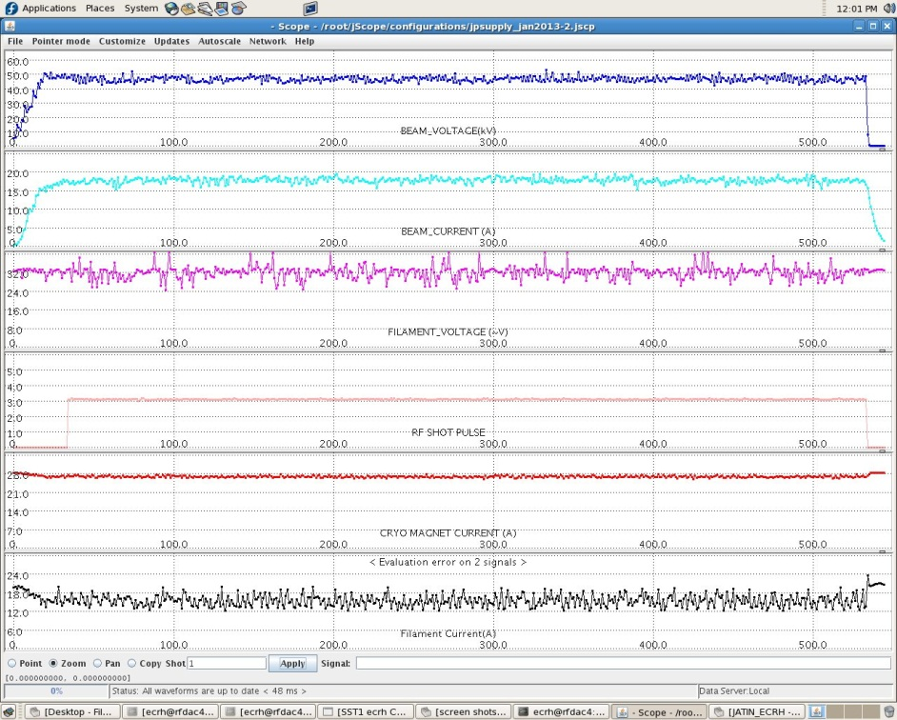
HV test of Gyrotron (DAC)
Parameters:
Beam Voltage: ~- 48kV, Beam Current: ~19A,
Anode voltage: +19kV,
Cryomagnet current: 28.2A, Filament Power: ~630W
10th IAEA-TM, Apr 20-24, 2015, IPR Gandhinagar, India

Slide 22
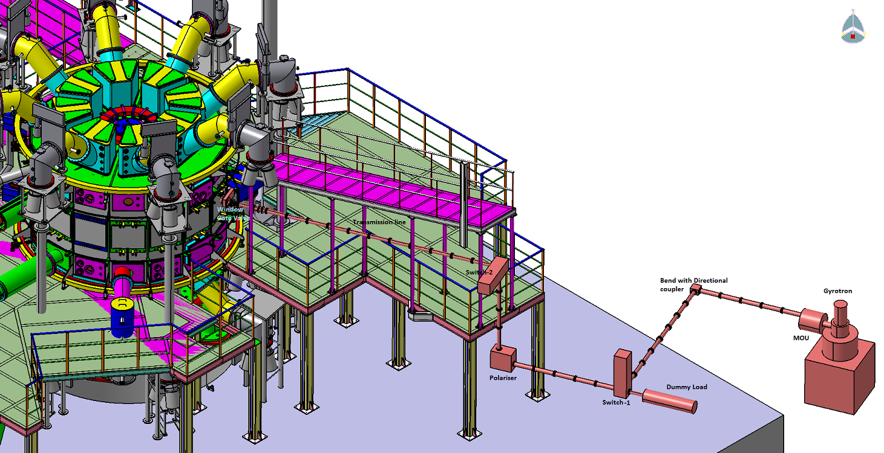
42GHz ECRH system on SST-1
10th IAEA-TM, Apr 20-24, 2015, IPR Gandhinagar, India

Slide 23
42GHz ECRH system on SST-1
Microwave Source (Gyrotron):
Depressed Collector type , Frequency : 42GHz, Power : 500 kW, Pulse duration : 500ms
Transmission line:
MOU, 63.5mm ID corrugated waveguide, polariser, bend, bellow, DC break
Launcher
Mirror based quasi-optical launcherr to launch focused beam for plasma breakdown in tokamak
10th IAEA-TM, Apr 20-24, 2015, IPR Gandhinagar, India

Slide 24
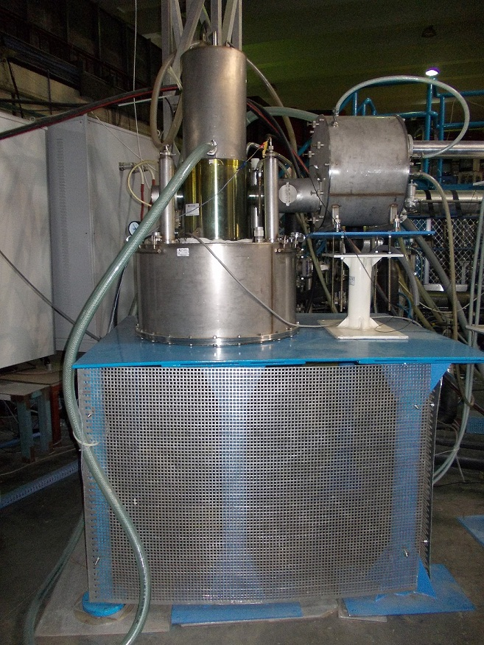
Gyrotron
Microwave Source (Gyrotron):
Depressed Collector type
Frequency : 42GHz
Power : 500 kW
Pulse duration : 500ms
Mode purity : > 95%
Gyrotron output : lateral-horizontal
Output mode : TEM₀₀ – Gaussian beam
Gyrotron output window : Ceramic (BN-edge cooled with)
Magnet of gyrotron : cryo-cooled
Cooling of gyrotron:
Collector, body, anode, ion pump and ballast load : cooled with DM water
10th IAEA-TM, Apr 20-24, 2015, IPR Gandhinagar, India

Slide 25
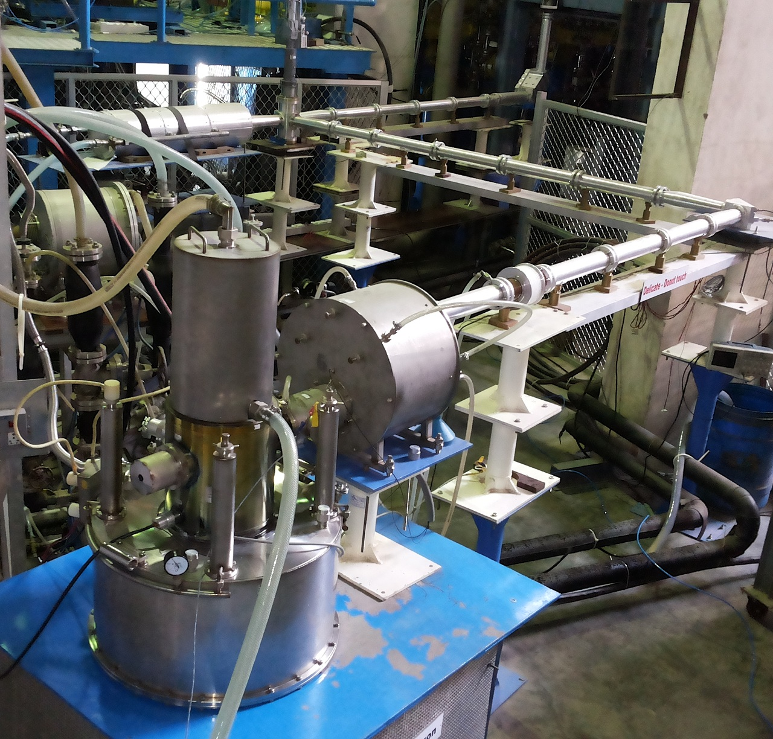
42GHz ECRH system in SST-1
Microwave Source (Gyrotron):
Operating parameters
Beam voltage: -50kV max
Beam current: 20A
Anode Voltage: +20kV
Cryomagnet current: 28.3A
Efficiency : 50%
Mode purity : > 95%
Gyrotron output : lateral-horizontal
Output mode : TEM₀₀ – Gaussian beam
Gyrotron output window : Ceramic (BN-edge cooled with)
Magnet of gyrotron : cryo-cooled
10th IAEA-TM, Apr 20-24, 2015, IPR Gandhinagar, India

Slide 26
ECRH assisted breakdown in SST-1
Parameters for 1.5T operation:
Tokamak Magnetic Field: 1.5T
ECH mode : O-1
(Polarization – Plane polarization E||B_{T})
Power: ~200kW
Pulse duration: 150-170ms
ECRH Pulse = +10.0ms (w.r.t. loop voltage)
Hydrogen Pressure : 8x10⁻⁶ to 3x10⁻⁵ mbar
Successful breakdown is achieved in all the shots where ECRH power launched successfully
Loop voltage : ~ 3.0 V
Plasma current: ~40-60kA (Small Discharges)
Delay in breakdown ~ No delay
Parameters for 0.75T operation:
Tokamak Magnetic Field: 0.75T
ECH mode : X-2
(Polarization – Right hand circular)
Power: 225kW
Pulse duration: 200ms
Pulse start at : -50ms w.r.t. loop voltage
Hydrogen Pressure : 1x10⁻⁵ mbar
Successful breakdown is achieved in all the shots where ECRH power launched successfully
The pre-ionized density : 4-8x10¹⁸m⁻³
Loop voltage : ~ 3.0 V
Plasma current: ~50kA
Delay in breakdown ~40ms
10th IAEA-TM, Apr 20-24, 2015, IPR Gandhinagar, India

Slide 27
ECRH assisted breakdown in SST-1
10th IAEA-TM, Apr 20-24, 2015, IPR Gandhinagar, India

Slide 28
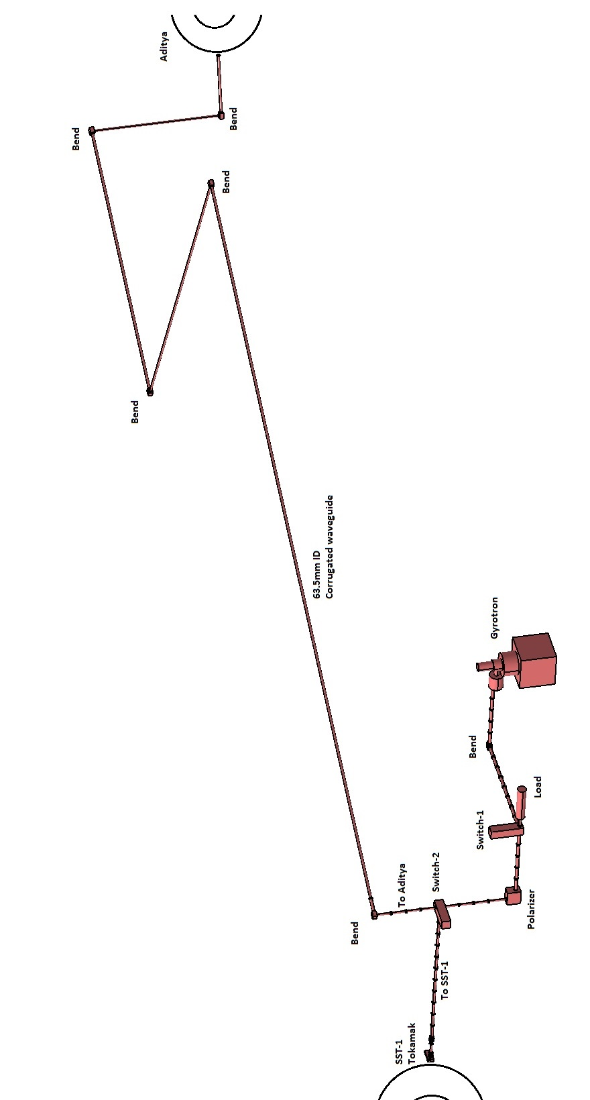
ECRH system in Aditya
10th IAEA-TM, Apr 20-24, 2015, IPR Gandhinagar, India

Slide 29
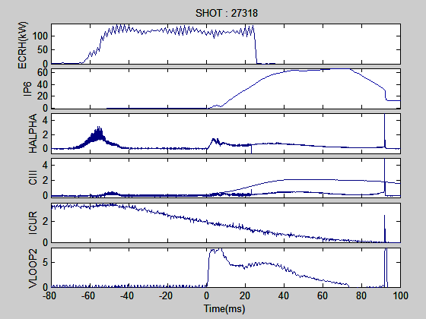
Low-loop voltage ECRH assisted breakdown in Aditya
ECRH Parameters:
X-2 launch
Aditya tokamak BT : 0.75T (0.75-0.85T)
Power varied from 80kW to 150kW
Pulse duration from 70ms to 100ms
ECRH start @ -50ms
Pressure varied from 8x10⁻⁵ to 2x10⁻⁴ torr
Loop voltage from 12V to 5V
10th IAEA-TM, Apr 20-24, 2015, IPR Gandhinagar, India

Slide 30
Upgradation of ECRH DAC system
Issues with VME system
Booting problems are witnessed in main processor board (SBS-VG4). Processor hangs on problem happened sometimes.
System Hardware is more than 10 years old. Possibility of aging effects in hardware.
Spare cards for main processor board (SBS-VG4) and analog input board (AVME 9325) are not available
Hardware and Software support is not available for old VxWorks 5.4 RTOS.No Scope for repair of old hardware.
New VME hardware supports latest version of VxWorks.
Required latest VxWorks 7 and Wind River workbench which is very costly for single application.
System integration problem so upgration with PXI system
PXI is a rugged PC-based modular instrumentation platform for measurement and automation systems.
PXI combines PCI electrical-bus features with the modular, Eurocard packaging of CompactPCI with specialized synchronization buses
PXI system:
Chassis , PXI Controller, PXI Modules : Analog and Digital I/O modules , FPGA modules
Software – NI Labview 13.0
10th IAEA-TM, Apr 20-24, 2015, IPR Gandhinagar, India

Slide 31

Conclusion
Gyrotron based ECRH is an important heating system on tokamak
Operation of gyrotron requires extreme care as it’s a delicate device
Prior to Gyrotron operation we need to carry out all the HV test for the system reliability
In SST-1 and Aditya, 42GHz/500kW/500ms are used to carry out various experiments at 0.75T and1.5T
VME based DAC system is being used for the gyrotron operation
The DAC system is under upgradation with PXI based ECRH system
10th IAEA-TM, Apr 20-24, 2015, IPR Gandhinagar, India

