Slide 1
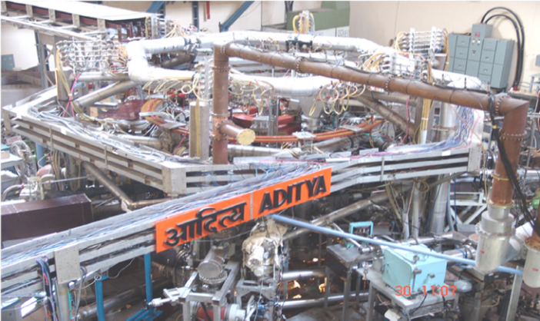
Controlling Plasma Disruptions and Runaway Electrons using novel techniques in Tokamak ADITYA
by
Joydeep Ghosh
Institute for Plasma Research, India
(Contribution from ADITYA Team)

Slide 2
Introduction and Outline
Disruptions in Tokamaks:
An abrupt termination of a tokamak discharge
Leading to the sudden loss of plasma stored energies
The force and heat loads, induced by disruption, damages the machine walls, support structure and in-vessel components
Runaway Electrons (RE) in Tokamaks:
Electrons that run away in velocity space due to driving force, eE, which overcomes the collisional drag force
RE generation with higher energies of several tens of MeV is expected during major disruptions in ITER
When locally deposited these REs can damage the first wall components

Slide 3
Introduction and Outline
Disruptions must be avoided
and
Runaway electrons should be mitigated
Both these topics of utmost importance to bigger Tokamak have been addressed in ADITYA using new techniques
The talk is organized as follows:
Novel approaches towards disruption Avoidance in ADITYA tokamak
Runaway electron mitigation in ADITYA tokamak
Summary

Slide 4
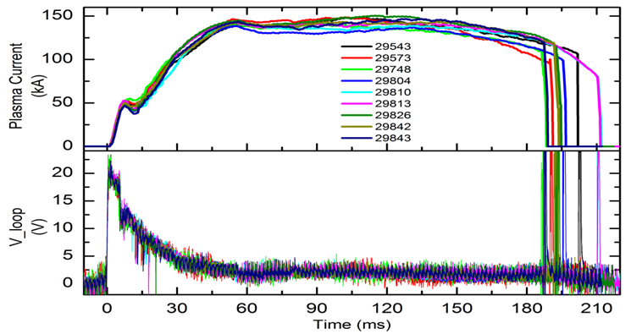
ADITYA Tokamak
Aditya tokamak is a mid-sized air-core tokamak
Machine Parameters:
Major Radius: 0.75 m
Minor Radius: 0.25 m
Toroidal field: 0.75 – 1.2 T
Peak loop voltage: 20 V
Circular Plasma with circular poloidal limiter
Plasma Parameters:
I_{P} ~ 70 – 160 kA
$\overline{n_{e}}$ ~ 1 – 4 x 10¹⁹ m⁻³
Te ~ 300 – 700 eV
Duration ~ 90 – 250 ms
Typical discharges of ADITYA tokamak

Slide 5
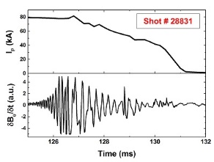
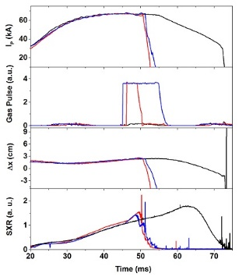
Disruptions in ADITYA
Majority (> 95 %) of disruptions in Aditya show
MHD growth prior to disruptions
(Identified as m/n = 2/1, 3/1 resistive tearing modes)
Cessation of mode rotations and locking
Growth of neighbouring chains of islands lead to loss of confinement
Total termination of plasma current
Disruption can be induced by controlled gas puffing
Edge cooling leading to generation of resistive tearing modes
Causing Disruptions
Deliberate disruption by Gas puffing

Slide 6
Disruption Mitigation by Biased Electrode
Experimental Set-up
Biased Electrodes induces sheared radial electric fields
Generation of sheared poloidal rotations in edge region
Sheared rotations are known to suppress the MHD fluctuation
Capacitor Bank
SCR
Material: Molybdenum
Diameter: 5 mm
Tip position inside limiter ~ 3 cm (near q_{edge} ~ 3)
Exposed length ~ 2 cm
Electrode Current
V_{bias}
Flexible
bellow
Gate Valve
Ceramic
Limiter
Plasma
ELECTRODE
Electrode
High Field Side
Vacuum Vessel
Hence, MHD generated disruptions in Aditya tokamak are targeted with sheared rotation induced by biased electrode

Slide 7
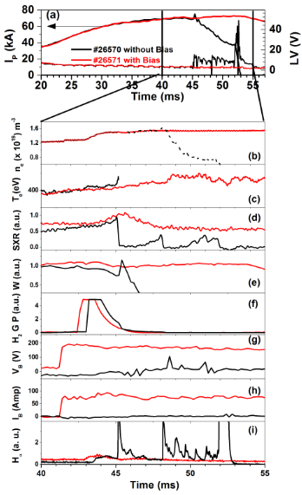
Disruption Mitigation by Biased Electrode
Disrupted Shot # 26570 without bias – in Black
Disruption avoided in Shot # 26571 with bias (~190V) – in Red
Bias applied
Gas puff applied
By applying bias voltage
Current quench avoided
Plasma current sustained
Density Restored
Temperature Restored
SXR emission Restored
Stored energy Restored
Gas Puff Pulse
Bias Voltage
Bias Current
DISRUPTION AVOIDED!!!

Slide 8
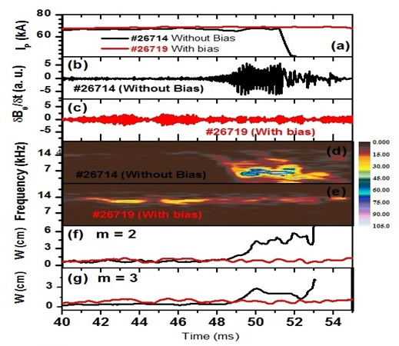
Disruption Mitigation by Biased Electrode
Shot # 26714 without bias – Disrupted (Black)
Shot # 26719 with bias (~ 220V) - Disruption avoided (Red)
With Gas puffing at t ~ 42 ms
MHD Oscillations increases with gas puff in Disruptive discharge
Growth of m/n = 2/1, 3/1 modes
Mode rotation ceases
With Application of bias at t ~ 41 ms
Modes do NOT grow
Mode rotation continues
And Disruption does NOT occur !!!

Slide 9
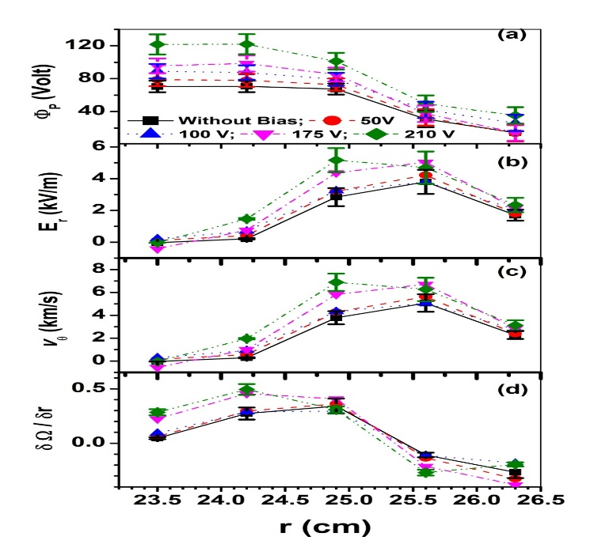
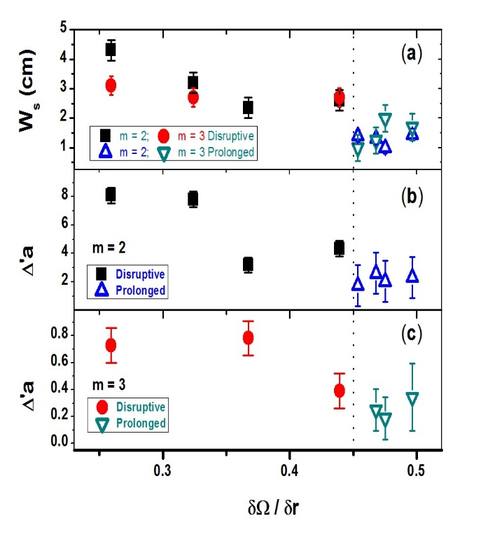
Disruption Mitigation by Biased Electrode
With Application of bias voltage
Plasma Potential profile gets modified and Radial Electric field E_{r} and its shear increases
Leading to
${\text{increase} \text{in} E}_{r}×B_{Φ}$ rotation and its shear
As the bias voltage is increased
Increased poloidal flow shear stabilizes both m/n = 2/1, 3/1 modes
Saturated island width and stability index Δ́a decreases slowly with increase in poloidal flow shear
For bias voltage ≥ 180 Volts, the flow shear (${δΩ}/{δr ≥0.45)}$ $≥$ magnetic shear
TM generated due to gas puff are stabilized and the Disruptions caused by these modes are mitigated
9

Slide 10
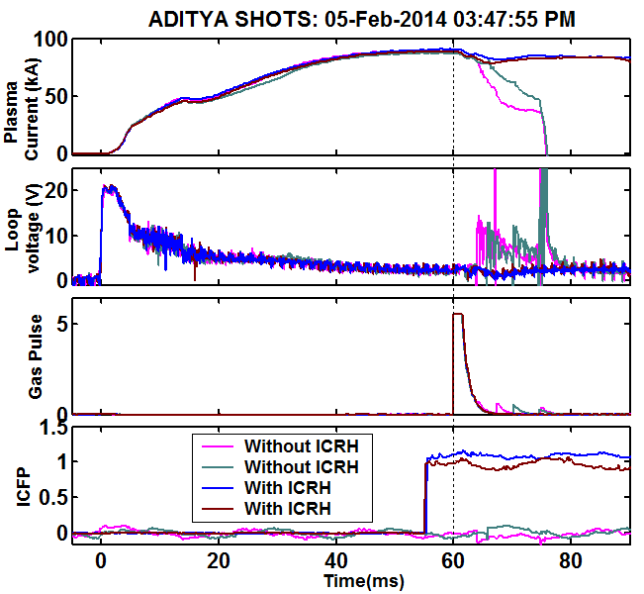
Disruption Mitigation by ICRH Power
A biased electrode cannot be put in the edge region of a reactor grade tokamak
Disruptions induced by hydrogen gas puffing are successfully mitigated by applying ICRH power through a fast wave antenna
Current quench avoided
Plasma current sustained
Disrupted shots
Power Injected
~ 50 to 70 kW
5 ms prior to gas puff injection
DISRUPTION AVOIDED!!!
Pre-Programmed ICRH power for disruption mitigation

Slide 11
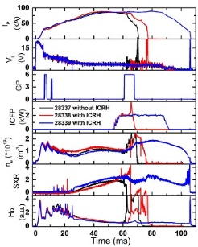
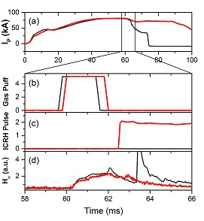
Disruption Mitigation by ICRH Power
Disruption Mitigation in Real time
Similar to bias experiments
The plasma density is restored
Temperature is restored
disruption avoided with ICR pulse
Gas-puff induced H_{α} intensity increase is used as a precursor for triggering the ICR pulse.

Slide 12
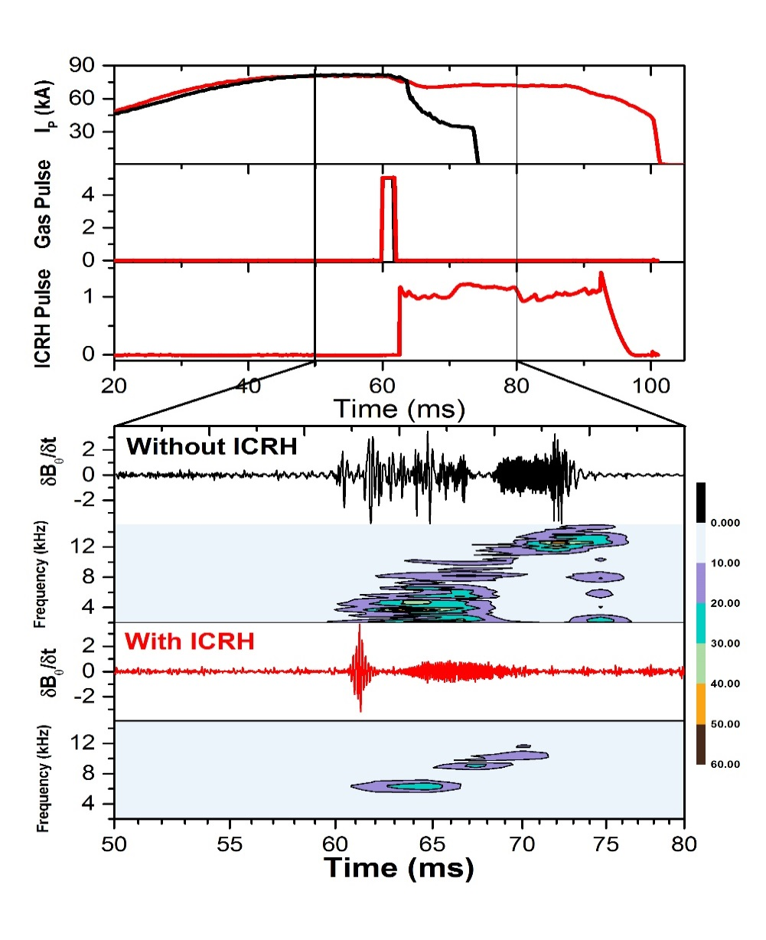
Disruption Mitigation by ICRH Power
Further Analysis Show
The MHD activity induced by gas puff gets reduced with ICRH pulse.
The disruption avoidance is observed with ~50 to 70 kW of ICR power
Increasing the power > 70 kW does not lead to disruption avoidance
Possible Cause
The disruption avoidance does not seem to be due to heating near the Islands. ICR Heating required power > 100 kW
ICR induced radial electric field generating a shear rotation and subsequent avoidance of disruption as in case of biasing may be a possibility
Radial Electric Field measurements in presence of ICR pulse is underway

Slide 13
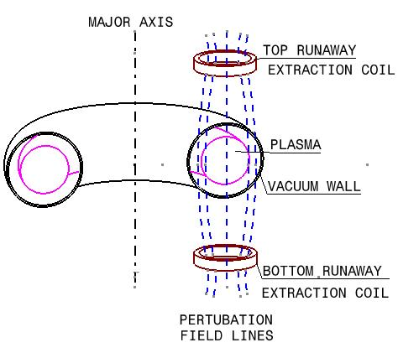
Runaway Electrons Mitigation
Mitigation techniques used in other tokamaks:
injection of high pressure gas jet through the nozzle or fast valves
Resonant magnetic perturbation (RMP) for runaway losses through magnetic fluctuation
In Aditya tokamak, Localized Vertical Magnetic field (LVF) perturbation technique is successfully attempted to mitigate REs
Application of a short localized vertical field perturbation of 150 to 260 Gauss
The perturbation causes no disruption of the thermal component of the plasma
The perturbation leads to a radial diffusion
$$D_{⊥}≈{\left[\left({B_{p}}/B\right)L\right]}^{2}v_{∥}/2πR$$
$v_{∥}→$ particle velocity along magnetic field, B
${ B}_{p}→$ perturbation magnetic field
L Scale length of the perturbation field gradient
As $D_{⊥}∝v_{∥}$ the runaway particle diffusion
must be larger than the thermal particle diffusion by at least a factor of $\frac{v_{∥r}}{v_{∥th}}$
LVF setup
Hence REs can be extracted without disturbing the thermal plasma

Slide 14
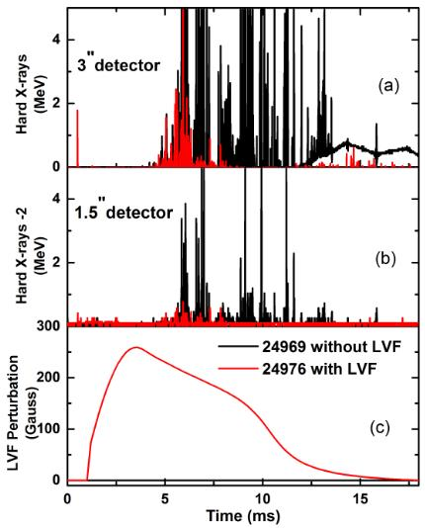
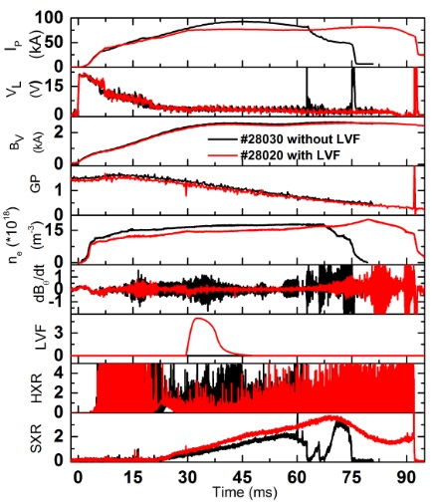
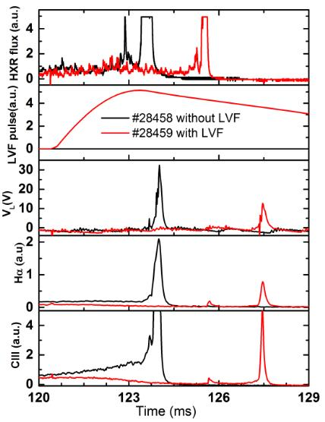
RE Extraction by LVF Perturbation
RE mitigation with application of LVF in different phases of plasma current
Breakdown phase
Current ramp up phase
Disruption phase
Results:
Significant reduction (~ 5 times) in initial RE population
Reduction in REs during current ramp up and disruption phases
Runaway current contribution in main current reduced and the discharge parameters are also improved

Slide 15
Conclusions
Disruptions, induced by hydrogen gas puffing are successfully mitigated using biased electrode and ICR pulse techniques
Both methods show identical characteristics such as MHD activity suppression leading to disruption avoidance.
Biasing voltage ~ 180 – 250 V and ICR power of 50 – 70 kW required for disruption avoidance
Induced poloidal rotation shear > magnetic shear with biasing stabilizes the resistive tearing modes leading to disruption avoidance
ICR induced radial electric field may be inducing sheared poloidal rotation leading to disruption avoidance
The runaway electrons (RE) are mitigated using local vertical field perturbation
The REs are mitigated during plasma current startup, plasma current flattop and discharge termination phases

Slide 16
Thank you!
The ADITYA Team:
R.Tanna, Pintu kumar, K. A. Jadeja, K. M. Patel, Nilesh Patel, K.S. Acharya, S. B. Bhatt, K.S. Shah, M.N. Makawana, C.N. Gupta, M. B. Kalal, D. S. Varia, V. K. Panchal, N. C. Patel, C. Chavda, A. Amardas, D. Sangwan, Harshita Raj, P. K. Chattopadhyay, K. Sathyanarayana, S. K. Jha, D. Raju, M.V. Gopalkrishna, K. Tahiliani, R. Jha, S. Purohit, J. V. Raval, Asim Kumar Chattopadhyay, Y. S. Joisa, C.V.S. Rao, Umesh Nagora, P. K. Atrey, S.K. Pathak, N. Virani, N. Ramaiya, S. Banerjee, M. B. Chowdhuri, R. Manchanda, Kiran Patel, J. Thomas, Ajai Kumar, Vinay Kumar, P. Vasu, J. Govindrajan, S. Gupta, Kumar Ajay, S. Pandya, K. Mahavar, M. Gupta, Praveenlal E.V, Minsha Shah, Praveena Kumari, R. Rajpal, S. V. Kulkarni & ICRH Group, B. K. Shukla & ECRH Group, P.K. Sharma & LHCD Group, R. Goswami, R. Srinivasan, I Bandyopadhyay, R.P. Bhattacharyay, Amit Sircar, N. Ramasubramanian, H. D. Pujara, H.A. Pathak, A. Vardharajalu, A. Das, S.P. Deshpande, K.K. Jain, Prabhat Ranjan, D. C. Reddy, D. Bora, Y. C. Saxena, S. K. Mattoo, A. Sen, P. I. John and P. K. Kaw.

Slide 17
Back up slides

Slide 18
Plasma biasing by non-resonant ponderomotive
forces of radio-frequency waves
By R. VAN NIEUWENHOVE,f V. PETRZILKAJ
AND J. A. TATARONIS§
Association Euratom-Etat Beige, Departement de Physique Statistique et Plasmas,
CP 231, Universite Libre de Bruxelles, Campus Plaine, 1050 Bruxelles, Belgium
(Received 12 December 1994)
A numerical code that computes stationary radial electric fields EOr induced by ponderomotive forces of radio-frequency waves is developed. The computed value of EOr is typically several hundred volts per centimetre when the wave frequency is 1 % lower or higher than the ion-cyclotron frequency. This value of EOr suggests that the ponderomotively induced electric field would be an effective bias in tokamaks. Numerical data are presented to illustrate the properties of this bias field.

Slide 19
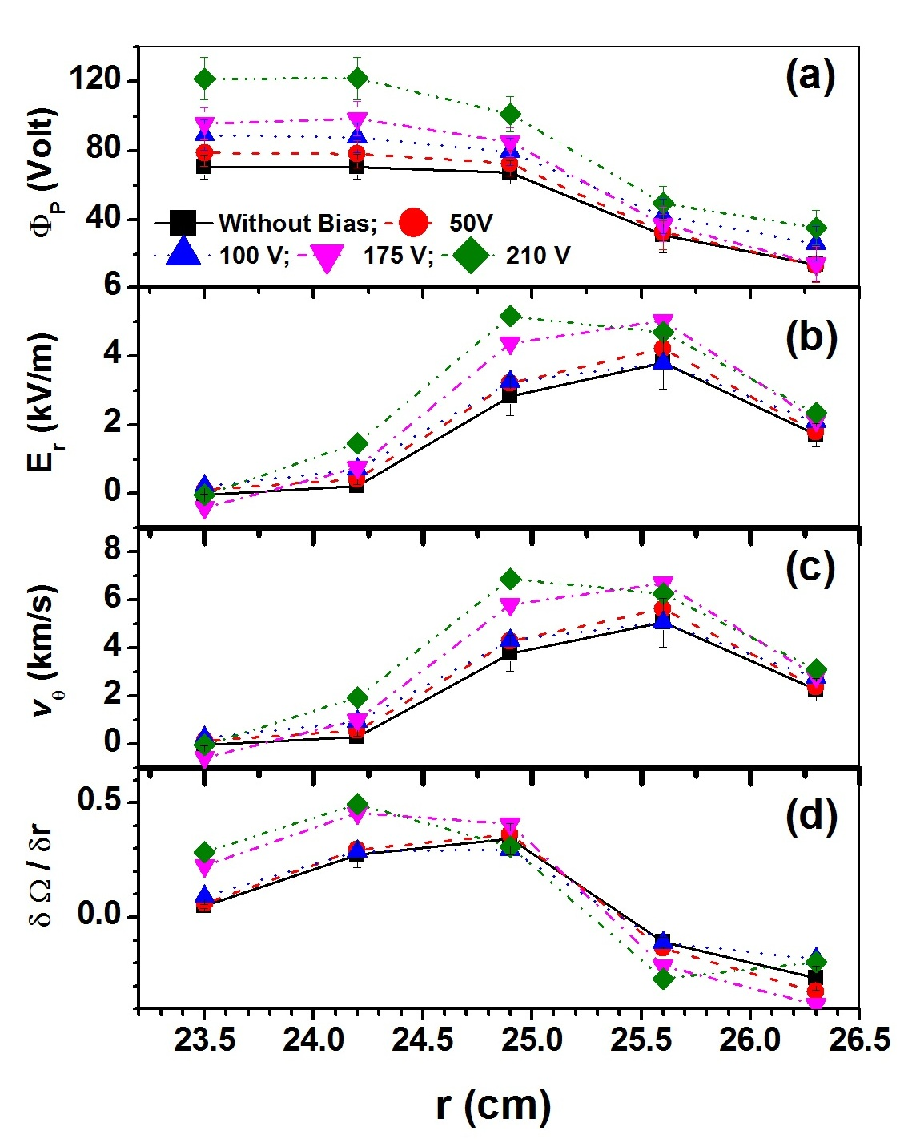
Plasma Poloidal Rotation with and without biasing
Radial profiles of
(a) plasma potential
(b) radial electric field
(c) poloidal flow velocity
(d) normalised poloidal flow Shear
rotation (in ion-diamagnetic drift
direction) of plasma at r ~ 24 cm increases from ~ 3.5 km/s (without bias)
to ~ 7.0 km/s (with +210 V bias)
Increased Poloidal Flow Shear with Bias

Slide 20
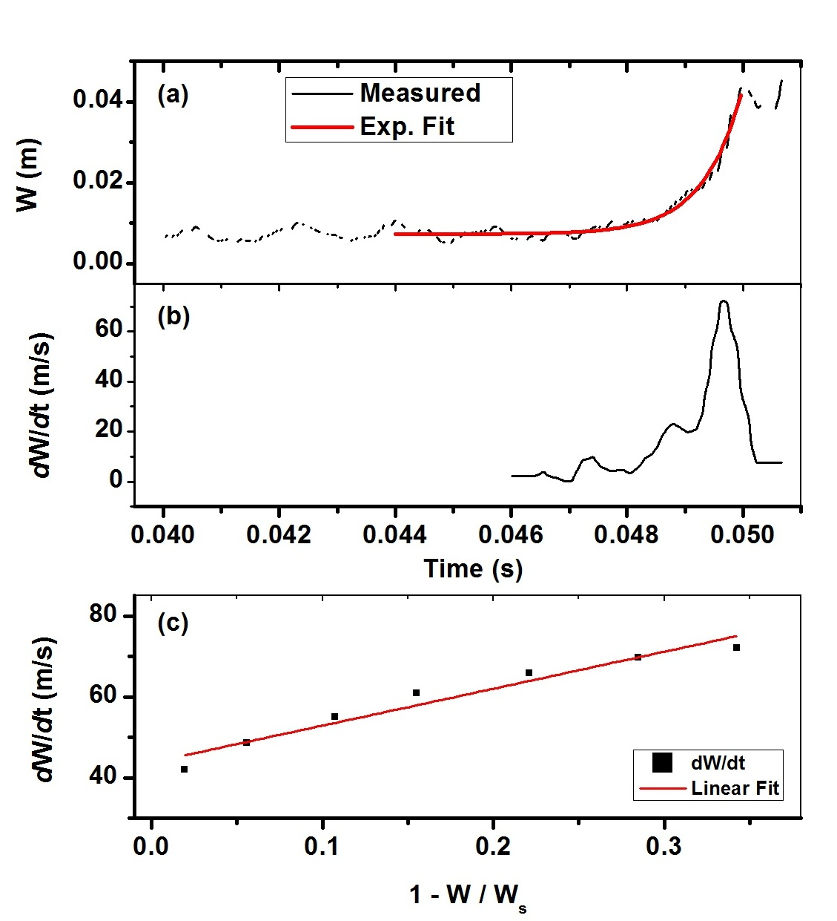
Stability index calculation from Mirnov Coil Measurements
Using
is resistive diffusion time
Alfven transit time
Using Rutherford equation:
W_{S} is saturation island width
is Spitzer resistivity

Slide 21
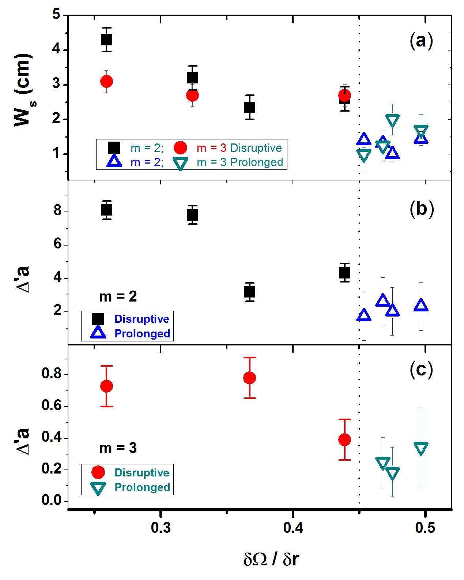
Variation of saturation island width (W_{S})
and (Δ’a ) as a function of poloidal flow
shear for m = 2 and m = 3 modes.
Disruptions Avoided for
When
Ratio of Flow Shear to Magnetic Shear

