Slide 1


Overview On Development Of Various Data Acquisition and Control Systems For Indian Negative Neutral Beam Development Program
Jignesh Soni¹, R. Yadav², H. Tyagi², A. Gahluat¹, G. Bansal¹, M. Bandyopadhay², K. Parmar¹,K. Pandya¹, V. Mahesh¹, D. Parmar², C. Rotti², S. Shah², H. Mistri¹and A. Chakraborty¹
1 Institute For Plasma Research, Bhat, Gandhinagar, Gujarat, India
2 ITER-India, Institute For Plasma Research, Bhat, Gandhinagar, Gujarat, India
email : jsoni@ipr.res.in

Slide 2
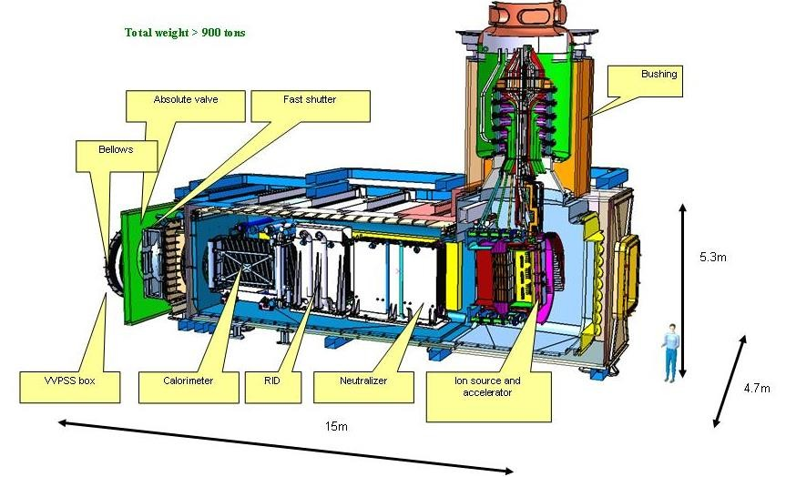
Introduction
The diagnostic neutral beam (DNB) is IN- Deliverable .
Diagnose the He ash content during ITER D-T phase using CXRS .
RF Based Negative NB system
Requirements are stringent with ~ 1MW of RF power at 1 MHz and 3600 S long pulse duration with 3sec On 20 Sec OFF cycle.

Slide 3
Negative Neutral Beam Development Program
TEST FACILITIES
ROBIN
Twin Source
IN-TF
Objective: Successful delivery of DNB and development of Indian RF based - -ve Neutral Beam system for Future Fusion Machine
For understand the physics and engineering aspects of neutral beams : Three test facilities planed
Single Driver source
Basic test facility
100 KW RF power
Developed for understanding the Multi-driver source
Two Driver source
180 KW RF power
NB system for characterized the DNB source
Eight Driver source
800 KW RF power

Slide 4
ROBIN DACS

Slide 5
ROBIN Parameter
ROBIN : A negative ion source test bed which replicate the Batman source in INDIA
Inductively coupled single driver plasma source
Specie : Hydrogen
Energy : 35 keV
RF Power : 100 KW , 1 Mhz
Extraction Current : 10 A
Plasma density : ~ 5 x 10¹¹ cm⁻³
Current density : ~ 30 mA /cm²

Slide 6
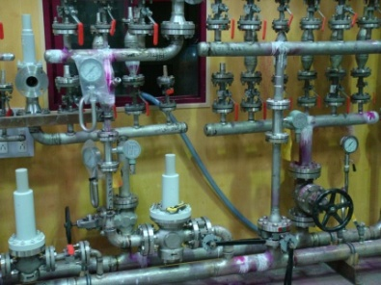
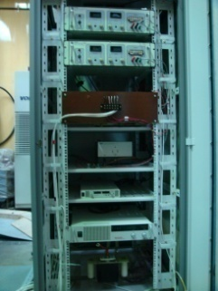
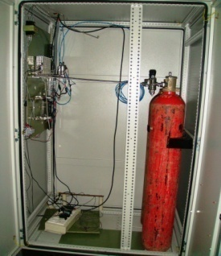
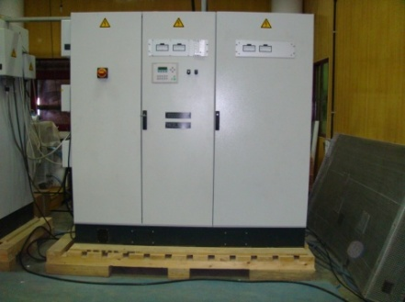
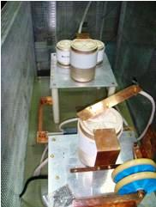
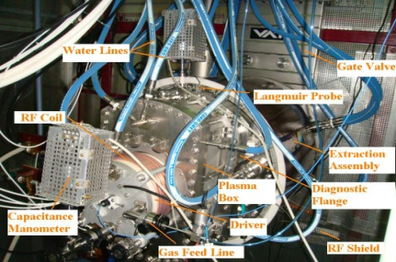
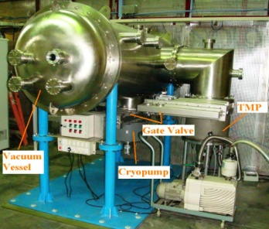
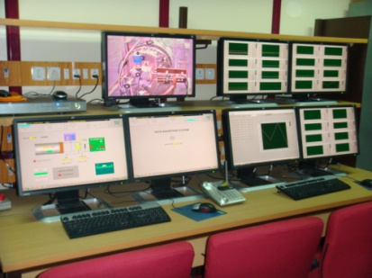
ROBIN and SUB-SYSTEMS
Auxiliary power supply
Hydraulics system
Gas feed system
Vacuum system
Matching unit
100 kW 1MHz RF generator
Diagnostics : 4 channel optical spectrometer + other
HVDC power supply
DACS

Slide 7
BASIC REQUIREMENT
Pulse operation : 30 S , Beam On time : 5 S
Operating States : 4 main , 6 Conditioning states
Control signal : 150 Analog , 200 digital
Control cycle time : 4 - 5 ms
Max. Sampling rate : 32 signals @ 100 µs,
96 signal @1ms
DAQ on time : 600 S @ 10 ms sampling
Real time continuous acquisition and online monitoring of 128 analog signals
User configurable sampling rate , no of channel and GUI for online data view
Report generation and backup facility
High voltage and RF environment

Slide 8


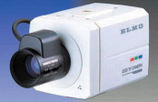
ROBIN DACS Architecture
ROBIN DACS Architecture
M1
M2
M3
M4
M5
M6
M7
M8
M9
Graphic card
Graphic card
LabVIEW
Presentation Layer
Work Station 3
for Offline
data analysis
Wincc SCADA
LabVIEW
Work Station 4
For Spectroscopy
diagnostics
Work Station 1 for
Control system
Work Station 2
for online data
monitoring
DVR
Network switch
RG 75 Video cable
USB cable
Ethernet cable
Control Layer
PXI RT
DAQ system
Step 7
Master Control
Siemens PLC system
LabVIEW RT
Signal
Conditioning Electronics
Signal
Conditioning Electronics
Spectroscopy
hardware
CCD cameras
Equipment Layer
Light signals of Various diagnostics
Control and monitoring signals of Various sub-system
Acquisition signals of Various sub-system
ROBIN Experiment setup
M1 to M9 are 22” monitors

Slide 9
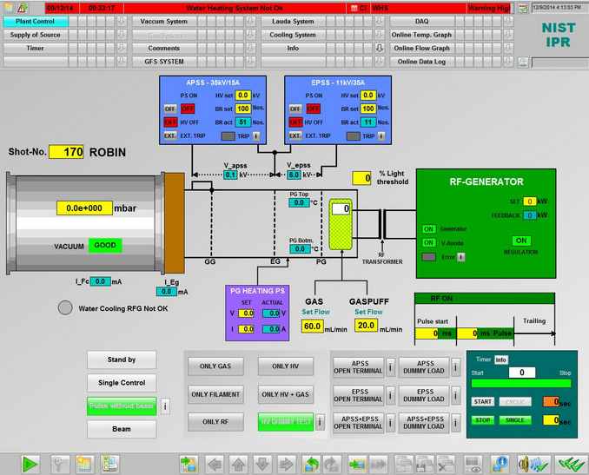
Main Control GUI

Slide 10
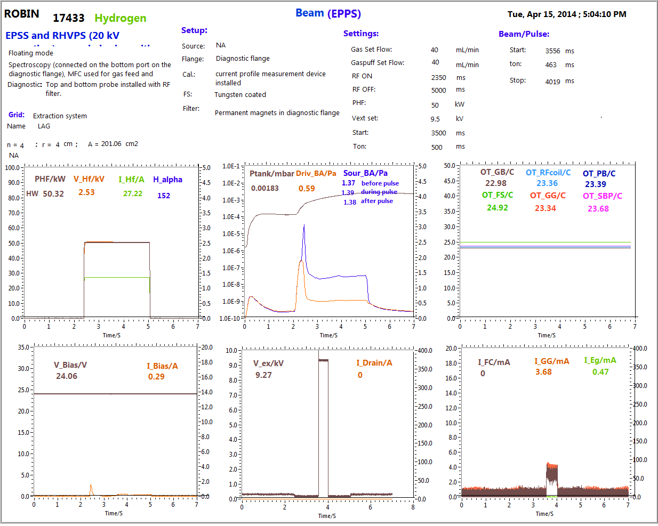
ROBIN DAQ REPOT Beam mode

Slide 11
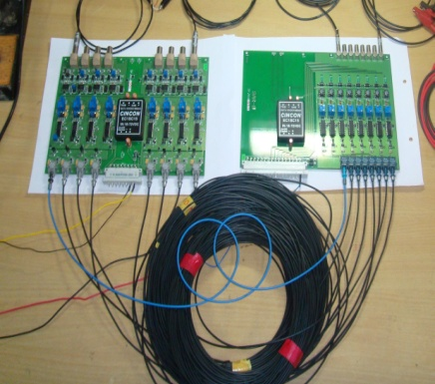
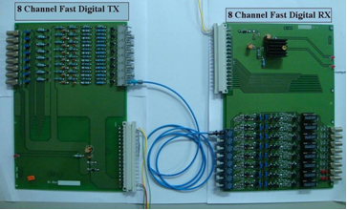
Front- end signal conditioning in DACS system
Two types of signal isolation scheme :
Fiber optics isolation for sub-system floated at high voltage (~ 35 KV) potential
(in-house development)
(2) Galvanic isolation for sub-system connected at ground level (COTS item)
In house Design and development of different types of Fiber optics links
1 And 8 channel FO link for slow analog signal
Input differential signal range : 0 to 10V, 0 to 1 V, +/- 5 V , +/- 10 V, 0 to 20mV , 0 to10mV, 4 to 20 mA, 0 to 20 mA and Thermocouple
Input signal range: 0 & 24 Vdc or TTL or PFC
Bandwidth: DC - 1Khz (flat response)
Accuracy , Linearity: 0.5 %
Rise time = 210µS , Fall time= 200µs , Delay = 32µs
1 And 8 channel FO link for slow Digital signal
Output signal range: 0 & 24 Vdc or TTL or PFC
Rise time = 368 nS, Fall time= 87.27 nS, Delay =4.2µ
Rise time = 2.2 µS, Fall time= 2. 5 µS
Accuracy, Linearity : 0.5 %
Bandwidth: DC - 100 Khz
Input and Output signal range : 0 to 10V or +/- 5 V
1 channel FO link for Fast analog signal
Output signal range: 0 to 10 V or +/- 5 V for all the input range

Slide 12
Twin Source –Data Acquisition and Control System (DACS) based on CODAC

Slide 13
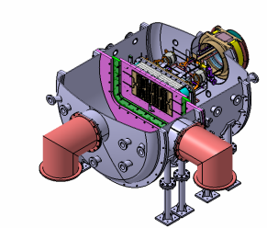
Twin Source Parameter
An Inductively coupled two RF driver based ion source experimental setup is initiated at IPR, with the objective of understanding the physics and technology of multi-driver coupling
Specie: Hydrogen
Energy: 45 KeV
Current: ~8-10 A @ 40KV
Plasma Density: ~ 5× 10¹² cm⁻³
Current Density: 30 mA/cm²
RF Power:180kW, 1MHz

Slide 14
BASIC REQUIREMENT
Pulse operation : 30 S , Beam On time : 5 S
Modulation : 5 cycles with 5Hz modulation for ~ 3s ON 20s OFF
Operating States : 4 main , 6 Conditioning states
Control signal : 160 Analog , 200 digital
Control cycle time : 4 - 5 ms
No. DAQ signals : 128
Max. Sampling rate : 32 signals @ 100 µs, 128signal @1ms
DAQ on time : 600 S @ 10 ms sampling
Real time continuous acquisition and online monitoring of 128 analog signals
User configurable sampling rate , no of channel and GUI for online data view
Report generation and backup facility
High voltage and RF environment
Framework based on ITER CODAC and proprietary software

Slide 15
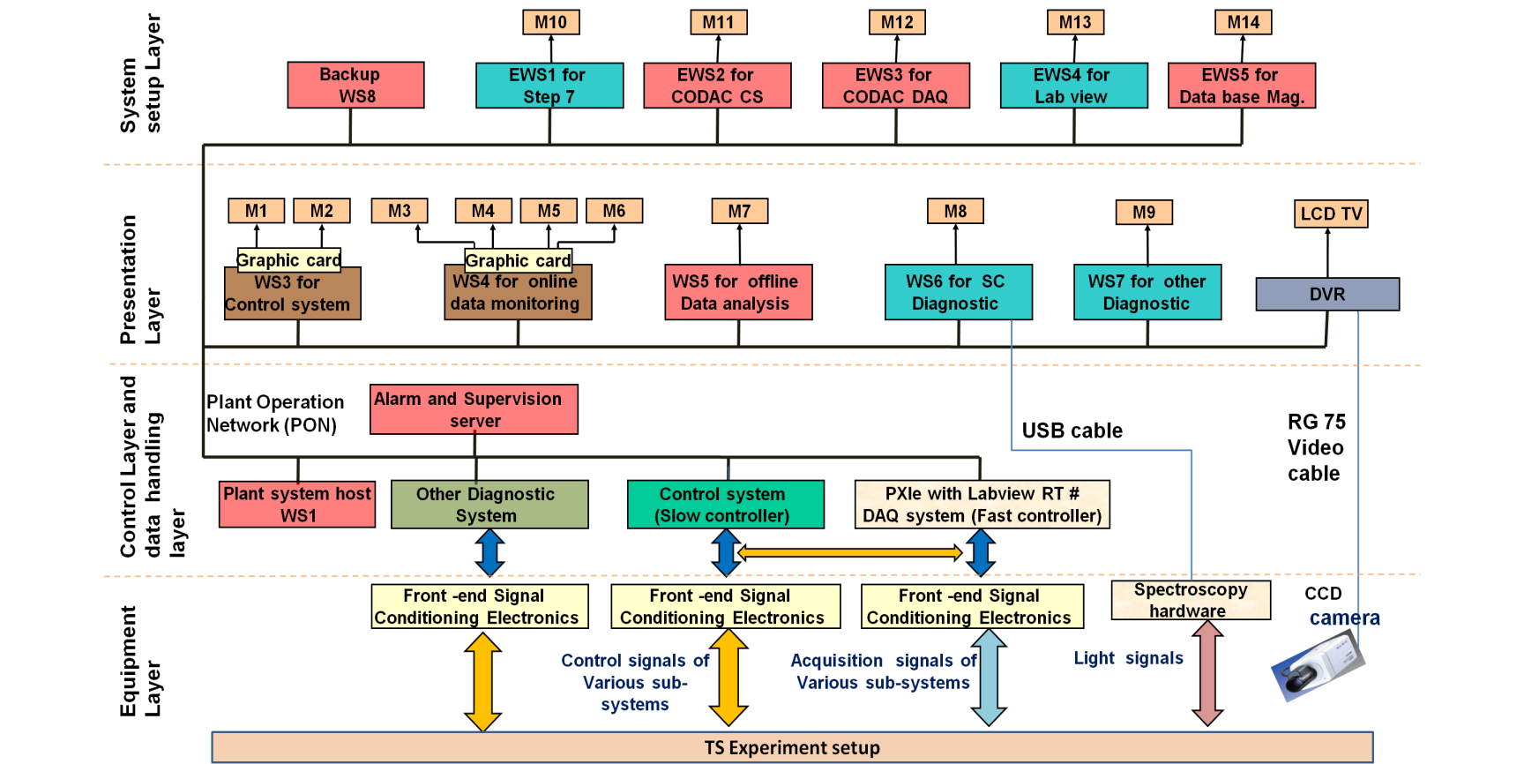
TS-DACS Architecture

Slide 16
Control System Architecture

Slide 17
TS-DACS Architecture

Slide 18
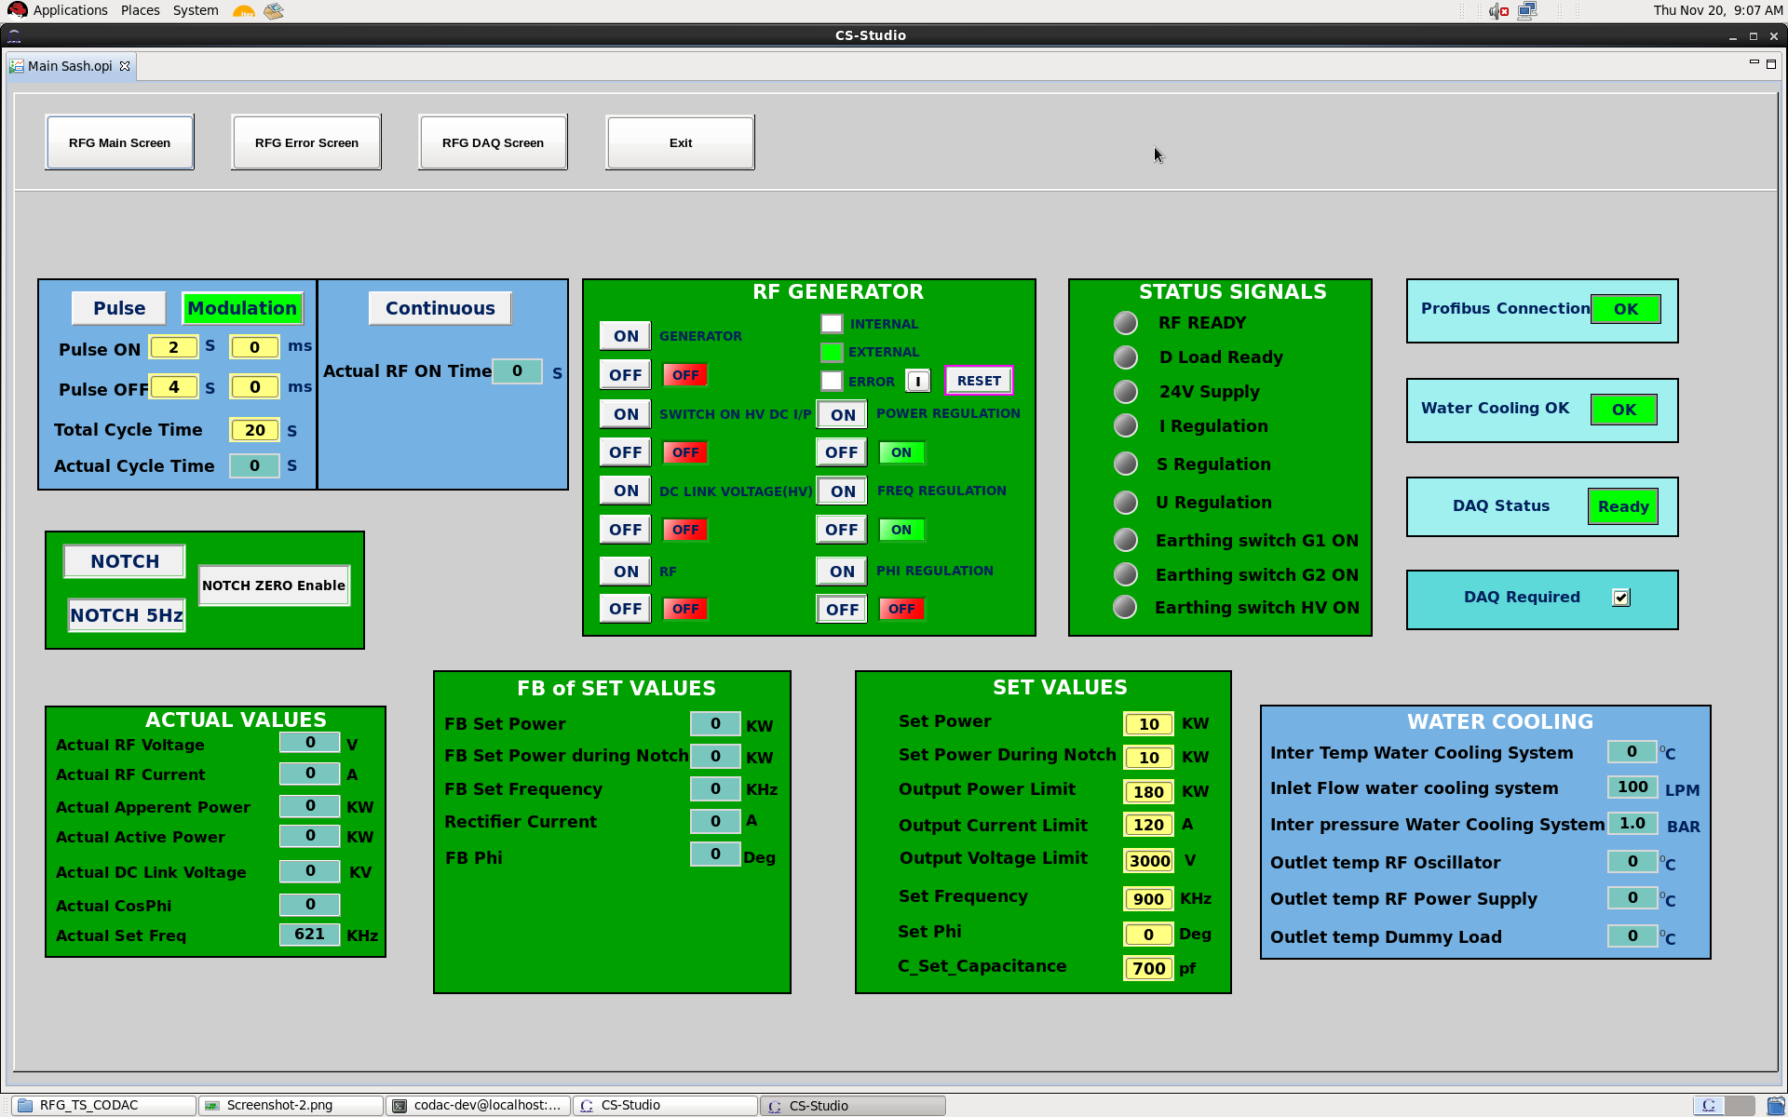
TS-RFG SAT using COADC Core System

Slide 19
INTF-DACS based on CODAC

Slide 20
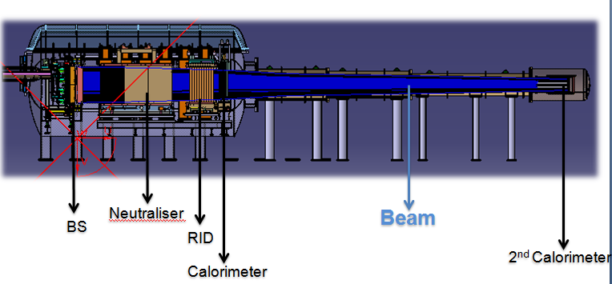
INTF Sub-Systems
Cesium System
Cryo Plant
Gas feed system
PS
HV Bushing
Vacuum System
Pneumatic System
Hydraulic System
Diagnostics

Slide 21
INTF DAC Requirements
Test facility to characterize DNB Beam Source scheduled to operate in Q4 2016.
Main Requirements
  Plasma operation: 3600 S
  Beam duty cycle 3 sec on 20s off modulated at 5 Hz
  ITER CODAC based Architecture and Design
  Control & DAQ signal : ~ 900 signals
  DAQ on time : 3600s, sampling rate : 200 ms – 100 µs
  Event based DAQ system for sampling rate : 10 ns
  Real time continuous acquisition and online monitoring
  IEC 61508 based separate Interlock and Safety system
  Post shot analysis with Report generation and backup facility (Data Archiving)
  High voltage and RF environment

Slide 22
INTF DACS Architecture

Slide 23
Slow Controller Configuration

Slide 24
Fast Controller Configuration

Slide 25
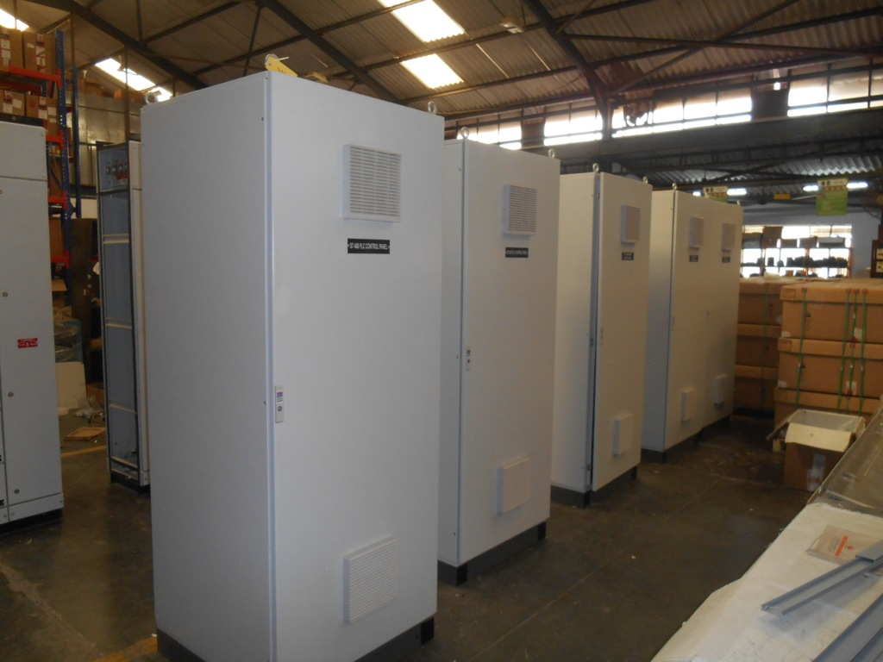
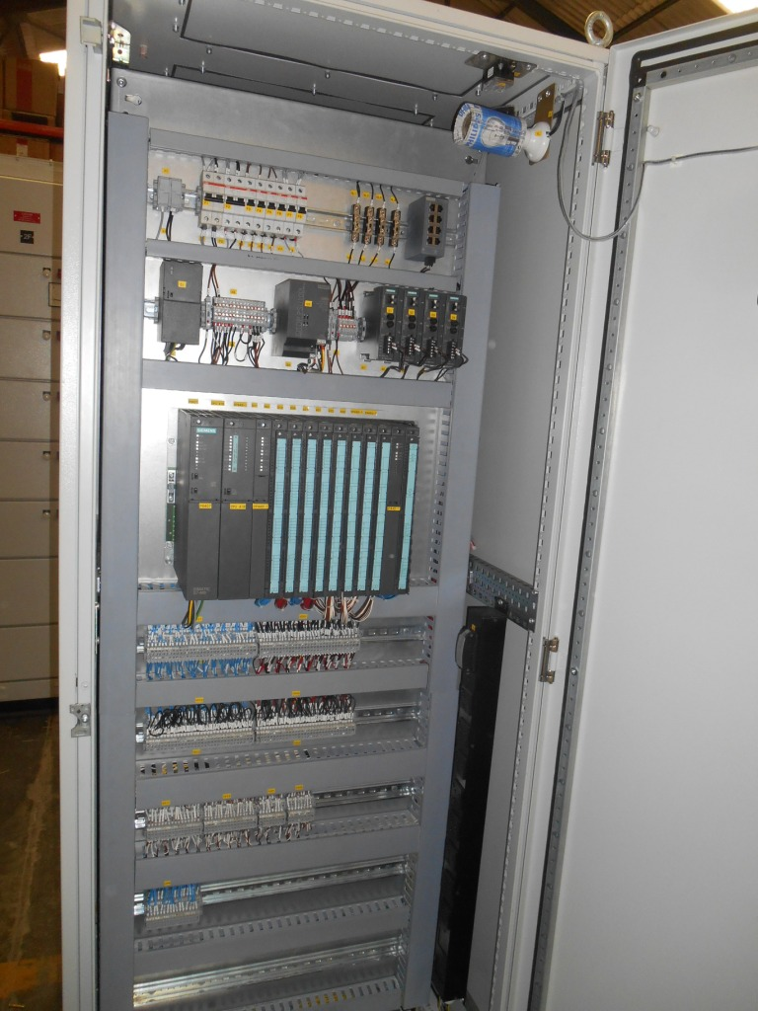
SAT of Control Panels

Slide 26
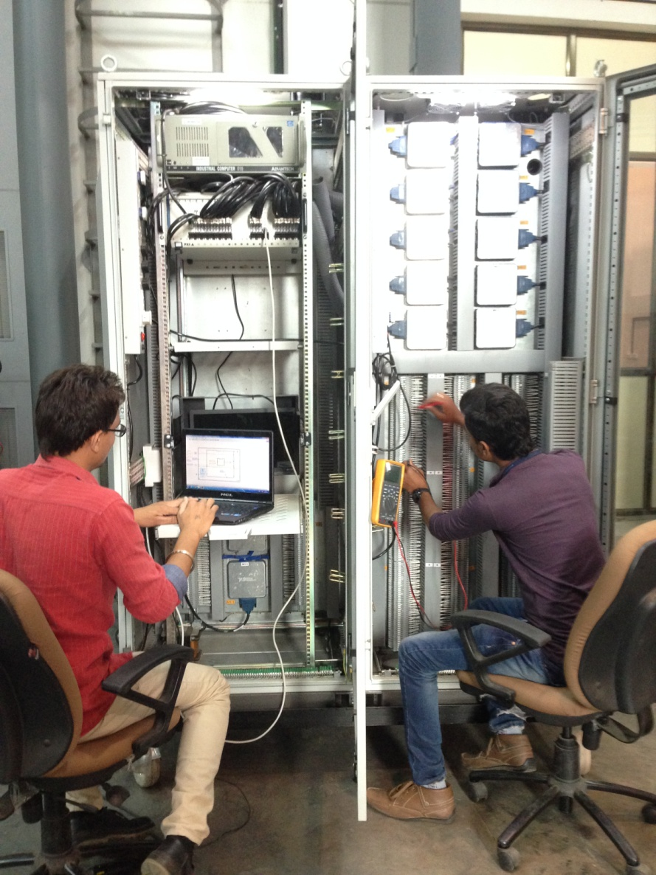
SAT of DAQ Panels

Slide 27
Interlock and Safety System

Slide 28
Interlock and Safety system for INTF
INTF is a complex system
The entire facility will be exposed high heat fluxes and RF radiations: Application of HV power supplies (100KV) and High RF power (~800KW) for 3600 sec. Hence
Based on ITER CODAC guidelines, separate Interlock system and Safety system
Based on IEC 61508
FMEA report and OHS HIRA process for identifying I&C related Interlock and safety functions

Slide 29
SUMMARY
TS -RF Generator site acceptance testing using CODAC core 4.3 has been successfully completed
Preliminary Design of the Interlock system and Safety system for INTF completed.
The ROBIN DACS has been commissioned and in operation. Many ROBIN experiment campaign has been completed reliably and successfully with the system
Design of the TS-DACS has been completed referring the ITER PCDH Guidelines. Procurements of all the required Hardware and Software for TS- DACS system completed . Commissioning is in advance stage of completion
Design of conventional control and data acquisition system for INTF has been completed and all the required Hardware are available and commissioning is initiated .

Slide 30
Thank You
Question ???
Notes:
N

Slide 31
Thank You
Question ???
Notes:
N

Slide 32
DACS Road Map for Test Facilities
Present status and plan
Design: Completed
Procurement Advance stage of completion
Commissioning- 2015 -2016
ROBIN DACS
TS-DACS
INTF -DACS
Single driver Source
Centralized system
Control and data acquisition signals : 450 with sampling rates from 5 Sps to 10 KSps
Two driver Source
Control and data acquisition signals : 500 with sampling rates from 5 Sps to 10 KSps
Centralized system with Remote I/O
Bigger system
Eight Driver Source
Bigger and complex system
Control and data acquisition signals more than 900, with sampling rates in range of 5 Sps to 10 KSps to 100 MSps
Distributed control and DAQ systems
Framework based on CODAC technology
Framework based on CODAC
Framework based on proprietary software
Interlock and Safety system
Present status
Integration and commissioning going on
Two sub systems integrated
Present status
Commissioned and in operational

