Slide 1
Overview of Instrumentation and data acquisition system of cryogenic sub-systems of SST-1 D. Sonara, R. Panchal, R. Patel, G. Mehsuria, P. Panchal H. Nimavat, V.L. Tanna, S. Pradhan Institute for Plasma Research (IPR), Bhat, Gandhinagar 382 428 10th IAEA Technical Meet April-2015

Slide 2
Outline of Presentation
Role of Cryogenics in SST-1
DAQ of 80K Thermal shields
DAQ of SC Current Feeder System
Compressors Station monitoring system
Portable Temperature DAQ system
Summary

Slide 3
Role of Cryogenics
+30 ˚C
SC Magnet
Thermal shield
N_{b}T_{i} Superconducting magnet achieve zero resistance state below -264 ˚C (9K)
Thermal shield at -193˚C (80K) intermediate temperature, prevent SC magnet from hot surface radiation heat effect
-193 ˚C
-269 ˚C

Slide 4
DAQ of 80K
Thermal shields

Slide 5
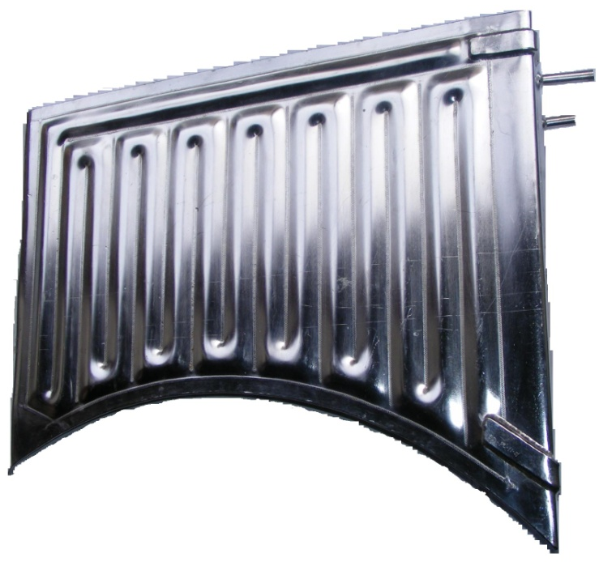
Thermal shield instrumentation & DAQ
SST-1 has ~130 m² surface area of thermal shield made from embossed stainless steel plate
Different shape of 130 panels were integrated and connected hydraulically with Liquid Nitrogen distribution network
For temperature mapping 103 Cryogenic grade pt-100 sensors were installed on panels.
Approximately 5 kW of ambient heat load on TF & PF magnet is prevented by the shield

Slide 6
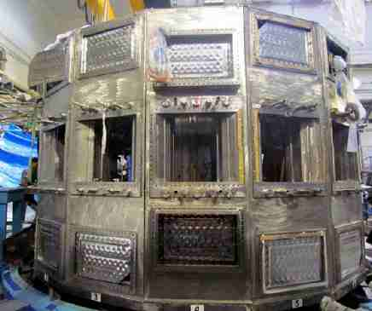
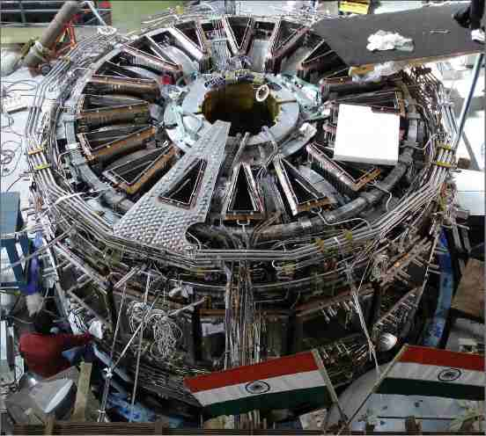
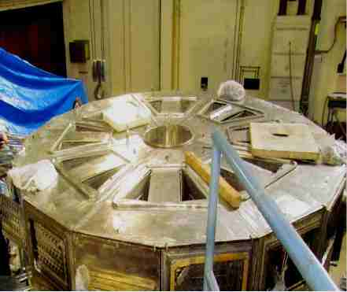
Thermal shields assembly in SST-1 machine
Thermal Shield

Slide 7
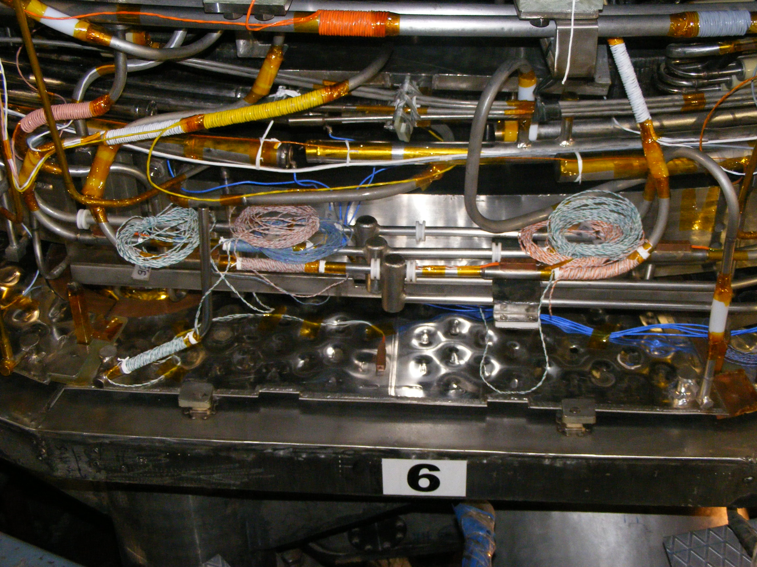
Sensor mounting method
Thermal anchoring
Sensor mounting

Slide 8
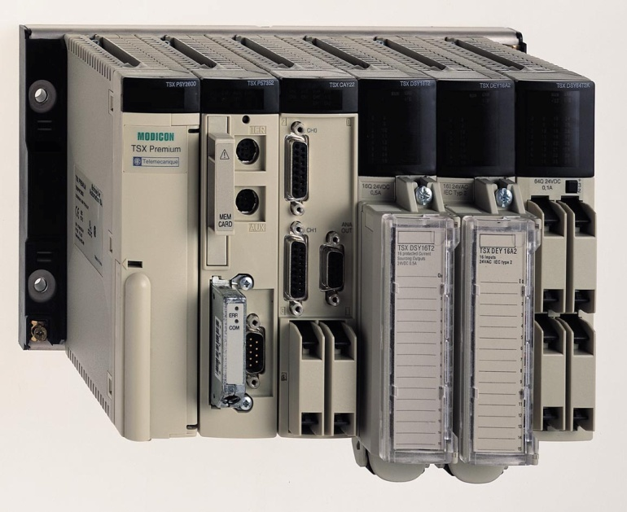
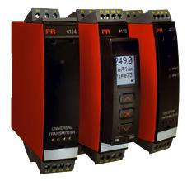
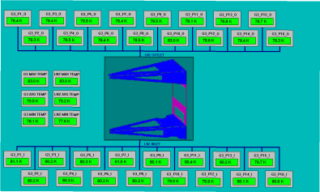
Instrumentation & DAQ set-up for 80K Shield
Temperature Tx
AI
Ethernet
Link
PLC TSX P57 5634M
Pt-100
Cryostat
SCADA PC

Slide 9
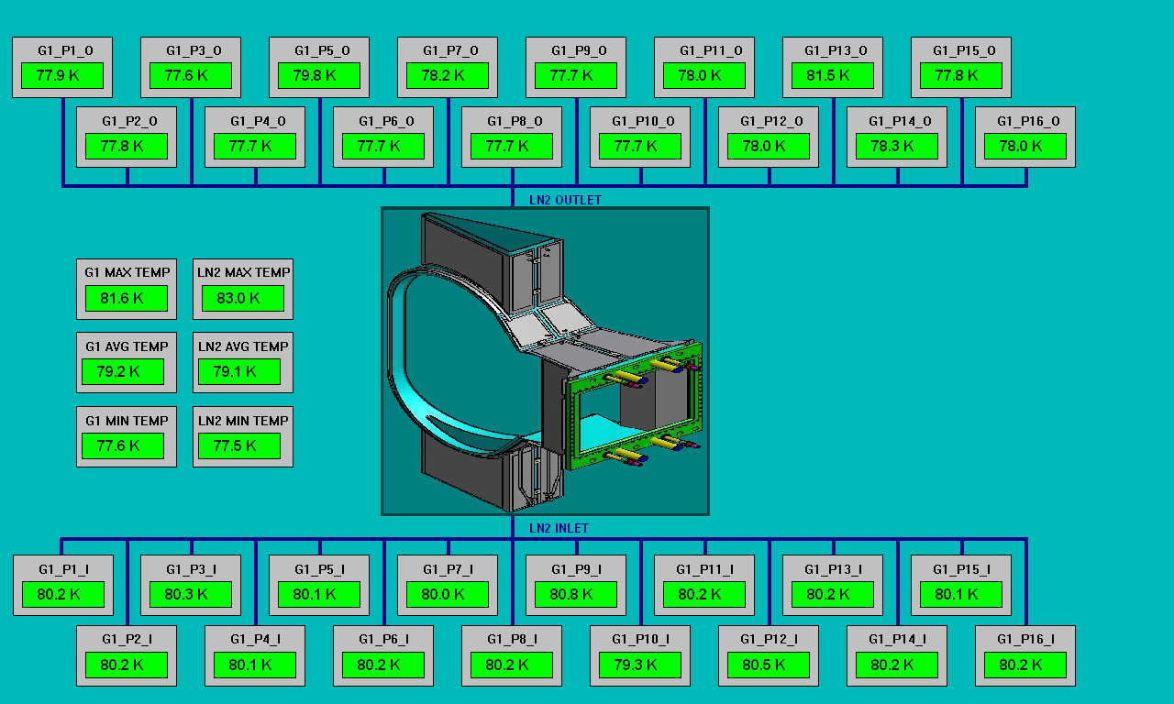
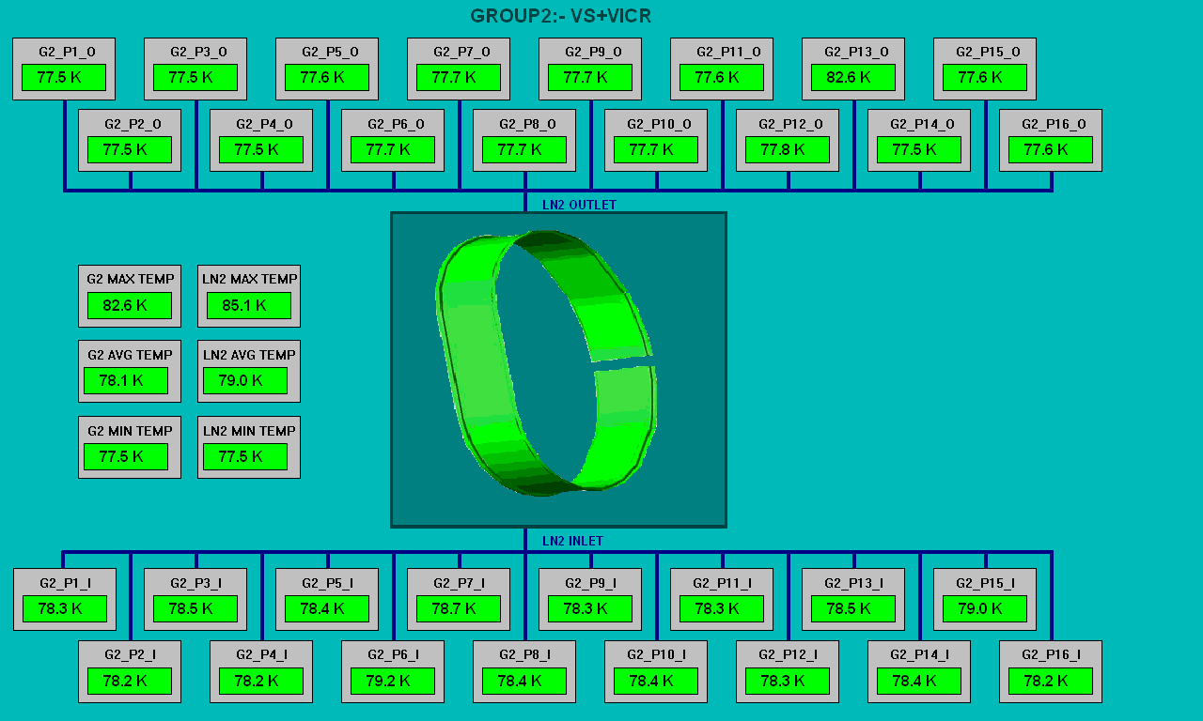
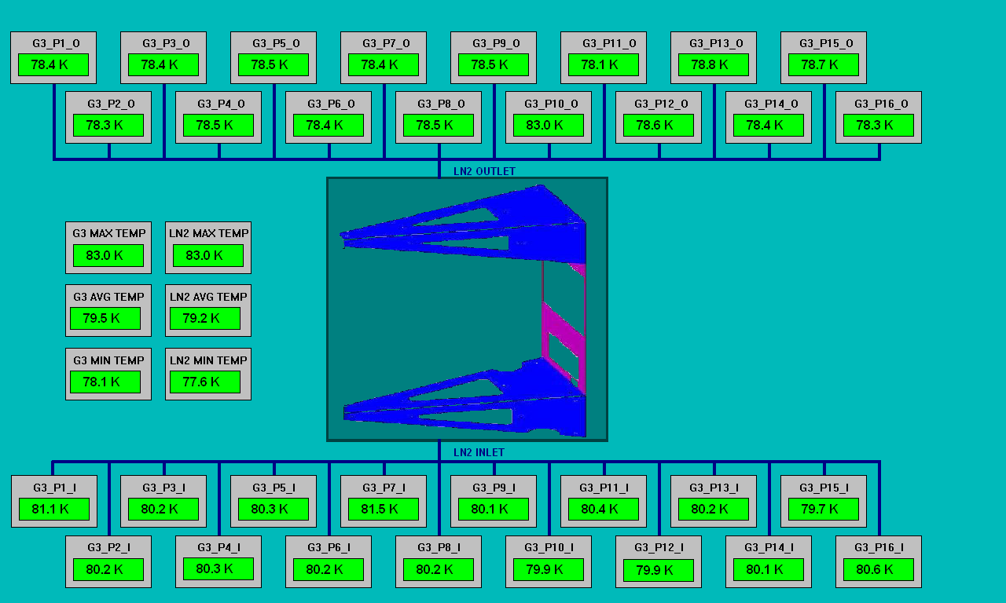
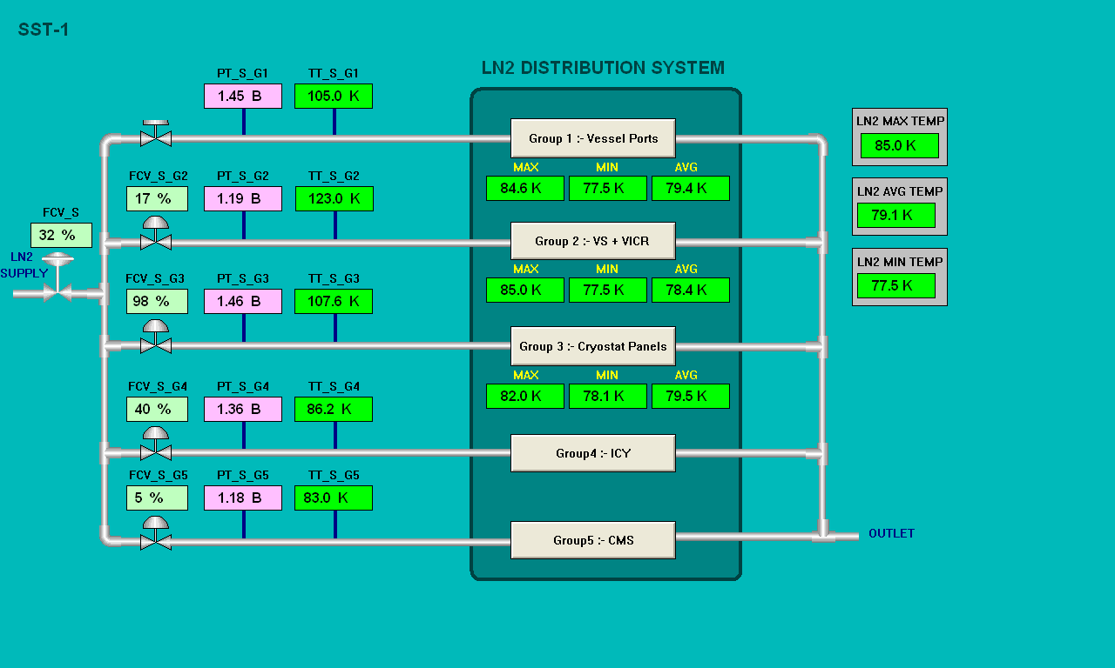
80K shield DAQ SCADA Mimic

Slide 10
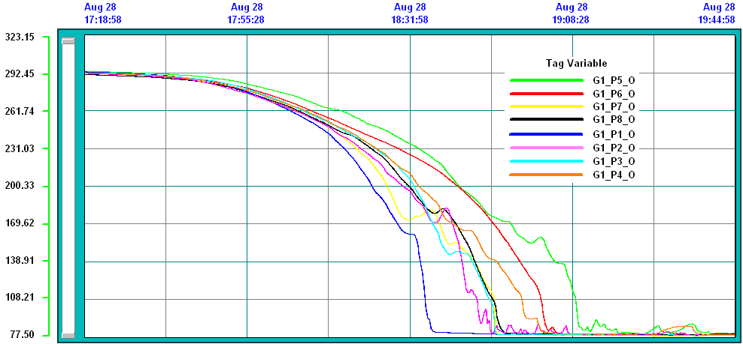
Typical cool-down trends of 80 K Thermal shields

Slide 11
DAQ for SC current
Feeder system

Slide 12
Superconducting Current Feeder System
Current lead is an interface device between superconducting magnet at very low temperature 4.5K and High current power supply kept at room temperature.
Vapor cooled current leads basically balances the Joule heating and Thermal conduction losses by enthalpy of evaporated Liquid Helium.

Slide 13
List of Measurement
# Following parameters are need to be measured and monitored for operation of CFS 1. Surface temperature of leads, thermal shield & flange temperature. 2. Voltages across the various part of current lead. 3. LHe Level measurement 4. Pressure measurement 5. Mass flow measurement 6. Differential Pressure measurement. 7. Electro pneumatic control valves 8. Vacuum Gauge (BA) 9. Quench detection signal

Slide 14
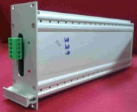
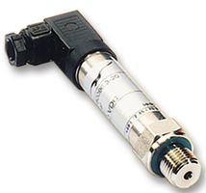
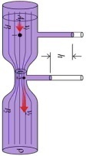
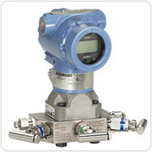
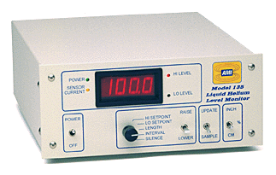
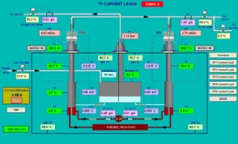
Instrument & Sensor set-up of CFS
PR 4114
AI
Pt-100
CCS
IPR Tx
V TAP
PR5114
PLC TSX P57 5634M
DO
Venturi
AO
Ethernet
Link
LHe Level
Heater control
Pad Heater
SCADA PC
Electro pneumeticValve

Slide 15
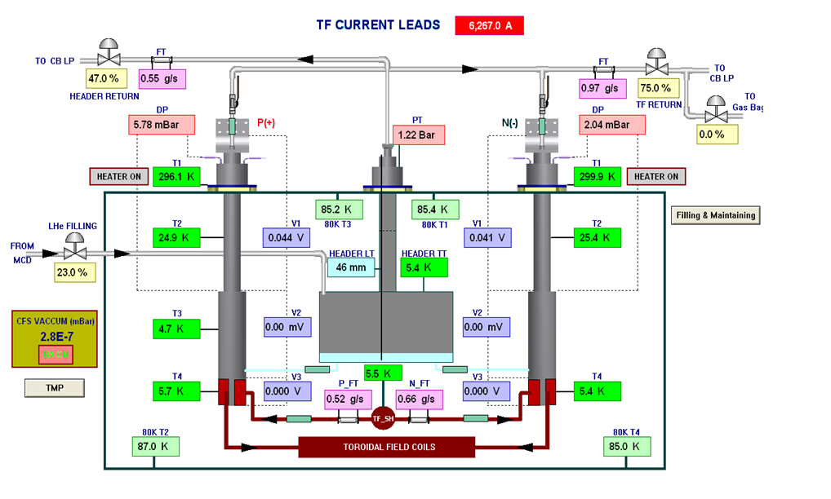
CFS SCADA MIMIC

Slide 16
Cryogenic Temperature Measurement
For monitoring 4.2 K cold surfaces, cernox and CCS sensors were installed at the strategic location of the system.
Sensors were connected to in-house developed transmitter cards. This provides galvanic isolation of 2.5 kV at i/p & 1.5 kV at o/p. Output of transmitter is linear 4-20 mA for temperature range of 4 K to 325K.
For monitoring 80K surfaces cryogenic grade pt-100 temperature sensors were installed.

Slide 17
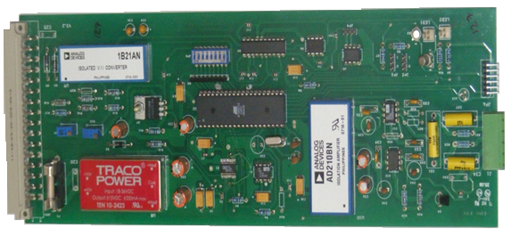
Cryogenic Temperature Transmitter
Three port isolation, input 2.5kV, output 1.5kV , power 1.5kV
Four wire measurement , with 10μA excitation current
Loop powered output 4 – 20 mA linear
Calibration curve of sensor is embedded with program code of microcontroller
Piecewise linear interpolation used for temperature calculation

Slide 18
Floating potential temperature measurement
EMI
Filter
Pre
Amp
ADC
2.5 kV
Isolated Power
1.5kV isolated DC Power Supply
Current Source
10μA
Micro controller
DAC
Sensor
4-20 mA
O/P
1.5 kV
Calibration Curve download
V/I converter

Slide 19
Compressor Station
monitoring system

Slide 20
Compressors Station monitoring system
SST-1 uses Helium Refrigeration/Liquefaction Plant of 1.3kW @-269 ˚C capacity to cool-down TF and PF coils.
Main work horse in HRL is the three compressor which is direct driven by heavy duty 350kW electrical motors.
Motors runs continually for 30 – 50 days during plasma campaign, because of such prolonged operation motors are prone to over heating and misalignment of shaft. This cause motor to vibrate beyond limit, eventually it can fail and cause heavy damage.
In most cases of plant brake down we observed that electrical motor is main cause of trouble.
By monitoring the health condition of these motors it’s possible to take precautionary measure and can avert catastrophe.

Slide 21
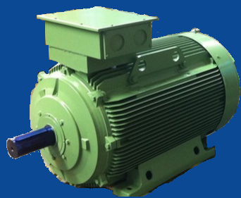
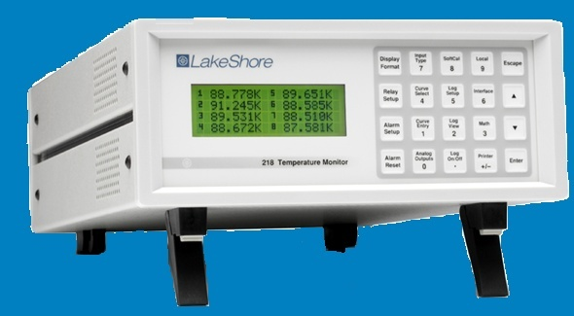
Compressor Station monitoring system
Vibration
Temperature
RS 232
LAN
CSMS Server App
CSMS Client App

Slide 22
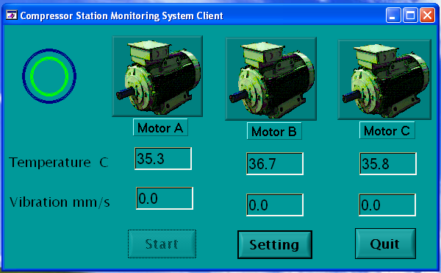
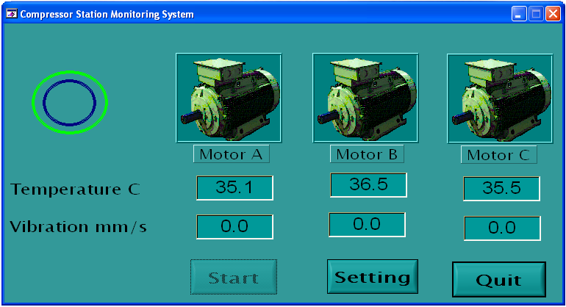
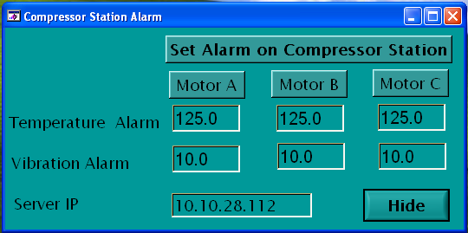
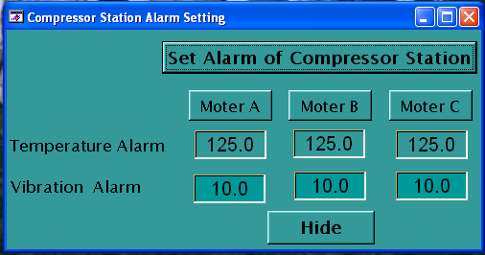
Compressor Station monitoring system GUI
Client App GUI
Server App GUI

Slide 23
Portable Temperature DAQ

Slide 24
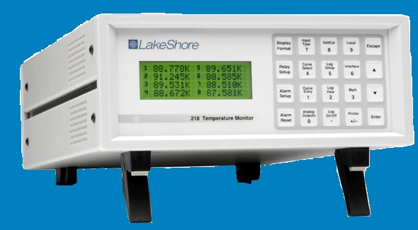
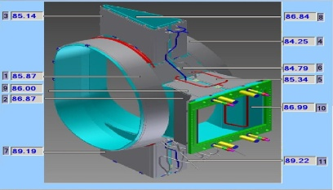
Portable Temperature DAQ Using GPIB
Using GPIB communication we have developed portable DAQ system for validation test of individual thermal shield.
Application software provides GUI for DATA presentation, online trend, data logging of temperature.
USB-GPIB

Slide 25
Cryogenic experiment set-up

Slide 26
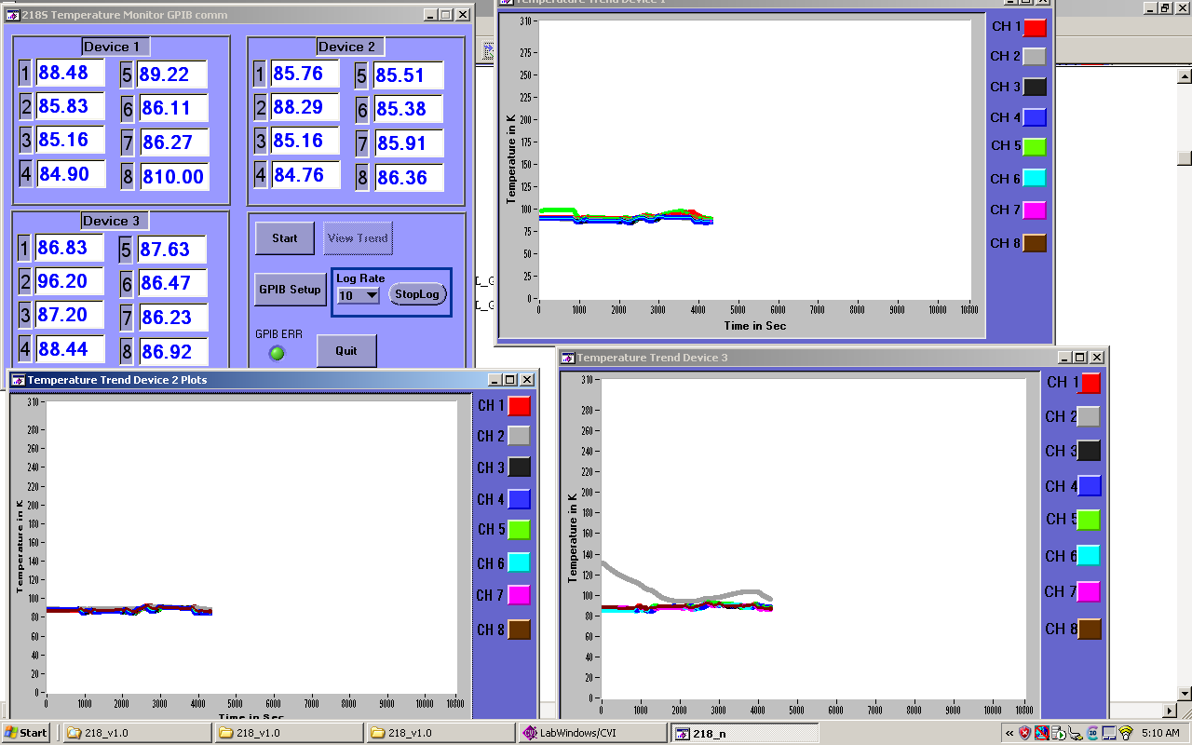
GUI of Portable Temperature DAQ

Slide 27
Summary
Large pool of reliable data of cryo-systems cool-down have been obtained using this DAQ system.
Temperature mapping provided by 80K DAQ system confirms the uniform temperature distribution, all shield reaches near 80K temperature.
Superconducting CFS is being operated in a very reliable way without any major technical issue related to Instrumentation.
With the use of portable temperature DAQ we have carried out many cryogenic experiment of SST-1 machine data derived by system was very useful for analysis.
CSMS is very useful for monitoring health of motor from any of network node of office campus.

Slide 28
Thanks for your kind attention

