Slide 1

Control Systems for
Diagnostics, Heating and Current Drive
Stefan Simrock
ITER Organization

Slide 2
Outline
ITER
Diagnostics
Heating and Current Drive
Control System and Plant I&C
Integration and Standardization
System Engineering for plant I&C
Conclusion

Slide 3
ITER

Slide 4
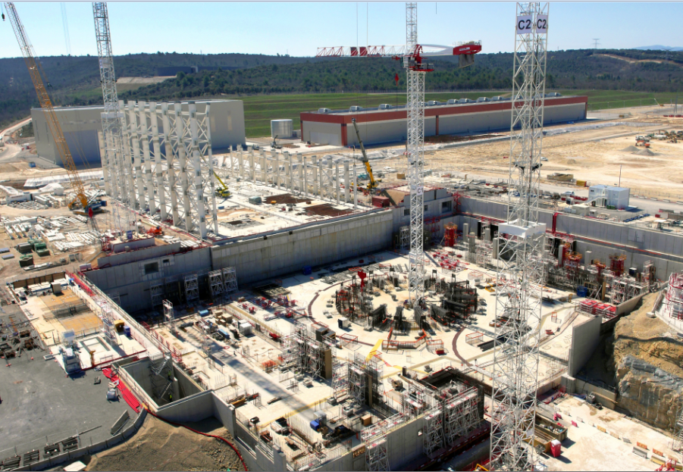
ITER Construction at St Paul lez Durance

Slide 5
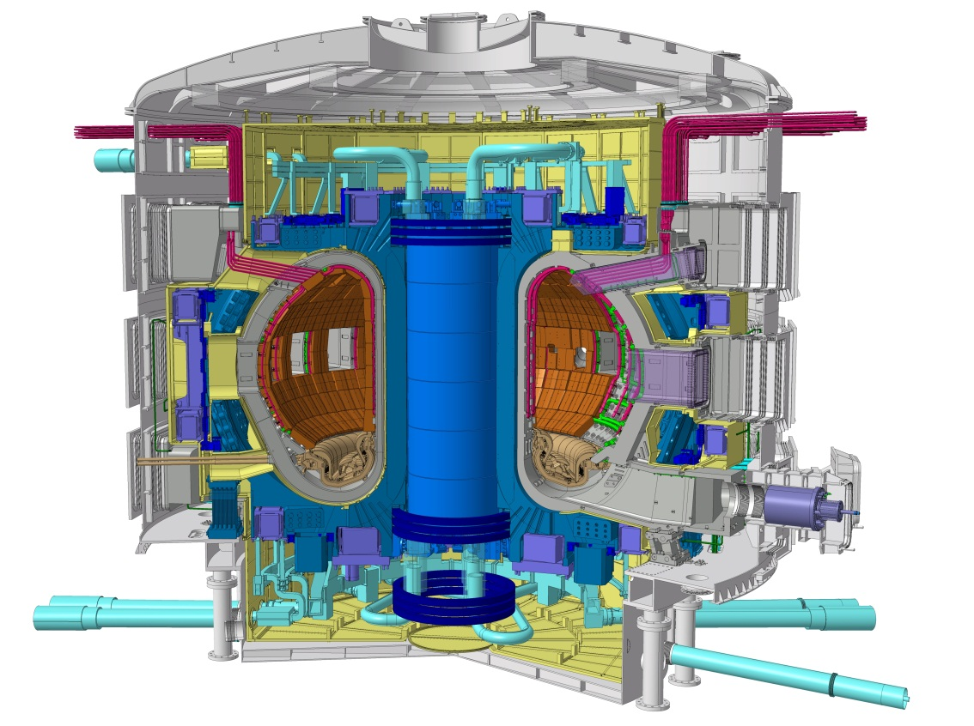
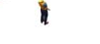
The ITER Mission
ITER Program Objective:
  to demonstrate the scientific and technological feasibility of fusion energy for peaceful purposes
Key Technical Goals:
  achieve extended burn of a DT plasma with dominant alpha-particle heating
  develop steady-state fusion power production as ultimate goal
  integrate and test all essential fusion power reactor technologies and components
  demonstrate safety and environmental acceptability of fusion
ITER tokamak

Slide 6
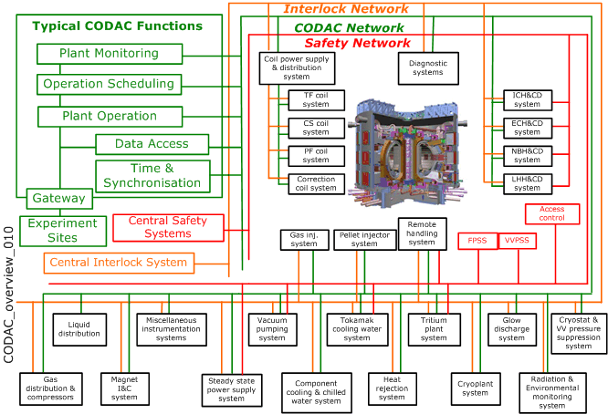
Control System View

Slide 7
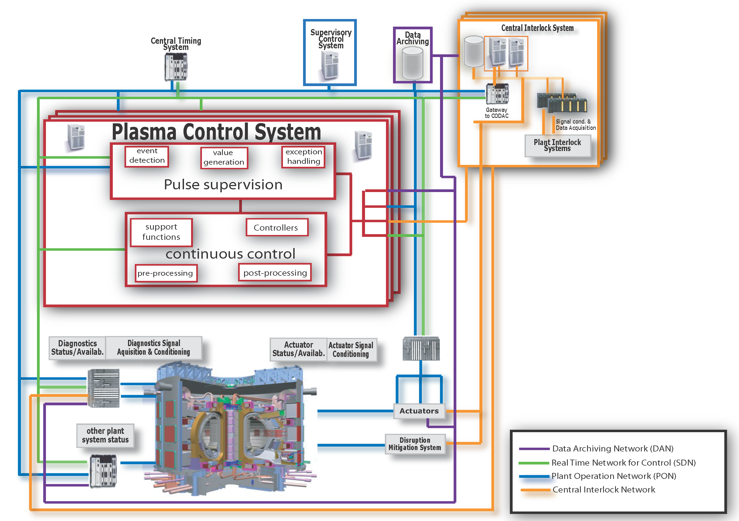
PCS View
Diagnostics
(sensors)
Heating and
Current Drive
(actuators)

Slide 8
Plasma Auxiliary Systems
Heating and current drive systems
The Auxiliary Heating Systems are the tools to make the plasma perform : Heating to thermonuclear temperatures, current drive for long pulses, mode stabilization, plasma breakdown and current rise.
Diagnostics
Diagnostics are key part of tokamak research
They provide the reality-check for our physics understanding
Instrumentation and Control System
All hardware and software required to control and operate the ITER machine. Comprises Plant System I&C and Central I&C Systems.
They are absolutely necessary for tokamak operation

Slide 9
Heating, and current Drive

Slide 10
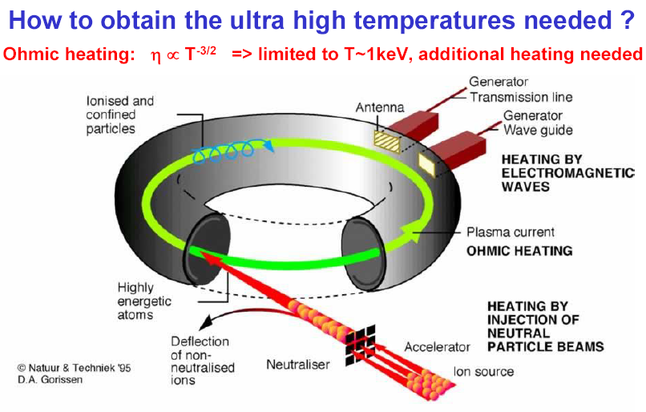
Heating and Current Drive Systems

Slide 11
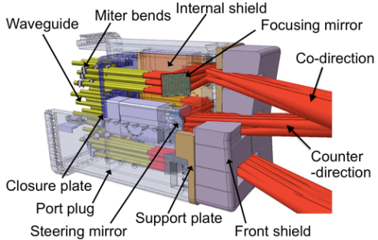
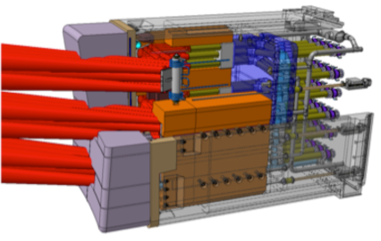
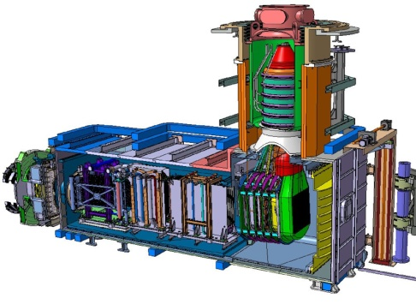
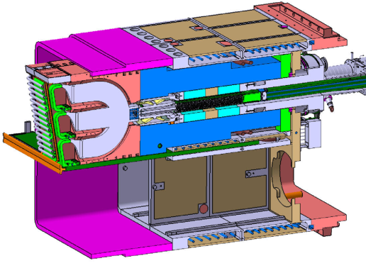
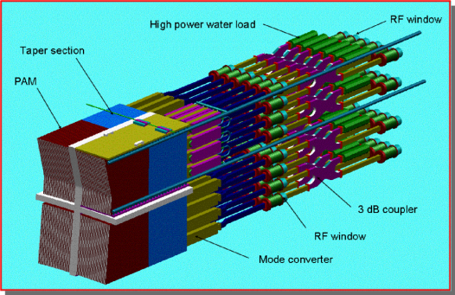
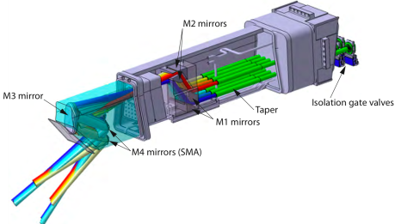

RF Heating and Current Drive Systems
NB
Neutral Beam - 1 MeV
33MW* +16.5MW#
Bulk current drive limited modulation
IC
Ion Cyclotron 40-55MHz
20MW* +20MW#
Sawtooth control modulation < 1 kHz
EC
Electron Cyclotron 170GHz
20MW* +20MW#
NTM/sawtooth control modulation up to 5 kHz
LH
Lower Hybrid ~5 GHz
0MW* +40MW#
Off-axis bulk current drive
*Baseline Power
#Possible Upgrade
P_{aux} for Q=10 nominal scenario: 50MW
130 MW (max installed)
(110 MW simultaneous)

Slide 12
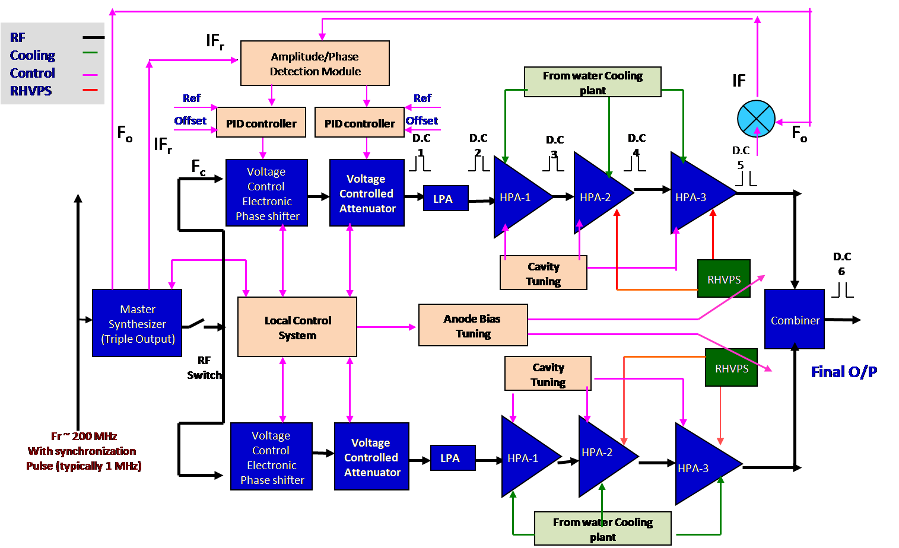
ICH RF Power Source Diagram

Slide 13
EC Control System (ECCS)

Slide 14
Diagnostics

Slide 15
How are diagnostics organised?
About 45 different diagnostics identified for different measurement roles; about 90 projects in all (>80% of systems after CDR now)
Significant number of extra supporting systems (several IO projects)
PBS55 - Diagnostics
A- Magnetics systems
B- Neutrons systems
C- Optical systems
D- Bolometry systems
E- Spectroscopy systems
F- Microwave systems
G- Operational systems
PBS55-Engineering of:
Q- Equatorial Ports
U- Upper Ports
L- Lower ports
NW- Windows
NE- Electrical Services
PBS57-Engineering of:
I - IVVS
All integrated directly in to machine or in the port plugs

Slide 16
ITER Diagnostics Technologies
A comprehensive diagnostic system (45+ individual systems) based on many different technologies is under design. Engineering design of port plugs with complicated structures is being
progressed.
A number of R&D projects including irradiation effects on diagnostic components, and innovative diagnostics has been carried out

Slide 17
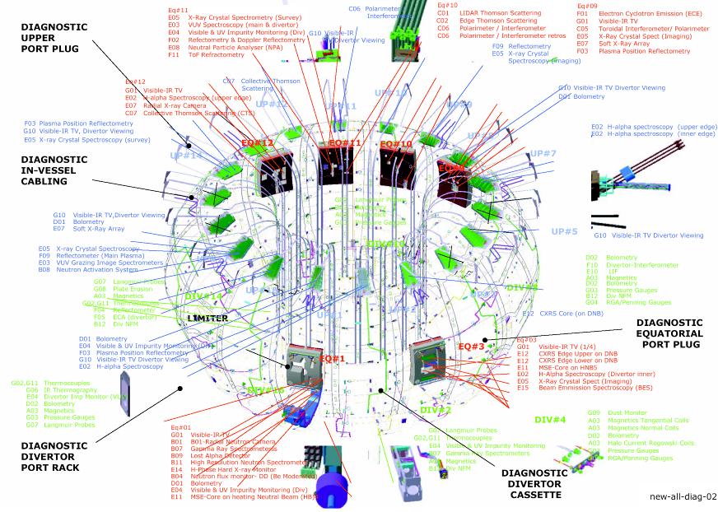
A more integrated system
Notes:
17

Slide 18
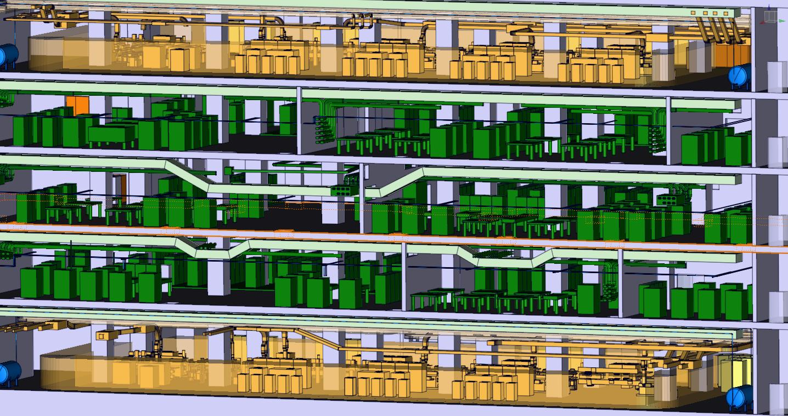
Diagnostic Building (700 Cubicles with plant I&C)

Slide 19
Control System

Slide 20

ITER Control System
Mission Statement
Ensure all ITER Plant Systems Instrumentation & Control are designed, implemented and integrated such that ITER can be operated as a fully integrated and automated system.
Successful integration = higher reliability
Minimize required operators
Minimize required maintenance crew
Minimize operator human errors
Single control room with standard equipment
Reduced total cost

Slide 21
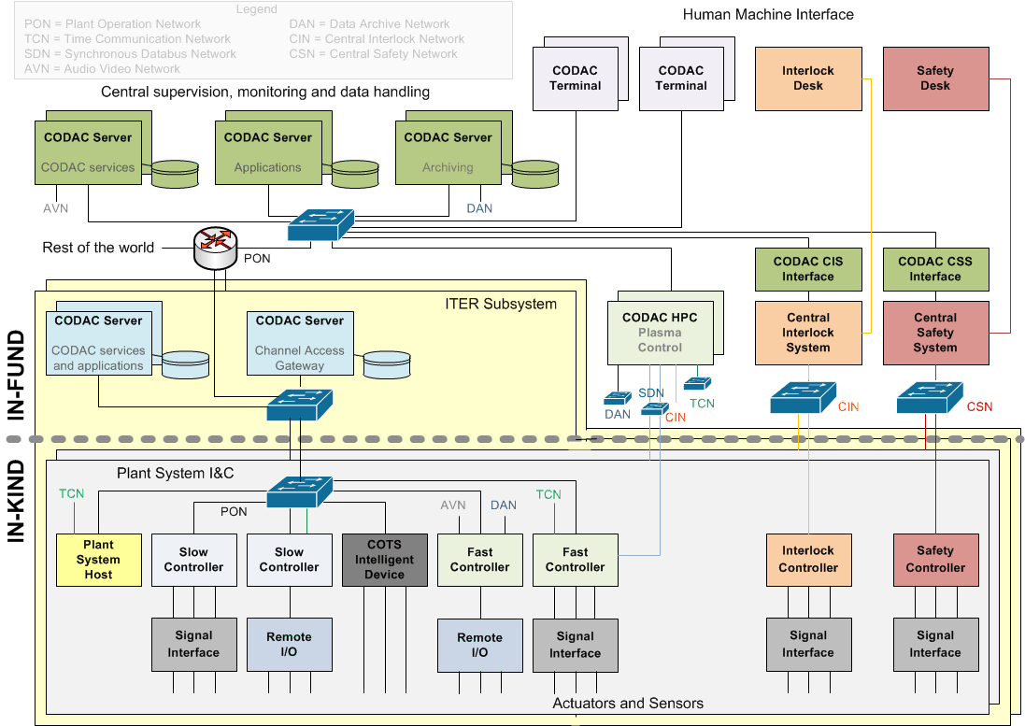
Architecture

Slide 22
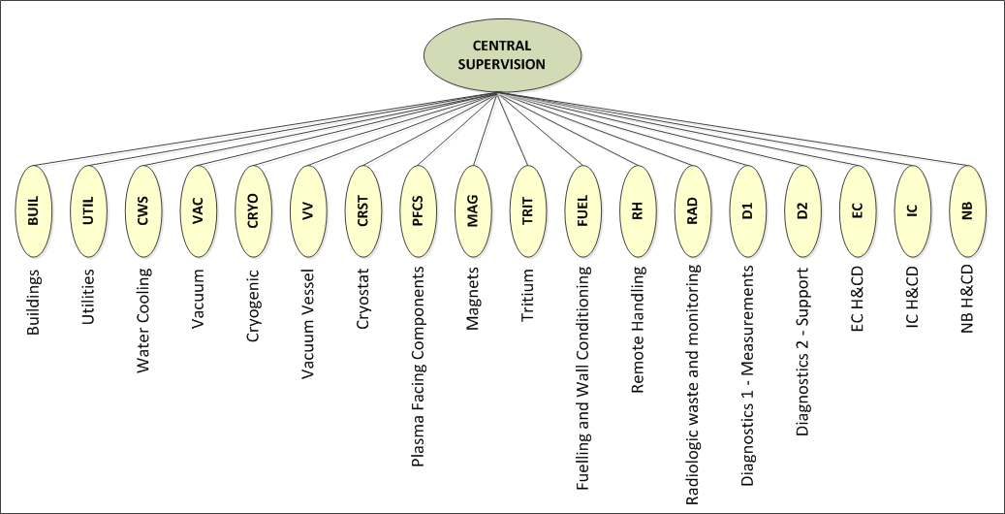
Control Breakdown Structure
ITER control system is broken down in 18 ITER Subsystems
An ITER Subsystem contains one or many local control systems
A local control system is a deliverable from a procurement arrangement

Slide 23
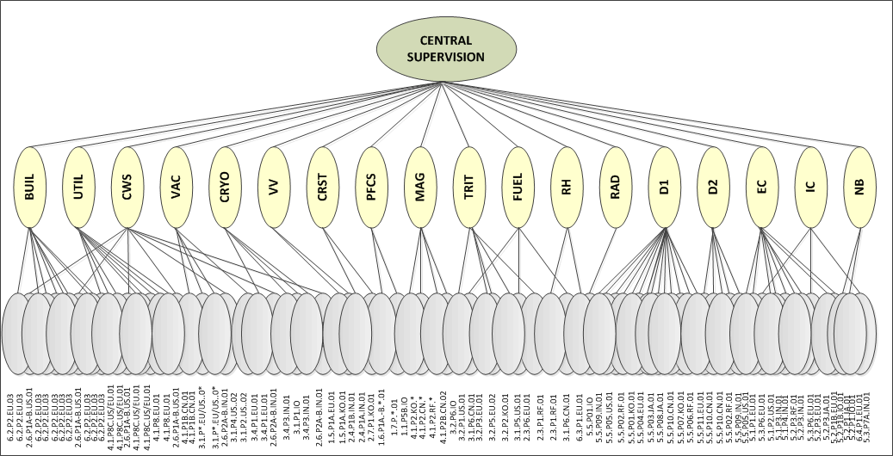
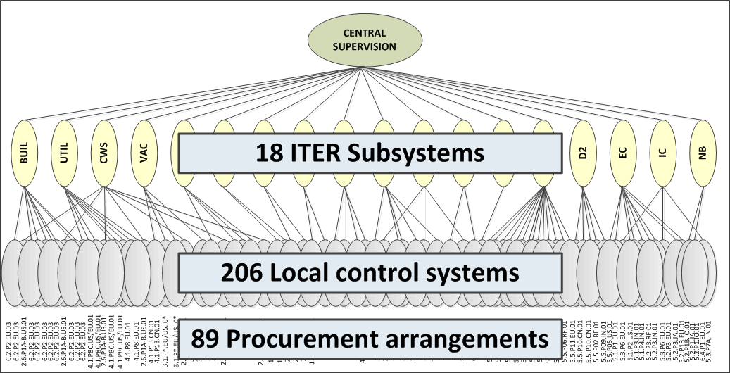
Control Breakdown Structure
~50%
~50%
ITER control system is broken down in 18 ITER Subsystems
An ITER Subsystem contains one or many local control systems
A local control system is a deliverable from a procurement arrangement (IN-KIND)
A procurement arrangement delivers one or many local control systems

Slide 24
Integration
The main challenge for ITER Control System is
INTEGRATION
MITIGATION
Define standards, specifications and interfaces applicable to all plant systems instrumentation and control (PCDH)
Develop and distribute a control system framework that implements standards defined in PCDH and guarantees that the local control system can be integrated into the central system (CODAC Core System)
Provide user support
Organize training; PCDH campaign,
CODAC Core System hands-on workshops
Provide I&C Integration Kit free of charge (PSH, Mini-CODAC, switch)

Slide 25
Diagnostic Use Cases

Slide 26
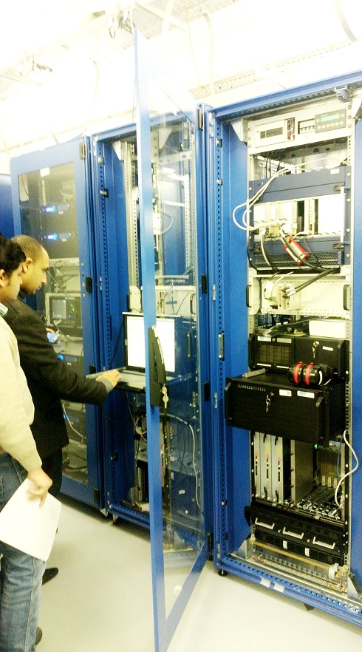
What is it?
Diagnostic Use Cases:
Templates and Examples for diagnostics plant I&C covering all life cycle phases
Implementation
Documentation
System Requirement Specification (SRS)
System Design Specification (SDS)
System Manufacturing Specification (SMS)
System Test Plan (STP)
Factory Acceptance Test Plan (FAT)
Factory Acceptance Test Report
Operation and Maintenance Manual

Slide 27
What are the main features?
Documentation Products (PCDH compliant):
System Requirement Specification (SRS)
System Design Specification (SDS)
System Manufacturing Specification (SMS)
System Test Plan/Reports (STP)
System Operation / Maintenance Manual (OMM)
Functional Diagrams in DB based repository
HW and SW Products (PCDH compliant):
Complete working example system with basic functions.
HW in fast controller catalog
SW in SVN: Linux Driver and EPICS device support
Automation (DSOS, COS)
Network Interfaces (TCN, DAN, SDN…)
HMI, SDD, Plant I&C Data in PSP …….

Slide 28
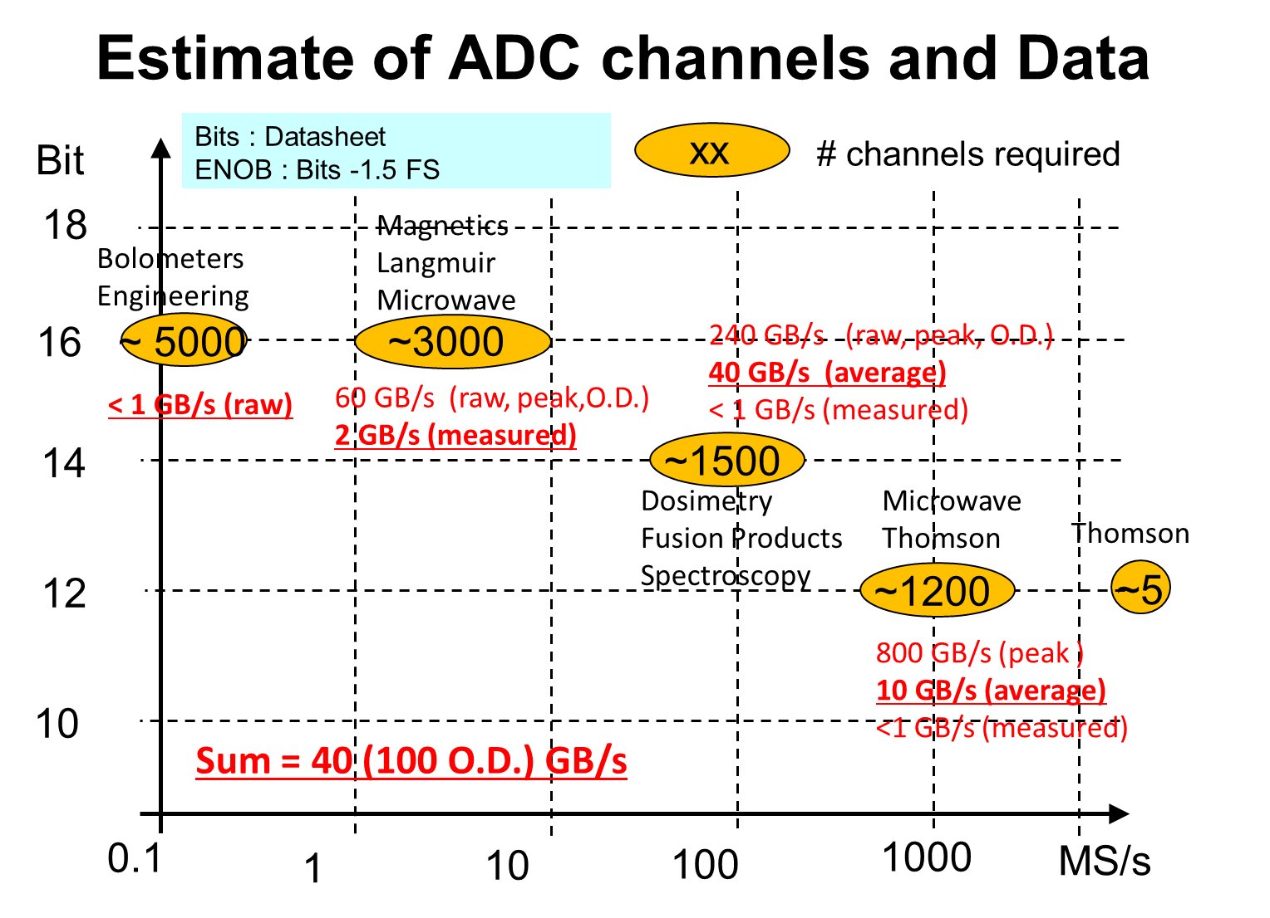
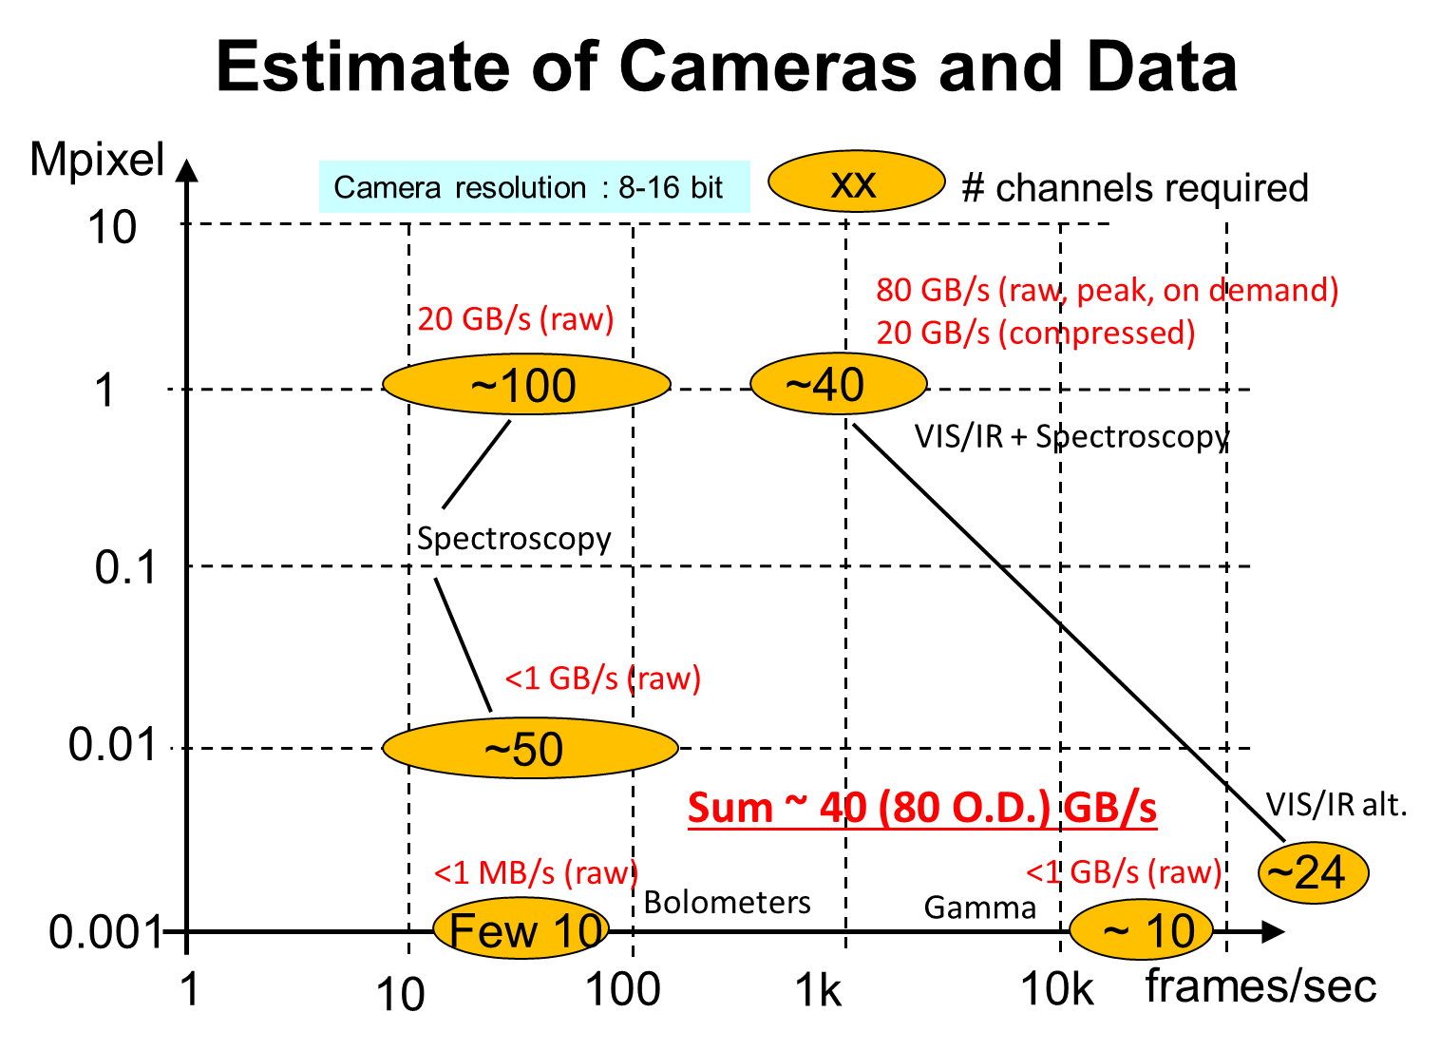
Selection of Use Cases
Estimated Coverage ~70% of Diagnostic Systems for Common Basic Functions
Neutronics Diagnostics (MFC) 100 MHz ADC
Image acquisition (VIS/IR) Mpixel / kHz framerate
Microwave Reflectometry 1-2 GS/s ADC
Magnetics Integrator Signal Conditioning

Slide 29
System Engineering

Slide 30
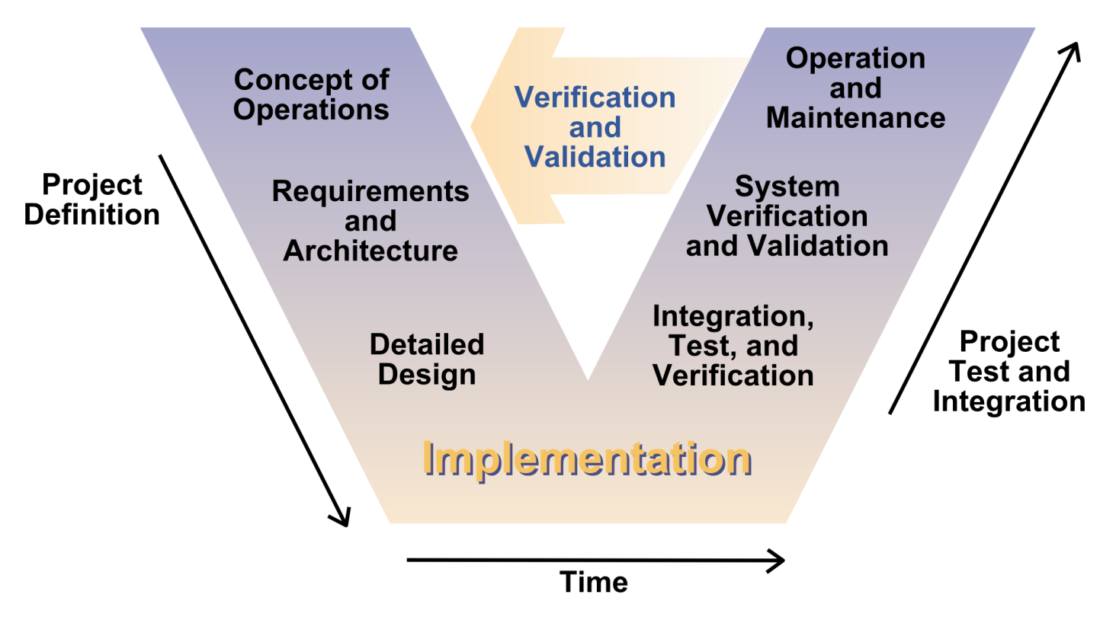
Requirements Engineering (the V)

Slide 31
Pre-requisites for successful Design
Understanding of Diagnostics
Common System Engineering Methodology
Common Language (SySML / UML - Diagrams)
Common Tools (Enterprise Architect)
➔ Cost and time savings

Slide 32
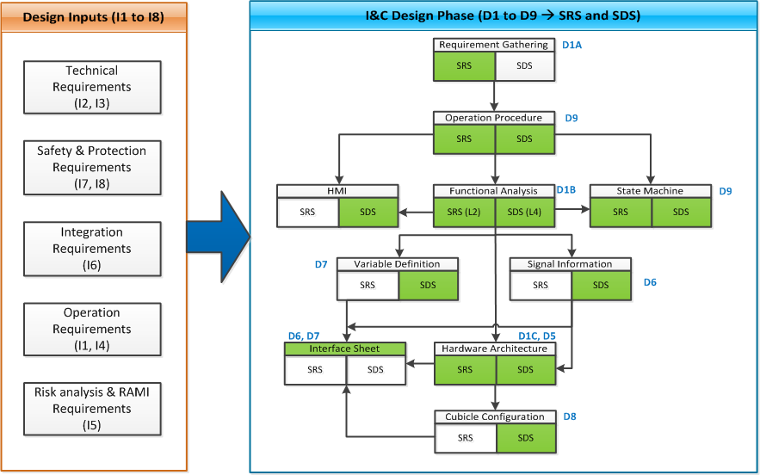
Workflow
Wrong start point !!!

Slide 33
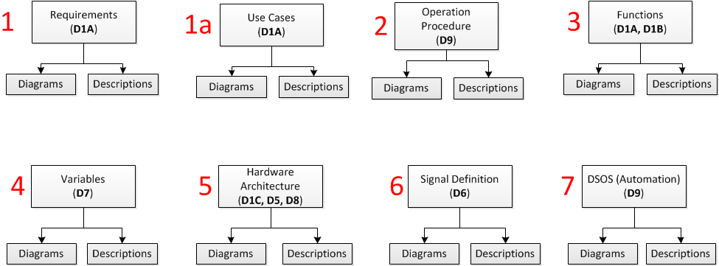
Design Documentation
Tracing
Allocation
Wrong start point !!!
Wrong start point !!!
Above includes:
Cubicle configuration
tracing of design elements to requirements
allocation of functions to hardware
HMI screens
Boundary definition
Design validation

Slide 34
Requirements
Collection of requirements from SRD, Annex B, PCDH, ICD, EDH, etc. and sort by type of requirement.
Requirement ID | Requirement | Description | Use Case Reference | Source | Section | Criticality | Requirement Type
D1-IG-UR-001 | Plant I&C Control | Plant system I&C shall perform control of the plant system under the authority of Central I&C Systems during any operating state. | D1-IG-UC-001 | 27LH2V | R1 | High | Functional
D1-IG-UR-002 | Plant I&C Compliance | Diagnostics Plant I&C Shall Comply to the Standard documented in PCDH | D1-IG-UC-001 | 28B39L | 55s858 | High | Functional
D1-IG-UR-003 | I&C Data Available | Plant system I&C shall make available all data acquired from sensors/actuators, with a time stamp, to Central I&C Systems for analysis, archiving, logging, monitoring and visualization | D1-IG-UC-001 | 27LH2V | R3 | Medium | Functional
Requirement ID | Requirement Name | Description | Use Case Reference | User Requirement Ref. | Source | Section | Criticality | Requirement Type
D1-IG-SR-021 | Plant I&C Protection | Time critical devices shall have built-in time-outs to ensure correct operation in case of Central I&C Systems failure | D1-IG-UC-001 | D1-IG-UR-008 | 27LH2V | R15 | Medium | Functional
D1-IG-SR-022 | Compiance with CODAC | Plant system I&C shall comply with project-wide supervisory control functions and central data handling functions (i.e. archiving, monitoring, logging and visualization) provided by CODAC System | D1-IG-UC-001 | D1-IG-UR-002 | 27LH2V | R2 | Medium | Functional
D1-IG-SR-023 | Diagnostics Alarm Monitoring | Diagnostic shall provide alarms for monitoring its operational state or conditions affecting other systems consistent with the operation of the CODAC system | D1-IG-UC-001 | D1-IG-UR-009 | 28B39L | 55s125 | Medium | Functional
D1-IG-SR-024 | Local Control Cubicle | The local control cubicle shall interface with the CODAC as its diagnostic control system | D1-IG-UC-001 | D1-IG-UR-015 | 28B39L | 55s128 | Medium | Functional

Slide 35
Requirements / Use Cases
ID | D1-IG-UC-001
Name | Measure total fusion power
Description | Measures total fusion power based on neutron flux measurement
Stakeholders | Plant System Operator, Plant System Designer, CODAC Engineer
Actors | Tokamak Operator, Expert Operator, SAT RO,
Priority | high
Expected Date | SAT
Frequency of Use | high
Cost/Complexity | medium
Preconditions | Fission chambers, power supplies and signal conditioning operational
Post-Conditions | -
Normal Flow | Power-up, Establish communication, configure Initialize, test, start measurement Validate measurement integrity, correct problems (calibration etc.) Perform measurements according to pulse schedule, Real-time data to PCS, physics and engineering data to Archiving
Exceptions | System or component failure, calibration error
Assumptions | SDN uses data buffer as main interface to other services
Business Rules | Configuration limited to authorized persons
Note/Issue/Limitation | Real-time applications supported
.....
UR ID | UR Name | Description | Criticality | UC Ref.
D1-IG-UR-001 | Plant I&C Control | Plant system I&C shall perform control of the plant system under the authority of Central I&C Systems during any operating state. | Medium | D1-IG-UC-01
D1-IG-UR-002 | Plant I&C Compliance | Diagnostics Plant I&C Shall Comply to the Standard documented in PCDH | Medium | D1-IG-UC-01
D1-IG-UR-003 | I&C Data Available | Plant system I&C shall make available all data acquired from sensors/actuators, with a time stamp, to Central I&C Systems for analysis, archiving, logging, monitoring and visualization | Medium | D1-IG-UC-01
D1-IG-UR-004 | No Local storage of Plant System I&C Data | In plant system I&C there should be no hidden data and there is no permanent local storage. | Medium | D1-IG-UC-01

Slide 36
Operation Procedures (Level 1)
Tokamak operation
Procedure L1:
Tokamak Operation
Expert Operation
Maintenance
Testing
Integ. Commissioning
Conditioning
Plant Protection
Occupational Safety
Procedures L2
Power up
Communication check
Configuration
Initialization
Health check
Calibration
Exception detection
Fault recovery
Maintenance
See next slide

Slide 37
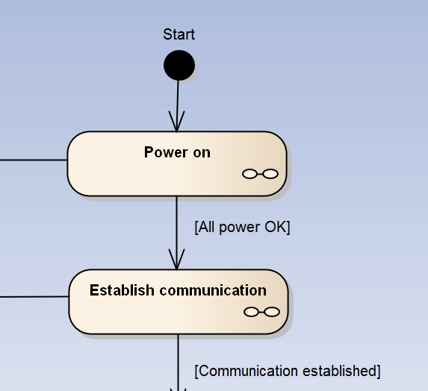
Operation Procedures Level 2
Level 2 Procedure
Description
Name | ID | Description | Stake holder | Actor | When Needed
Power ON | D1-I3-OP-001 | This procedure will turn on all devices | I&C | I&C Engineer, Operator
ID | Pre-Conditions | Allocation to Functions | Freq. of Use | Complexity | Note
D1-I3-OP-001 | All devices should be connected |  | At the beginning of each operation | Simple

Slide 38
Functional Analysis (L1 + L2)
L1 + L2 functions
Important level 3 functions
Determine production state
Measurement quality flag
Time stamping of data
Data streaming to archive
Real time data publishing
Determine calibration coefficient
Apply calibration coefficient
Important level 4 functions
Determine measurement error
Set DAQ clock and trigger
Detect exception
Handle exception
Generate warning
Generate alarms
Detect events
Evaluate conditions flags

Slide 39
Functional Analysis (L1 + L2
Function Name | FBS ID | Function Code | Description
Global | 01 | GI | Global Function - this function provide functional interface across the plant system. .I & C data will be exchange with other plant system. All data will be exchange through CODAC.
Signal Conditioning | 02 | SC | Signal Conditioning Function - This function will describe signal conditioning within plant I&C. those signal condition level 2 function have I&C interface need to mention under Level 1 function.
Data Acquisition | 03 | DQ | Data Acquisition – This function describe data acquisition functions like acquire raw data, configure timing for data acquisition, control etc. of plant I&C.
Data Processing | 04 | DP | Data Processing – Data processing function converts acquired data into measurement (Engineering) data. Data processing function is also used to do analysis on process data, calculate measurement error, Alarm and sometimes control.
System Management | 05 | SM | System Management – This function is used to define system management of plant I&C component (Hardware and Software) like cubicle, PSH, PCF, Slow controller, Health management and monitoring etc.
Operation | 06 | OP | Operation – This function describe the functions required for operation like Plant Automation, Configuration, Plant Function Diagnostics etc.
Machine Protection | 07 | MP | This function will take the measures for protection of the plant system.
Occu Safety | 08 | OS | Occupational Safety - This function is not applicable for this Plant I&C
COTS | 09 | CM | Commercial measurement and control (COTS devices) - his function is not applicable for this Plant I&C
Interface | 10 | IF | Interface – This function will be used to describe plant I&C interface like PON, TCN, SDN
Function Name | FBS ID | Function Code | Description
Measurement | 0401 | ME | The measurement of temperature of the port plug is the essential parameter to be measured for the UPP#18 diagnostics. This function will convert raw data to measurement data (Temperature). This function also measure temperature error.
Control | 0402 | CL | The temperature of the port plug is to be controlled by the electric heater.
Alarm | 0403 | AL | When the temperature of a part of the port plug is more than the set point temperature, then the condition of overheating arises. When overheating occurs alarm will be generated. This function will configure and monitor alarms.
Calibrate | 0404 | CB | Calibration for Upper port plug 18 - This function will be used to calibrate thermocouple signal to get accurate temperature.
Analysis | 0406 | AN | In this function temperature analysis will be done. Following analysis will be done : Calculate RMS temperature value, minimum, maximum temperature etc.

Slide 40
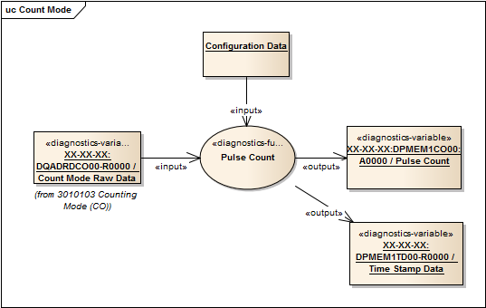
Functional Analysis (variable definition)
Ref ID | Function Name | Description | Interface Type | Protocol
0401-SW-001 | Temperature Measurement | Raw data will be converted in to process / engineering data. Calculate measurement error. | PON | CA
0401-SW-002 | Archive Data | Archive engineering data | DAN | UDP
Variables
Variable Name | Description | Interface | Hardware Allocation
XX-XX-XX:GLVAMEPR00-R0000 | Read Pressure Value | PON | FPGA
XX-XX-XX:GLVAMEPR00-E0000 | Read Pressure Error | PON | FPGA
Ref ID | H/W Interface Type | Description | Direction(I/O)
04-HW-001 | PON | All Processed data will be send to CODAC over PON Network. This function will receive some configuration data from HMI. | Input & Output
04-HW-002 | DAN | All Processed temperature data will be send archiving server over DAN network | Input & Output
Attributes (Code) | Description
Read (R) | Read Pressure value
Error (E) | Read Pressure Error
PON (P) | PON interface
Ref ID | Function Name | Description | Interface Name
0401-HM-001 | Temperature Measurement | Display Port plug structure temperature on HMI | PON
0401-HM-002 | Temperature Error | Display Port plug structure temperature, error on HMI | PON
Constraint | Description
Scan Rate – 1 Sec | Read pressure value at every 1 second

Slide 41
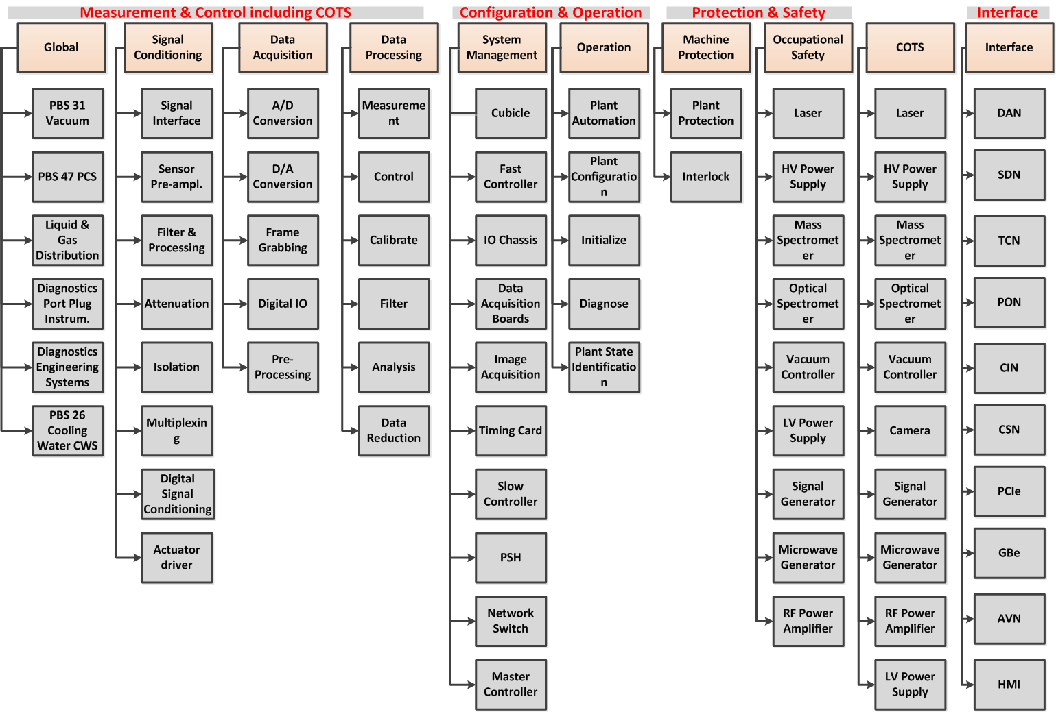
Functional Breakdown of plant I&C (L1 + L2)

Slide 42
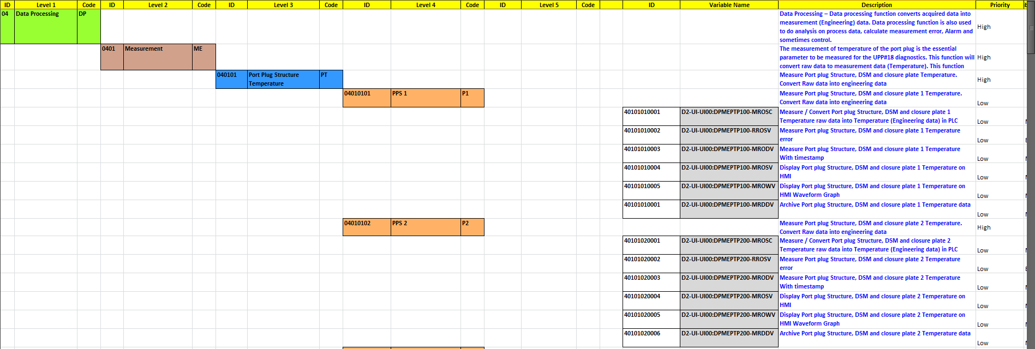
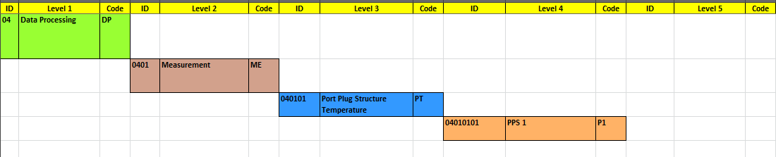
Functional Analysis import from Excel-Sheet

Slide 43
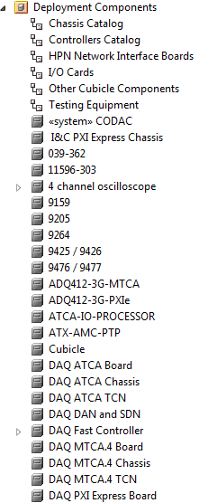
Hardware Architecture
FC Catalog in EA

Slide 44
Detailed Operating State Machine (DSOS)
PSOS State | Power UP
State ID | D1-I3-PSOS-M1
Description | Power up plant I&C
Entry Procedure(s) | Check C1 Turn cubicle power on
During Procedure(s) | Power up all chassis/boards (start IOCs) Check conditions C2 and C3
Exit Procedure(s) | Report power on status
Conditions | SSEN available Cubicle health ok Power consumption ok
Events | Circuit breaker trip Overheating Request for communicate
Transitions | If E3 goto to communicate If E1 or E2 goto OFF state

Slide 45
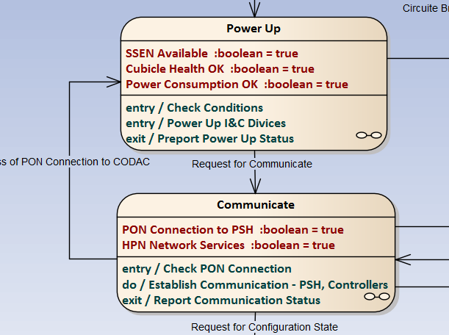
Detailed Operating State Machine (DSOS)
PSOS State | Power UP
State ID | D1-I3-PSOS-M1
Description | Power up plant I&C
Entry Procedure(s) | Check C1 Turn cubicle power on
During Procedure(s) | Power up all chassis/boards (start IOCs) Check conditions C2 and C3
Exit Procedure(s) | Report power on status
Conditions | SSEN available Cubicle health ok Power consumption ok
Events | Circuit breaker trip Overheating Request for communicate
Transitions | If E3 goto to communicate If E1 or E2 goto OFF state

Slide 46

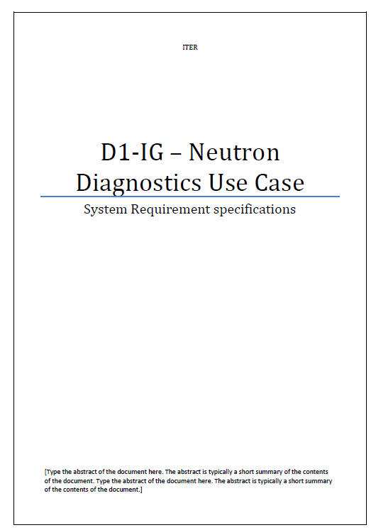
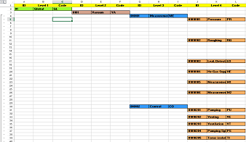
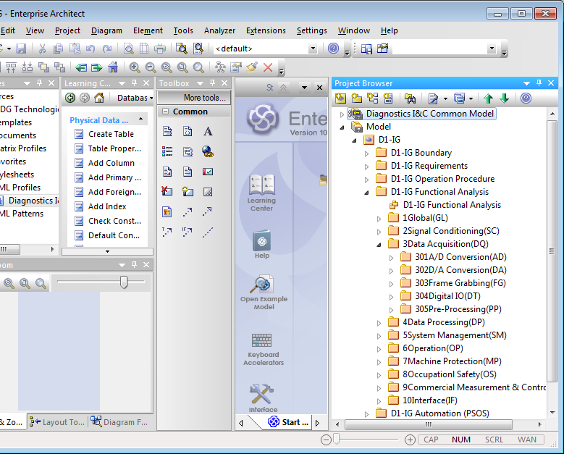
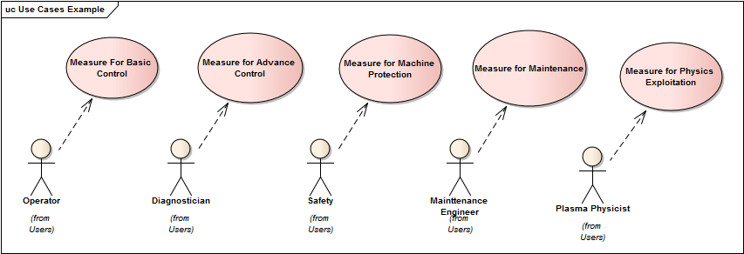
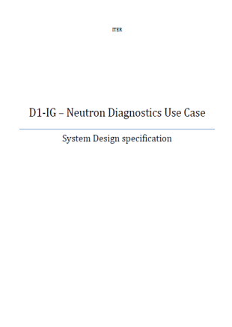
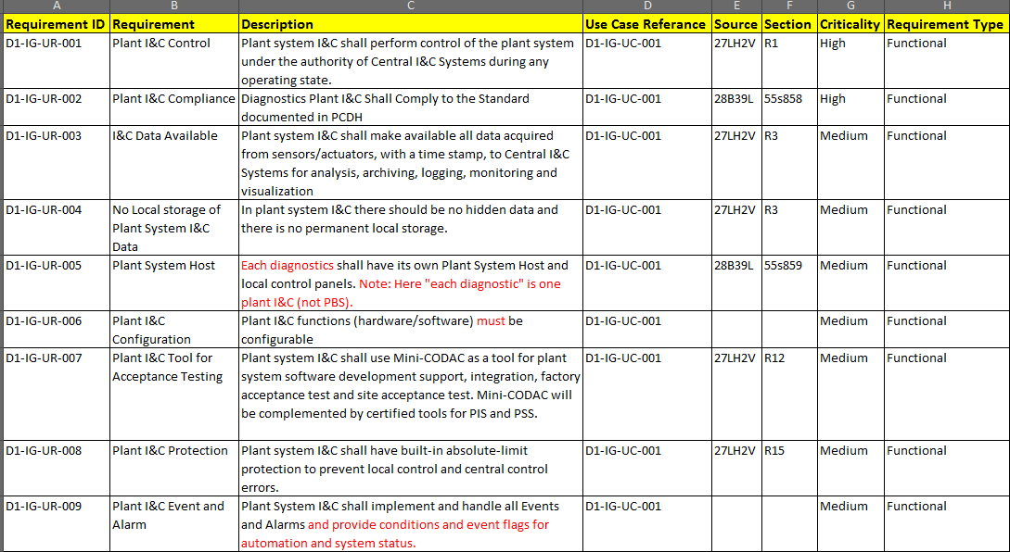
Design Document Generation from EA
Input Templates
Add-in
Templates and Technologies in EA
Add-in
Reports
Functional Analysis
Diagram automation tool using MDG Technologies
Interface diagram
Functional Analysis diagram
Custom UML profile
Requirements
Purpose and Objective of Add-in
EA Provides Add-in feature. Using this feature it can be easily communicate to external world / application
Add-in will help designer to simplify design process.
Add-in will help designer to reduce documentation effort

Slide 47
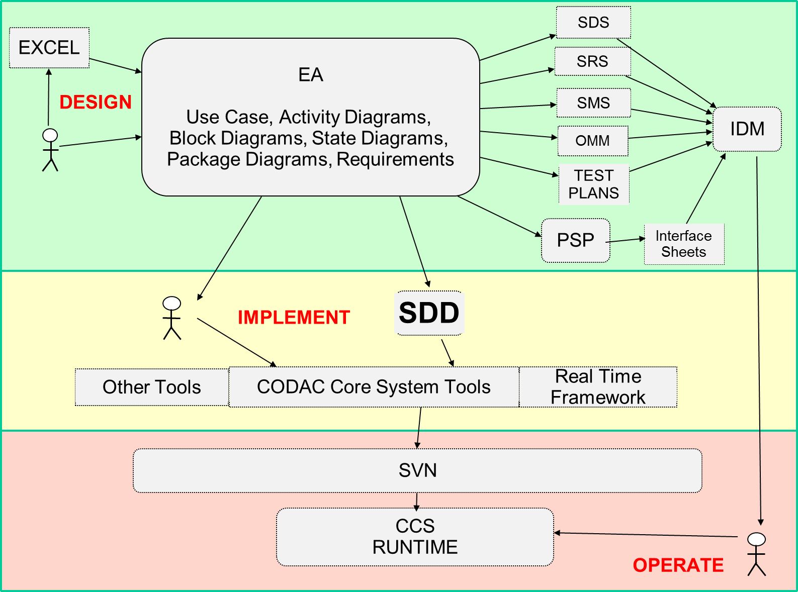
Role of EA for Implementation
Interfaces
Generates
See implementation workflow
See next slide
Validate

Slide 48
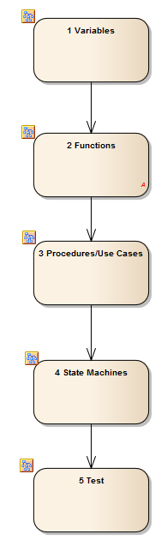
Implementation Steps
1. Load all variables to SDD, generate and run basic IOC with HMI
2. Implement plant I&C functions in EPICS, C++ and firmware
3. Build procedures based on functions and operate manually (HMI !)
4. Implement automation (SNL)
6. Test and validate plant I&C

Slide 49
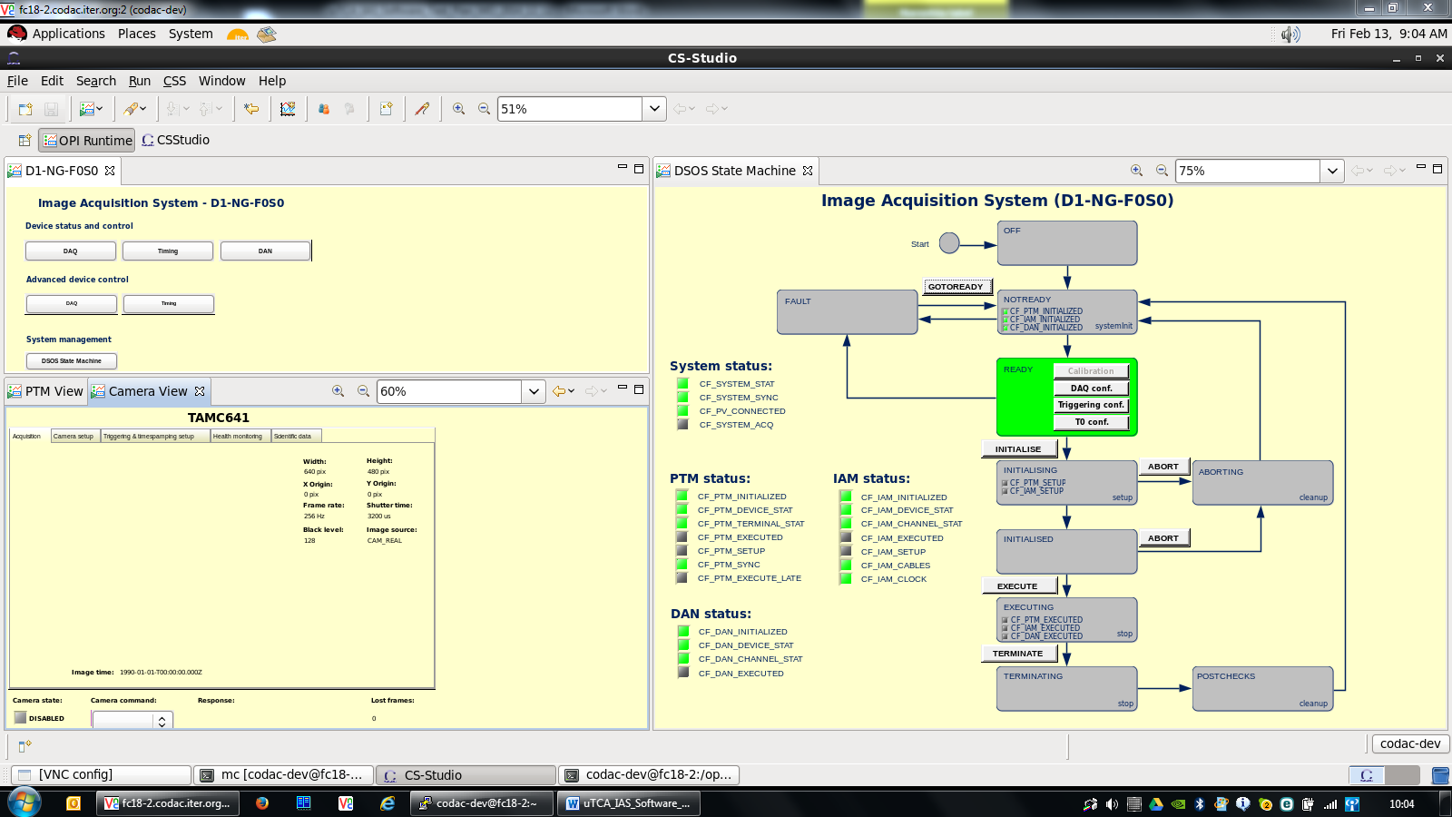
Demo of PSOS for Image Acquisition

Slide 50
Conclusion
Control systems design for diagnostics, heating and current drive have many similarities
System engineering methodology has been defined and is supported through templates and examples
Enterprise Architect used as principal tool. Supports automated document generation
Implementation process defined and based on usage of complete design documentation
  → Significant reduction in design effort through
  - Re-use of common documentation and
  - implementation components possible

