Slide 1
Overview and implementation concepts of configuration, supervision and real-time control system of ITER
A. Winter, B. Bauvir, G. Neu, A. Neto, A. V. Stephen, W. Treutterer

Slide 2
Overview
Scheduling and configuration
Supervision
Real-time applications
How to deal with the diagnostic measurements
Plasma control

Slide 3
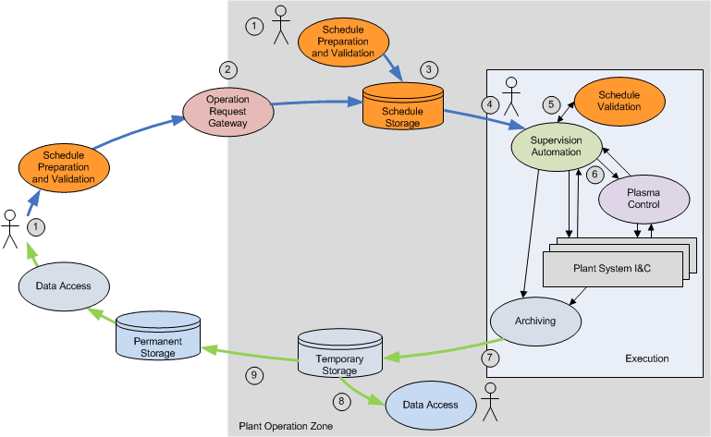
Data flow during operation
global

Slide 4
Stakeholder analysis and requirements
Scheduling
Physics expert:
Must be able to validate a pulse (long-term) before execution, both for physics feasibility AND executability (i.e. can the machine take the demand, are all plant systems foreseen to be there etc.)
Wants to specify pulse specific data (typically control functions, setpoints, waveforms etc.)
Will typically specify physics quantities → must bridge gap to machine parameters
Machine operator
Needs to specify non-plasma pulse procedures which need the cooperation of a number of plant systems, e.g. baking, GDC, etc.

Slide 5
Stakeholder analysis and requirements
Scheduling
Plant system expert:
Wants to retain ownership of his particular plant system settings (version control, different lifecycles, etc)
wants be able to re-configure plant system on demand (→ commissioning) irrespective of a pulse
Wants to have possibility to specify constraints and dependencies of configuration values (lesson learnt from JET)
Needs decent support tools to enable above
Wants to be constrained as little as possible

Slide 6
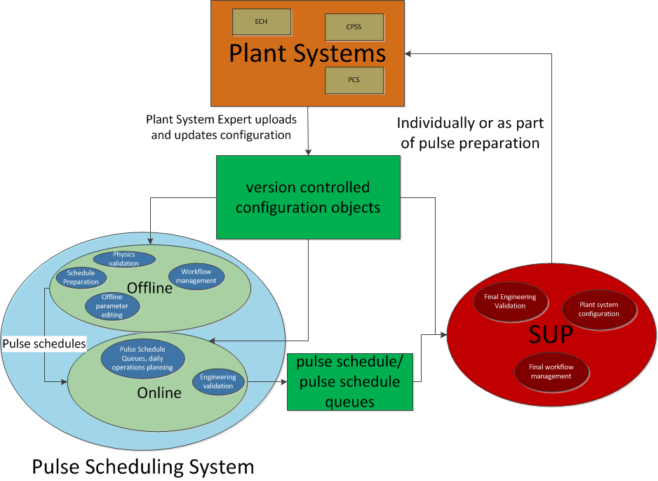
Scope and context
Scheduling
Configuration is an interplay of two CODAC systems
PSPS
SUP
and all plant systems
PSPS provides tools to create, edit and manage configurations
All configurations are passed to plant systems via SUP using EPICS channel access, either as part of pulse preparation and on demand if applicable
Interface to plant systems are EPICS process variables

Slide 7
Scope and context
Scheduling
Plant system configuration captured in independent, version controlled objects
Stored centrally, but under control of plant system RO
Separation of concern between SUP and PSS
All configurations are passed to plant systems via SUP using EPICS channel access, either as part of pulse preparation and on demand if applicable
Pulse Scheduling system provides tools also to plant system RO to easily compile and manage configuration objects
via HMI
via snapshots

Slide 8
Configuration Objects as atomic units
Scheduling
Make use of markup language based template (aka .xml schema)
Human and machine readable
can handle simple key-value pairs but are also flexible enough to handle complex data structures, relationships, state notations, etc.
Can be used to describe static and dynamic configuration
Template and instance conform to the same language
Editor for template and instance can be identical → readily available for .xml
Editor can customize itself automatically from template
Specialization using different templates to fulfil multiple purposes → see next slide
Allow to describe relationships and constraints between parameters internal and external to plant system
Allow for strict version control and signoff procedures
atomic blocks of which larger schedules can be composed
Derives information about variables and metadata from SDD as far as possible → need SDD support for appropriate identification of data set via configuration objects

Slide 9
Template, schema, configuration object
Scheduling
Plant system specific structure
also version controlled
Internal and external constraints
Logic and/or function calls to automatically derive values
Configuration template
Dependency template
Configuration template
Dependency template
Configuration objects are instantiated (filled) templates

Slide 10
How to build a pulse schedule? – LEGO™
Scheduling
Level 0: configuration objects for necessary plant systems
Contains the configuration data which remains constant during a pulse or will change event based, e.g. two sets of configuration parameters which may depend on an event to trigger change
Level 1: PCS configuration (algorithms and architecture, not parameters) → RTF config schema
Level 2: segment information with all necessary parameters/waveforms/etc.
Level 3: metadata such as operational limits, pulse number, physics goal, audit trail etc.
Pulse schedule composed of building blocks

Slide 11
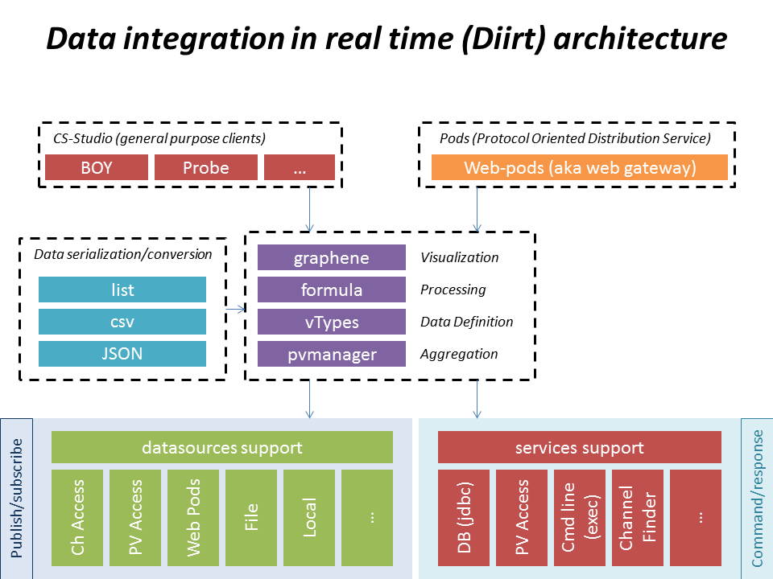
Architecture concept for scheduling software
Scheduling
Example:
Separate HMI from underlying infrastructure
Abstraction from data sources
Support for service-based architectures to allow full re-usability in different environments
Similar to DIIRT in the EPICS world
Architecture design foreseen for 2016
Targeted support for FAT/SAT from CCS 2016a
G. Carcassi

Slide 12
Functional scope
SUP & automation
Orchestration
Automated orchestration of plasma pulse preparation
Execution of conditioning functions w/out plasma (GDC, baking, etc.)
Execution of other operationally relevant procedures which can be automated (start-up, transitions to short-term maintenance, etc.)
Manage interdependencies between functional groups and Plant Systems
Verify relevant pre-conditions prior to attempting any action
Control Plant Systems to reach required passive state
Timing
Management of countdown phase and definition of pulse time scale
Configuration
Verification, validation and propagation of machine configuration to PCS and all PS I&C
Monitoring
Monitor system and infrastructure health, pulse schedule execution, etc.
Verify machine state is adequate for the intended configuration, etc.
Provide Plant-level status information
Notes:
12

Slide 13
Orchestration
SUP & automation
SUP orchestrates activities prior to, and just after plasma pulse
Human-in-the-loop automation
SUP involved during pulse only for monitoring purposes
Interdependencies between functional groups and Plant Systems may have to be managed in order to orchestrate the pulse preparation phase
Conditions in one part of the machine required prior to start of an activity in another part
Notes:
13

Slide 14
Configuration
SUP & automation
Retrieve PCS and Plant System I&C configuration from the pulse schedule identified for execution
Machine configuration is fully defined in the schedule by the experimenter, EiC and machine experts
Perform final engineering verification of the pulse schedule data
Verify against operational limits ‘of the day’
E.g. some Plant Systems may not be able to deliver full performance
Verify or resolve dependency to machine state (and/or history)
E.g. neutron budget, accumulated mech. stress, etc. pre-conditions or constraints
Availability of required Plant Systems
E.g. some required PS may not be available
Propagate configuration using appropriate interface
Configuration to all Plant System I&C, PCS, etc.
Notes:
14

Slide 15
Monitoring
SUP & automation
Detect faults of failure during preparation phase
Human decision to abort or pause/recover
Verify that Plant Systems have reached required state prior to hand-over to PCS
Monitoring and notification during pulse
No automated action foreseen, yet informing operation about operationally relevant situation incl. in non plasma-related systems
Continuous monitoring of machine state and infrastructure health
Extremely large scope, take a chance at detecting relevant conditions before they become issues
Incl. availability of all expected hardware, software, infrastructure resources
Provide middle-layer service
Elaborate Plant-level state information combining information spanning more than one Plant System I&C
Support notification of Plant-level or context-specific alarms
Notes:
15

Slide 16
Architecture & schedule
SUP & automation
Functional overlap with scheduling for validation → common infrastructure foreseen to allow re-useable algorithms
EPICS will allow for direct implementation of most slow monitoring functions using IOC’s and PV’s as a middlelayer service
Prototyping/phase 1 design work will begin in 2016 with releases foreseen on a yearly basis starting 2017
Support for FAT/SAT available with CCS 2016a

Slide 17
Implementation of real-time tasks
Real-time
These tasks typically concern systems which contribute to real-time plasma control, e.g. diagnostics, PCS and actuator systems
Control functions will take diagnostic measurements as input
Procurement of I&C for diagnostic and actuator systems is in scope of various DA’s
division of responsibilities for different parts of a control cycle (measurement, algorithm, actuation) is a (major) headache → maintainability, consistency and flexibility.
CODAC is responsible to implement control functions specified by POP, but not only those. In addition:
Integrated commissioning support
Real-time protection
one integrated solution for implementation and development of real-time tasks for all stakeholders highly desirable

Slide 18
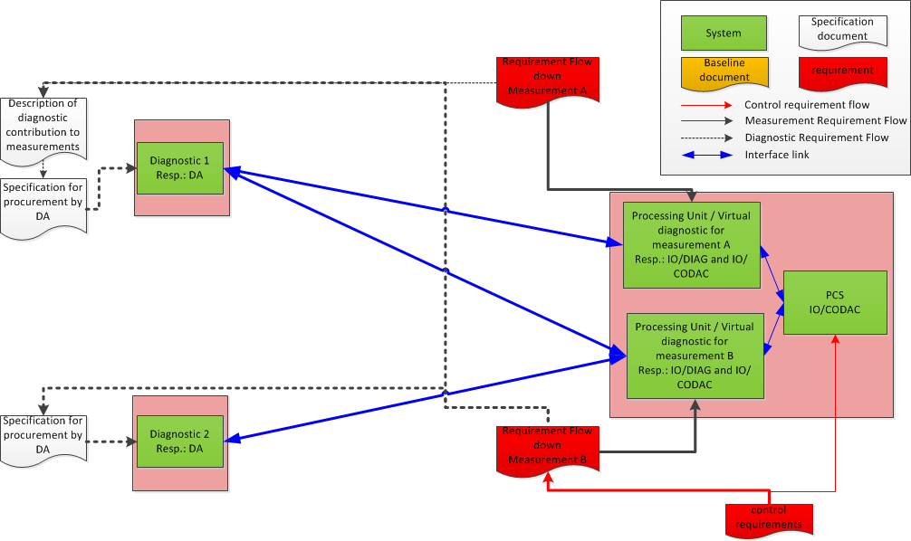
Diagnostics and plasma control: IF flow
Real-time

Slide 19
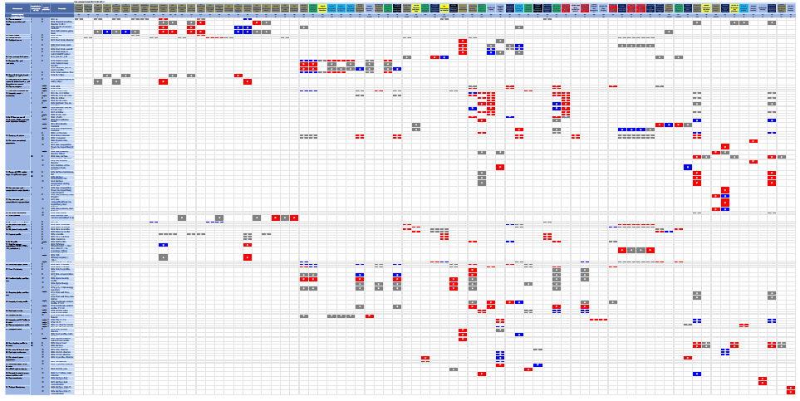
Challenge: diagnostic integration
Real-time
Don’t try to read that, but the bottom line:
Around 50 diagnostics provide around 60 measurements with a highly non-diagonal coupling matrix
IO CODAC and diagnostic will implement these functions centrally to simplify interface management & maintainability

Slide 20
Simplification of implementation
Real-time
Diagnostic signal conditioning
Provide toolset to DA’s to facilitate implementation of real-time tasks within plant system I&C and allow for seamless integration into distributed control → large synergy can be achieved through reusability and simplified acceptance
Derivation of diagnostic measurements
Typically combines input from multiple diagnostics and responsibility is somewhat ambiguously defined in current IO procurement scheme
Common infrastructure and centralization of implementation simplifies life for everyone as interfaces become internal to IO
CODAC and diagnostics are pursuing agreement to centralize implementation (CODAC) while specification of algorithms remains within scope of the DA’s
PCS
Implementation in scope of CODAC, specification in scope of POP
Infrastructure requirements are superset of requirements for diagnostic measurements
IO will provide a framework to fulfil all requirements for 1-3
in time for DA to implement their diagnostic scope

Slide 21
Key features of a framework
Real-time
Multi-platform C++ middleware
“Simulink-type” way of describing the problem
Modular
Clear separation between algorithms, hardware interaction and system configuration
Change input data sources (e.g. data from archive to test algorithm) without the code even knowing
Full access to all data inside the framework (e.g. cross-diagnostic input if needed)
Test the code in any environment (e.g. windows PC in the office, at another fusion machine)
Reusability and maintainability
Simulation capability
Configuration driven
Integration with rapid prototyping environment (e.g. Simulink) and automated code generation
Minimize constraints due to operational environment (portability)
Can run in the office or in a real-time environment, so any code developed can be transferred from one environment to the other without re-compilation aka. test at diagnostic algorithms at existing machine– implement at ITER with minimum hassle
Let developer focus on what he knows best and provides extensive support services
Statistics and connection to and abstraction from external components (logging, archiving, networks etc.)

Slide 22
Scope of the development environment
Real-time
Make use of rapid prototyping software now commonly available offering very elegant and easy ways of creating algorithms without worrying about infrastructure, e.g. Simulink
Focus on the graphical development of algorithms without low-level programming
Support multi-machine modeling with device-independent and device-specific libraries
Support model validation and provide appropriate analysis tools
Support simultaneous archive of simulation setup and results
Support easy connection of module inputs/outputs
And finally: coupling to real-time framework to make use of automated code generation from graphical algorithm model

Slide 23
Objective: reduce development time/effort
Real-time
Architecture and algorithm development in both diagnostics and control
Minimize time, cost, and effort
Maximize performance and reduce risk
Flexible & easy to use:
for developing and prototyping PCS/diagnostics/actuator algorithms
for constructing Plant simulations for testing
for both open- and closed-loop simulation testing
Fast execution of "accurate enough" simulations
Archive/restore of simulation data:
Results data: support examining/documenting test results
Setup data: support test cases, automated test suites
Simulation State: support reproduction of prior simulations, starting at user-selected times (special type of Results data)
Automated conversion into framework modules without need for manual coding

Slide 24
Simulation support: PCSSP
Real-time
plant simulation may include modules for
plasma
actuators
diagnostics
Interlock
interfaces with ext.modules
PCS simulation may include modules for
(continuous) controllers
Pulse Supervision Control
Event Generator(s) functionality
to provoke events not implicitly generated by plant / PCS modules
Tokamak Plant Simulator
Event
Generator
Project is ongoing with DINA and RAPTOR codes being integrated into PCCSP
Public release foreseen for second half of 2015
Event
Generator
Supervision
Control
PCS
Simulator
Continuous
Control

Slide 25
Timeline, Outlook & Conclusion
Scope well identified for both SUP and scheduling and prototyping work in ongoing driven by FAT/SAT support for plant systems
Concept of schema-based configuration objects as atomic units of a pulse schedule fulfils all use cases
Architectural design work for both SUP and scheduling will begin in 2016 with releases foreseen on a yearly basis starting 2017
Support for FAT/SAT available with CCS 2016a for both applications
Supply of real-time infrastructure requested by diagnostics to support DA’s, implement IO internal scope and simplify interface management
Requirements for infrastructure have been identified and architecture design has been started in 2014 and will be finalized with a target date of 2016.
PCSSP is progressing well with public release foreseen this year and integration of several larger codes foreseen.
Development has slowed down compared to IAEA 2013 target as need date is pushed back due to schedule delay but is still ongoing

Slide 26
Thank you for your attention.
Questions?

